Slide 1
Studyr
Created by
Sarah Abrahamson,
Steve Cardozo,
Sensen Chen,
and Shawn Minarik

Slide 2
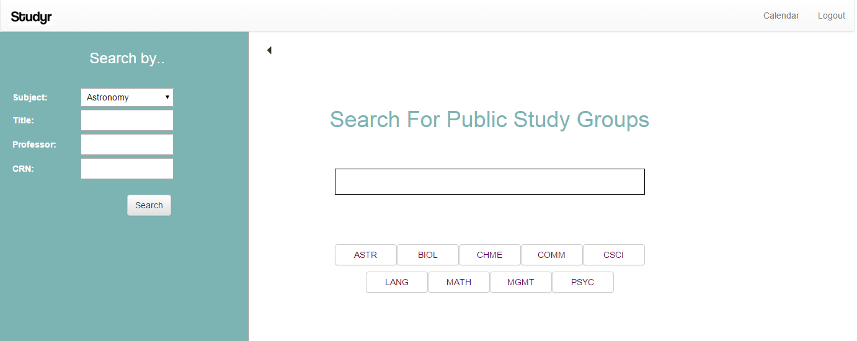
The Purpose of Studyr
Public study groups - Private study groups - Organize schedules
Notes:
Studyr is an application for RPI students which facilitates the creation of study groups. After registering, users can import their Google Calendar, join public study groups, and create a public or private study group. Multiple users can join the same study group. Users must be added by the group founder to join private groups. The group founder can also enter useful links that are shown on that study group’s page.

Slide 3
Users
General users can
Founders of study groups
search for public study groups
create a study group
join public study groups
be added to private groups
import a Google Calendar
Are general users with access to adding data within their group
Can add useful links to their group page
Can add members if the group is private

Slide 4
Users
Administrators can
Founders of study groups
add professors
add locations
assign other users as admins
add courses
do whatever general users can
Are general users with access to adding data within their group
Can add useful links to their group page
Can add members if the group is private

Slide 5
Functional Requirements
Usability:
Easy to navigate and use
Page layout is mostly uniform

Slide 6
Nonfunctional Requirements
Software
Scalability
Apache, MySQL, and PHP to interact with the web server and database.
HTML5, CSS3, and Javascript to serve pages to users.
Implemented the Bootstrap framework to provide a nicer look and responsive site.
Properly documented and commented the code for ourselves and future developers.
Handled errors to provide simple explanations in the event of a crash or incorrect form input.

