Slide 1

Reddit Sentiments
Ciara Spencer, Matthew Padgett, Alex Goldstein, Danielle White

Slide 2
Project Mission
Run Sentiment analysis on subReddit comments from cryptocurrency and compare sentiment with stock price over a 3-month period.
Question - Does overall subReddit sentiment correlate with change in the stock price?

Slide 3
Project Methods
Run sentiment analysis using VADER tool on subreddit cryptocurrency using PRAW (reddit API)
Run data using train / test in Naive Bayes model to compare results to VADER model
Run comparison analysis against day to day stock price over the course of 3 months using coingecko API based on hour to hour interpreted sentiment.

Slide 4
REDDIT COMMENT EXTRACTION USING PRAW, PSAW, PMAW

Slide 5
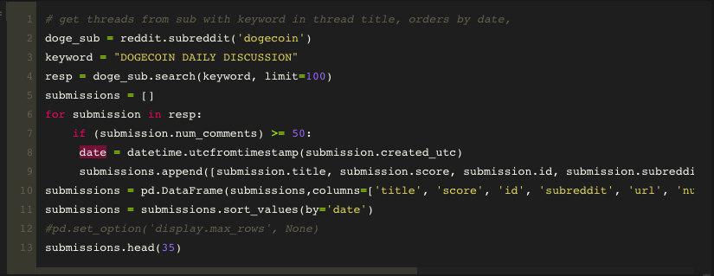
Daily Discussion Thread title extraction using Praw (REDDIT API)

Slide 6
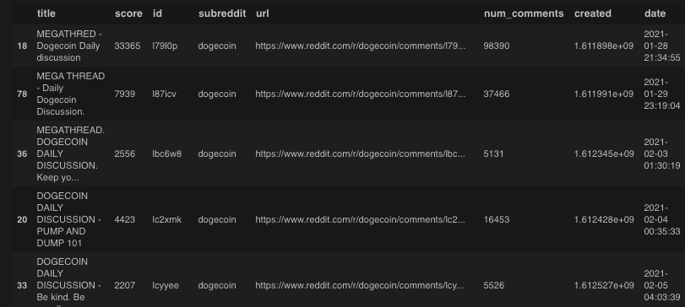
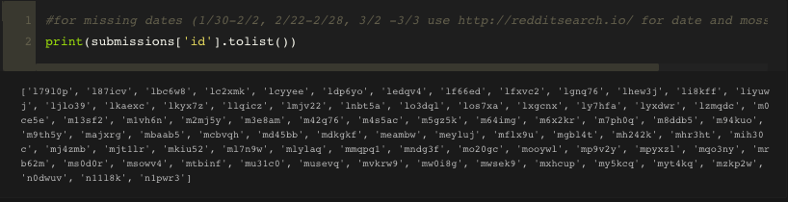
PRAW THREAD Extraction
Resulted in 67 thread returns / 90

Slide 7
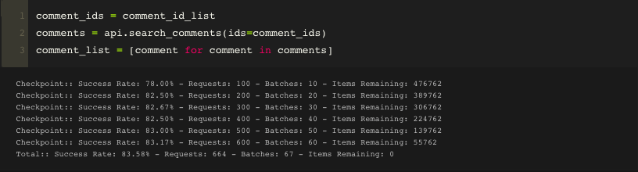
PMAW comment extraction
PMAW wrapper for pushshift.io, supports multi-threading, batch requests
For comparison - PRAW (doesn’t support multithreading) test on thread of 37k comments > 3hrs

Slide 8
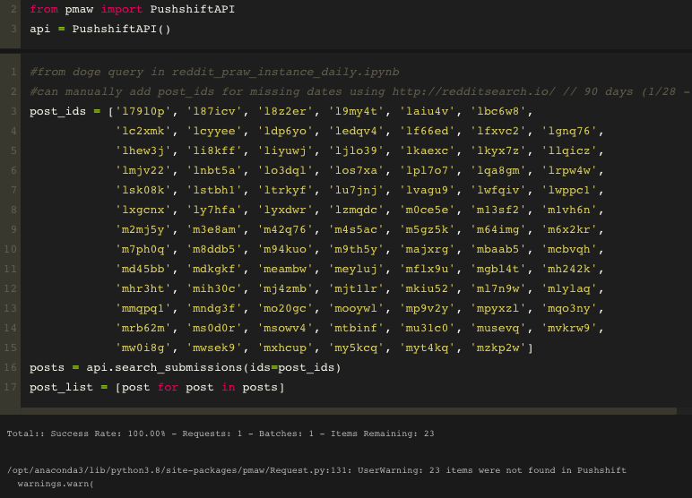
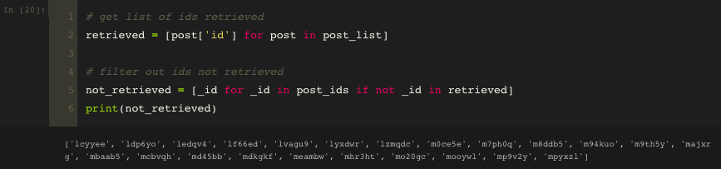
Missing threads?

Slide 9
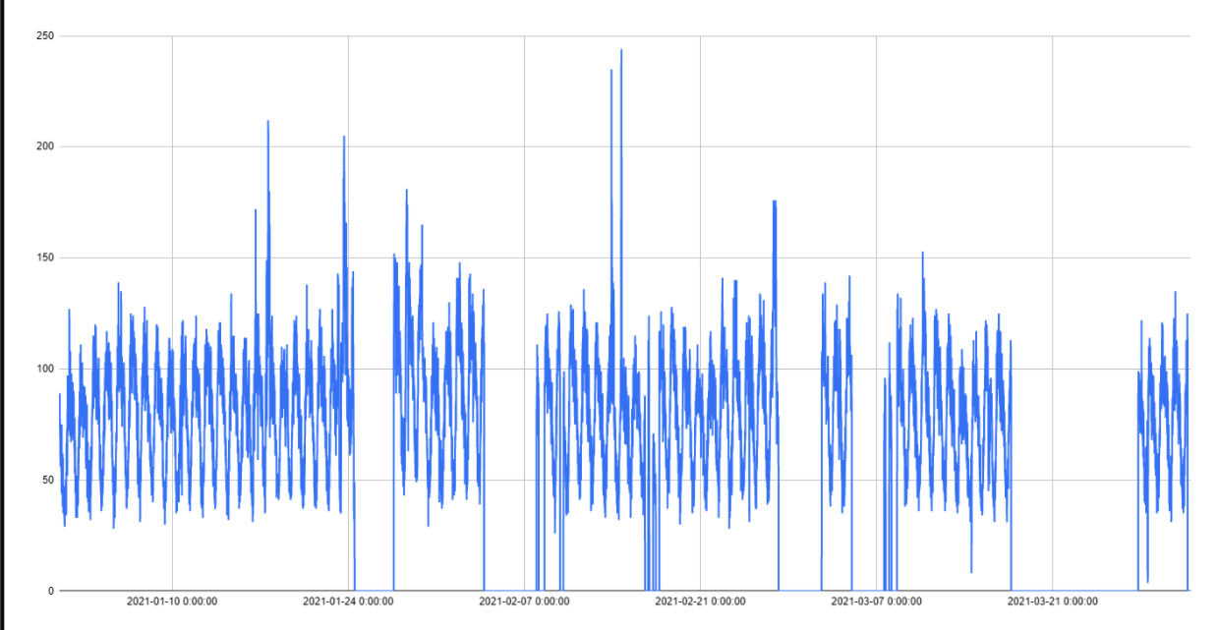
Data gaps in pushshift.io

Slide 10
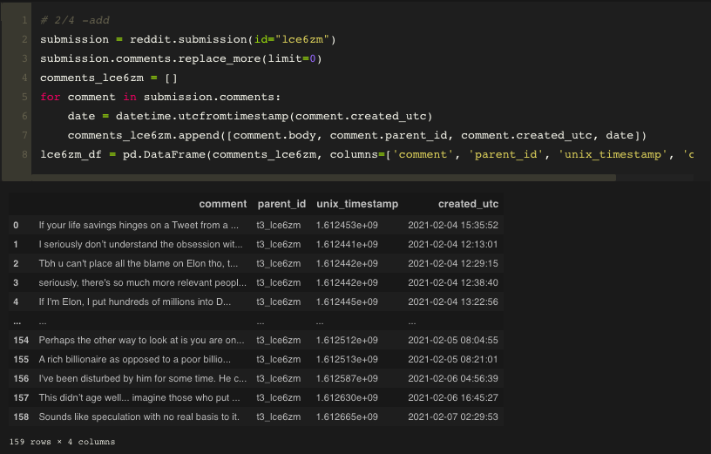
Missing thread extraction in PRAW
23 missing threads from pushshift.io (PSAW)

Slide 11
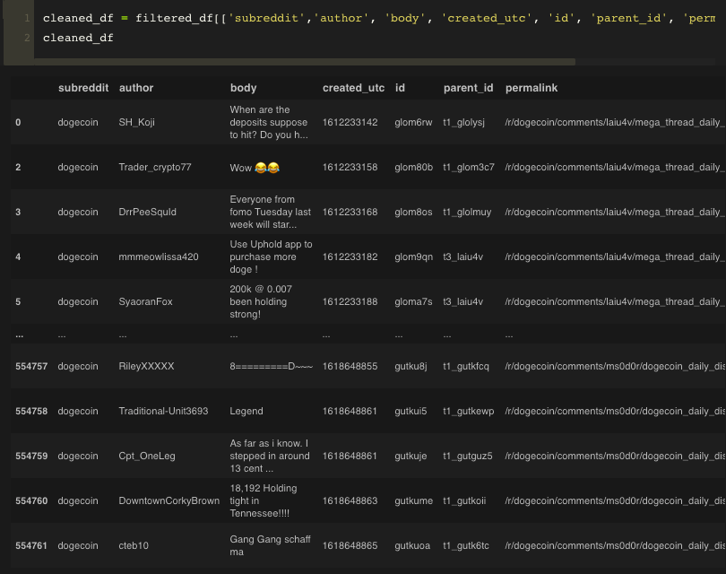
Total Comment Extraction

Slide 12
VADER

Slide 13
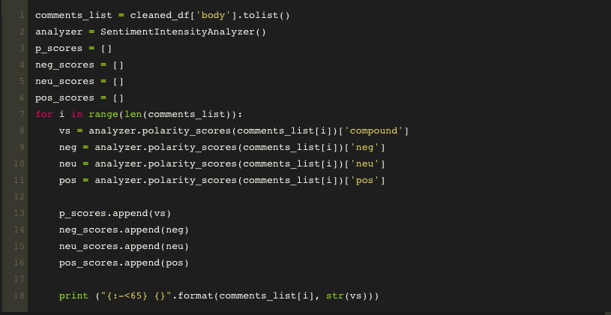
VADER instance scoring through all comments

Slide 14
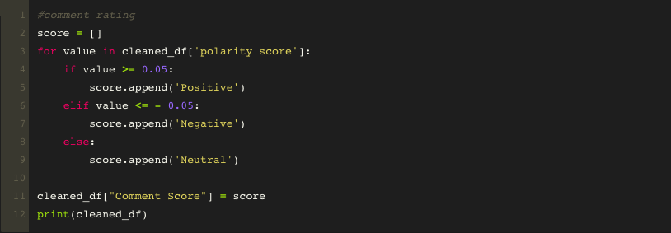
Polarity Scoring
Comment Rating (Positive, Neutral, Negative) based on Polarity Score
Polarity Score unique to Social Media sentiment, based on comment intensity. Much like bag-of-words, etc. incorporates booster dictionary unique lexicon scores for emoji, slang, comment sentiment.
Compared to other models giving sentiment scores on a plain -1, 0 , 1 - negative, neutral, positive, respectively

Slide 15
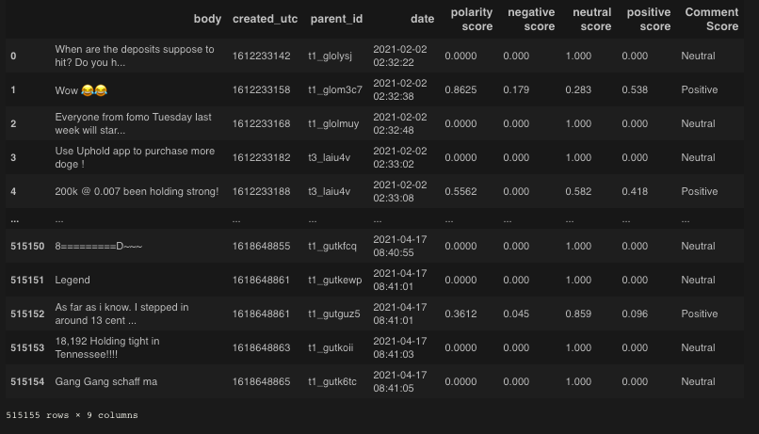
Full Comment Scores

Slide 16
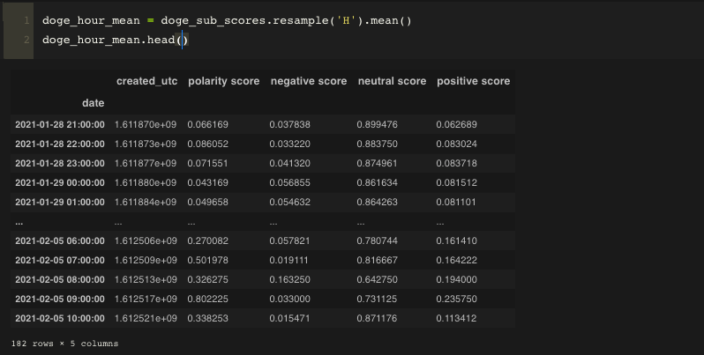
Grouped Scores by hour on mean average

Slide 17
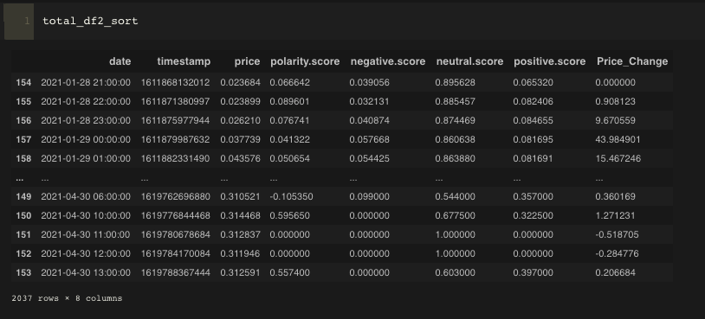
Combined hourly scores with hourly crypto price
Hourly crypto price from coingecko API: https://www.coingecko.com/en/api

Slide 18
CRYPTO PRICE SENTIMENT CHARTS

Slide 19
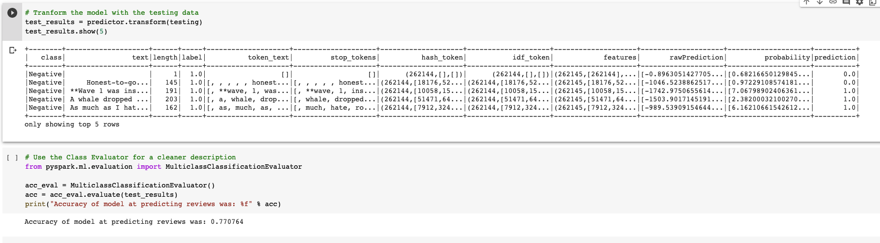
NB ML prediction compared to VADER sentiment
NB accuracy compared to VADER sentiment: 0.770764
positive, neutral, negative prediction

Slide 20
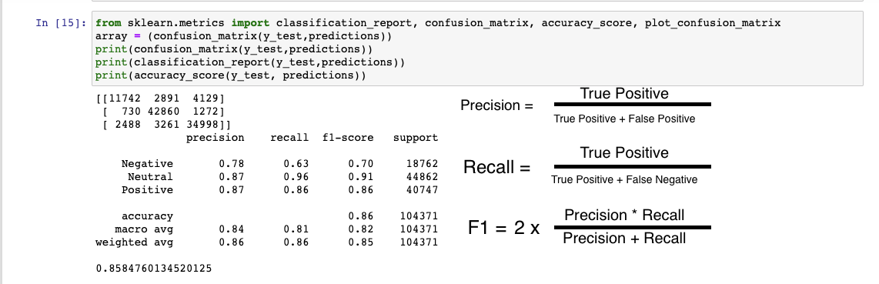
RF ML prediction compared to VADER sentiment
RF accuracy compared to VADER sentiment: 0.858476
positive, neutral, negative prediction

Slide 21
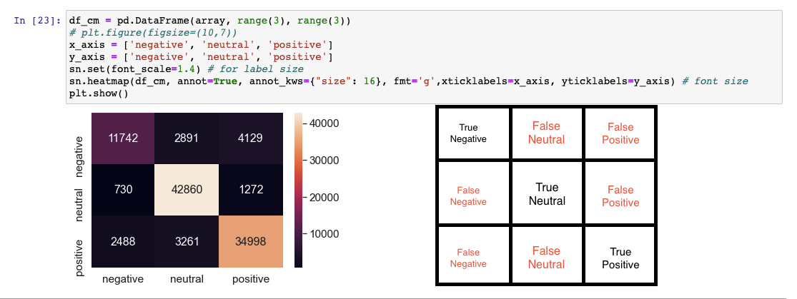
RF Confusion Matrix compared to VADER sentiment
positive, neutral, negative prediction

Slide 22
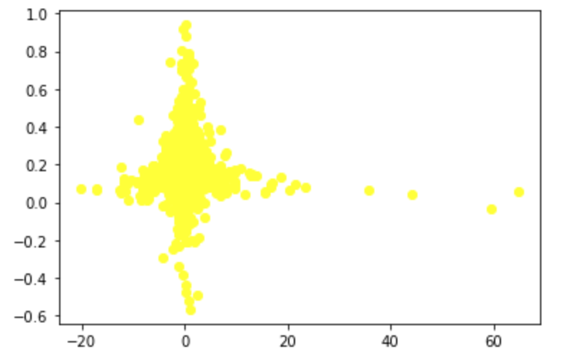
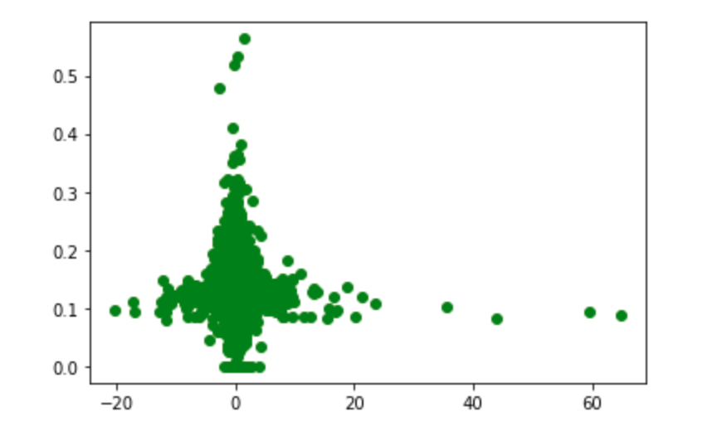
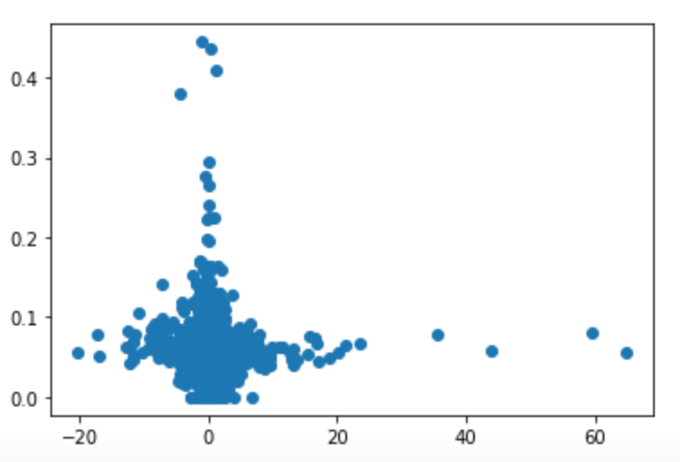
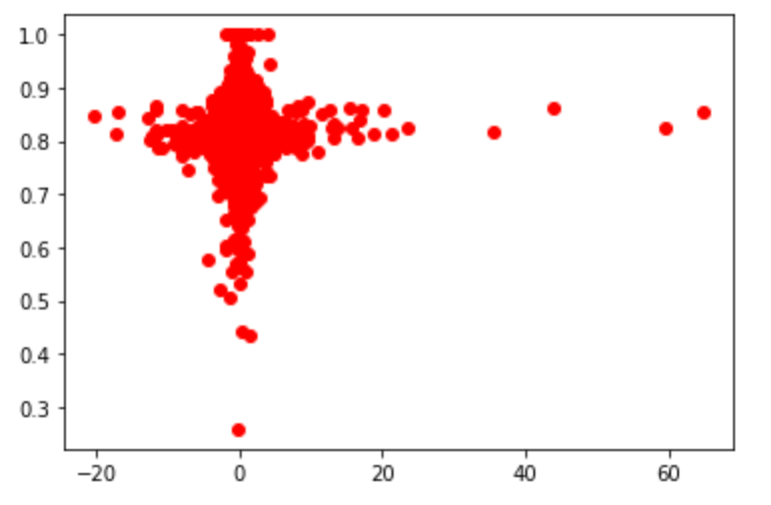
LR models on Price vs Sentiment Scores
price change v polarity
price change v positive sentiment
price change v negative sentiment
price change v neutral sentiment

Slide 23
Tools used
VADER
PRAW (reddit API)
CoinGecko (crypto API)
web scraping
pushshift
plotly

Slide 24
conclusions

Slide 25
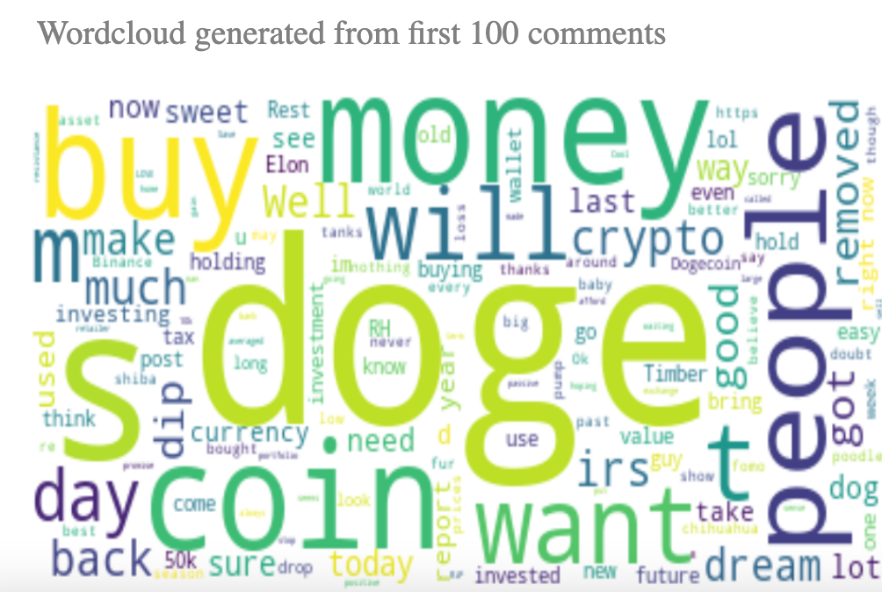

Slide 26
challenges
Figuring out how to account for a lag in price changes and reddit posts
Converting timestamps into month/day/year format
Scraping reddit data
Time it takes to run a Jupyter Notebook that parses through thousands of reddit comments
Accounting for missing threads

Slide 27
data sources
https://www.reddit.com/r/dogecoin/
https://www.coingecko.com/en/api
https://github.com/cjhutto/vaderSentiment
https://github.com/rhiever/reddit-analysis
https://www.specrom.com/reddit-wordcloud-generator/

