Slide 1

Visualisation of Refugee Movements
Collaborations Workshop 2017
Diana Suleimenova, Mario Antonioletti, Joanna Leng,
Edwards Smith, Andy South, Thomas Kluyver

Slide 2
Problem
How to visualise and predict refugee movements in conflict regions?
Motivation
Visualisation of flow and accurate predictions can help save refugee lives
Governments and NGOs can conduct a better informed allocation of humanitarian resources

Slide 3
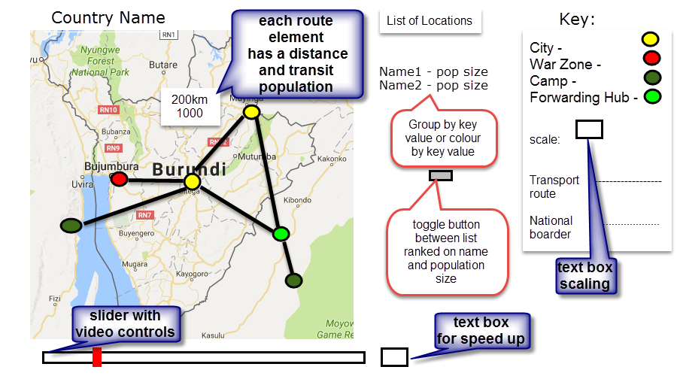
Prototype
Repository: https://github.com/cspgdds/Visualflee
Publicly available
Under a BSD 2-clause license

Slide 4
Data acquisition
Simulation
FLEE
Visualisation

Slide 5

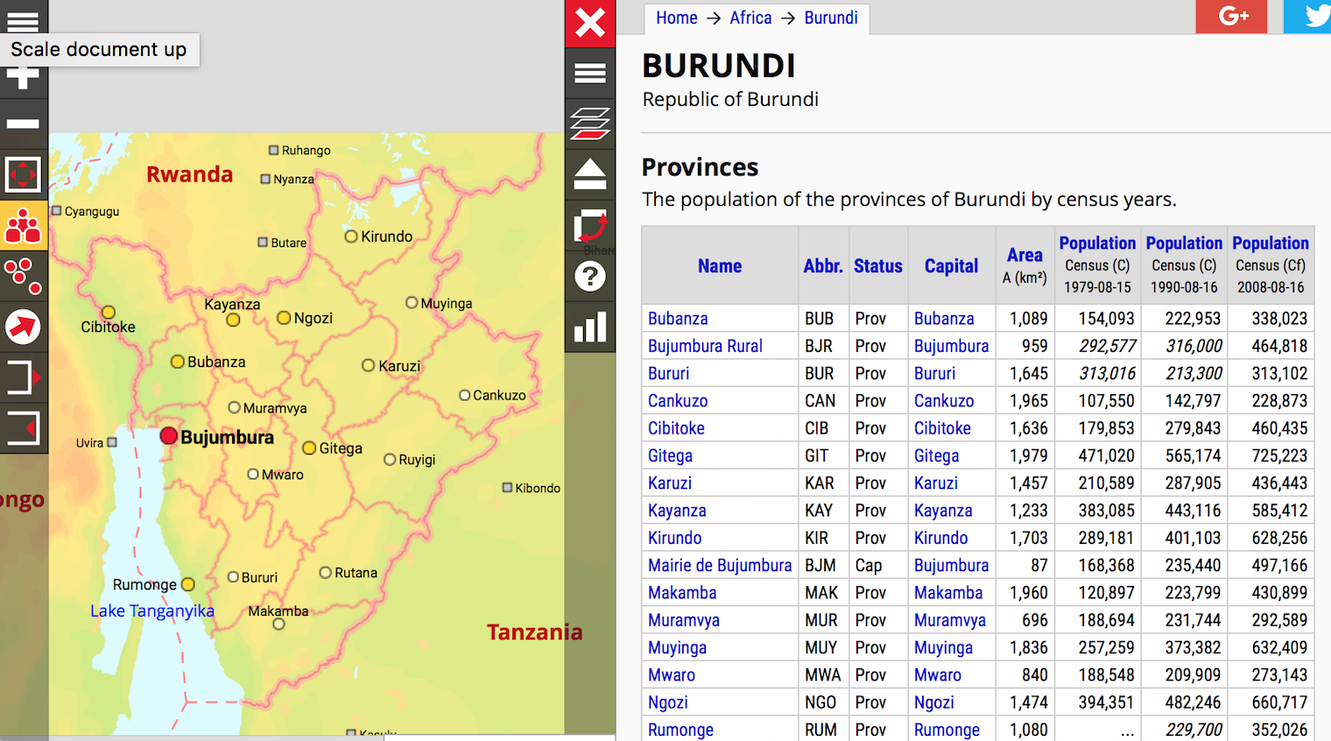
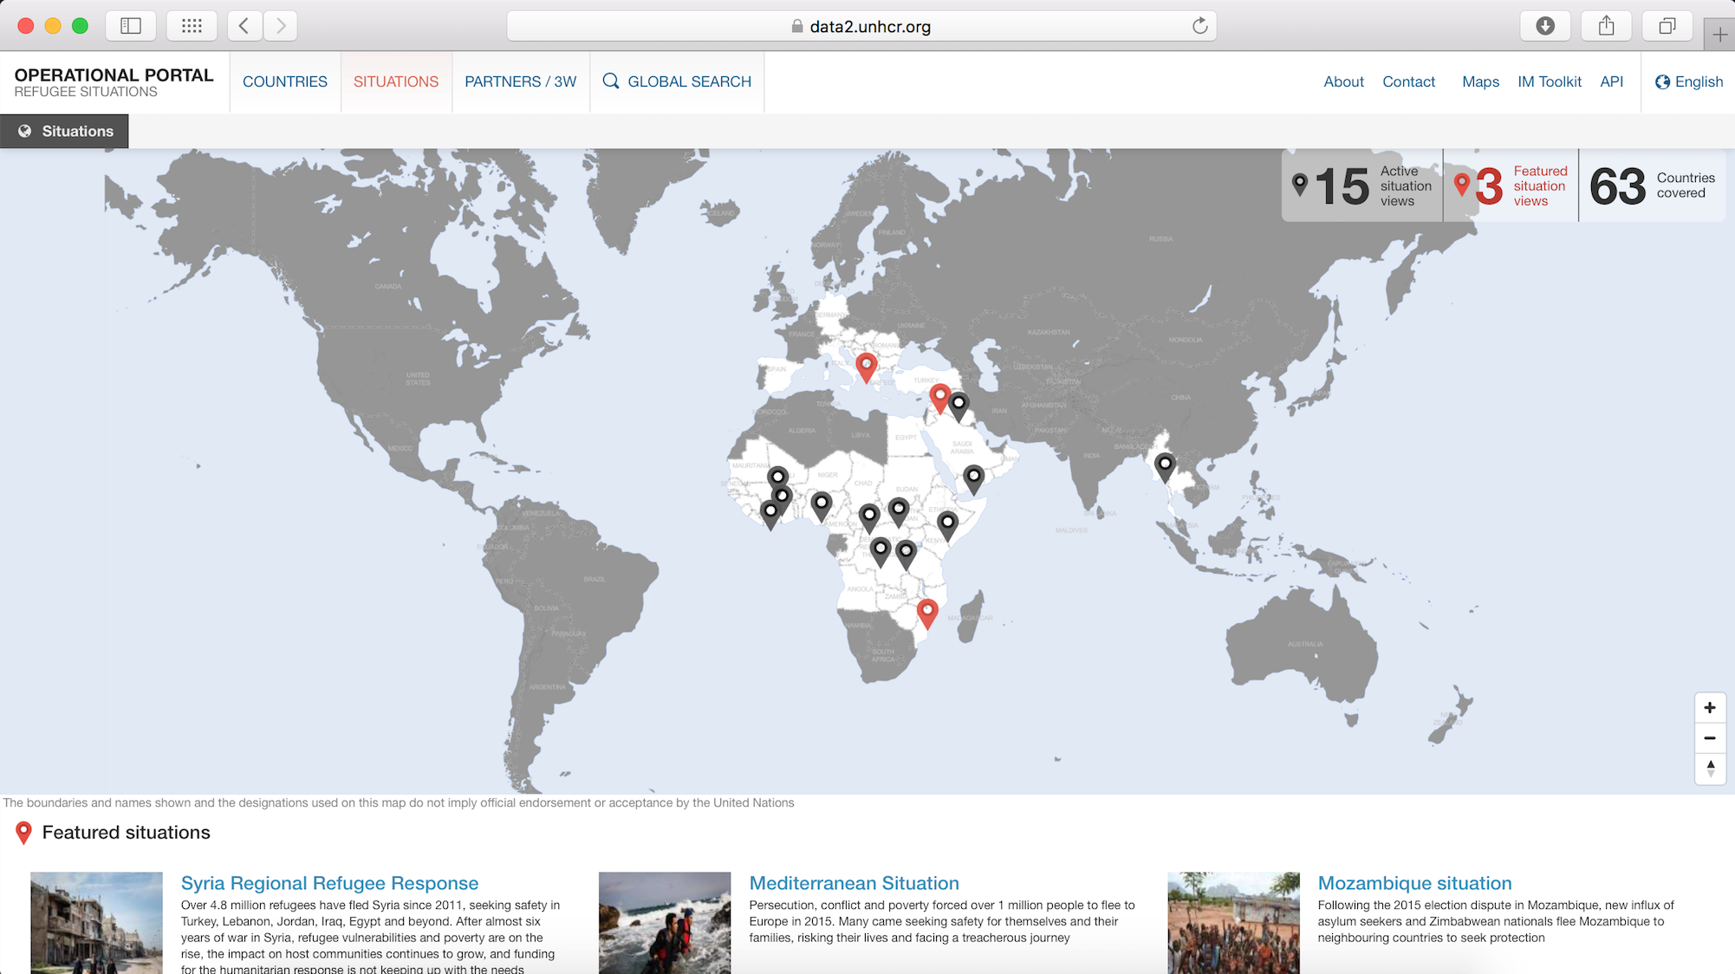
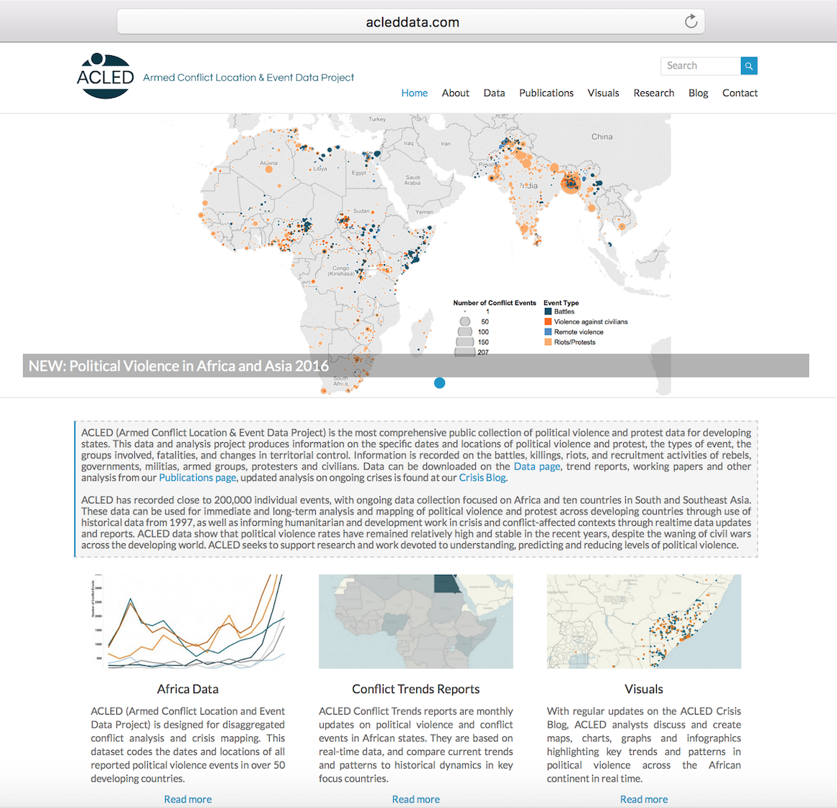
Data Acquisition
CAMPS
CONFLICT ZONES
POPULATIONS
UNHCR database
The UN Refugee Agency
http://data2.unhcr.org/en
/situations
Armed Conflict Location
and Event Data
http://www.acleddata.com/data/acled-version-7-1997-2016/
City population
https://www.citypopulation.de

Slide 6
Visualisation
http://www.cpl-library.org/general/flight.html
Plan
Using Python, display 4 location types on a map with size of population as a function of time
What we did
A suite of functions to read, collect data, transfer to JavaScript and display on an interactive html map
Issues
No Python only solution so split tasks into data pipeline and visualisation

