Slide 1

Visualisation of Refugee Movements
Collaborations Workshop 2017
Diana Suleimenova, Mario Antonioletti, Joanna Leng,
Edwards Smith, Andy South, Thomas Kluyver

Slide 2
Problem
How to visualise and predict refugee movements in conflict regions?
Motivation
Visualisation of flow and accurate predictions can help save refugee lives
Governments and NGOs can conduct a better informed allocation of humanitarian resources

Slide 3
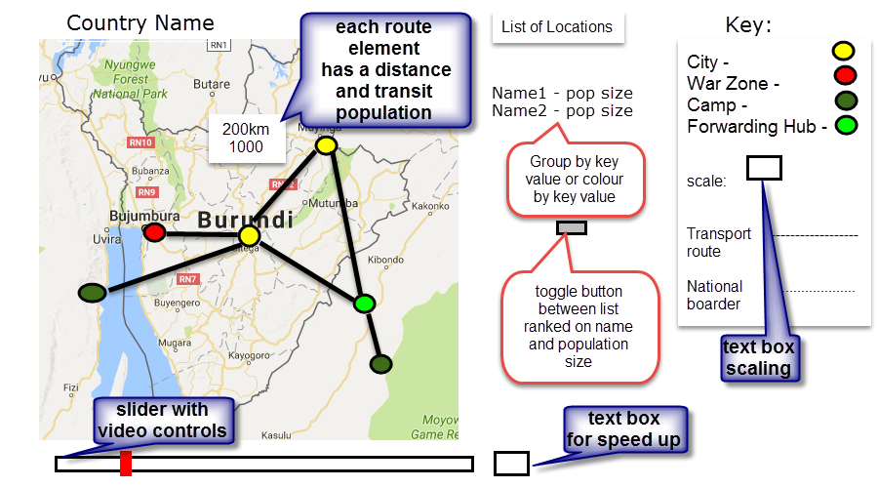
Prototype
Repository: https://github.com/cspgdds/Visualflee
Publicly available
Under a BSD 2-clause license

Slide 4

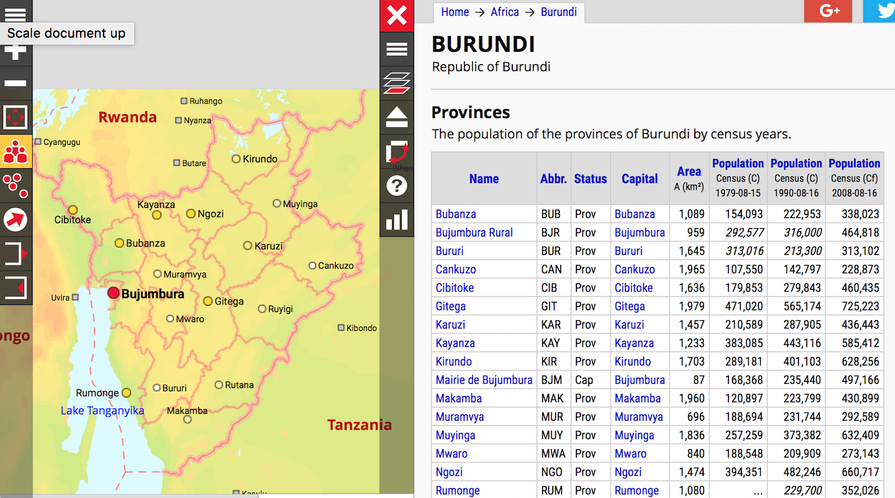
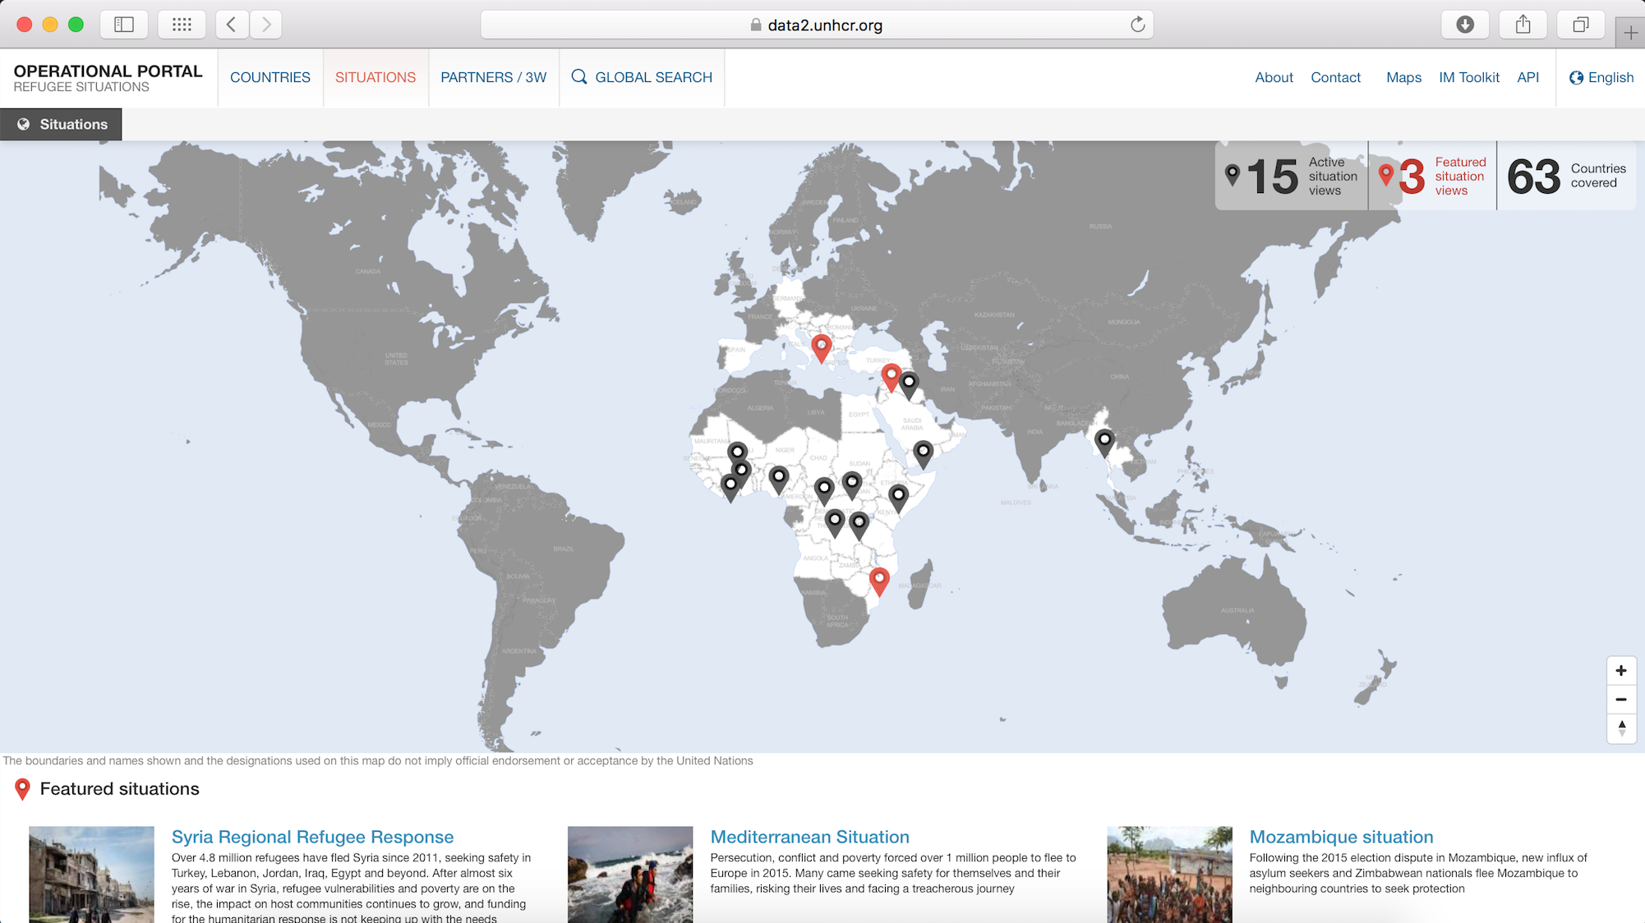
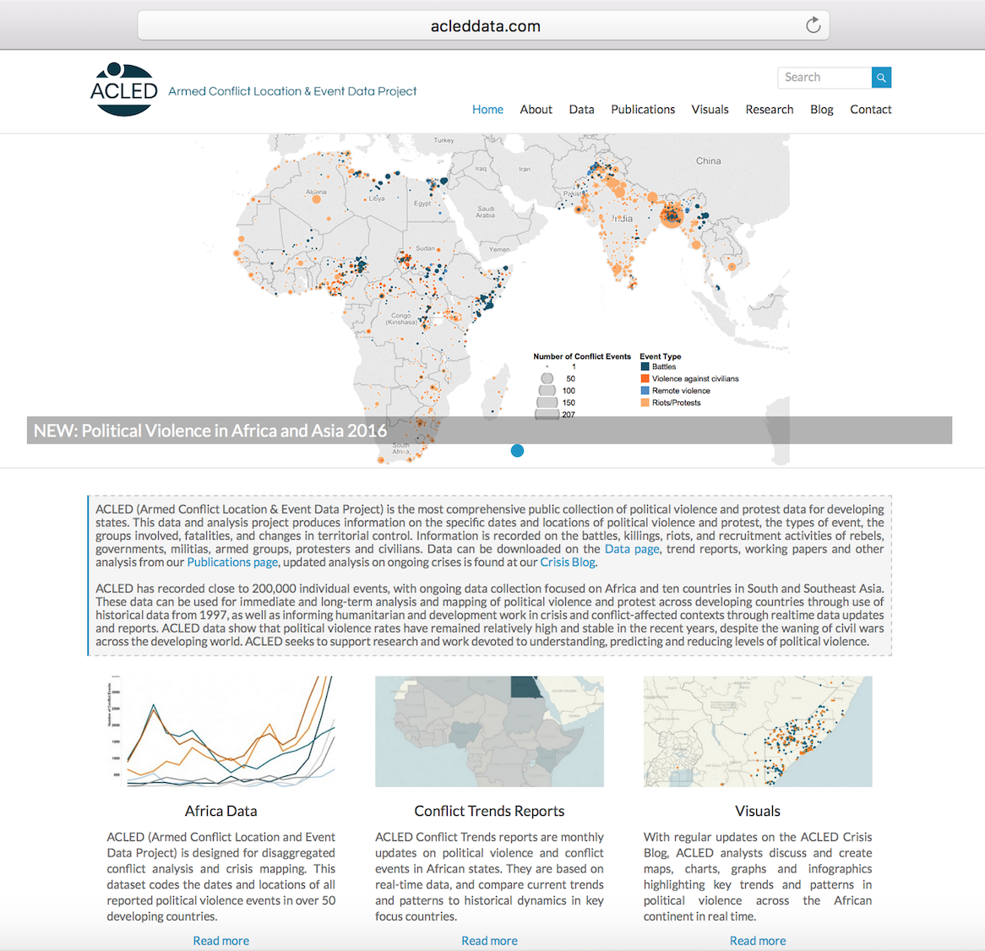
Data Acquisition
CAMPS
CONFLICT ZONES
POPULATIONS
UNHCR database
The UN Refugee Agency
http://data2.unhcr.org/en
/situations
Armed Conflict Location
and Event Data
http://www.acleddata.com/data/acled-version-7-1997-2016/
City population
https://www.citypopulation.de

Slide 5
Visualisation
file:///Users/dianasuleimenova/Desktop/Codes/Visualflee/flight.html
Plan
Using Python, display 4 location types on a map with size as a function of time
What we did
A suite of functions to read, collect data, transfer to JavaScript and display on an interactive html map
Issues
No Python only solution so split tasks into data pipeline and visualisation

Slide 6
Conclusion
I will continue on working on this
Conference paper, promised my collaborators authorship
Hope to make links with organisations

