Slide 1
ZK-ACTUS
DaDFiR3 Workshop
2nd International Workshop on Automated Regulatory Financial Reporting
Feb ’24 University of Zurich
Verifiable Financial Contracts
ZK-ACTUS: Verifiable Financial Contracts
January '24

Slide 2
Part 1: ACTUS
An Emerging Financial Standard
ZK-ACTUS: Verifiable Financial Contracts
January '24

Slide 3
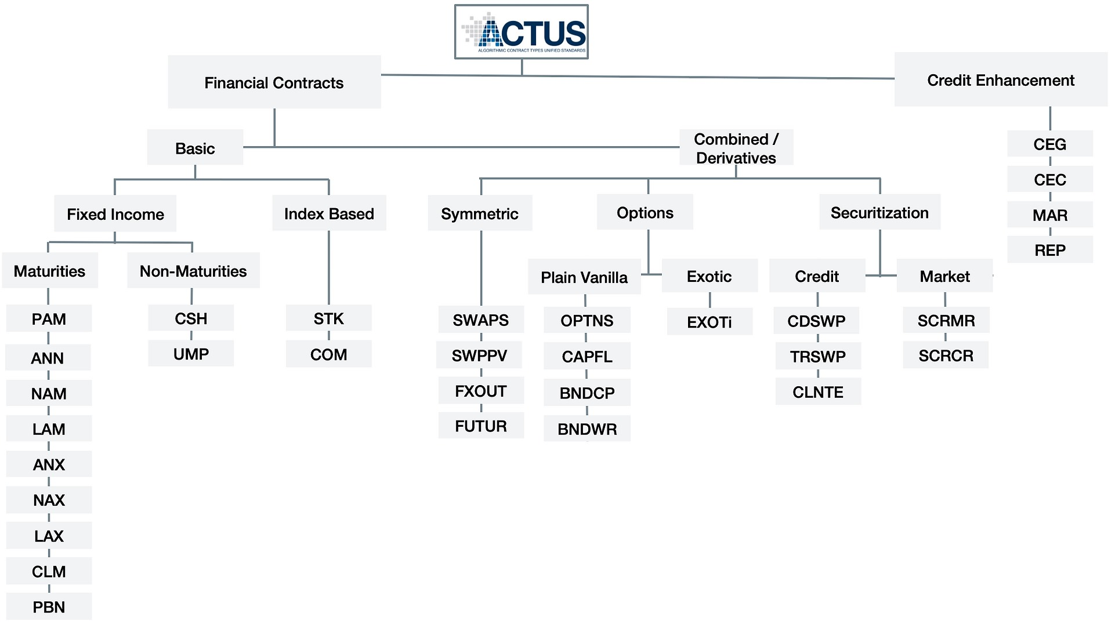
ACTUS
Taxonomy
ZK-ACTUS: Verifiable Financial Contracts
January '24

Slide 4
ACTUS
Domain Model
Dictionary
Taxonomy
Contract
Term
Term Set
Applicability
Enum
Scalar Type
Function Type
ZK-ACTUS: Verifiable Financial Contracts
January '24

Slide 5
ACTUS
Algorithms
Types
Utility Functions
State Transition Functions
Payoff Functions
Inputs
Machine readable termsets
Terms are composable
Hetereogenous
Output
Event Sequence (1..N)
Equivalent to cash flows
Homogeneous
Algorithms
ZK-ACTUS: Verifiable Financial Contracts
January '24

Slide 6
ACTUS
Implementations
JAVA
(reference)
RUST
(WIP)
HASKELL
PYTHON
(WIP)
TYPESCRIPT
(WIP)
SOLIDITY
ZK-ACTUS: Verifiable Financial Contracts
January '24

Slide 7
Part 2: ACTUS + ZK + DLT
Verifiable Financial Contracts
ZK-ACTUS: Verifiable Financial Contracts
January '24

Slide 8
ACTUS + ZK + DLT
VFC Pillars
VFC
Integrity
VFC
Tokenisation
VFC
Payments
ZK-ACTUS: Verifiable Financial Contracts
January '24

Slide 9
ACTUS + ZK + DLT
VFC Integrity
ACTUS
(Counter Parties, Term Set, Algorithm, Cash Flows)
Cryptographic Proofs
(Signatures, Attestations, Fingerprints, ZK-Proofs)
DLT
(Smart Contract)
ZK-ACTUS: Verifiable Financial Contracts
January '24

Slide 10
ACTUS + ZK + DLT
VFC Tokenisation
Minting
(Identifiers, Direction, Counter Parties, Units, Metadata)
DLT
(Smart Contract)
Servicing
(Auditors, Rating, Regulators, Markets)
ZK-ACTUS: Verifiable Financial Contracts
January '24

Slide 11
ACTUS + ZK + DLT
VFC Payments
ACTUS Cash Flow
(Timestamp, Direction, Amount, Denomination, Obligor)
Payments Engine
(Verify, Calculate, Open, Close, Default, Notify)
DLT
(Smart Contract)
ZK-ACTUS: Verifiable Financial Contracts
January '24

Slide 12
ACTUS + ZK + DLT
VFC Principles
Occams Razor
As Little As Possible, As Much As Necessary
Chain Agnostic
Standard Smart Contracts
Privacy Preserving
Who, What, When, Why
Trust But Verify
Cryptographic Proofs Everywhere
VFC Principles
ZK-ACTUS: Verifiable Financial Contracts
January '24

Slide 13
ACTUS + ZK + DLT
VFC Challenges
Regulatory Certitude
Robust. Nuanced. Adaptive.
Counter-Party Risk
Identity -> KYC/AML. Defaults -> ???
Post Quantum Security
Cryptography equivalent to Y2K
Jurisdictional Anchoring
Smart Legal Contracts
Technological Flux
Multi-Decadal Platforms
VFC Challenges
ZK-ACTUS: Verifiable Financial Contracts
January '24

Slide 14
Part 3: ACTUS ZK Proofs
Computational Integrity
ZK-ACTUS: Verifiable Financial Contracts
January '24

Slide 15
ACTUS + ZK + DLT
VFC Integrity
ACTUS
(Counter Parties, Term Set, Algorithm, Cash Flows)
Cryptographic Proofs
(Signatures, Attestations, Fingerprints, ZK-Proofs)
DLT
(Smart Contract)
ZK-ACTUS: Verifiable Financial Contracts
January '24

Slide 16
ACTUS + ZK + DLT
ZK Proofs
ZK-Proofs
f(x,w) → {True,False}
Properties
Succint
Sound
Expensive to compute Cheap to verify
Elements
Arithmetic Circuit
Constraint System
Polynomial
Polynomial Commitment
Developers
Virtual Machines
E-DSLs
Rollups
Applications
ZK-ACTUS: Verifiable Financial Contracts
January '24

Slide 17
Part 4: ACTUS Gateway
L2 <-> L1 Infrastructure
ZK-ACTUS: Verifiable Financial Contracts
January '24

Slide 18
ACTUS Gateway
Introduction
Leveraging DLT to service ACTUS compliant financial contracts is the R&D team’s focalising use case. It is an activity well suited to a tightening regulatory environment in which ‘crypto’ is deemed a regulated activity.
ACTUS algorithms must be formally and operationally verifiable. In respect of operational verifiability, the R&D team is building a special purpose ZK infrastructure to service ACTUS financial contracts at scale.
DLT will be used to publish set of cryptographic proofs encompassing the entire lifecycle of a financial contract. Such proofs include standard constructs such as data fingerprints (i.e. hashes) as well as ZK proofs pertaining to the verifiably correct execution of ACTUS algorithms.
The bedrock of published proofs represents an integrity layer upon which tokenisation & payment systems may be established.
Introduction
ZK-ACTUS: Verifiable Financial Contracts
January '24

Slide 19
ACTUS Gateway
Solution Elements
API Gateway
ZK Provers
Data Availability
DLT Contracts
ZK-ACTUS: Verifiable Financial Contracts
January '24

Slide 20
ZK-ACTUS
DaDFiR3 Workshop
2nd International Workshop on Automated Regulatory Financial Reporting
Feb ’24 University of Zurich
Verifiable Financial Contracts
ZK-ACTUS: Verifiable Financial Contracts
January '24

