Slide 1
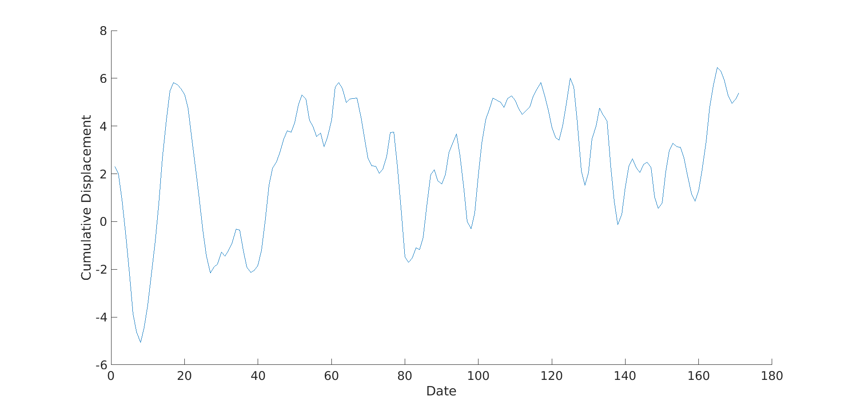
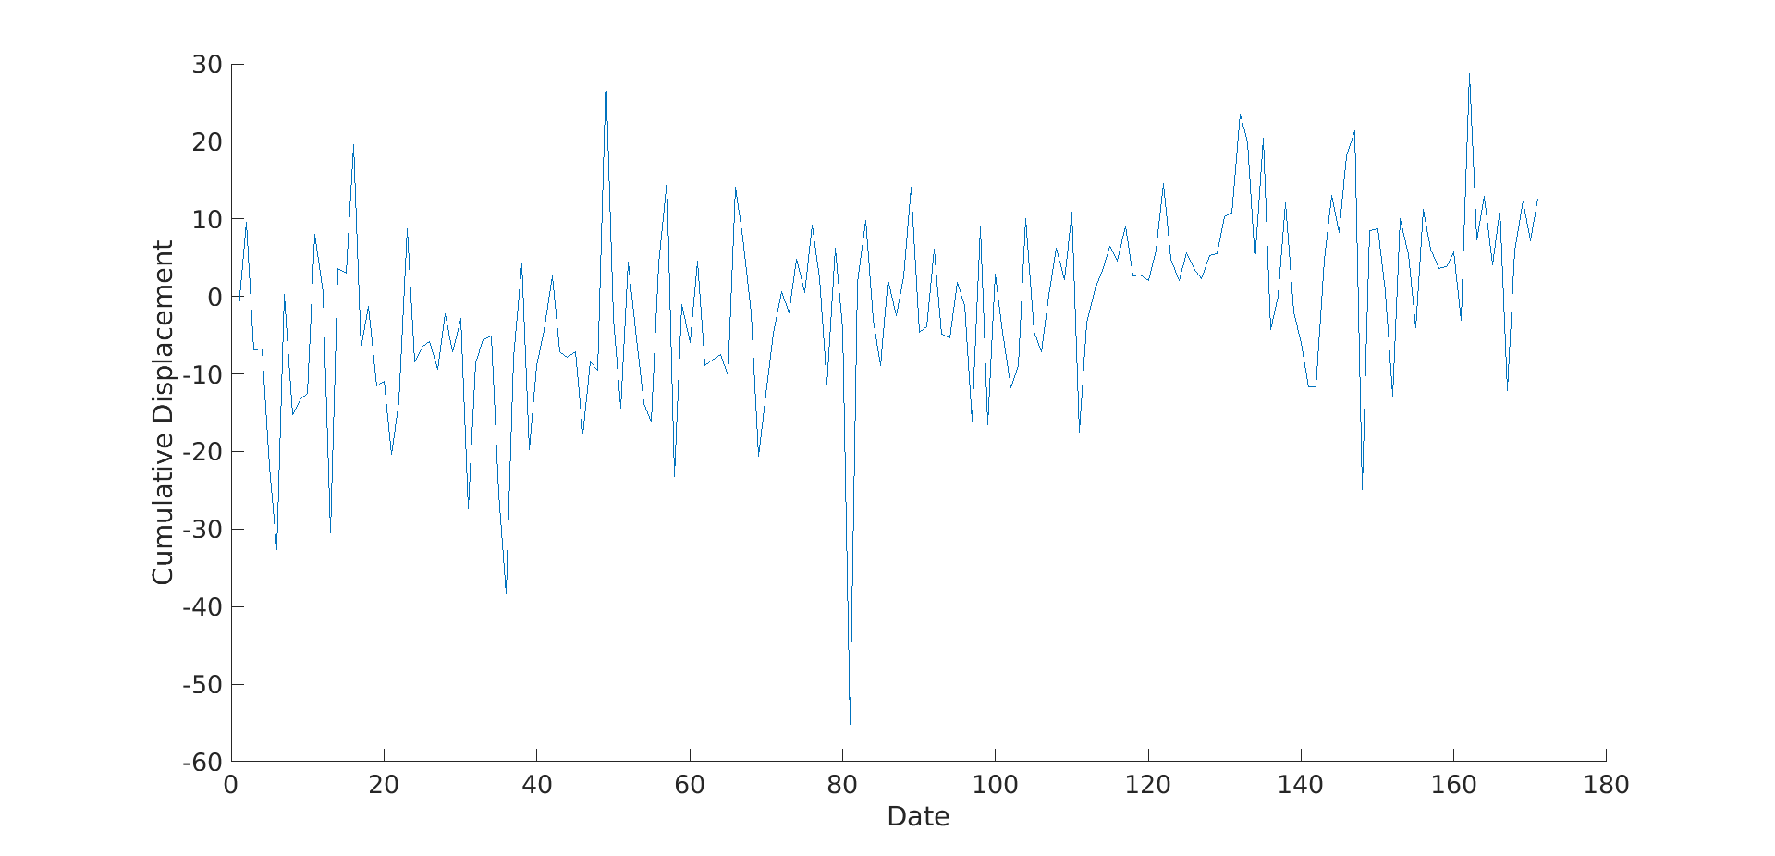
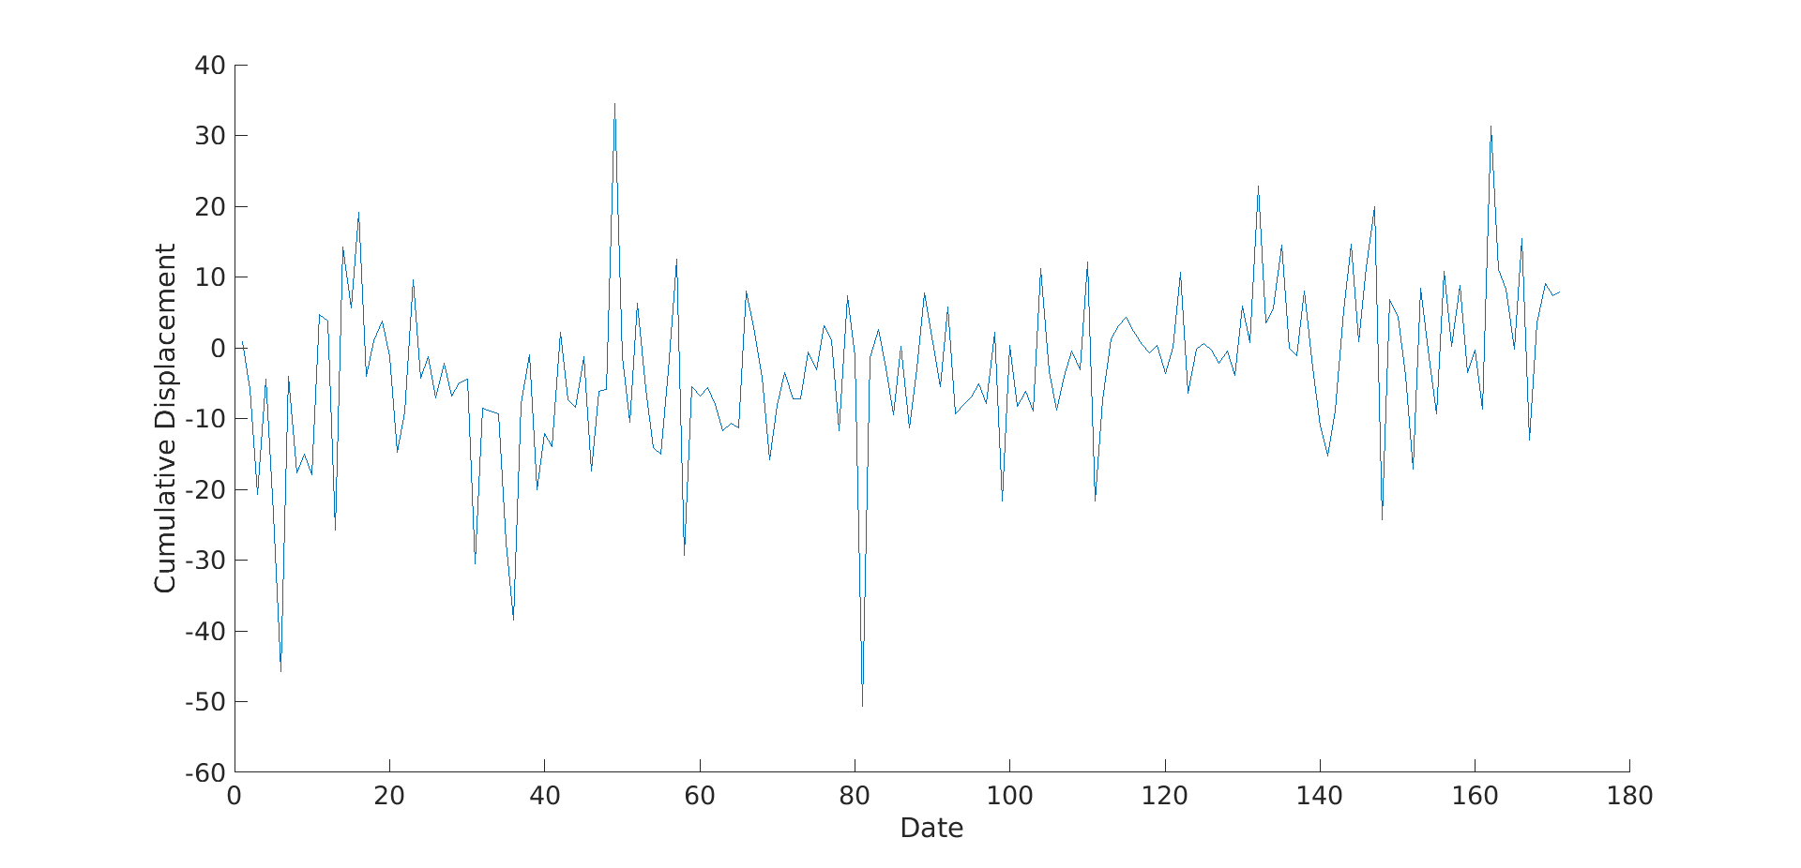
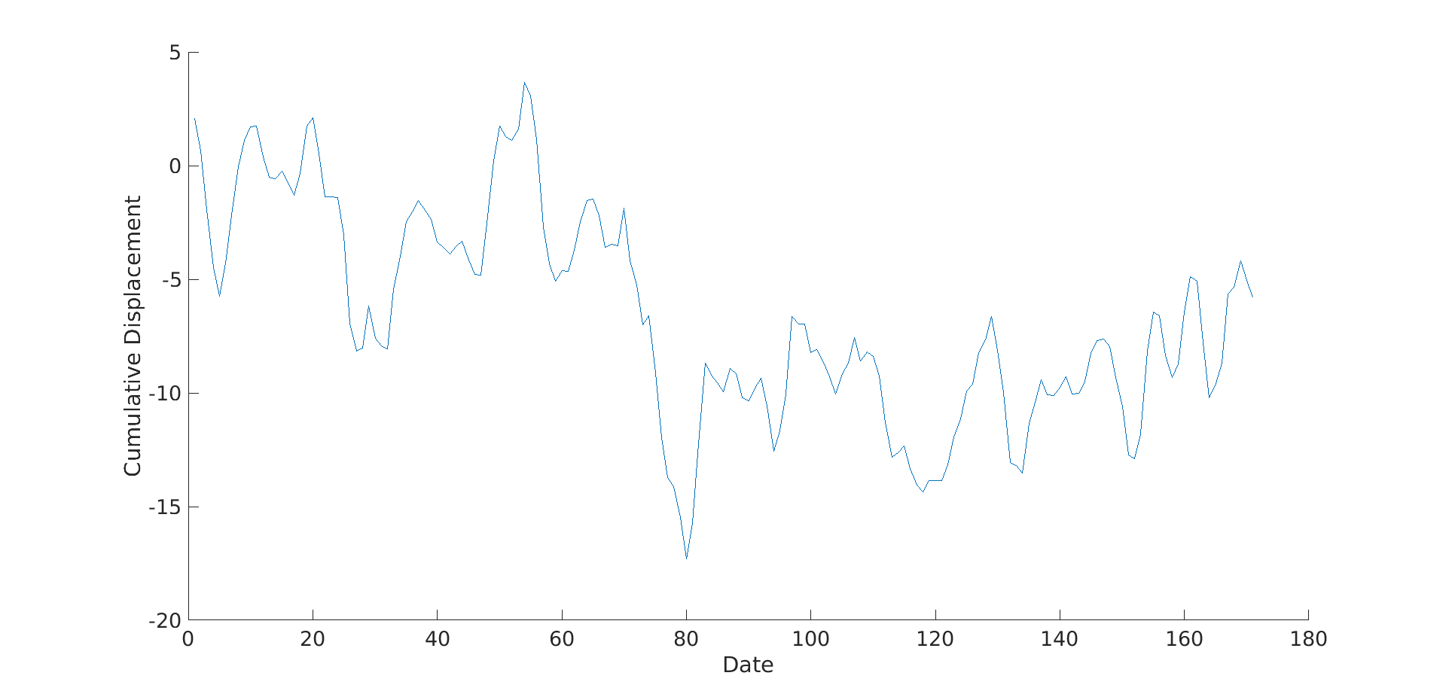
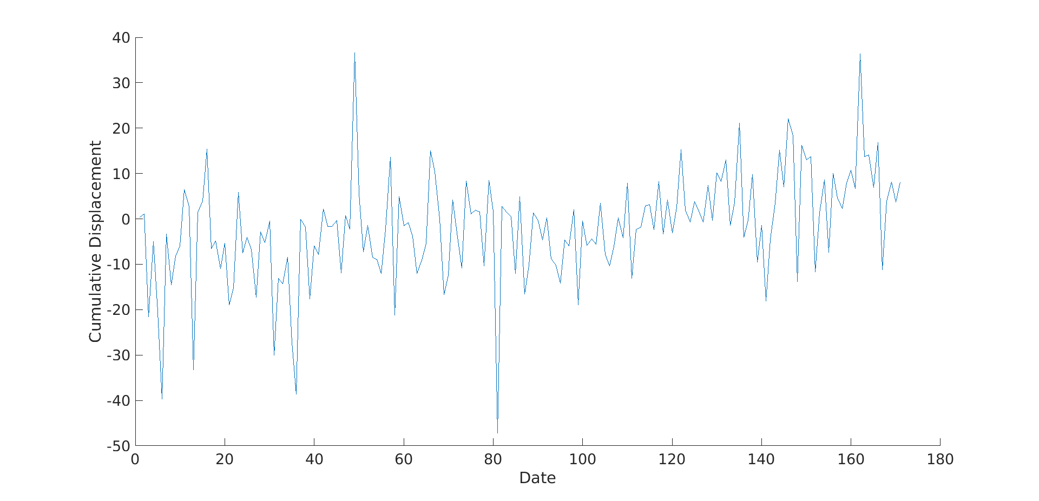
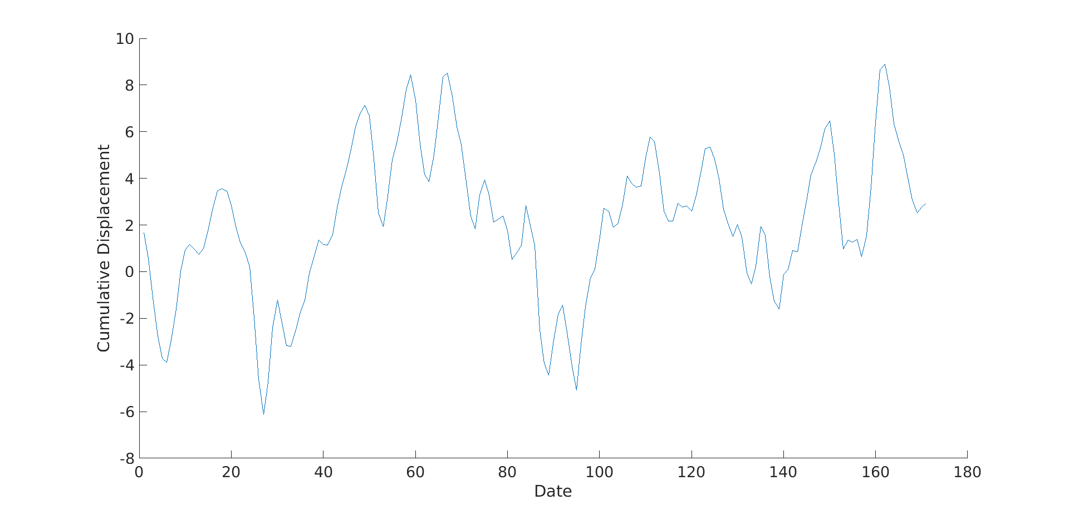
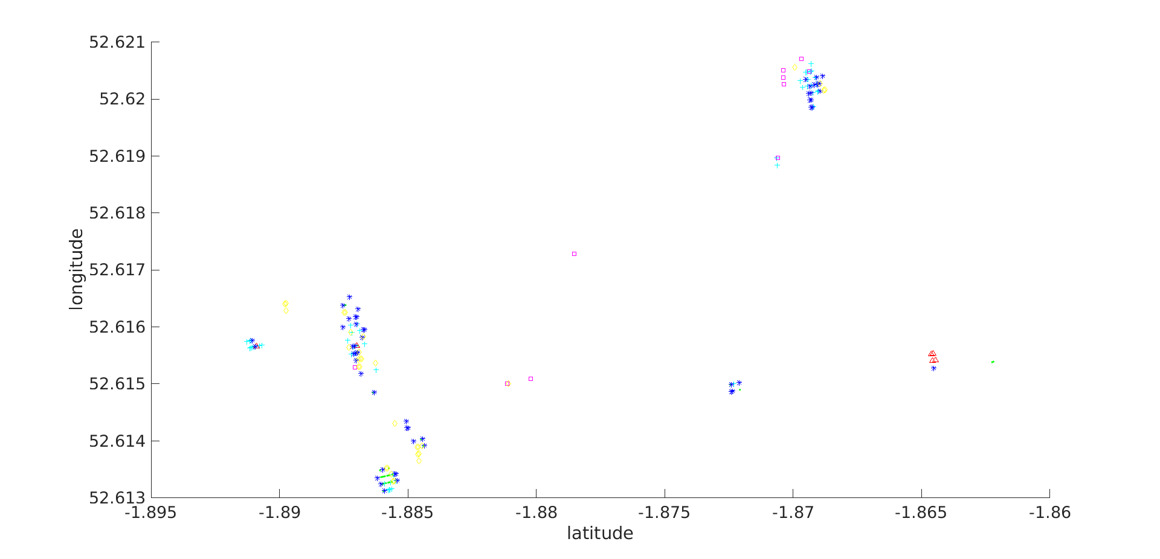
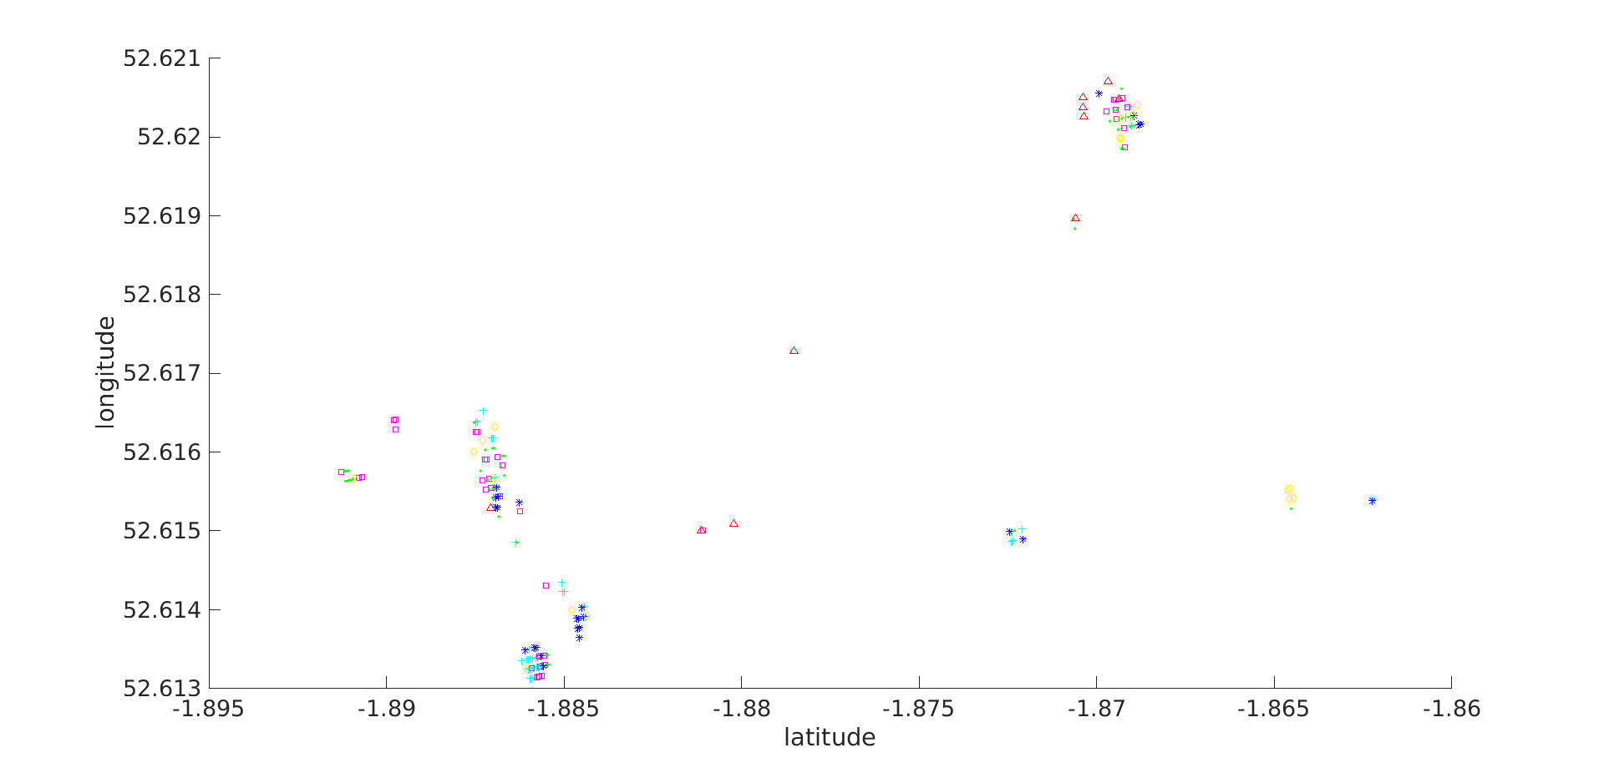
Temporal Clustering of Cumulative Displacement Sequences
Clearer group differences on the filtered sequences may help to handle better with data distributions
Temporal K-means using distance based on Dynamic Time Warping
(K=6 used for better visualisation)
Cluster 3
Cluster 1
Cluster 4
Cluster 5

Slide 2
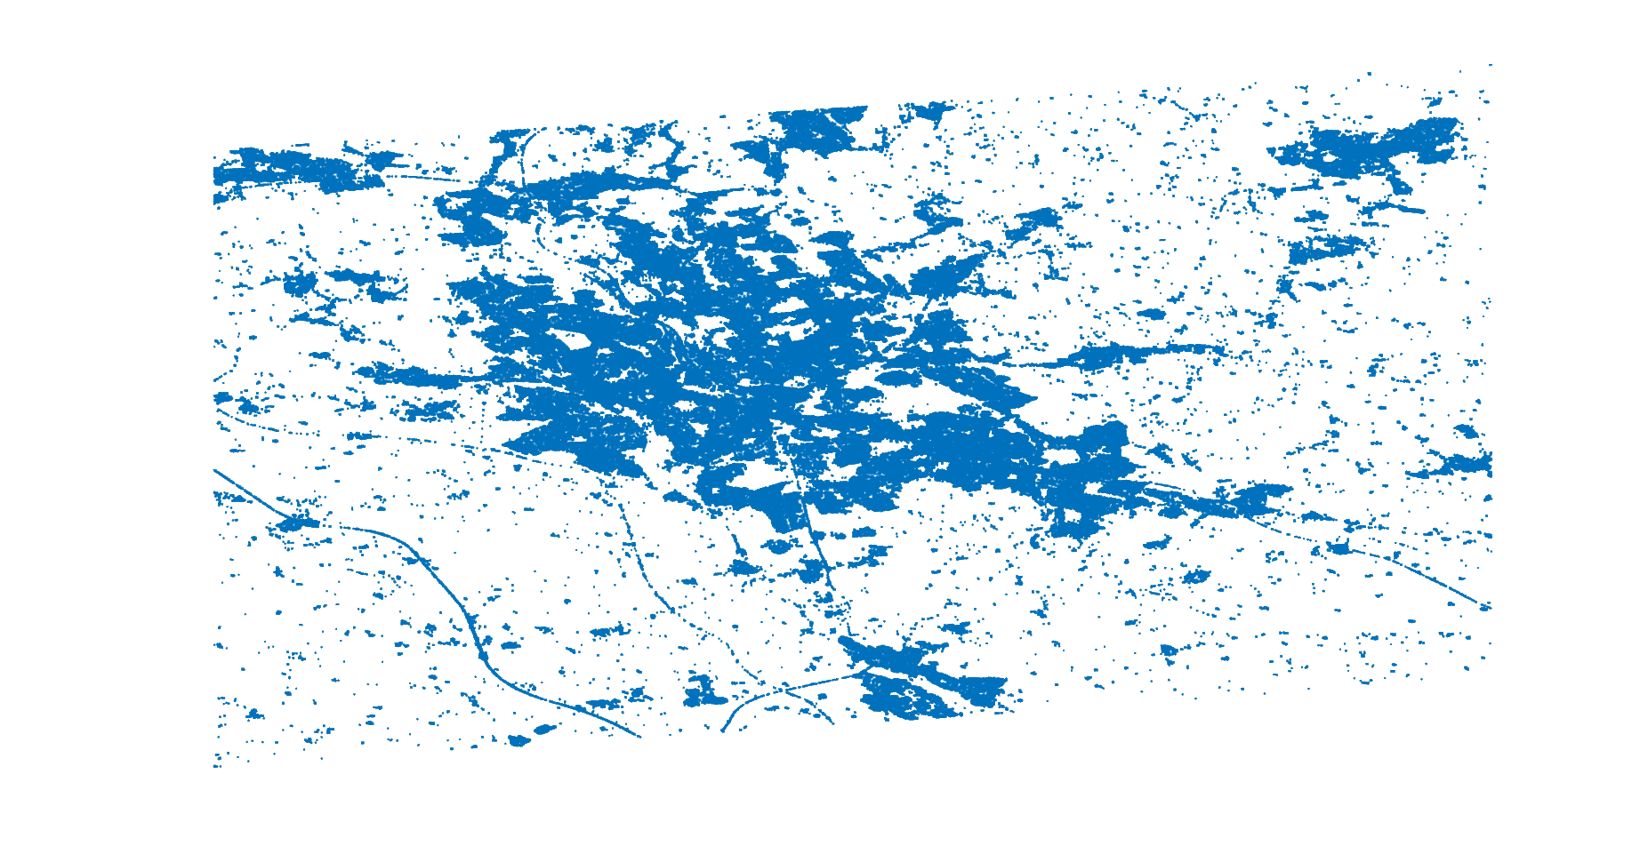
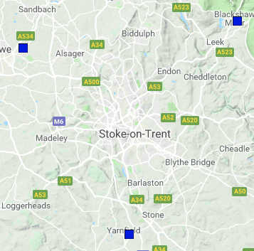
LSTMs can provide a measure of how good displacements can be predicted on given locations:
Each date become a sample of the network.
Locations become the features of the network.
Train and test sets contain the same number of observable variables (locations).
Features can include temporal information about past and future observations.
Example 1: 7 locations in the area limited by a GPS location (STO1) around Stokes-on-Trent: Focussed area.
Example 2: 10K locations in the area limited by 3 GPS stations around Stoke-on-Trent: Increased area.
CREW
LEEK
Blue dots are considered locations in the area with existing cumulative displacements captured from InSAR data.
CREW, LEEK, and STO1 are the closest GPS stations around the Stoke area
STO1

Slide 3
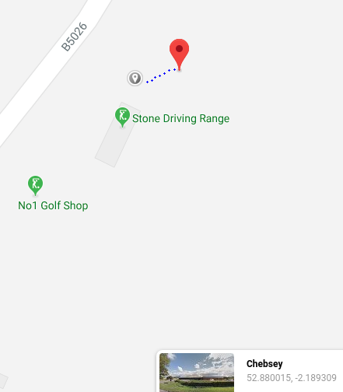
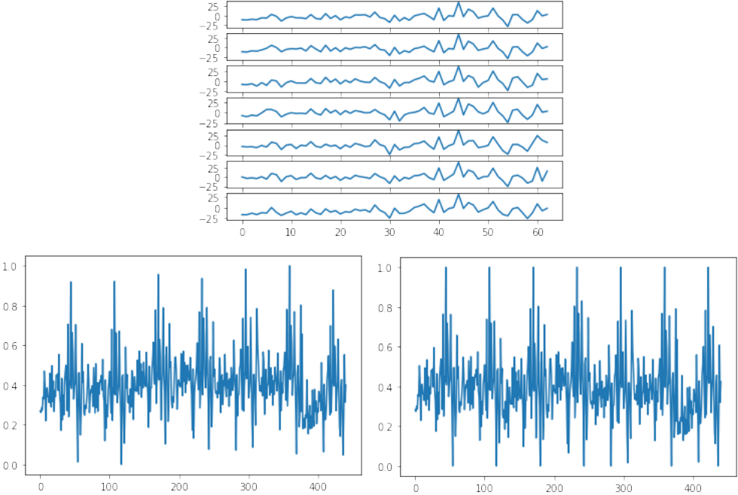
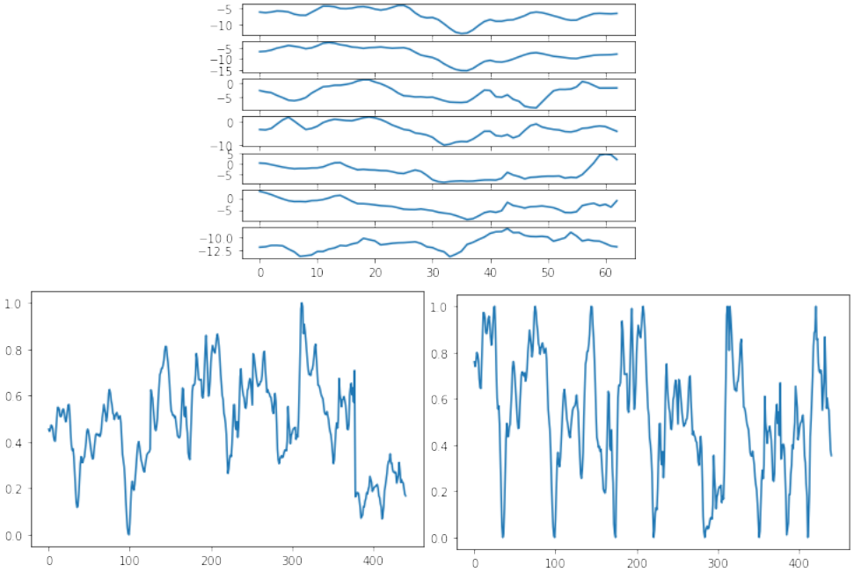
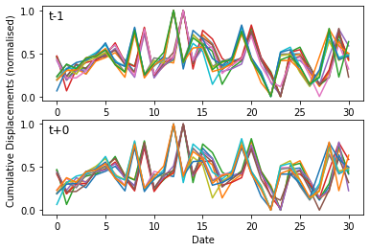
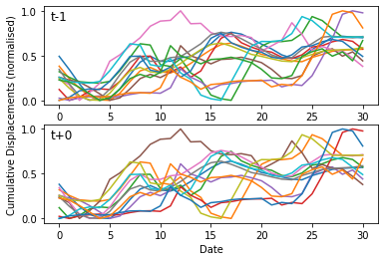
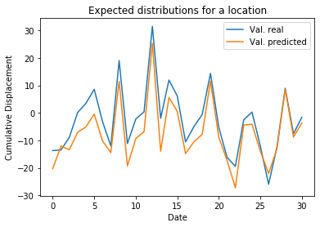
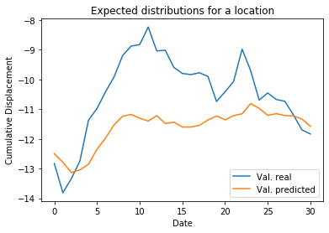
Example 1: 7 specific locations in the area limited by a GPS location (STO1) around
Stokes-on-Trent
Focused Area
Non-filtered
Cumulative
Displacements
62 days between
NOV'17 and DEC'18
Last Filter of
Cumulative
Displacements
Normalisation after concatenation (global)
or
Normalisation before concatenation (local)
Each validation sequence is a time-series of
non-filtered displacements along 31 dates
(late half from the whole period)
that corresponds to each location at the
observed timestep
Each validation sequence is a
time-series of filtered displacements along 31 dates that corresponds to each location at the observed timestep
Real displacements VS predicted displacements along late dates
(test samples)
LSTM learns better on
Filtered displacements
for this set of locations
Train Score: 2.61 RMSE Val. Score: 5.785 RMSE
Train Score: 0.51 RMSE Val. Score: 0.81 RMSE

Slide 4
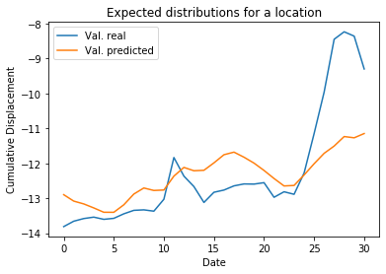
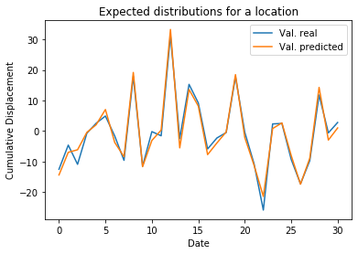
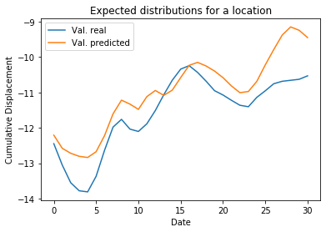
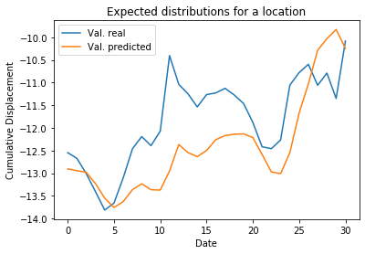
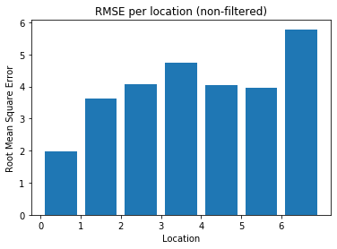
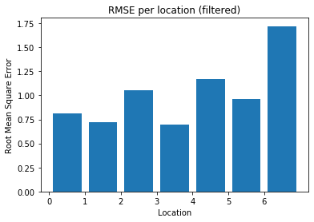
Example 1: Focused Area
Ranges of filtered displacements (right) are tighter, which results to lower RMSEs.
Distributions of non-filtered cumulative displacements (left) over consecutive locations remain pretty similar.

Slide 5

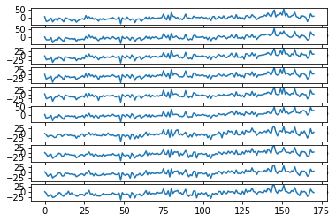
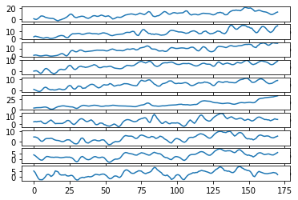
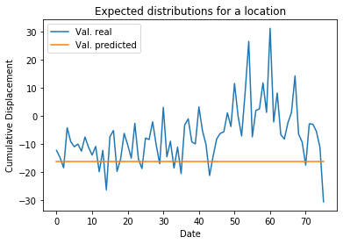
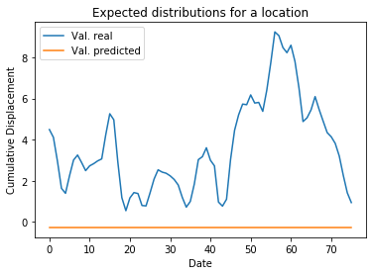
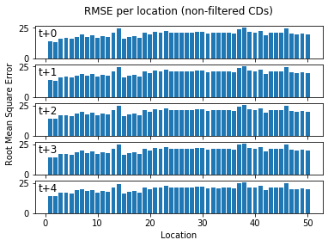
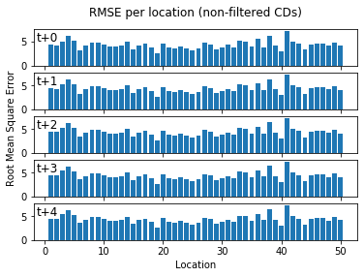
Example 2: 10K locations in the area limited by 3 GPS stations around Stoke-on-Trent
Increased
Area
Non-filtered
Cumulative
Displacements
171 days between
MAY'15 and DEC'18
Last Filter of
Cumulative
Displacements
...
...
Most predicted values are the same for all dates. This can be caused by overfitting or bias to a dense set of close locations.
Training only from past observations makes learning more difficult
Additional dates and locations will require more layers to train the multivariate
multistep LSTM.

Slide 6

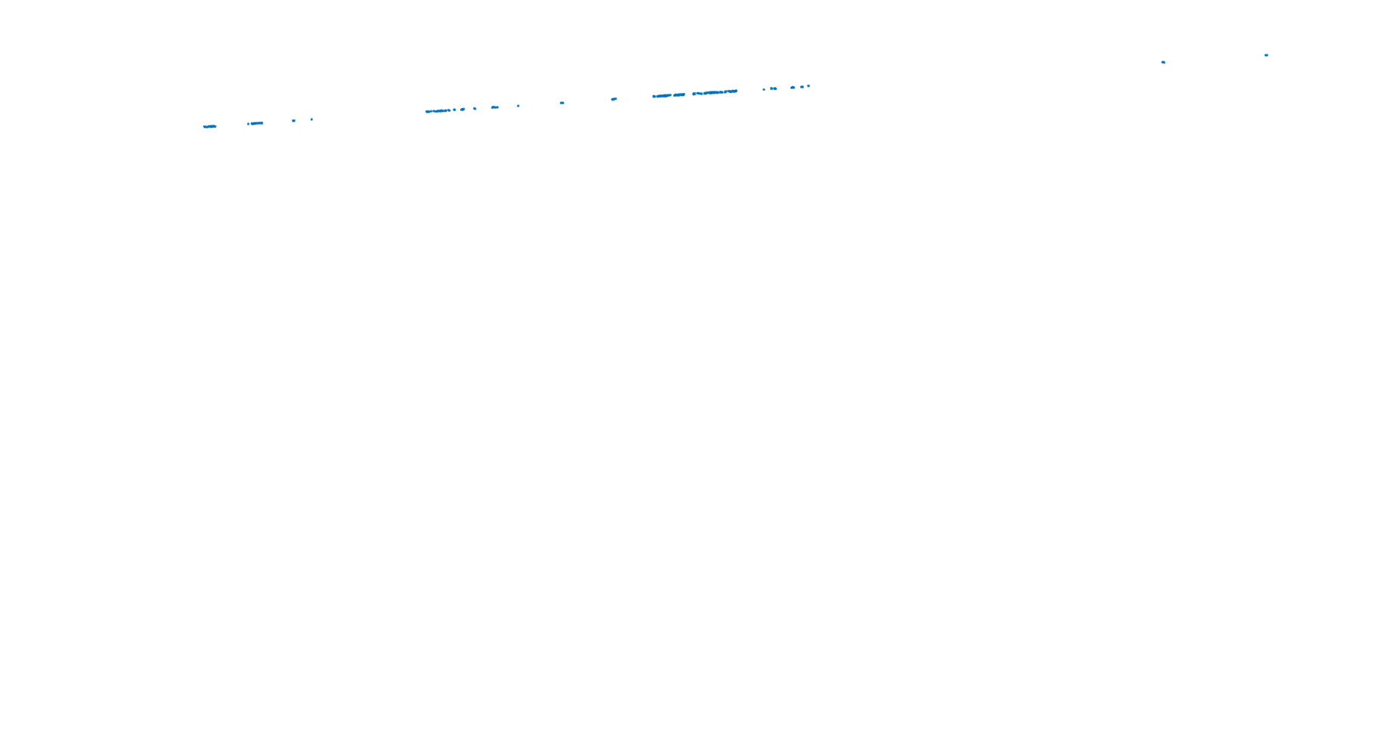
Example 3: 500 locations in the area limited by 3 GPS stations around Stoke-on-Trent
Transferable
Areas
An adequate definition of LSTM input and outputs is first required to generalise better according to the number of locations and dates. This will avoid overfitting.
Then, predictions across different locations can be considered to transfer learning region-to-region, especially if we know that some displacements are similar for a considerable period of time.
Close locations often contain similar non-filtered cumulative displacements. However, the last filter levels are able to provide significant differences amongst them.
A trade-off is needed between network complexity and relevant locations (features).

