Slide 1
Did it do the thing?
Measuring training impact in the Government

Slide 2
The Government does not have a good way to measure training impact.
The problem

Slide 3
Every year public servants get thousands of dollars to spend on training.
The problem
Notes:
Hundreds of millions of Canadian taxpayer dollars
It’s our duty to spend these dollars responsibly

Slide 4
How can we know that training is improving Government services?
Q
The problem

Slide 5
The world is evolving and organizations need to adapt.
Why it matters
Notes:
Brining in people with the right skills.
Giving existing people the right skills.

Slide 6
Our problem is rooted in DND’s need to have a data literate workforce.
Why it matters
Notes:
They make real-time, evidence based decisions to deploy resources

Slide 7
The solution? More training!
Why it matters
Notes:
But how do you know what training?
You need evidence!

Slide 8
Evidence based decision making requires...
Why it matters

Slide 9
Evidence
Why it matters
Notes:
We don’t have a lot right now.
Surveys, post training certification, “feelings”
Missing the needs analysis, before skills, after skills and impact on the job.

Slide 10
We want to capture a complete picture of the learner’s experience.
Our idea
Notes:
CONTINUOUS/Lifelong: Before, During, After

Slide 11
Obviously, there’s an app for that.
Our idea

Slide 12
False
Our idea
Notes:
Learning Management systems track learners’ training and course feedback
Performance Management tracks goals and competencies
Talent Management uses person information to fill positions
*Learning apps provide training specific feedback for their proprietary courses
HOWEVER this is largely centered around training courses, managed by system administrators, and often data is not updated in a timely manner to get a true picture at any given time.
Talk about different learning and interaction platforms that exist.
Sli.do,
Wooclap,
Top Hat,
Moodle,
Socrative,
Saba
Training evaluations
Competencies dictionaries

Slide 13
Our team goal is to analyse existing data and prototype an app to collect more.
Our idea

Slide 14
Before, during and after training
Frequent feedback and help
Measure comprehension, sentiment and job tasks
Integrated with training
Lifelong learning
Our idea

Slide 15
The journey

Slide 16
Define evaluation framework
Analyse DND training data
Prototype application
User research
The journey

Slide 17
Our framework
The journey

Slide 18

A definition of data literacy
Three defined user types
Competencies & proficiency levels
Foundations in education research
The journey

Slide 19
Evaluation interactions are...
Results
Anchored in principles of adult learning
Use a systems approach to design a goal-based evaluation model
Measured against a competency dictionary to gauge proficiency level
Behaviour
Learning
Reaction
Kirkpatrick Model
The journey

Slide 20
Data analysis
The journey

Slide 21
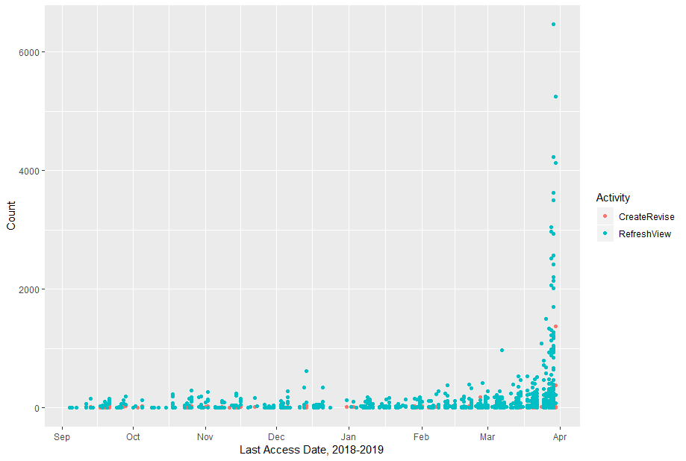
User activity
139,767
11,189
viewed or refreshed
created or edited
Notes:
463 people have only done one of create/revise or refresh/view
Most activity is viewing

Slide 22
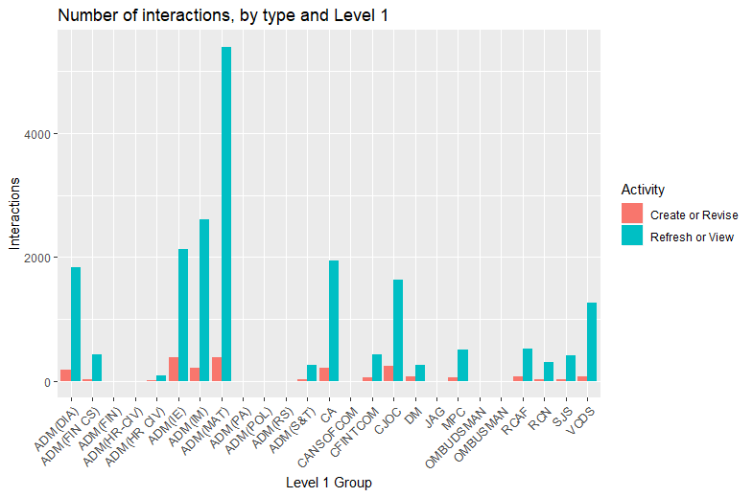
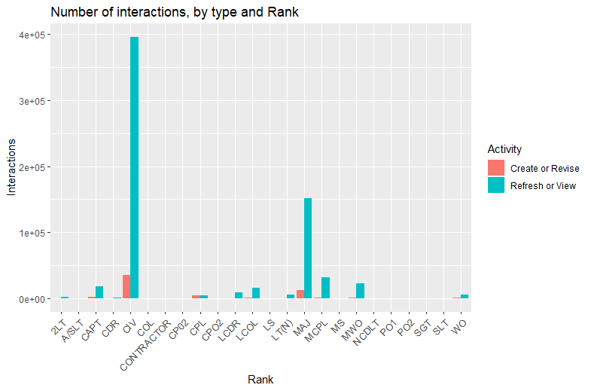
Who’s using the software
By branch
By rank

Slide 23
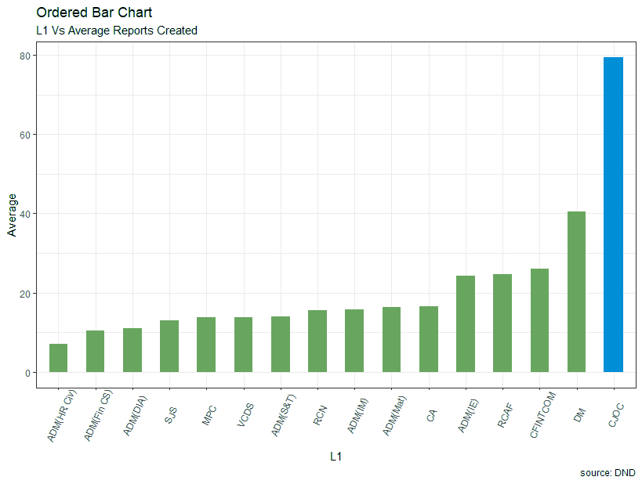
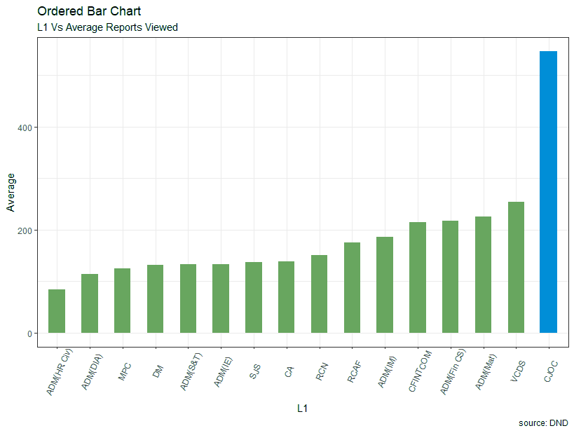
Branch activity (after training)
Average reports created
Average reports viewed

Slide 24
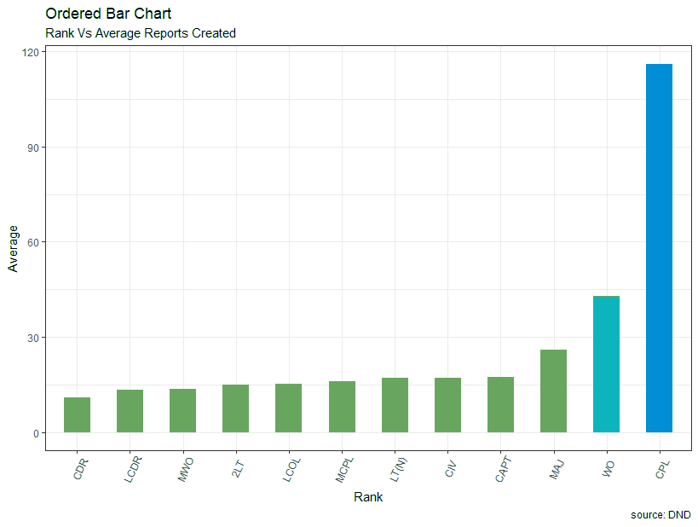
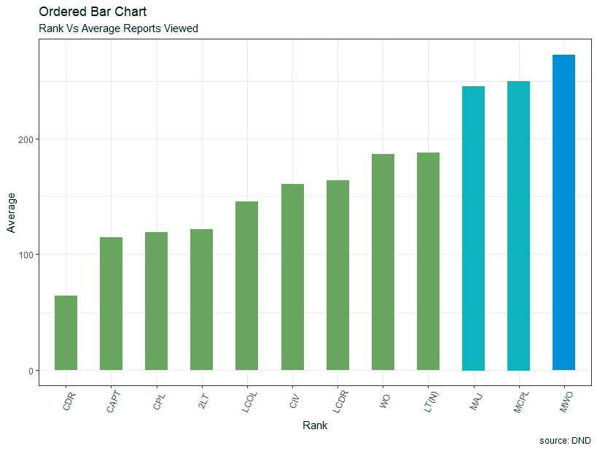
Rank activity (after training)
Average reports created
Average reports viewed

Slide 25
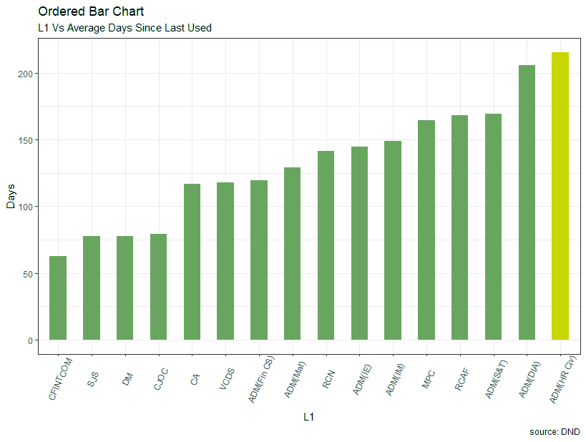
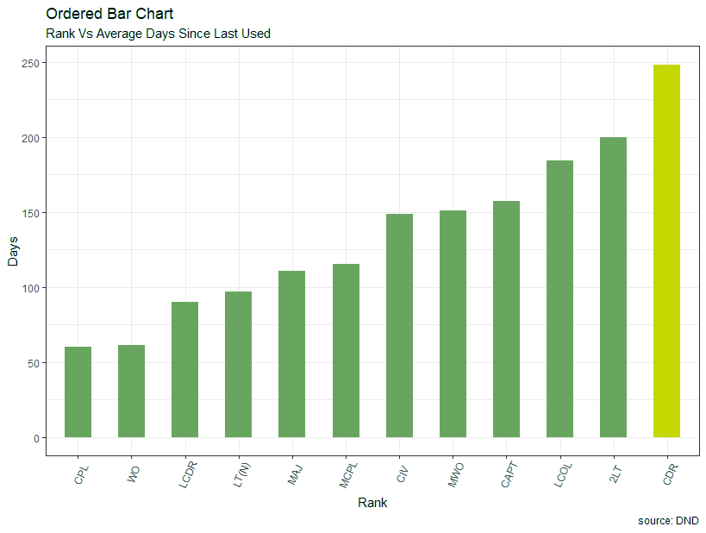
Days since last use (after training)
By branch
By rank

Slide 26
The app (for that)
The journey

Slide 27

Interactive
Real-time evaluation and feedback
Identify skills and gaps
Collect and analyse data
Visualize progress
Topic agnostic
The journey
Notes:
Can be used for and training and non-formal learning
Data used for training improvement for
Individual learners - personalized (not specific to course or position)
Class - gauge level of knowledge for progressing
Instructors - adjust to class
Training Organization - measure effectiveness of learning
Organization at large - talent management

Slide 28
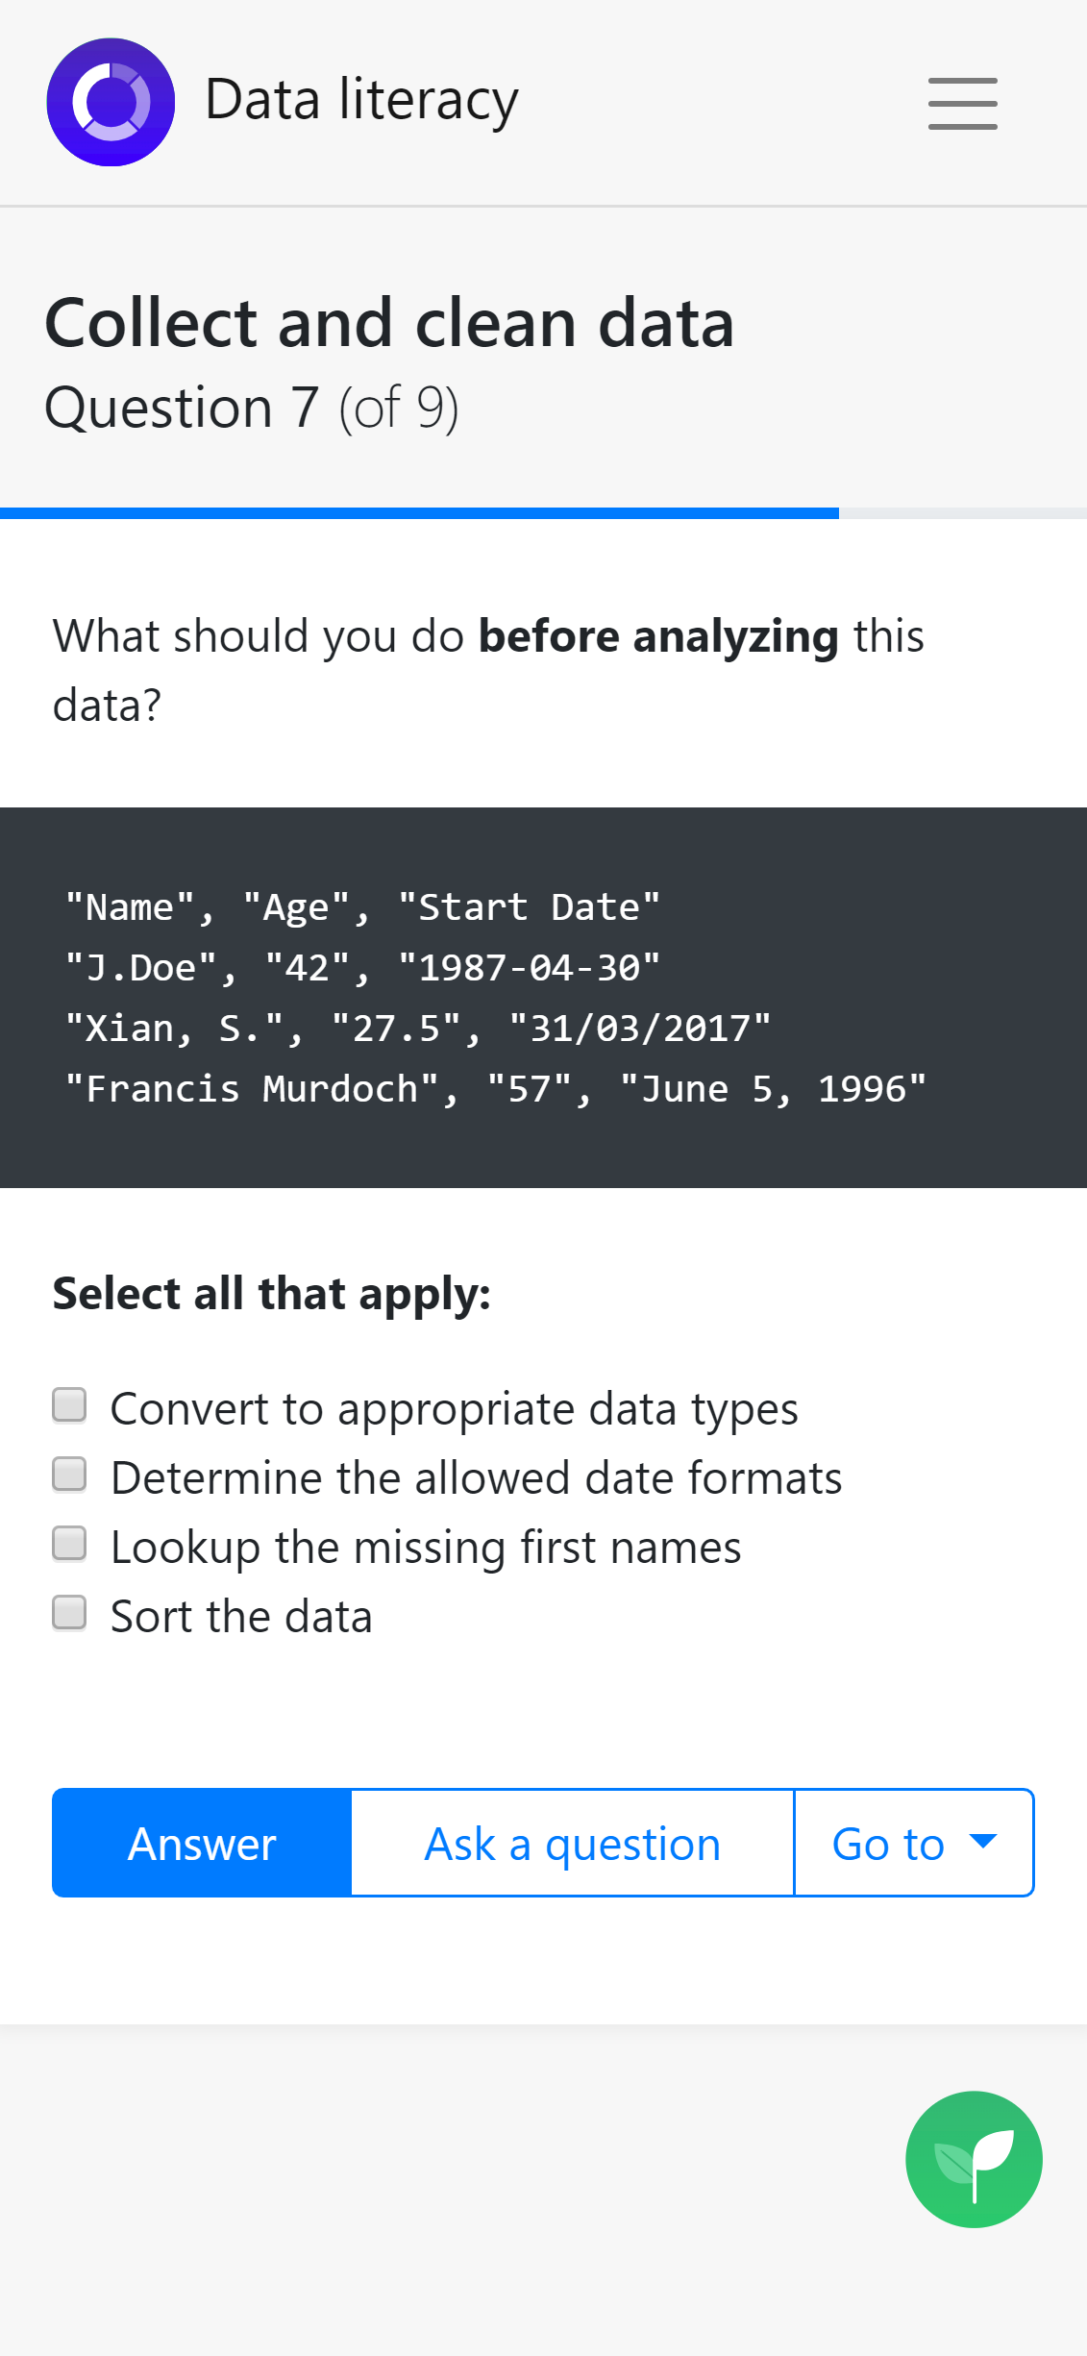

Slide 29
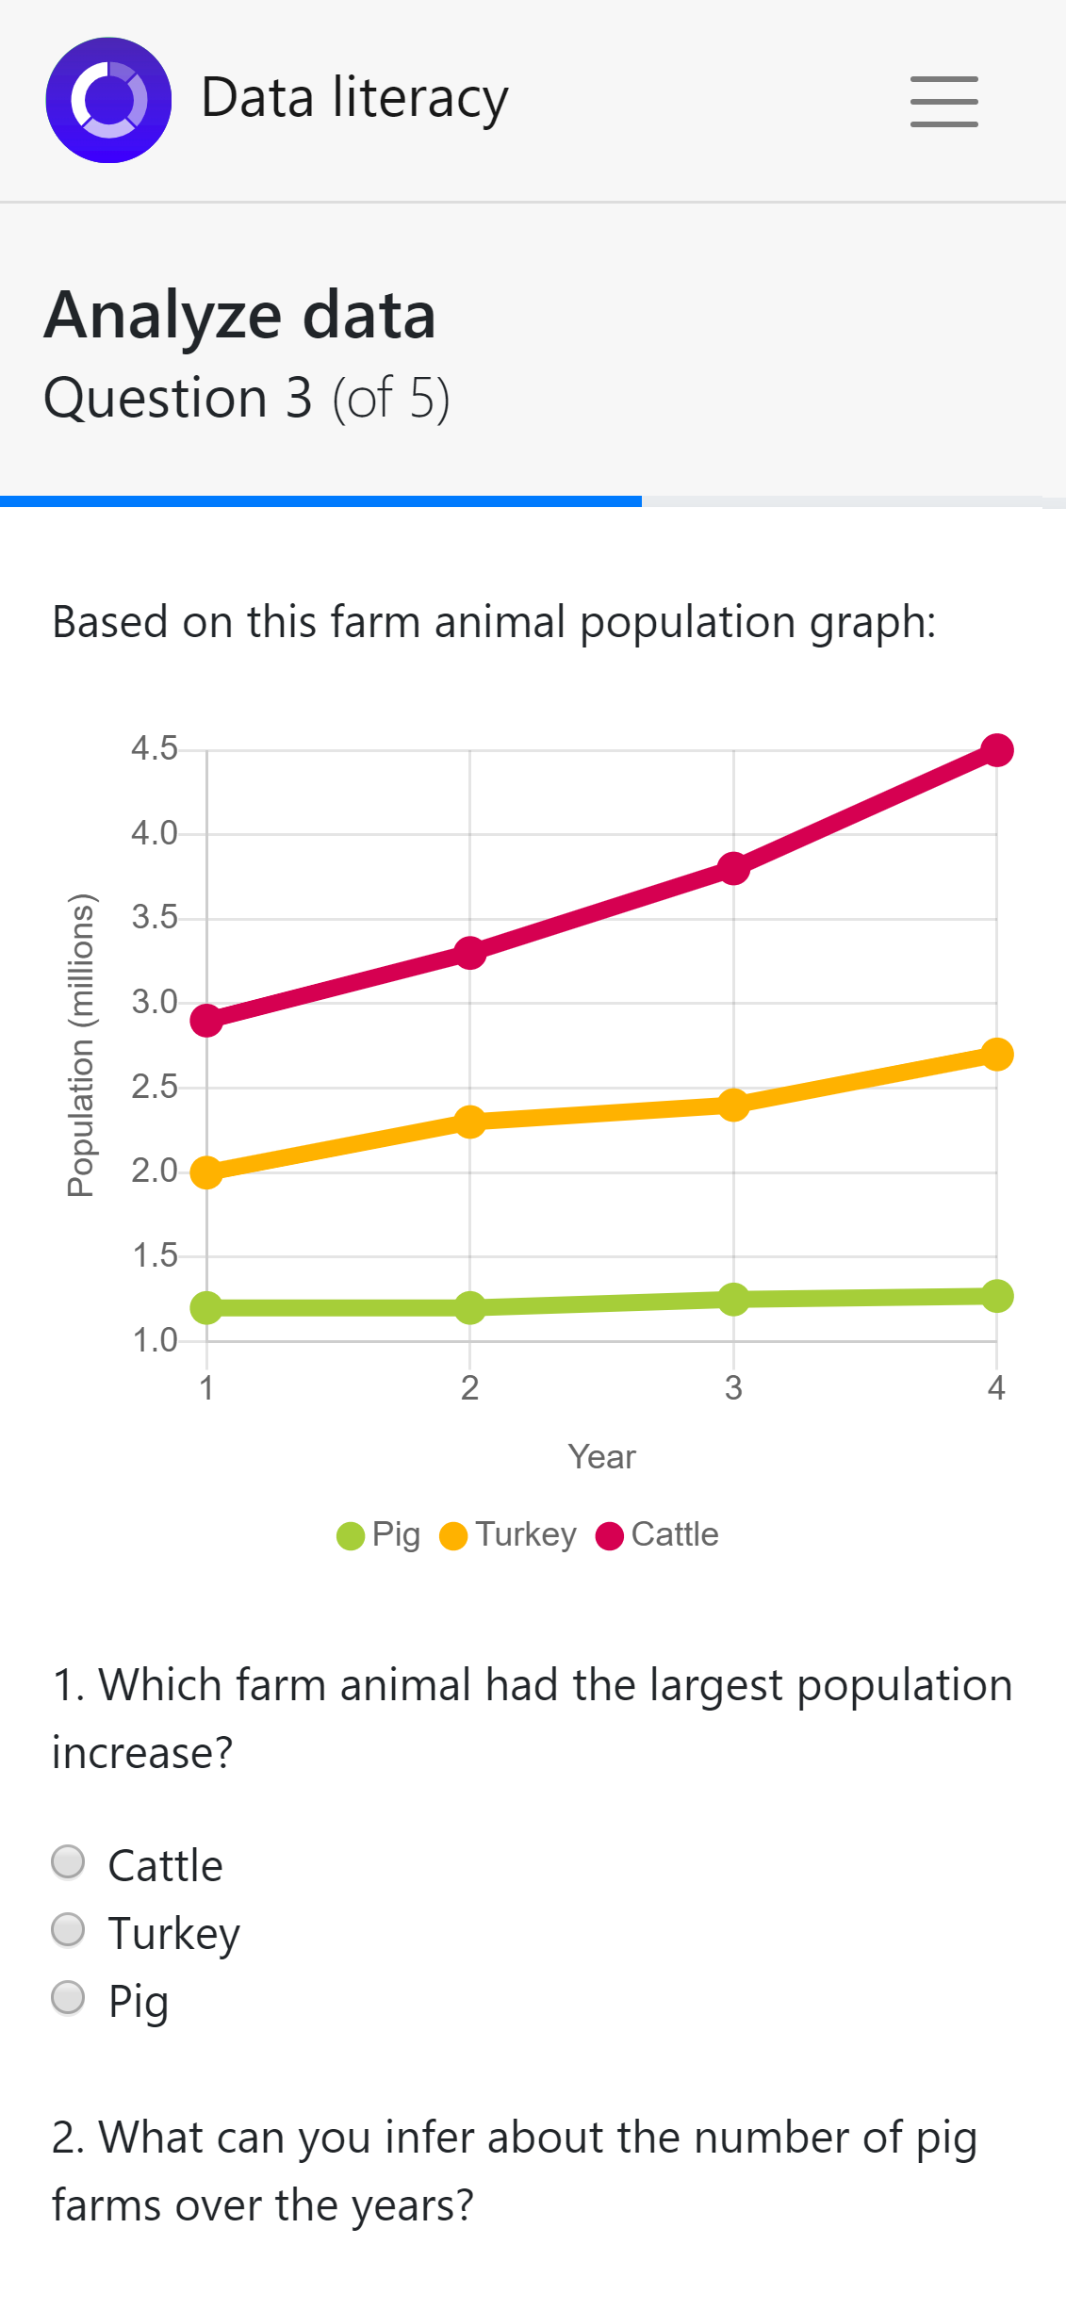

Slide 30
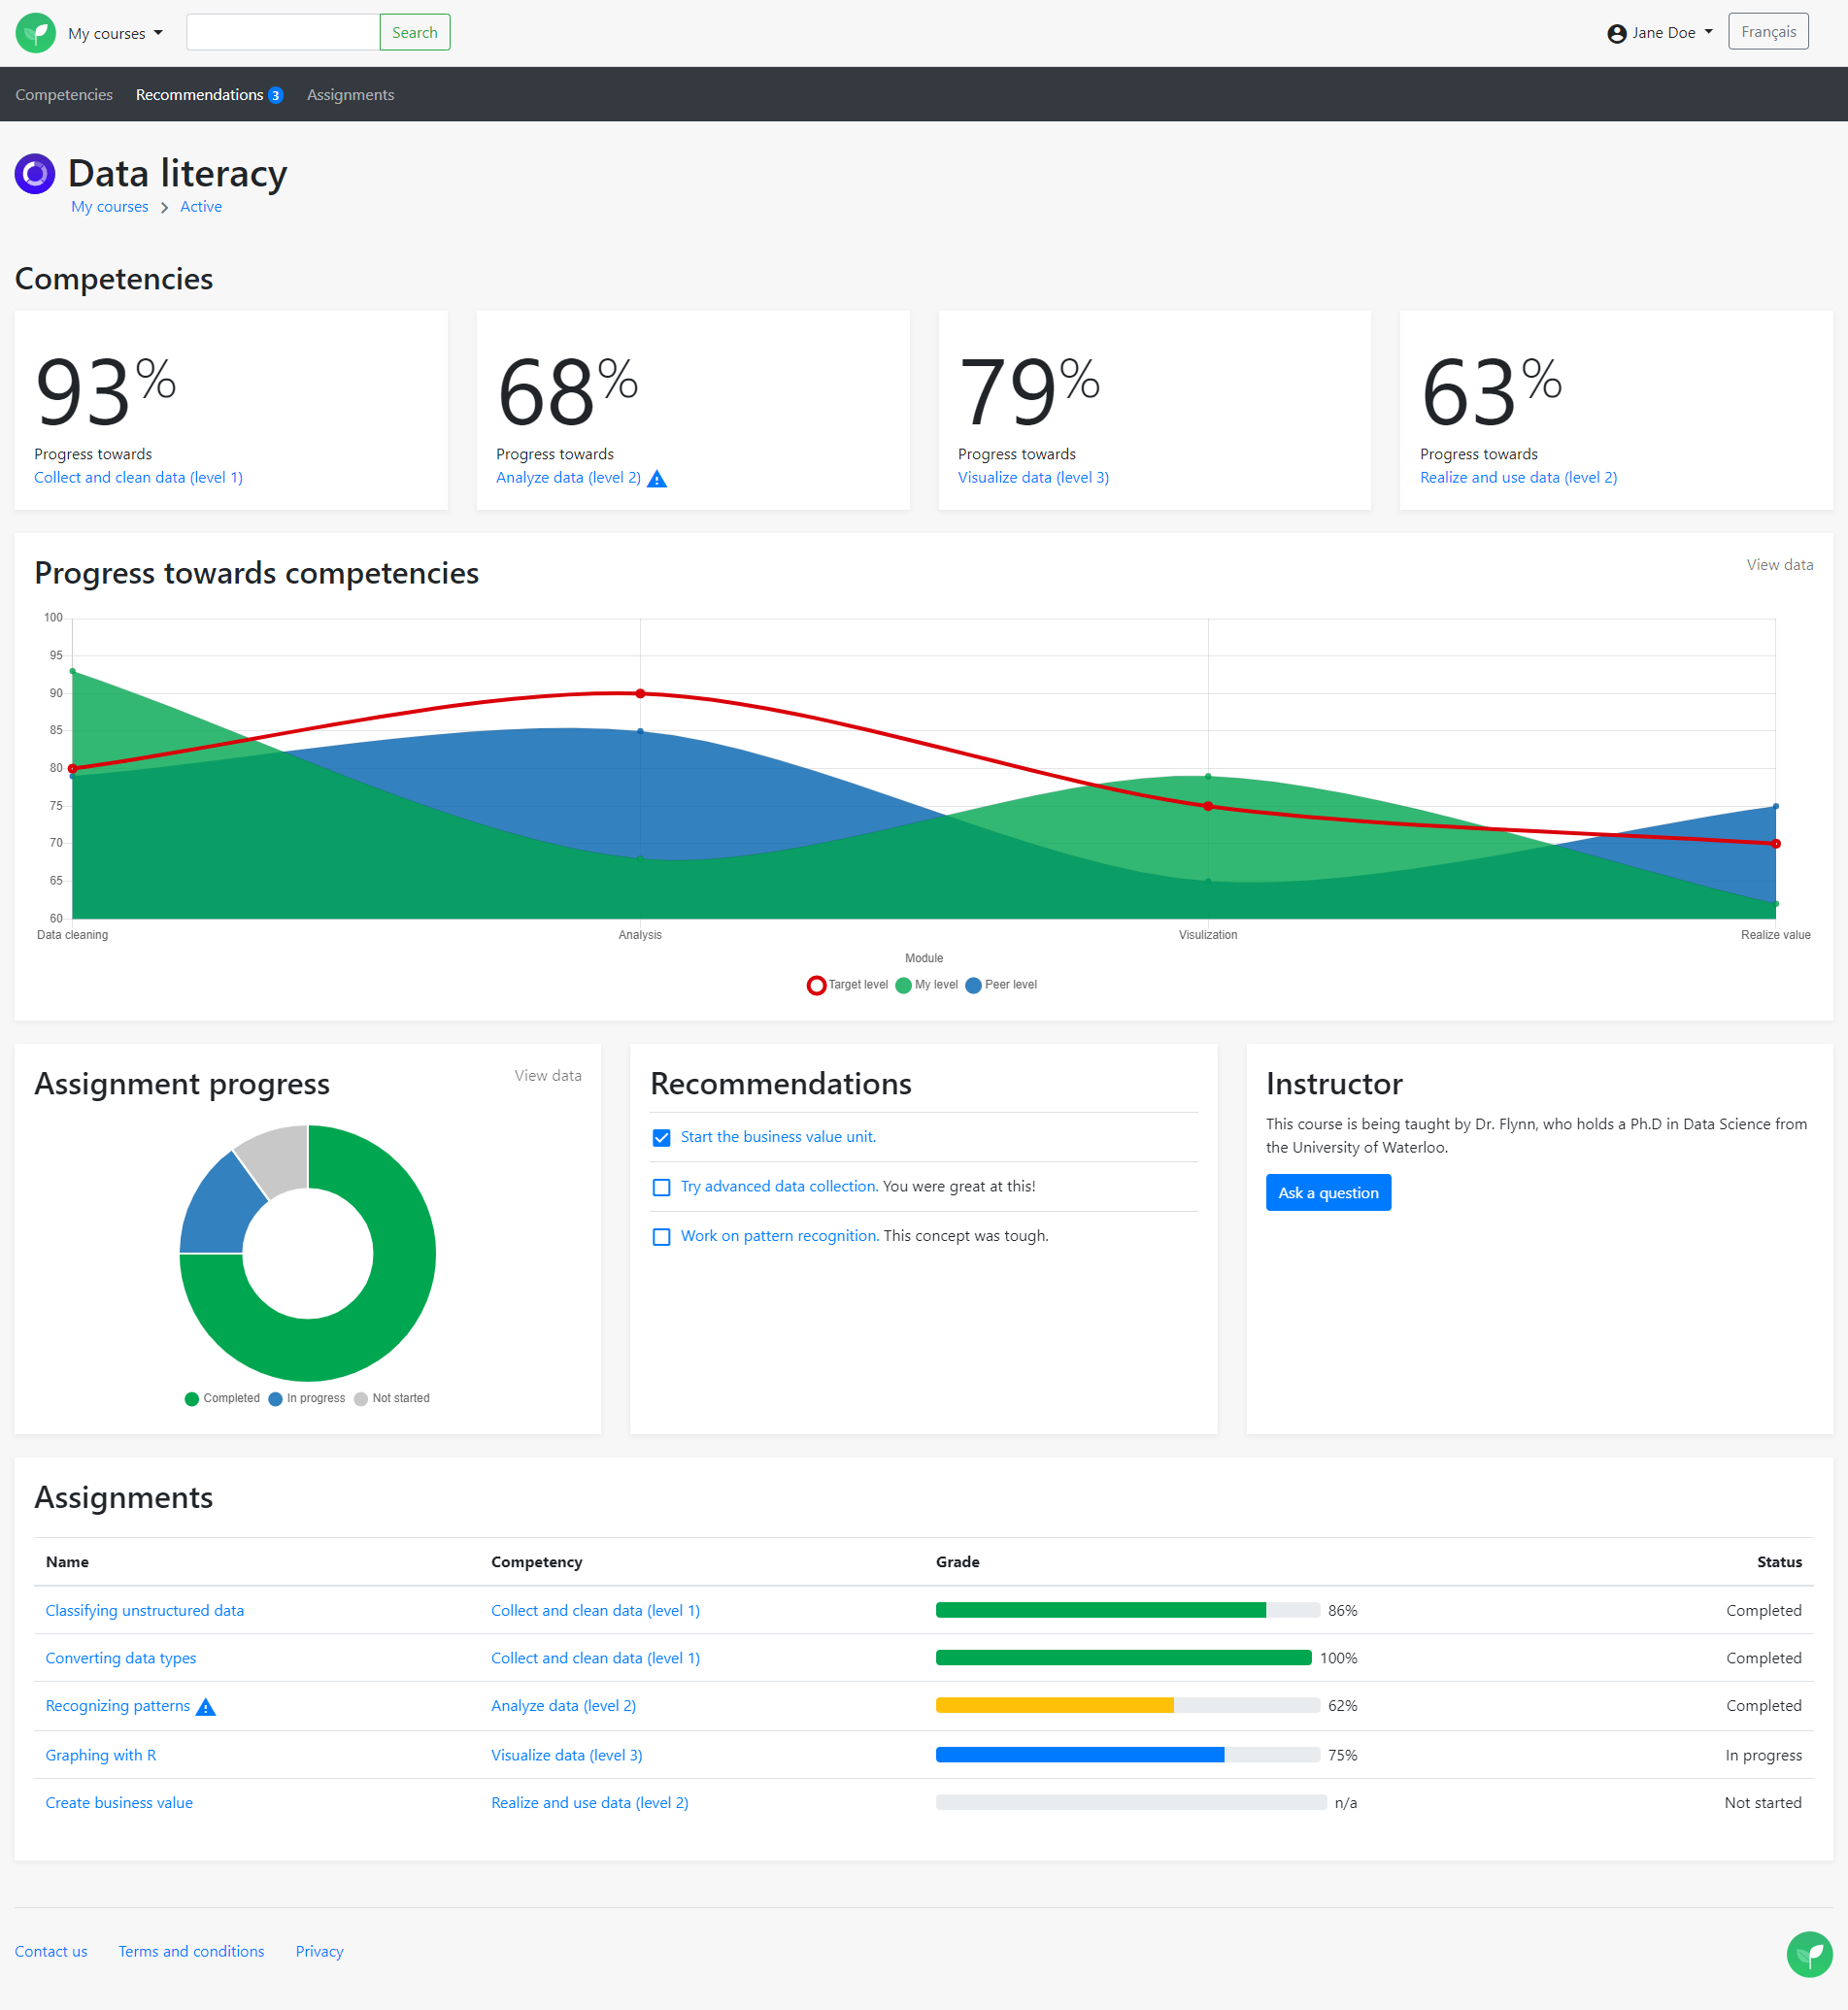

Slide 31
What’s next?
Notes:
Prototype the interactions with wireframes and testing
Data visualization

