Slide 1
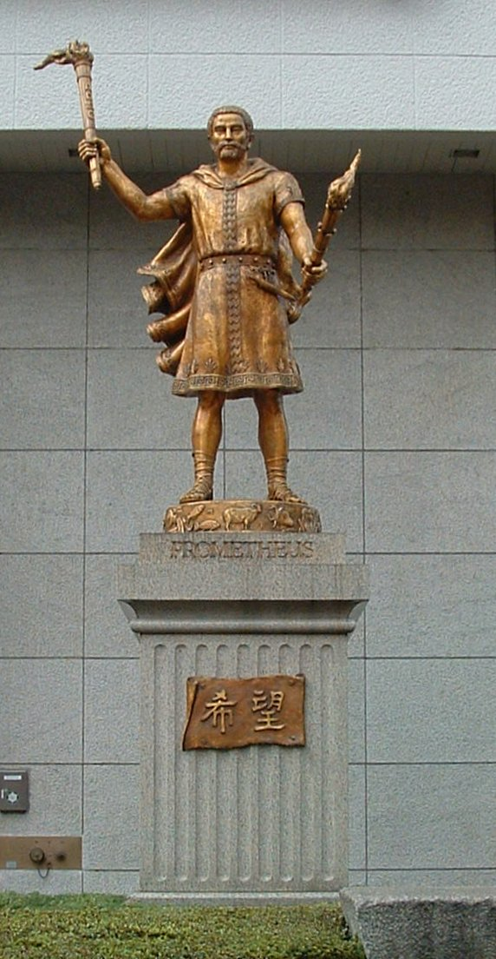
Cracking the PSP
24C3
TyRaNiD

Slide 2
Background
Developing on PSP for almost 3 years
Developer of PSPLink, PRXTool
Member of team who developed PSPSDK
Contributor to Prometheus / Team C+D
Worked in the past on PS2, Sega Saturn and others

Slide 3
Thanks and Greets
Main members of Prometheus:
  Nem, Fanjita, Joek, Dark Alex, Chris Swindle, Jim, Adrahil, psp250, ditlew, Skylark, hitchhiker, Mathieulh
All the rest:
  Booster, Edison Carter, Groepaz, M.R. Brown, Marcus C, ooPo, Oobles, Chip and others I forget...
And a special slow hand clap for:
  Sony Computer Entertainment

Slide 4
Overview
Overview of PSP Security Model
Breaking the V1.0 Firmware
Service Mode and Creation of Pandora

Slide 5
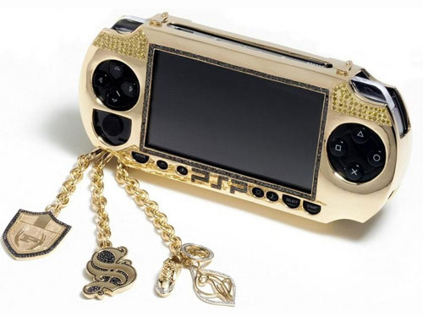
PSP Security Model
  How it was supposed to work

Slide 6
PSP Security Model
PSP was designed to be secure, or so it would seem
Two distinct areas of security:
  Boot Time / Hardware Security
  Runtime Security
All designed to prevent unauthorised software from running

Slide 7
Boot Time Security
Firmware to be flash upgradable
Needs method to prevent unauthorised firmware being flashed
In built hardware security engine (KIRK)
What better than a chain of trust boot process?

Slide 8
Chain of Trust
CPU
Flash ROM
Pre-IPL
(boot code)
IPL
Sysmem
Loadcore
Main Kernel
KIRK

Slide 9
Runtime Security
Becomes important once system has initialized
Firmware restarting uses circular chain of trust
Restrictions on types of files to load
  From where they can be loaded
  Whether they need to be encrypted
Kernel and User privilege separation

Slide 10
Other Security “Features”
Save games encrypted using on board hardware (difficult to reproduce without access to the PSP)
Update files encrypted and checked
No user accessible process to downgrade firmware version
Some important operating data encrypted in flash on a per PSP basis (IdStorage)

Slide 11
Executing from MS
Executable for memory stick usage packaged in an special meta-data format.
Referred to as an EBOOT.PBP
Executables should be packed inside in an encrypted form
Updates run from a special directory (PSP/GAME/UPDATE) which enables a special update operating mode

Slide 12
So?
On paper:
  Static Root of Trust with Chained boot process should stop replacement of the firmware
  Runtime security should prevent people running code, and prevent privilege elevation
  Save game encryption would make it harder to attack badly written games
  Update process prevents reverting to older firmware if a flaw was found

Slide 13

How Not to Implement Security
  A tale of cost versus time versus security
  Or a reason to be happy with Nintendo

Slide 14
PSP Released
PSP released in Japan Dec 12th 2004
Came with version 1.0 firmware
Release date brought forward to steal some of Nintendo's thunder (DS released on Dec 2nd in Japan)
So... People got to work

Slide 15
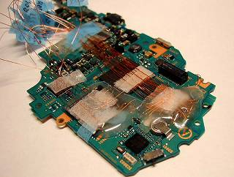
It all started so innocently

Slide 16
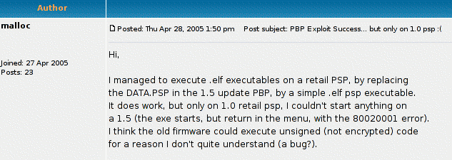
The Breakthrough
Member of ps2dev.org forums makes an interesting discovery:

Slide 17
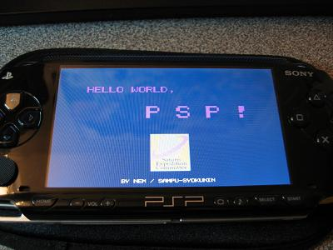
Hello World
A mandatory requirement for a new system, Japanese hacker Nem obliges.

Slide 18
But we want kernel mode!
Running code only gave user-mode access
Anything interesting is in kernel mode but how to get there?
  Exploitation?
  Encrypting an Executable?
None of the above: Just tell the ELF loader you are a kernel module and it obliges!

Slide 19
WTF?
Version 1.0 identifies two types of executables:
  Standard MIPS ELFs
  Modified Relocatable ELFs (PRX files)
Standard ELF left in for development, they forgot to add protection checks for this format
PRXes MUST be encrypted to load off memory stick and act to in kernel mode

Slide 20
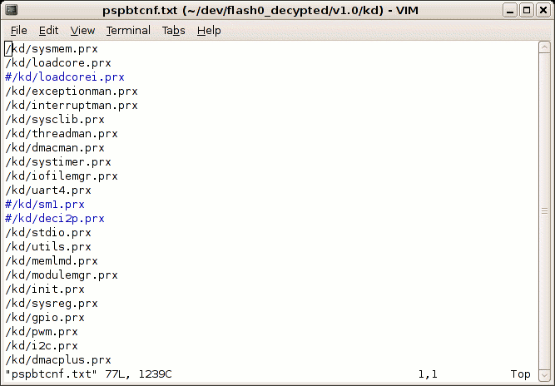
Speculation
Sony rushed the firmware to get it out in time

Slide 21
Other Flaws
Sony has tried desperately to fix their firmware, however few revisions have been secure
  Race conditions and printf formatting bugs
  Third party library exploits
    libTIFF, twice!
  Save game buffer overflows
    save game encryption rendered useless
  Kernel parameter checking errors

Slide 22
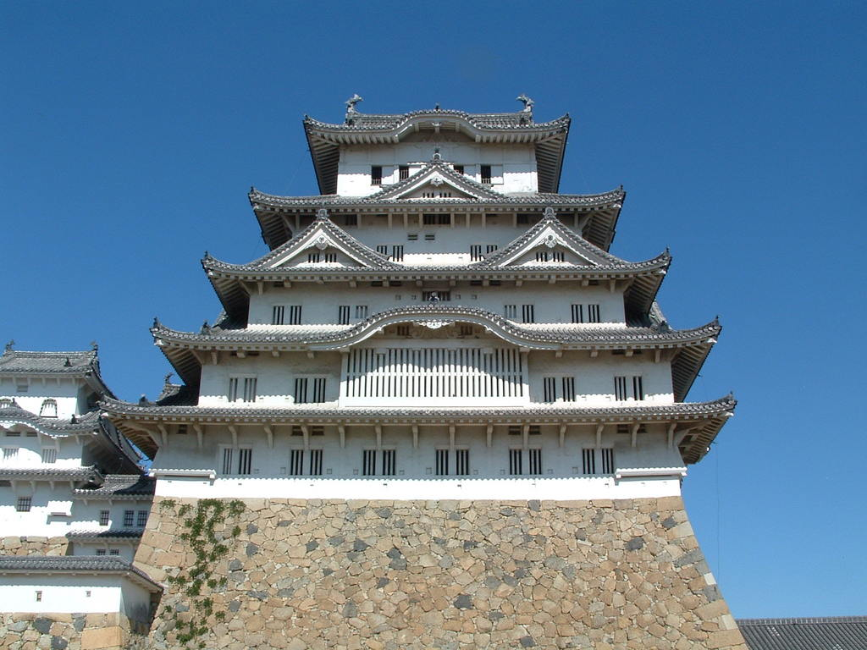
Opening Pandora's Box
  Pre-IPL FTW

Slide 23
Service Mode?
Sony had left a Service Mode in the PSP to externally access flash
Based on information leaks it is accessed with a special battery and memory stick
Nothing found in the IPL, therefore it must be in Pre-IPL
But it seems the PSP's IPL disables the Pre-IPL before we can get close
How can we access it?

Slide 24
Encrypted IPL Block
0
16
Block Encryption Key
Unknown
32
Header Hash
48
Data Hash
64
Unknown
112
Data Size
Pre-Data Size
Unknown
Unknown
128
Encrypted Pre-Data
144
Encrypted Data
4096

Slide 25
Decrypted IPL Format
0
Data Load Address
4
Data Size
8
Pre-Data
Entry Point (if not 0)
12
Previous Data Block's 32bit Checksum
16
Data
Size+16

Slide 26
Decrypted IPL Chains
Block 0
Block 1
Block N
0x040F0000
0x040F0F50
0x04XXXXXX
0xF50
0xF50
Repeat
0xF50
0
0
0x040F0000
0
0x3740C83E
Block N-1 CHK
CHK=0x3740C83E
CHK=0xB71C6EBA
Begin Execution at 0x040F0000
Notes:
Checksum is simple to calculate, just the sum of each 32bit word in the previous decrypted block
Previous block checksum initialised to zero in the Pre-IPL so the first block has this field set to zero
Can't arbitrarily replace a block with another as checksum would no longer match

Slide 27
Zero Checksums
Zero may not have been the best choice for the initial checksum
Some other blocks in the IPL have zero checksums
By removing a few blocks it is possible to create a memory hole
Of course how do we exploit this?

Slide 28
How it Works
0x40F0000
0x4XXXXXX
Block 0
CHK=0x3740C83
PREV=0
Block 1
CHK=0
PREV=0x3740C83
Block 2
CHK=0x68F5CA1
PREV=0
Block N-1
CHK=0xF1A8272
PREV=XXXXXXX
Block N
CHK=0x9188200
PREV=0xF1A8272
Entry
Point

Slide 29
How it Works
0x40F0000
0x4XXXXXX
Uninitialised Memory
Block 2
CHK=0x68F5CA1
PREV=0
Block N-1
CHK=0xF1A8272
PREV=XXXXXXX
Block N
CHK=0x9188200
PREV=0xF1A8272
Entry
Point

Slide 30
How it Works
0x40F0000
0x4XXXXXX
Custom Code ?
Block 2
CHK=0x68F5CA1
PREV=0
Block N-1
CHK=0xF1A8272
PREV=XXXXXXX
Block N
CHK=0x9188200
PREV=0xF1A8272
Entry
Point

Slide 31
Exploiting this Flaw
RAM not cleared when PSP power cycled quickly
By using a modchip it was possible to switch between two different firmwares during this power cycle
Fill memory hole using a working firmware
Switch to exploited firmware, original memory used instead of decrypted IPL

Slide 32
So Was It Useful
Amazing Sony didn't realise this problem
Perhaps they assumed you couldn't fill memory with a useful program
Joek, the developer, had delivered the holy grail

Slide 33
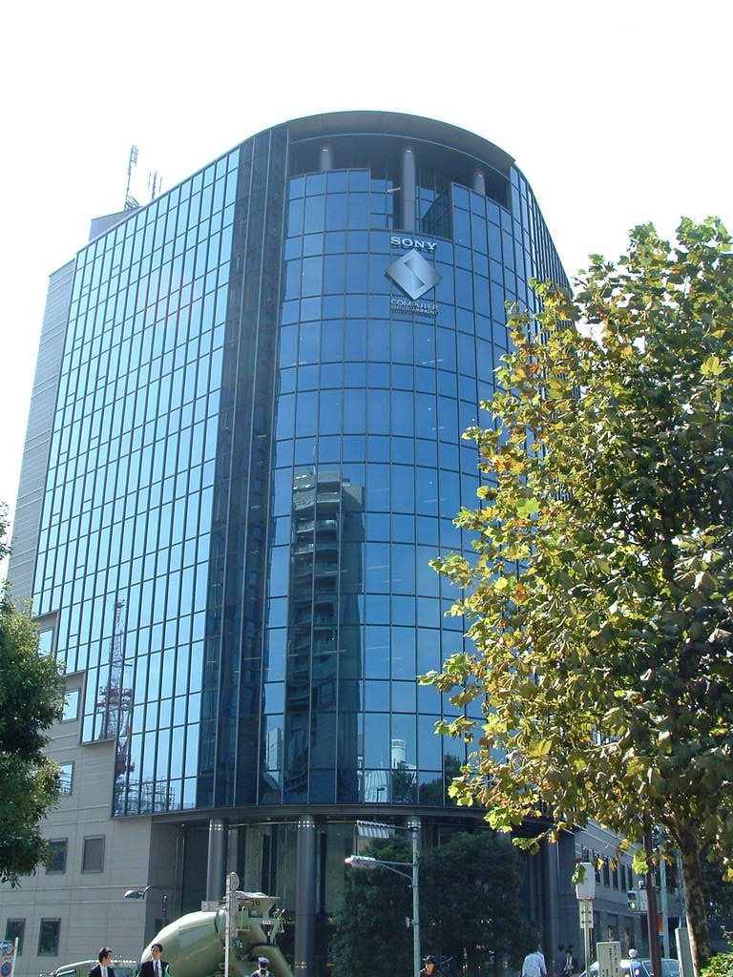
The Quest Continues
  Reversing the Pre-IPL
  Assault and a Battery

Slide 34
Interesting Finds in Pre-IPL
The Pre-IPL was not very large, less that 4KBytes
Based on a hardware register the Pre-IPL would either:
  Read IPL from Flash
  Read IPL from Memory Stick
This tied in with the leaked information about the service mode

Slide 35
What About the Battery?
Various tricks were tried with the battery to determine what might enable service mode
PSP battery contains a small ROM including information such as serial number
Setting serial to 0xFFFFFFFF would auto start and enable service mode

Slide 36
Creating a Battery
Of course more difficult to use if hardware needs to be built
Sony gave us another option
  Serial stored in EEPROM on most batteries
  Kernel provided functions to change serial
sceSysconBatteryWriteNVM(0x07, 0xFFFF);
sceSysconBatteryWriteNVM(0x09, 0xFFFF);

Slide 37
4*2^32 != 2^128
|+0 +1 +2 +3 +4 +5 +6 +7 +8 +9 +a +b +c +d +e +f
---------+-----------------------------------------------
00000000 00 00 00 00 00 00 00 00 00 01 d0 bf 00 00 00 00
00000010 00 00 00 00 00 00 00 00 00 00 00 00 00 00 00 00
00000020 52 a1 05 cd 3a 52 59 28 0a d1 31 f1 bd 87 2e cc
00000030 14 da 02 2f 77 88 c7 66 f3 32 07 bd 1a 08 9e 4c
00000040 00 00 00 00 00 00 00 00 00 00 00 00 00 00 00 00
00000050 00 00 00 00 00 00 00 00 00 00 00 00 00 00 00 00
00000060 01 00 00 00 00 00 00 00 00 00 00 00 00 00 00 00
00000070 04 00 00 00 10 00 00 00 00 00 00 00 00 00 00 00
00000080 00 00 00 00 00 00 00 00 00 00 00 00 00 00 00 00
00000090 00 00 00 00 00 00 00 00 00 00 00 00 00 00 00 00
000000a0 00 00 00 00 00 00 00 00 00 00 00 01 c6 5f 74 12

Slide 38
A Lofty Goal
So service mode is possible
Not much use without a valid IPL for the Memory Stick
Need some method of implementing our own IPL code
Can we create our own IPL code which passes all the checks but is useful?
We need to create the two hashes and create the encrypted data

Slide 39
Brute Forcing Hash Values
Nem and Booster noted that KIRK was susceptible to a side channel timing attack
Returned early when a single 32bit value was incorrect in a hash
This difference enough to break 2^128 searches into 4 of 2^32 instead
Possible to forge both header and data hashes in reasonable time scales

Slide 40
What About Encryption?
We would need 24 decrypted bytes
What can be done to reduce that number?
Four Pre-IPL/KIRK issues made it possible
  Pre-IPL will always load 4KB encrypted data
  Each block is decrypted in place
  No check is made of how many bytes are expected
  Pre-IPL will jump to an arbitrary entry point

Slide 41
IPL Decryption Process
Flash ROM
Decryption Buffer
Addr: 0xBFD00000
RAM
Encrypted
Block
(4KB)
Encrypted
Block
(4KB)
Decrypted
Block
(Size)
Decrypted
Block
(~4KB)
Decrypted
Block
(Size)
Copy
Copy

Slide 42
Making Use Of This
Smallest KIRK decryption is 4 bytes
In place decryption means these 4 bytes are written to the start of the loaded block
Leaves 4092 untouched bytes
Decrypt area static, can set the entry point address to point to it
Notes:
First 16 bytes of encrypted block is the key for the data
Can be anything we like, just affects the symmetric decryption
Set this to all zeros except for the entry point which points to the Pre-IPLs decryption buffer + some value
KIRK can be set to decrypt only 4 bytes
Brute force 4 bytes of zeros

Slide 43
Encrypted IPL Block
0
16
Block Encryption Key
Unknown
32
Header Hash
48
Data Hash
64
Unknown
112
Data Size
Pre-Data Size
Unknown
Unknown
128
Encrypted Pre-Data
144
Encrypted Data
4096

Slide 44
How It Works
0xBFD00000
16
0000 0000 0000 0000 0001 d0bf 0000 0000
Unknown
32
52a1 05cd 3a52 5928 0ad1 31f1 bd87 2ecc
48
14da 022f 7788 c766 f332 07bd 1a08 9e4c
64
Unknown
112
4
0
Unknown
Unknown
128
0000 0000 0000 0000 0000 0000 0000 0000
144
0000 0000 0000 0000 0000 0001 c65f 7412
256
Unvalidated Data
4096
Notes:
The Pre-IPL reads an entire block into its buffer and hands it to KIRK for decryption
The rest of the block can be anything, it is not validated in any way
KIRK validates the hashes, decrypts four zero bytes and writes them to the start of the decryption buffer
Everything else untouched, Pre-IPL reads entry point and jumps into unverified code

Slide 45
Decrypted IPL Format
0xBFD00000
0
4
0
8
0xBFD00100
12
0
16
256
Unvalidated Data
4096

Slide 46
Decrypted IPL Format
0xBFD00000
0
4
0
8
0xBFD00100
12
0
Jump to
Entry
16
256
Unvalidated Data
4096

Slide 47
Victory
Obviously this totally breaks the PSP's security model
Combined with the service mode battery it became Pandora
Could now downgrade any PSP irrespective of the firmware
Success only tainted by one of the group leaking the files
Still works on the PSP Slim and Lite

Slide 48
Conclusions
An attempt was made to secure the PSP
It failed through a number of inherent hardware and software faults
Once Sony lost the possibility of security through obscurity it was all downhill
But the PSP is better for it

Slide 49
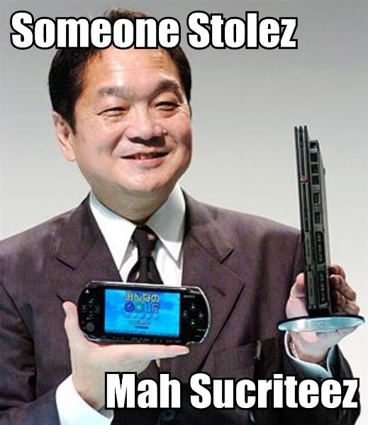
Questions?

