Slide 1

motivation
World is relying on data to yield efficient results.
Retail transactions are a direct input to nation’s GDP.
Mindset towards cutting-edge technologies and for problem solving.
Gaining Time management, Task ownership, Tool training skills.

Slide 2
abstract
Mining algorithms for frequent item sets lack a mechanism that enables automatic parallelization, load balancing, data distribution, and fault tolerance on large clusters.
The above features can be enhanced and implemented by introducing parallel frequent item sets mining algorithm called FiDoop using the Map Reduce programming model. To achieve compressed storage and avoid building conditional pattern bases, FiDoop incorporates the frequent items ultra-metric tree, rather than conventional FP trees.
In FiDoop, three Map Reduce jobs are implemented to complete the mining task. In the crucial third Map Reduce job, the mappers independently decompose item sets, the reducers perform combination operations by constructing small ultra-metric trees, and the actual mining of these trees separately.
We implement FiDoop on our in-house Hadoop cluster. We show that FiDoop on the cluster is sensitive to data distribution and dimensions, because item sets with different lengths have different decomposition and construction costs.
To improve FiDoop’s performance, we develop a workload balance metric to measure load balance across the cluster’s computing nodes. We develop FiDoop-HD, an extension of FiDoop, to speed up the mining performance for high-dimensional data analysis. Extensive experiments using real-world celestial spectral data demonstrate that our proposed solution is efficient and scalable.

Slide 3
Problem description
As discussed in the previous slide, the Existing methodologies for efficient finding of frequent itemsets lack a many features.
Frequent itemsets mining (FIM) is a core problem in association rule mining (ARM), sequence mining, and the like. Speeding up the process of FIM is critical and indispensable, because FIM consumption accounts for a significant portion of mining time due to its high computation and input/output (I/O) intensity.
When datasets in modern data mining applications become excessively large, sequential FIM algorithms running on a single machine suffer from performance deterioration.
To address this issue, we investigate how to perform FIM using Map Reduce—a widely adopted programming model for processing big datasets by exploiting the parallelism among computing nodes of a cluster.
Therefore the problem is to tackle the process of mining and to ensure that it results in the best information.

Slide 4
introduction
Traditional parallel Frequent Itemset Mining techniques are focused on load balancing; data are equally partitioned and distributed among computing nodes of a cluster. More often than not, the lack of analysis of correlation among data leads to poor data locality.
The absence of data collocation increases the data shuffling costs and the network overhead, reducing the effectiveness of data partitioning.
In this study, we show that redundant transaction transmission and itemset mining tasks are likely to be created by inappropriate data partitioning decisions. As a result, data partitioning in FIM affects not only network traffic but also computing loads.
Our evidence shows that data partitioning algorithms should pay attention to network and computing loads in addition to the issue of load balancing. We propose a parallel FIM approach called FiDoop using the MapReduce programming model.

Slide 5
introduction
The process of extracting information from the huge data set is termed as data mining. Market analysis, fraud detection, customer retention, production control and science exploration are the applications used to extract the information or knowledge.
The FiDoop is used for the frequent item sets mining algorithm in data mining. The FiDoop is implemented with the mechanism which enables in automatic parallelization, load balancing and data distribution for parallel mining of frequent item sets on the large cluster.
FiDoop used the map-reduce programming model because to improve the performance of the frequent itemset mining Hadoop clusters in data mining, the FIM is considered as a critical part of data analysis and it is to extract the information from data sets based on frequently occurring events.
FIM algorithms are classified into two, such as,
FP-growth schema
FIUT scheme

Slide 6
System REQUIREMENTS
The requirements are proposed minimum.
Any desktop / Laptop system with below configuration or higher level
System : Pentium IV 2.4 GHz.
Hard Disk : 500 GB
Ram : 4 GB
Operating system : Windows 7 or above
Web Technology : Servlet, JSP
Framework : Hadoop
Web Server : Tomcat 7.0
IDE : Eclipse Galileo
Database : My-SQL 5.0
UGI for DB : SQLyog

Slide 7
Existing system
In the existing system given a large dataset, data partitioning strategies solutions suffer high communication and mining overhead induced by redundant transactions transmitted among computing nodes.
Existing data partitioning solutions of FIM built in Hadoop aim at balancing computation load by equally distributing data among nodes. We address this problem by developing a data partitioning approach called FiDoop-DP using the Map Reduce programming model.

Slide 8
Disadvantage of Existing system
The scalability problem has been addressed by the implementation of a handful of FP-growth-like parallel FIM algorithms. Searching efficiency is less.
A major disadvantage of FP-growth like parallel algorithms, however, lies in the infeasibility to construct in-memory FP trees to accommodate large-scale databases.

Slide 9
proposed system
In this project, we propose a design of a parallel mining of frequent item data sets for retail store, which reduces the complexity of data access and retrieval.
When we have to dealing with big data i.e. huge amount of data traditional existing system seems inefficient. We use Hadoop with concept called frequent Item sets which makes it FiDoop-Dp(Frequent item Hadoop), it runs on Hadoop cluster.
Job of map reduce is partitioning of data, it splits the local input data to generate local 1-itemset and it further reduce to specific reduced data. It sorts the data in decreasing order of frequency.
In second step, job of map reduce is FP-Growth based partitions and last job is to aggregate the result from previous stages to generate output. LSH (Locality-sensitive hashing) based partitioning boosts the performance of system by avoiding large number of comparisons. It uses bucket to keep similar transaction together.
FiDoop-DP places highly similar transactions into a data partition to improve locality without creating an excessive number of redundant transactions.

Slide 10
advantage of proposed system
To reduce the amount of data transferred through the network during the shuffle phase. More Security is given to application
To minimize local mining load. Recall that high shuffling cost and local mining load are incurred by redundant transactions.
We made a complete overhaul to FIUT (i.e., the frequent items ultra metric trees method), and addressed the performance issues of FP growth

Slide 11

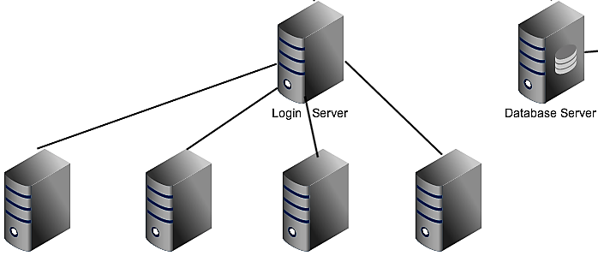
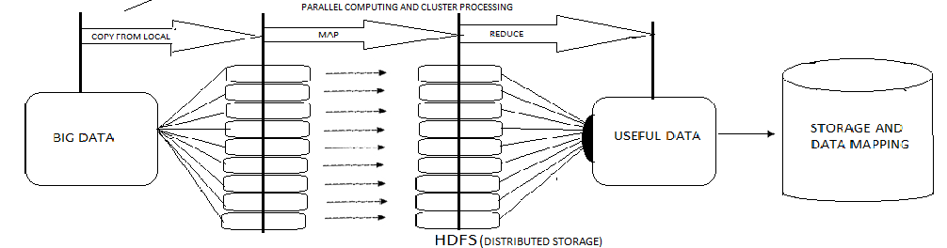
System architecture
Client Operations
Admin -Dashboard
EXCEL SHEET I/P
Parallel Computing and Cluster Processing
HDFS Storage
Data Mapping

Slide 12


GUI
Server
Master Server
Authentication
HBase
DB Transaction
HBase - Data Access
HTML,CSS
Region Servers
Service layer
Pre-Processing
Decision Making – FP / FIUT
Clustering
HADOOP HDFS
JSP
Statistics Layer
HDFS - Data Access
HDFS Report
HBase Report
Figure 3 : Block diagrammatic architecture

Slide 13
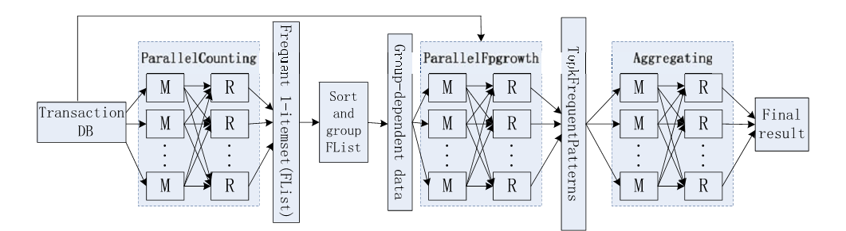
Figure 4 : Diagram describing internal processing of MapReduce

Slide 14
System flow
Figure 5 : Diagram describing the path taken by the software to obtain the list of frequent items

Slide 15
System flow
Admin login to his account by giving valid userid and password.
Admin uploads the excel sheet which contains invoice details.
In the server, it will process the excel data and stores the data in the HDFS.
Admin selects the type of process (FP growth or FIUT).
Admin gives the number of records to be fetch from the HDFS and the support value.
Admin views the time efficiency of the FP-growth and FIUT.
Admin clears all the database content.
Admin logout from the session.

Slide 16
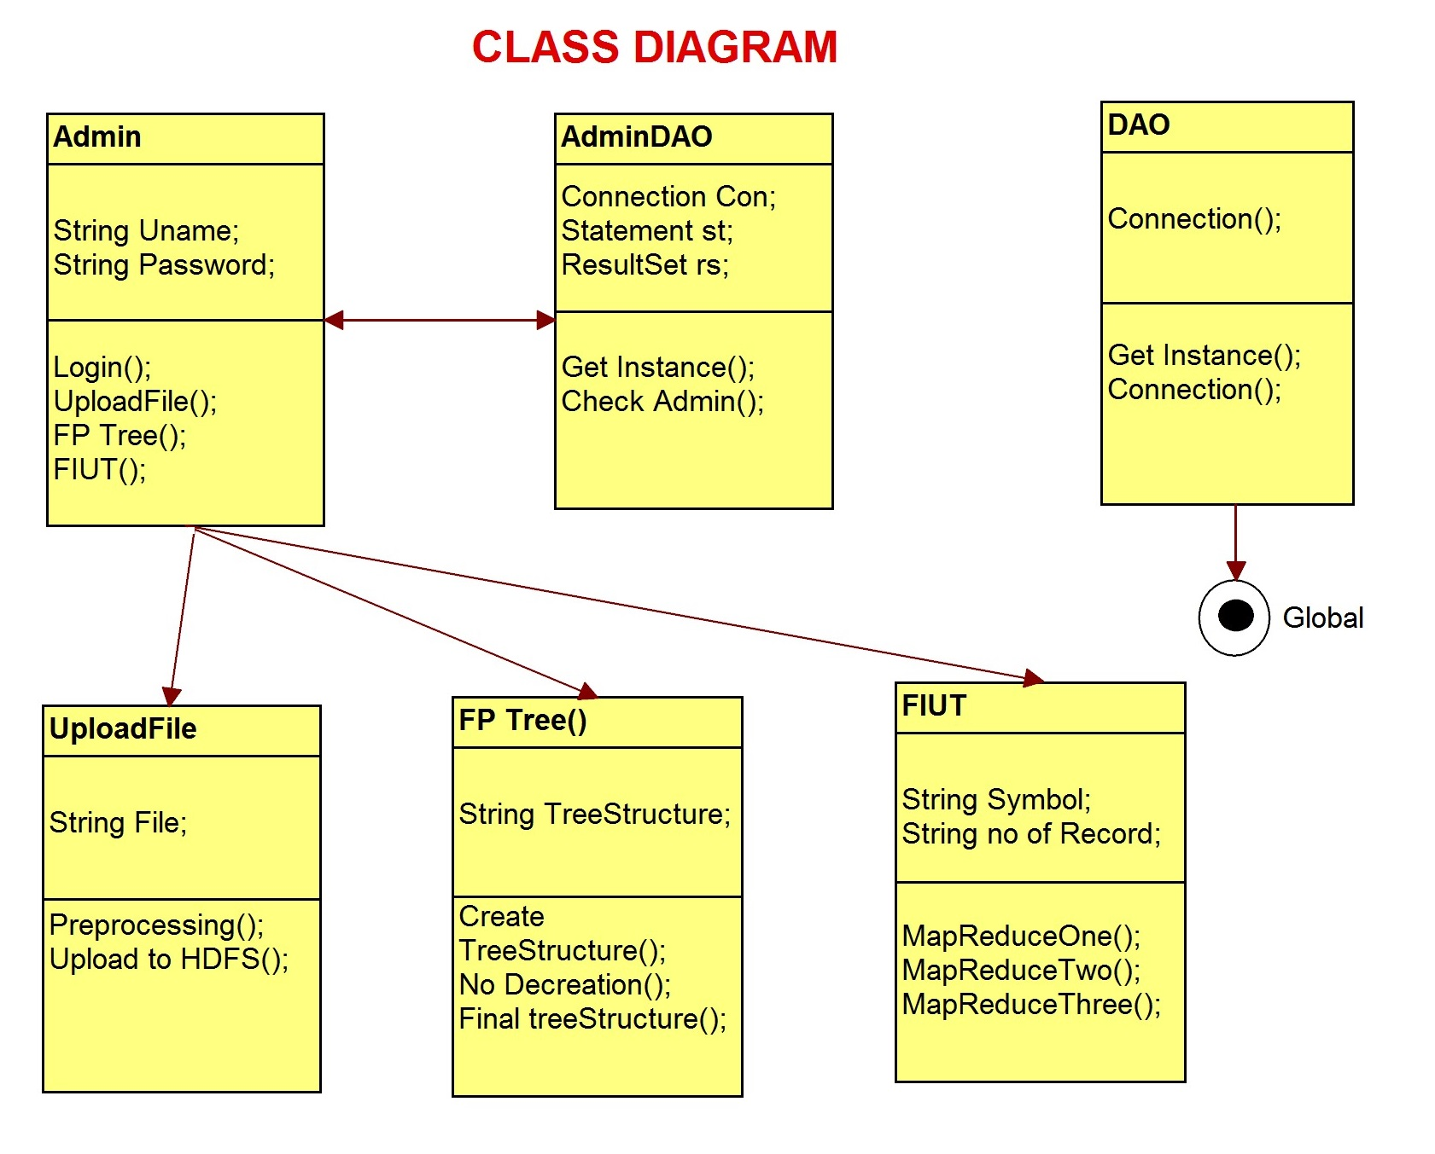
Class diagram

Slide 17
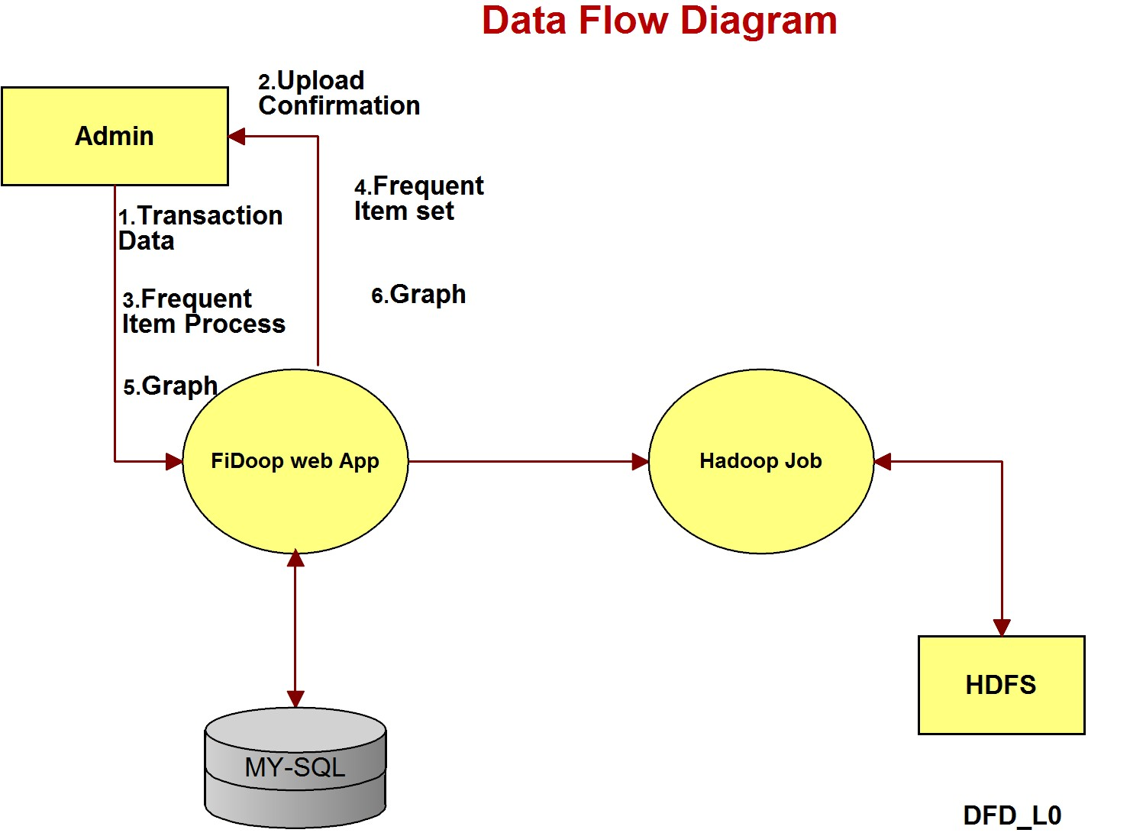
Data flow diagram

Slide 18
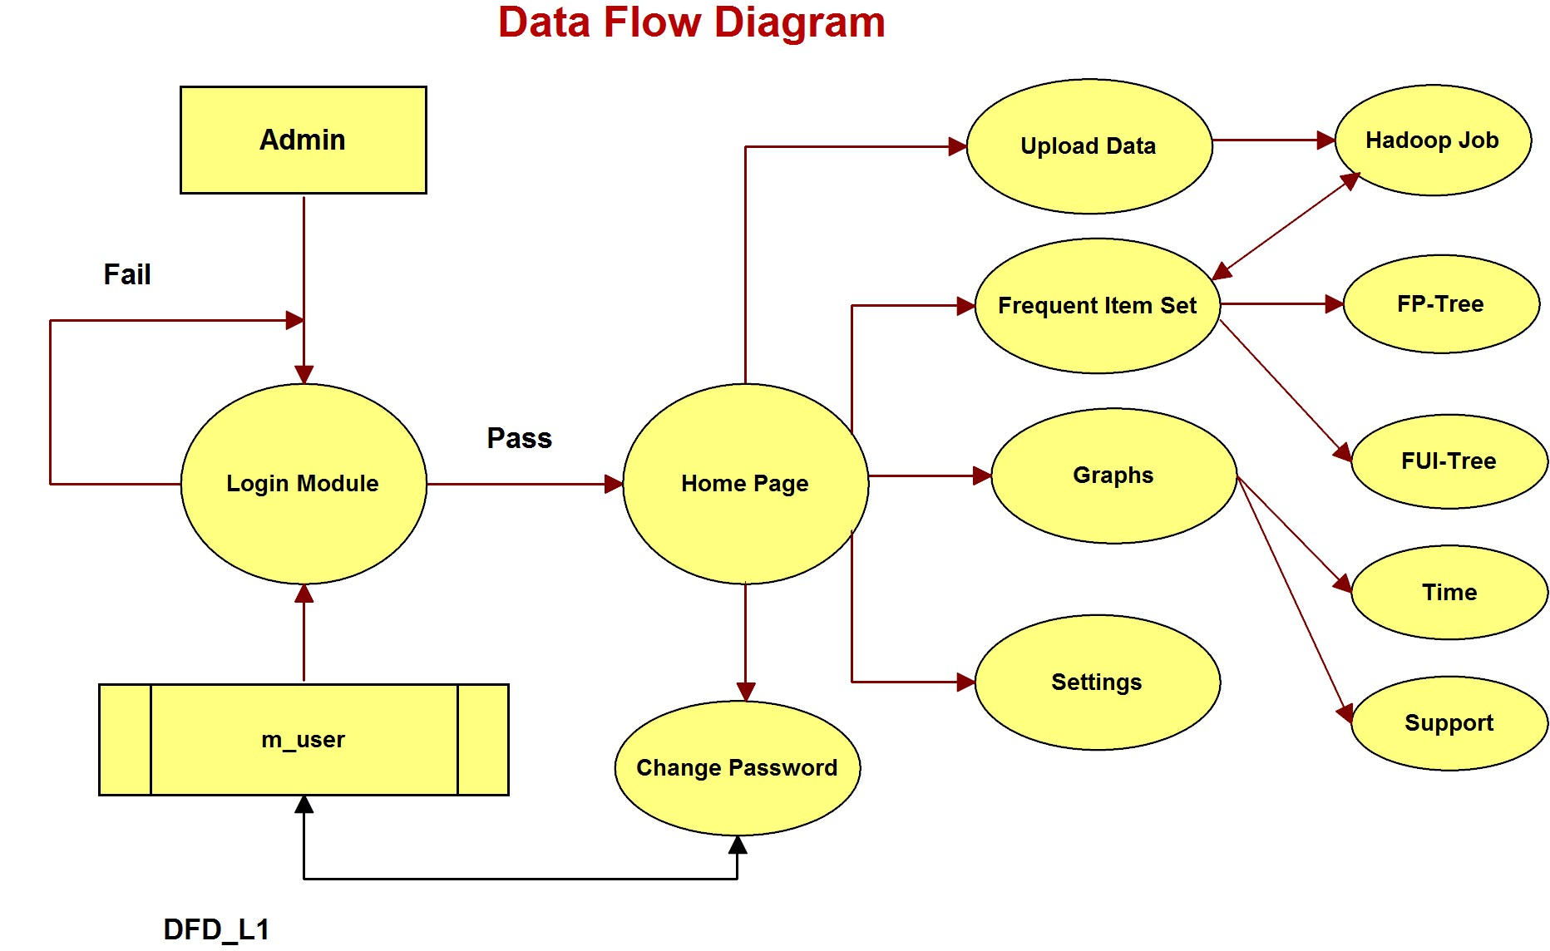
Data flow diagram level 1

Slide 19
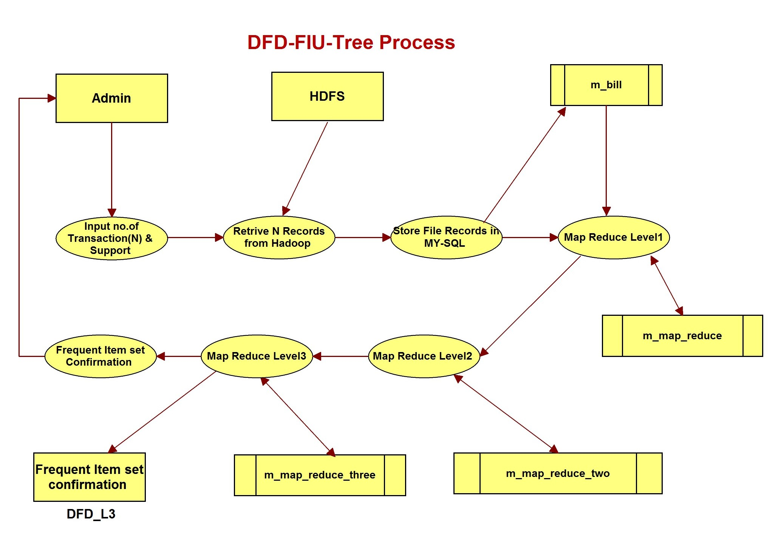
Dfd-fiu-tree process

Slide 20
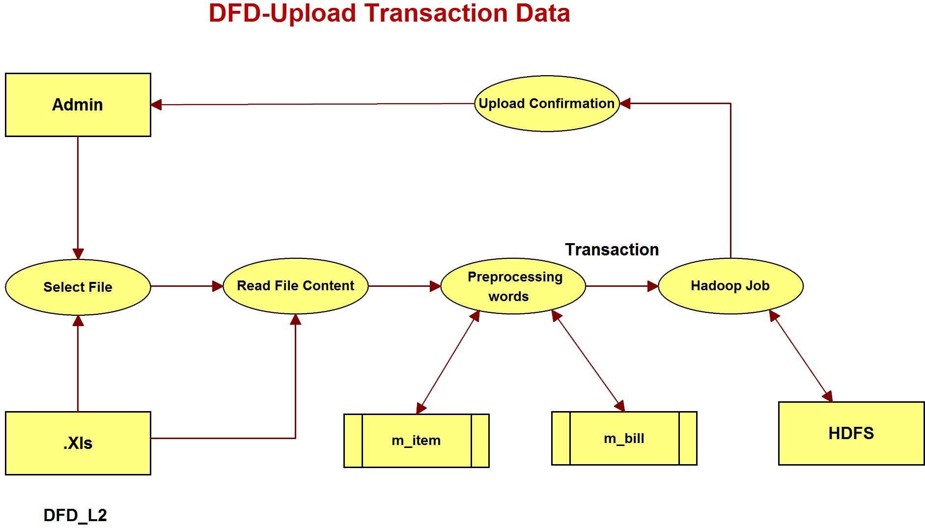
Dfd-upload transaction data

Slide 21
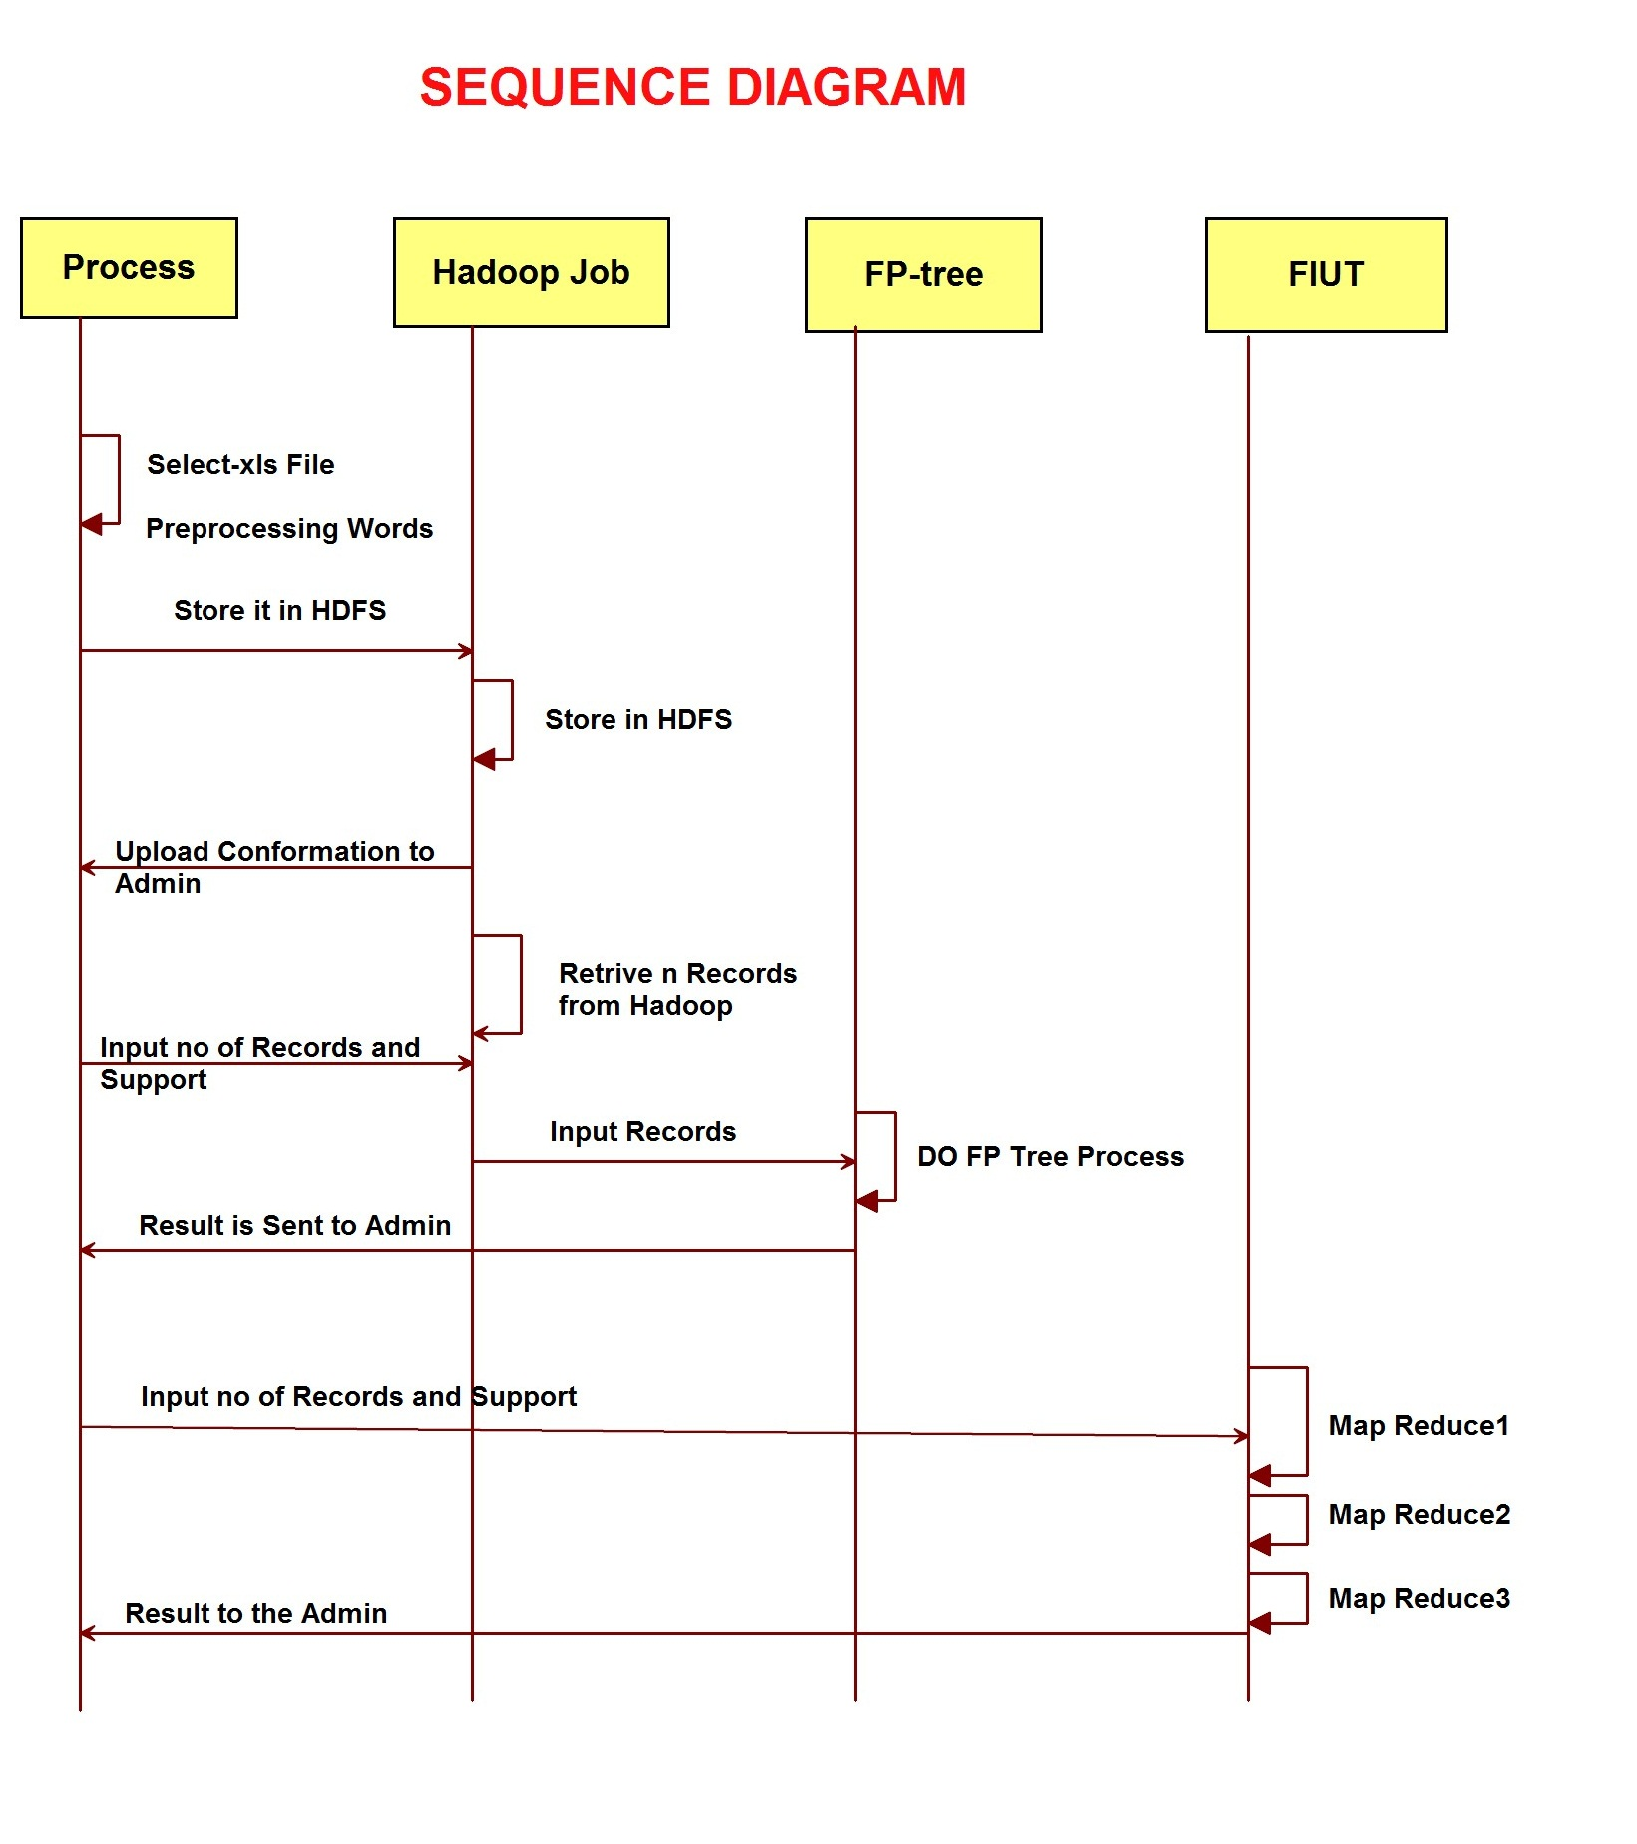
Sequence diagram

Slide 22
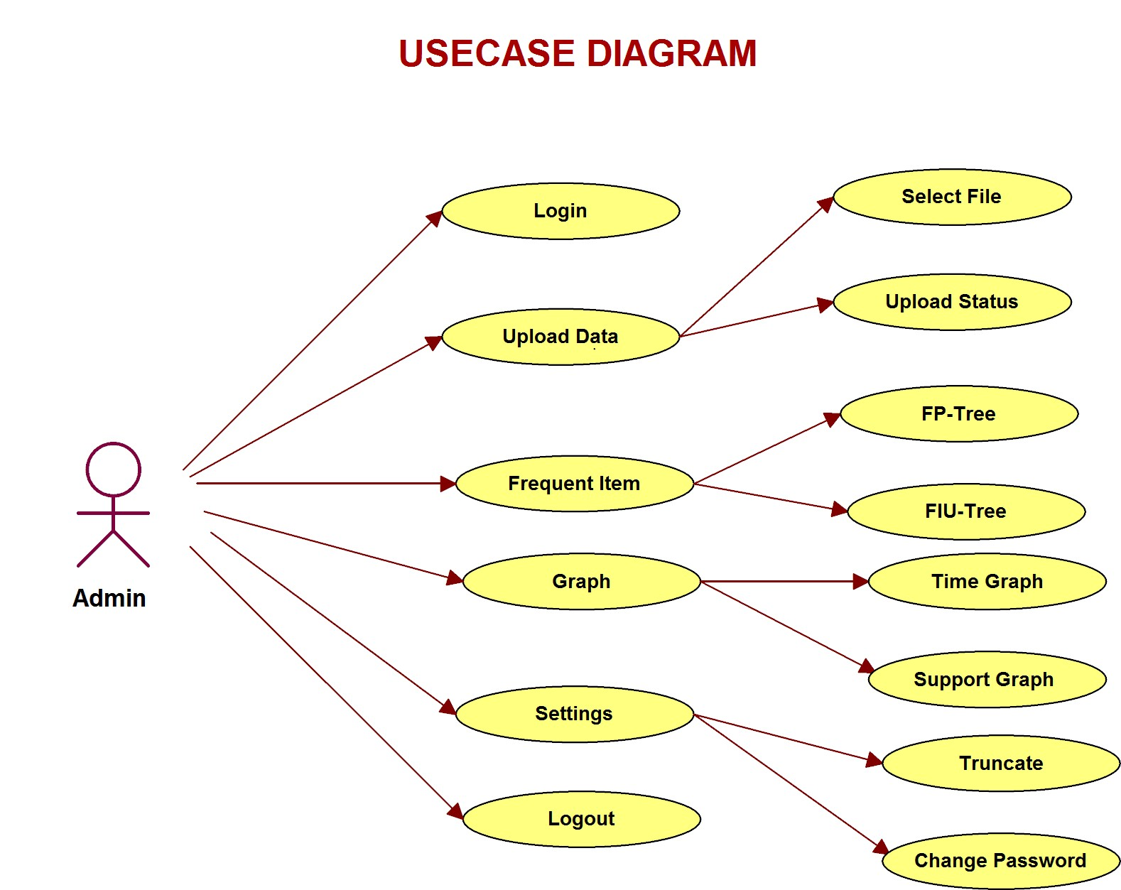
Usecase diagram

Slide 23
Conclusion
We present two efficient algorithms to perform frequent itemsets mining.
We applied the MapReduce programming model to develop a parallel frequent itemsets mining algorithm called FiDoop.
We implemented FiDoop on a real-world Hadoop cluster.
We achieved the efficiency
FiDoop does not encounter the memory issues in HDFS during the whole experiment period.
The average operating time of various files shows that FIUT takes similar time to response to each request even when the number of files in the system are increased.

Slide 24
references
M.-Y. Lin, P.-Y. Lee, and S.-C. Hsueh, “Apriori-based frequent itemset mining algorithms on MapReduce,” in Proc. 6th Int. Conf. Ubiquit. Inf. Manage. Commun. (ICUIMC), Danang, Vietnam, 2012, pp. 76:1–76:8. Available: http://doi.acm.org/10.1145/2184751.2184842
M. J. Zaki, “Parallel and distributed association mining: A survey,” IEEE Concurrency, vol. 7, no. 4, pp. 14–25, Oct./Dec. 1999.
R. Agrawal and J. C. Shafer, “Parallel mining of association rules,” IEEE Trans. Knowl. Data Eng., vol. 8, no. 6, pp. 962–969, Dec. 1996.
L. Liu, E. Li, Y. Zhang, and Z. Tang, “Optimization of frequent itemset mining on multiple-core processor,” in Proc. 33rd Int. Conf. Very Large Data Bases, Vienna, Austria, 2007, pp. 1275–1285
Y.-J. Tsay, T.-J. Hsu, and J.-R. Yu, “FIUT: A new method for mining frequent itemsets,” Inf. Sci., vol. 179, no. 11, pp. 1724–1737, 2009.
L. Zhou et al., “Balanced parallel FP-growth with MapReduce,” in Proc. IEEE Youth Conf. Inf. Comput. Telecommun. (YC-ICT), Beijing, China, 2010, pp. 243–246.
P. Tang and M. P. Turkia, “Parallelizing frequent itemset mining with FP-trees,” in Proc. 21st Int. Conf. Comput. Appl., Seattle, WA, USA, 2006, pp. 30–35.

Slide 25


