Slide 1

Foreign Plan Costing (FPC) in PostgreSQL
Rajmohan Ashoke

Slide 2
What PostgreSQL Optimizer does?
Create optimal execution plan.
Complex, cost based.
Considers numerous factors and determines the best way to evaluate a query.
Exhaustive search on all different scans and joins possible.

Slide 3
Foreign plan costing
Force a plan to be used by the query optimizer to process a query
Why do we need?
  certain queries benefit from user intervention and some level of hand tuning.
  More flexibility for DB Admin.

Slide 4
Our goal
Implement plan forcing in postgreSQL and evaluate its performance.
Accept valid xml formatted plan as input and force that plan.

Slide 5
We started with…
Studying the implementation of plan forcing in MS sql server 2012.
Studying PostgreSQL v9.3.2 Optimizer model and how scan and join decisions are made.
Understanding 'explain' and 'explain analyze' outputs.
Analyze XML Tags in ‘XML format explain output’ for various queries and build a compact XML Parser (using libxml2).

Slide 6
Our implementation strategy
Add an additional option in input query to specify xml file containing the plan to be forced.
Build an xml parser.
Read xml plan and store in convenient way
Using GUC configuration, tweak the optimizer into choosing the forced plan for both the scan and join queries.
Implement as a feature in the form a dynamically loaded shared library.

Slide 7
Implementation
Added “fpc” keyword to the input query, by which users can specify the forced plan.
Input format : <query> fpc <xml_plan_file>
Built a compact XML parser using libxml2.
Added GUC custom parameter to implement fpc.
Added hooks to control the choice of the optimizer.

Slide 8
Hooks defined
fpc_planner()
hook
planner()
fpc_get_relation_info()
hook
get_relation_info()
fpc_join_search()
hook
join_search()
fpc_xml.so
PostgreSQL core

Slide 9
Purpose of the hooks
Saving and restoring GUC context
hook implementations:
  planner() hook → do parsing of xml plan and store data in structures for later use.
  get_relation_info() hook → set/reset GUC parameters controlling scan methods.
  join_search() hook → set/reset GUC parameters controlling join types and orders

Slide 10
System diagram
Input Query
Query Parser
Planner
FPC?
No
Scan Search
Set Scan
config.
Yes
Parse XML file
Set Join
config.
Join Search
Store
Plan Tree
Hint info. (Scan and Join)
Executor
fpc_xml.so

Slide 11
What we can do!
force the following scans
  Sequential scan
  Index scan
  Bitmap scan
  Index only scan
force the following joins
  nested loop join
  merge join
  hash join
force the join order

Slide 12
Limitations
We can force index scan only if there are indexes available on the relevant relation.
Only query plans that can be found by the typical search strategy of the query optimizer can be forced.
Can only be used with select queries

Slide 13
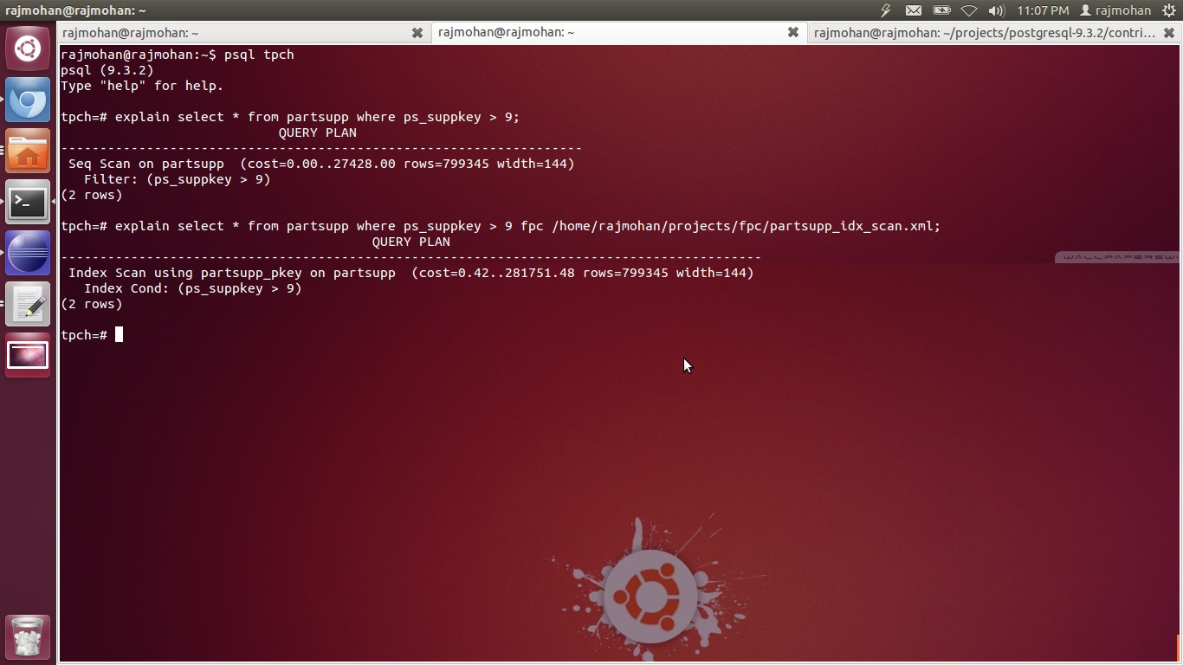
Output Snapshots
Forcing Index scan on an otherwise Seq Scan
Seq Scan -> Index Scan (Forced)

Slide 14
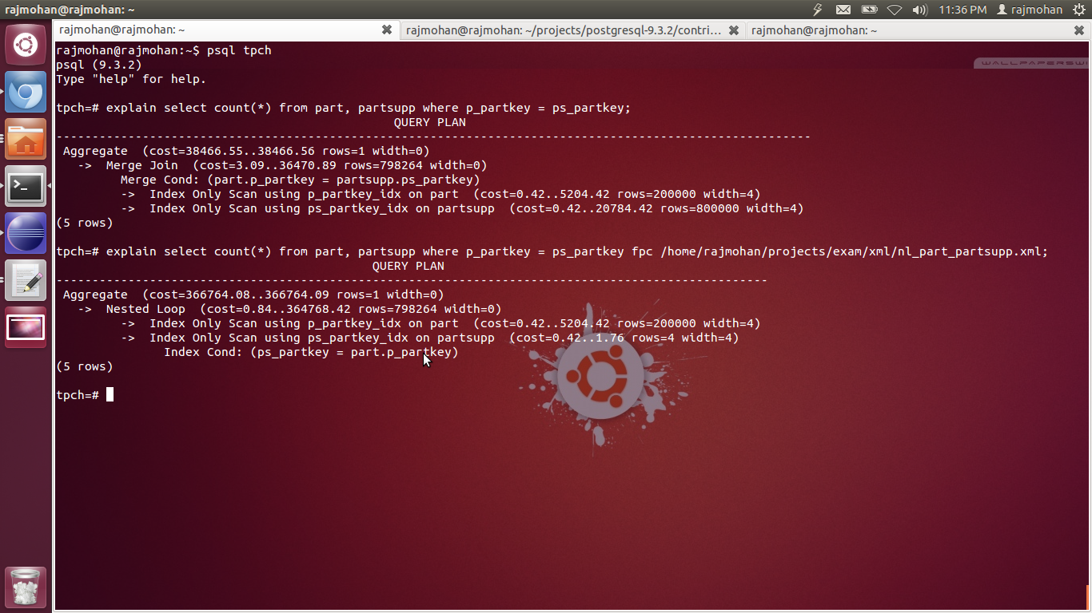
Merge -> NL (Forced)

Slide 15
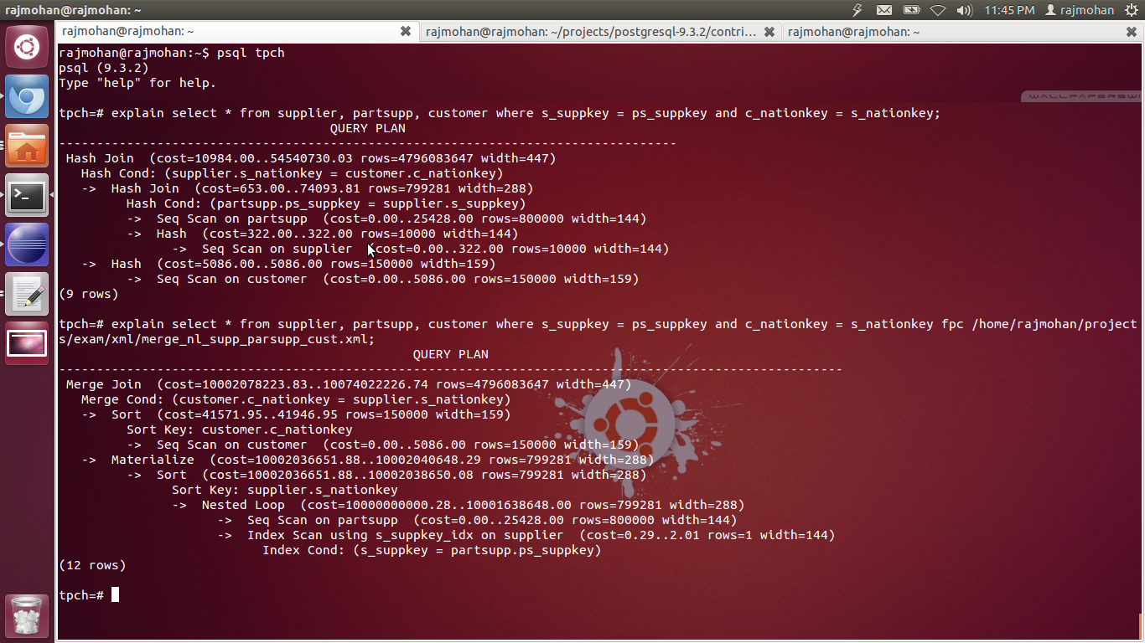
(Hash ,Hash) -> (Merge, NL)

Slide 16
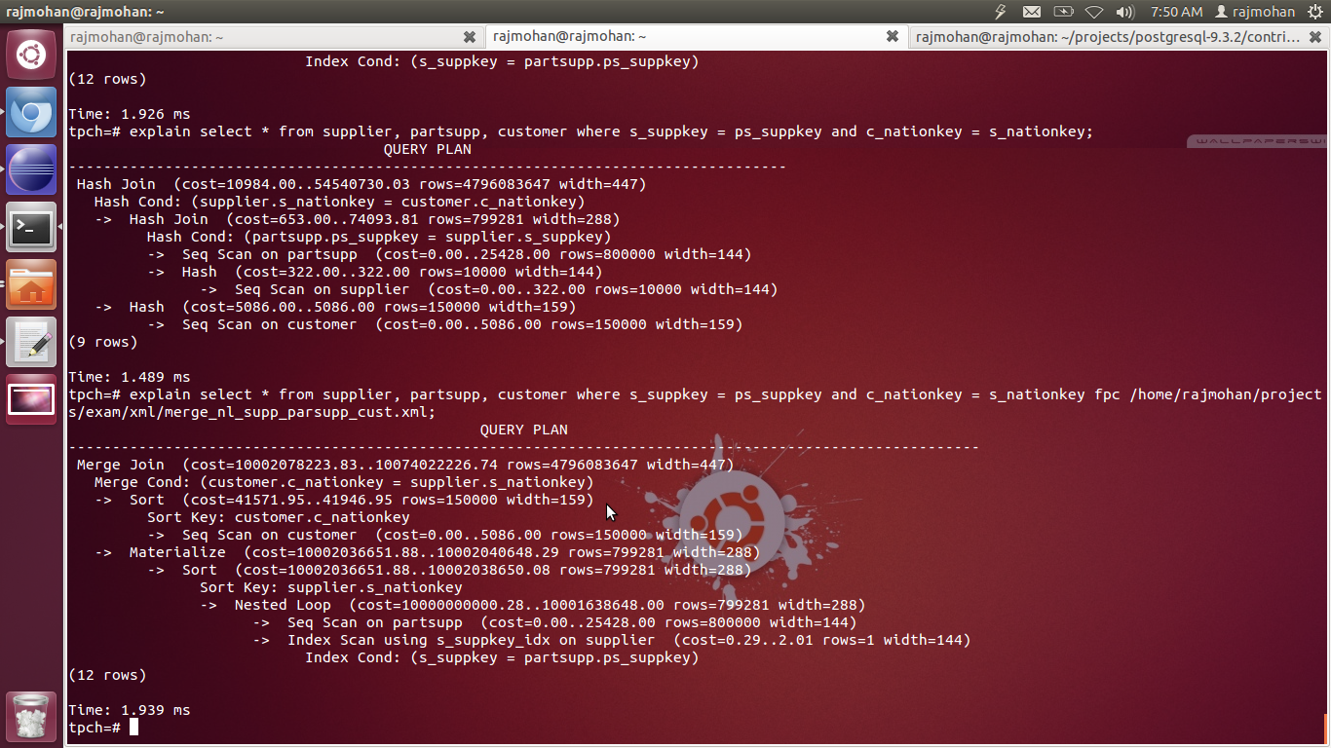
Time Analysis

Slide 17
Questions?

