Slide 1
Hello World!
Notes:
1st slide

Slide 2
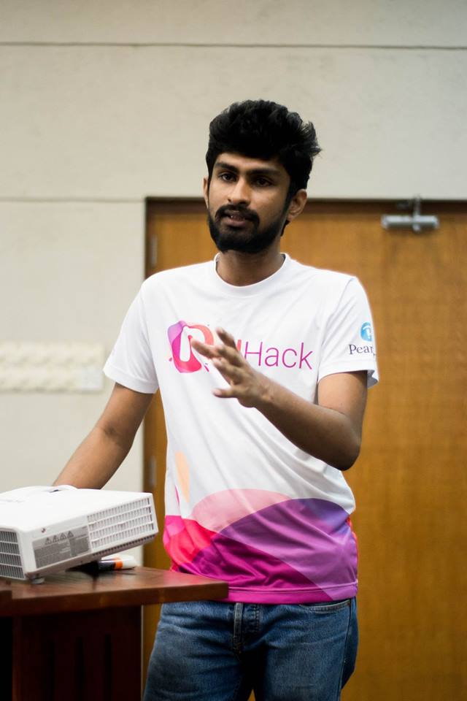
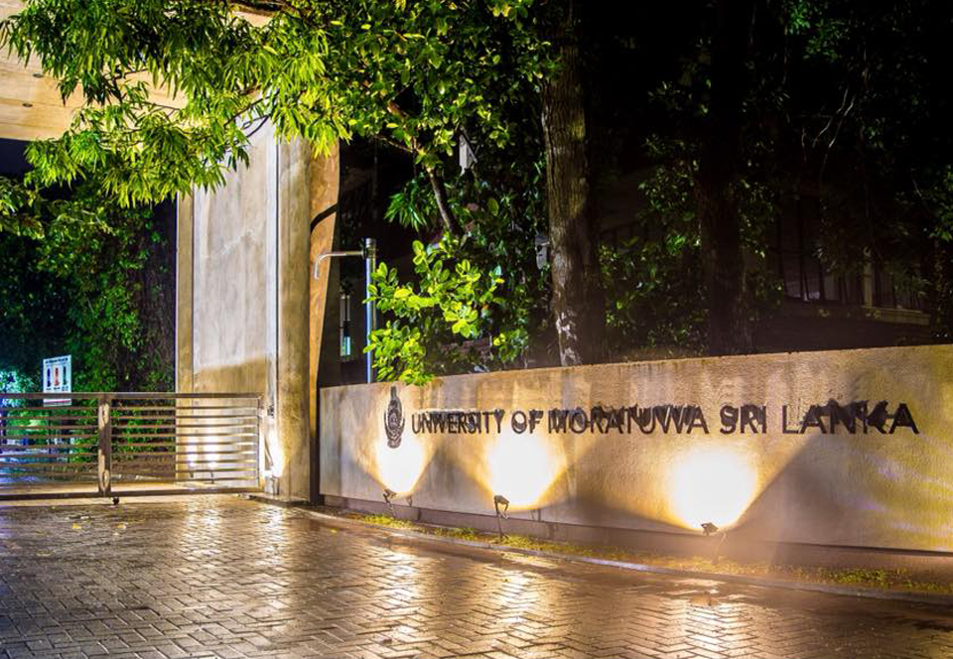
Chamath Sandaru
3rd year Undergraduate University of Moratuwa
Faculty of Information Technology
Notes:
2nd slide

Slide 3
Life Goals?
Notes:
3rd slide

