Slide 1
Hello World!

Slide 2
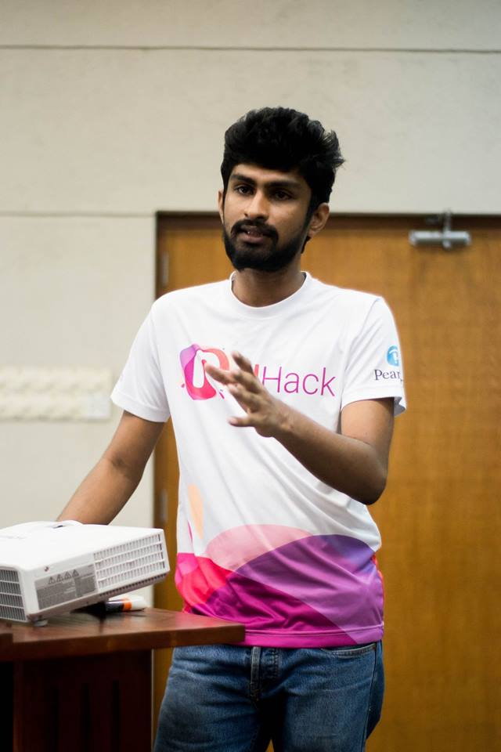
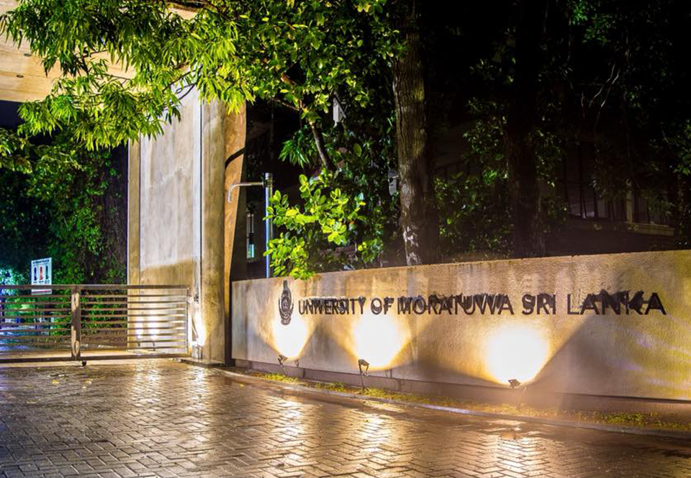
Chamath Sandaru
3rd year Undergraduate University of Moratuwa
Faculty of Information Technology

Slide 3
Life Goals?

