Slide 1
Welcome
CSS

Slide 3
Basic Selectors:
Universal selector
Selects all elements. Optionally, it may be restricted to a specific namespace or to all namespaces. Syntax: * ns|* *|* Example: * will match all the elements of the document.
Type selector
Selects all elements that have the given node name. Syntax: elementname Example: input will match any <input> element.
Class selector
Selects all elements that have the given class attribute. Syntax: .classname Example: .index will match any element that has a class of "index".
ID selector
Selects an element based on the value of its id attribute. There should be only one element with a given ID in a document. Syntax: #idname Example: #toc will match the element that has the ID "toc".
Attribute selector
Selects all elements that have the given attribute. Syntax: [attr] [attr=value] [attr~=value] [attr|=value] [attr^=value] [attr$=value] [attr*=value] Example: [autoplay] will match all elements that have the autoplay attribute set (to any value).

Slide 4
Attribute selector Example1:
<ul>
<li><a href="#internal">Internal link</a></li>
<li><a href="http://example.com">Example link</a></li>
<li><a href="#InSensitive">Insensitive internal link</a></li>
<li><a href="http://example.org">Example org link</a></li>
</ul>
<style>
a {
color: blue;
}
/* Internal links, beginning with "#" */
a[href^="#"] {
background-color: gold;
}
/* Links with "example" anywhere in the URL */
a[href*="example"] {
background-color: silver;
}
/* Links with "insensitive" anywhere in the URL, regardless of capitalization */
a[href*="insensitive" i] {
color: cyan;
}
/* Links with "cAsE" anywhere in the URL, with matching capitalization */
a[href*="cAsE" s] {
color: pink;
}
/* Links that end in ".org" */
a[href$=".org"] {
color: red;
}
</style>

Slide 5
Attribute selector Example2:
<div lang="en-us en-gb en-au en-nz">Hello World!</div>
<div lang="pt">Olá Mundo!</div>
<div lang="zh-CN">世界您好！</div>
<div lang="zh-TW">世界您好！</div>
<div data-lang="zh-TW">世界您好！</div>
<style>
/* All divs with a `lang` attribute are bold. */
div[lang] {
font-weight: bold;
}
/* All divs in US English are blue. */
div[lang~="en-us"] {
color: blue;
}
/* All divs in Portuguese are green. */
div[lang="pt"] {
color: green;
}
/* All divs in Chinese are red, whether simplified (zh-CN) or traditional (zh-TW). */
div[lang|="zh"] {
color: red;
}
/* All divs with a Traditional Chinese `data-lang` are purple. */
/* Note: You could also use hyphenated attributes without double quotes */
div[data-lang="zh-TW"] {
color: purple;
}
</style>

Slide 6
Attribute selector Example3:
<ol type="A">
<li>Example list</li>
</ol>
<style>
/* List types require the case sensitive flag due to a quirk in how HTML treats the type attribute. */
ol[type="a"] {
list-style-type: lower-alpha;
background: red;
}
ol[type="a" s] {
list-style-type: lower-alpha;
background: lime;
}
ol[type="A" s] {
list-style-type: upper-alpha;
background: lime;
}
</style>

Slide 7
Combinators
Descendant combinator
The (space) combinator selects nodes that are descendants of the first element. Syntax: A B Example: div span will match all <span> elements that are inside a <div> element.
Child combinator
The > combinator selects nodes that are direct children of the first element. Syntax: A > B Example: ul > li will match all <li> elements that are nested directly inside a <ul> element.
General sibling combinator
The ~ combinator selects siblings. This means that the second element follows the first (though not necessarily immediately), and both share the same parent. Syntax: A ~ B Example: p ~ span will match all <span> elements that follow a <p>, immediately or not.
Adjacent sibling combinator
The + combinator selects adjacent siblings. This means that the second element directly follows the first, and both share the same parent. Syntax: A + B Example: h2 + p will match all <p> elements that directly follow an <h2>.
Column combinator
The || combinator selects nodes which belong to a column. Syntax: A || B Example: col || td will match all <td> elements that belong to the scope of the <col>.

Slide 8
Examples
General sibling combinator
<span>This is not red.</span>
<p>Here is a paragraph.</p>
<code>Here is some code.</code>
<span>And here is a red span!</span>
<code>More code...</code>
<span>And this is a red span!</span>
<style>
p ~ span {
color: red;
}
</style>
Adjacent sibling combinator
<ul>
<li>One</li>
<li>Two!</li>
<li>Three</li>
</ul>
<style>
li:first-of-type + li {
color: red;
}
</style>

Slide 9
Pseudo-classes
:active
:any-link
:checked
:blank
:default
:defined
:dir()
:disabled
:empty
:enabled
:first
:first-child
:first-of-type
:fullscreen
:focus
:focus-visible
:focus-within
:has()
:host()
:host-context()
:hover
:indeterminate
:in-range
:invalid
:is() (:matches(), :any())
:lang()
:last-child
:last-of-type
:left
:link
:not()
:nth-child()
:nth-last-child()
:nth-last-of-type()
:nth-of-type()
:only-child
:only-of-type
:optional
:out-of-range
:placeholder-shown
:read-only
:read-write
:required
:right
:root
:scope
:target
:valid
:visited
:where()

Slide 10
Pseudo-elements
::-moz-progress-bar
::-moz-range-progress
::-moz-range-thumb
::-moz-range-track
::-ms-browse
::-ms-check
::-ms-clear
::-ms-expand
::-ms-fill
::-ms-fill-lower
::-ms-fill-upper
::-ms-reveal
::-ms-thumb
::-ms-ticks-after
::-ms-ticks-before
::-ms-tooltip
::-ms-track
::-ms-value
::-webkit-progress-bar
::-webkit-progress-value
::-webkit-slider-runnable-track
::-webkit-slider-thumb
::after (:after)
::backdrop
::before (:before)
::cue
::first-letter (:first-letter)
::first-line (:first-line)
::grammar-error
::marker
::part()
::placeholder
::selection
::slotted()
::spelling-error

Slide 11
Box Model
border-bottom-width
border-left-width
border-right-width
border-top-width
border-width
box-sizing
height
line-height
margin-bottom
margin-left
margin-right
margin-top
Margin
max-height
max-width
min-height
min-width
padding-bottom
padding-left
padding-right
padding-top
Padding
width

Slide 12
Flexbox
align-content
align-items
align-self
flex-basis
flex-direction
flex-flow
flex-grow
flex-shrink
flex-wrap
justify-content
order

Slide 13
Positioning
Transitions
bottom
left
position
right
top
z-index
transition-delay
transition-duration
transition-property
transition-timing-function
transition

Slide 14
Backgrounds
background-attachment
background-clip
background-color
background-image
background-origin
background-position
background-repeat
background-size
background

Slide 15
Animations
animation-delay
animation-direction
animation-duration
animation-fill-mode
animation-iteration-count
animation-name
animation-play-state
animation-timing-function
animation

Slide 16
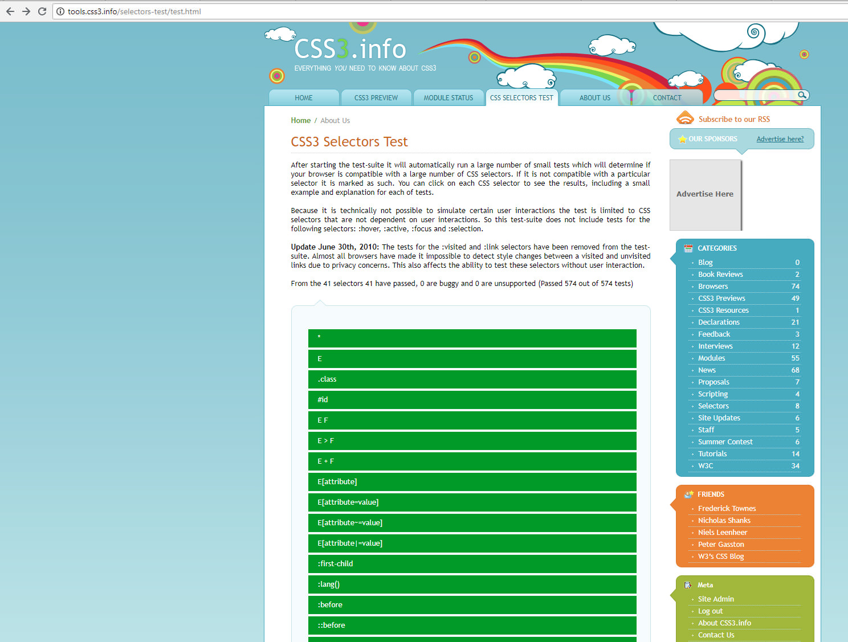

Slide 17
