Slide 1
Welcome
WORDPRESS

Slide 3
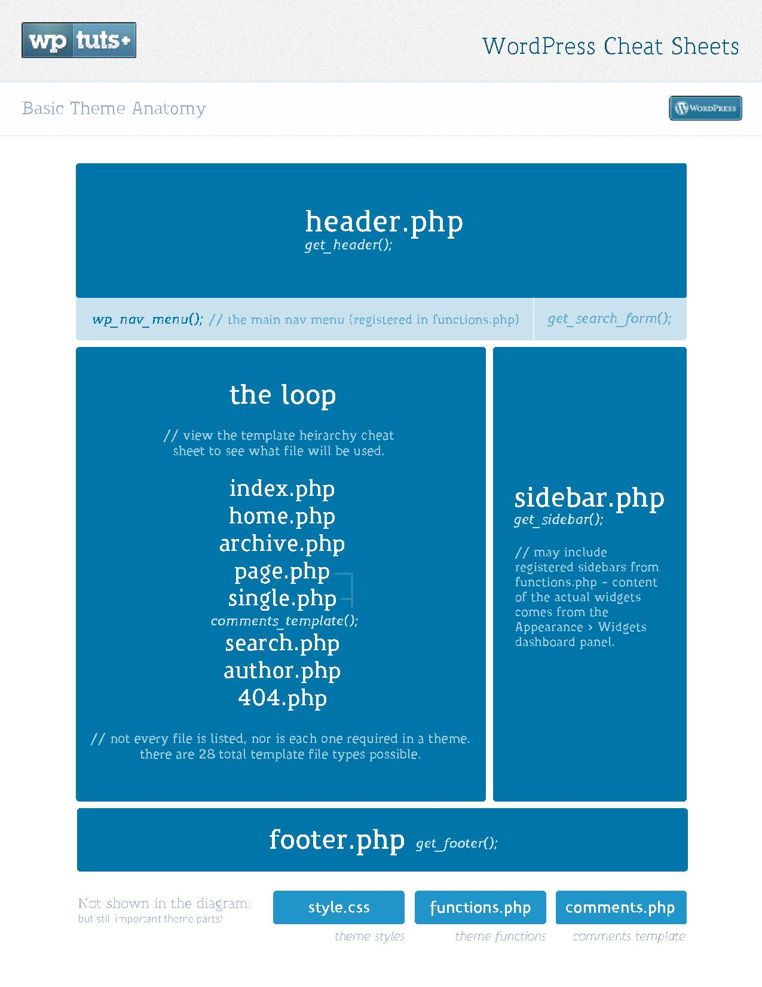

Slide 4
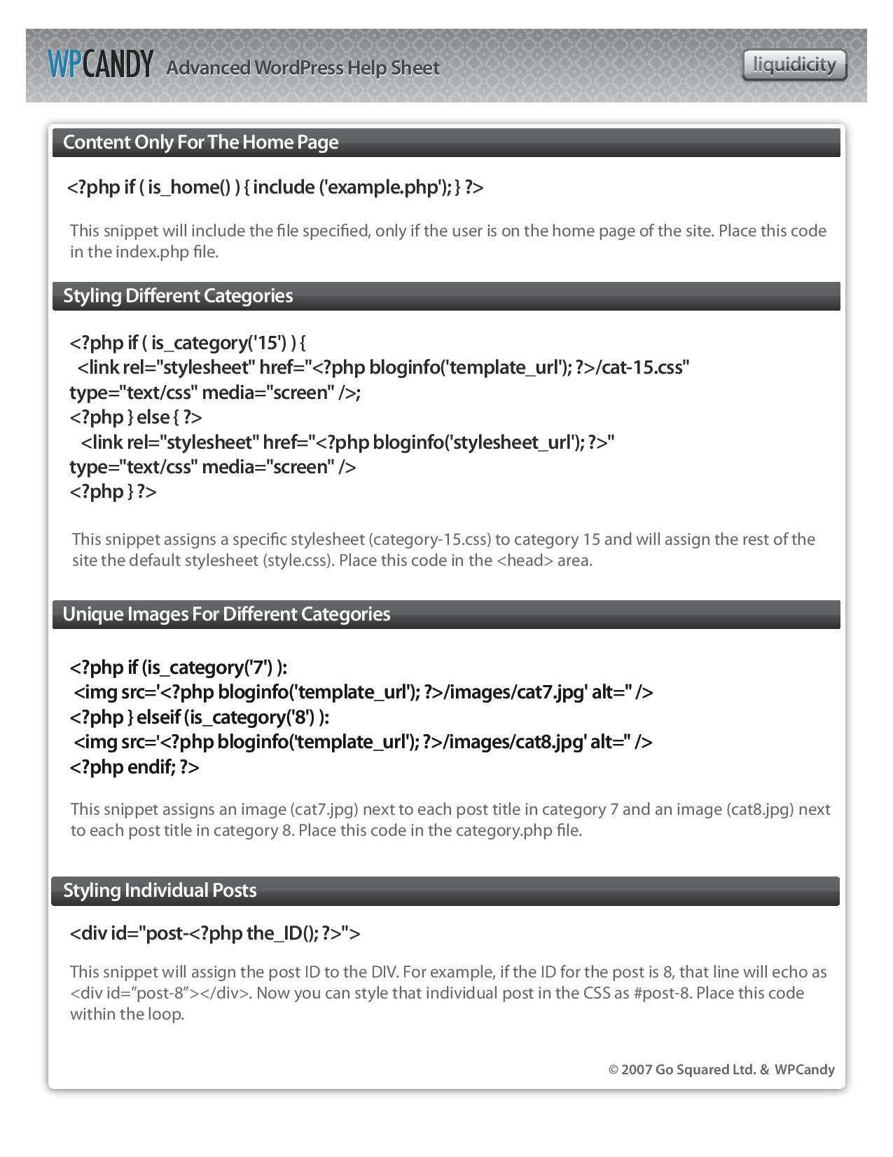

Slide 5
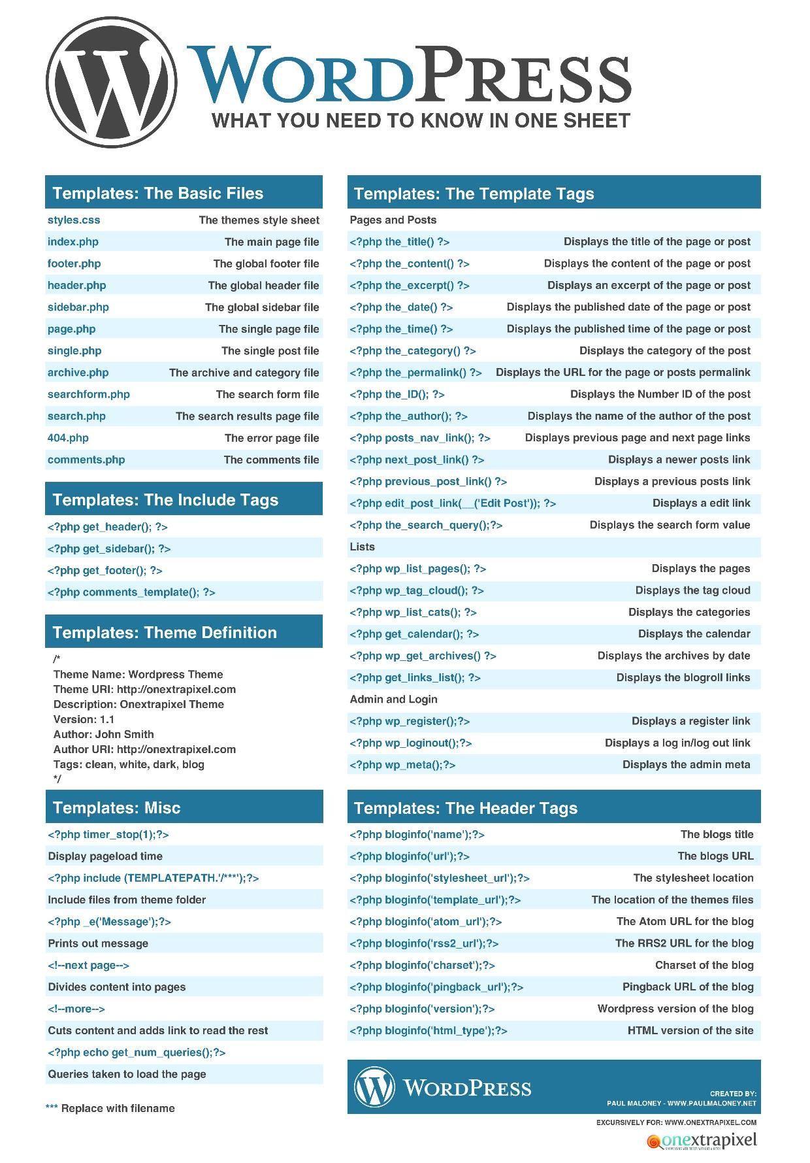

Slide 6
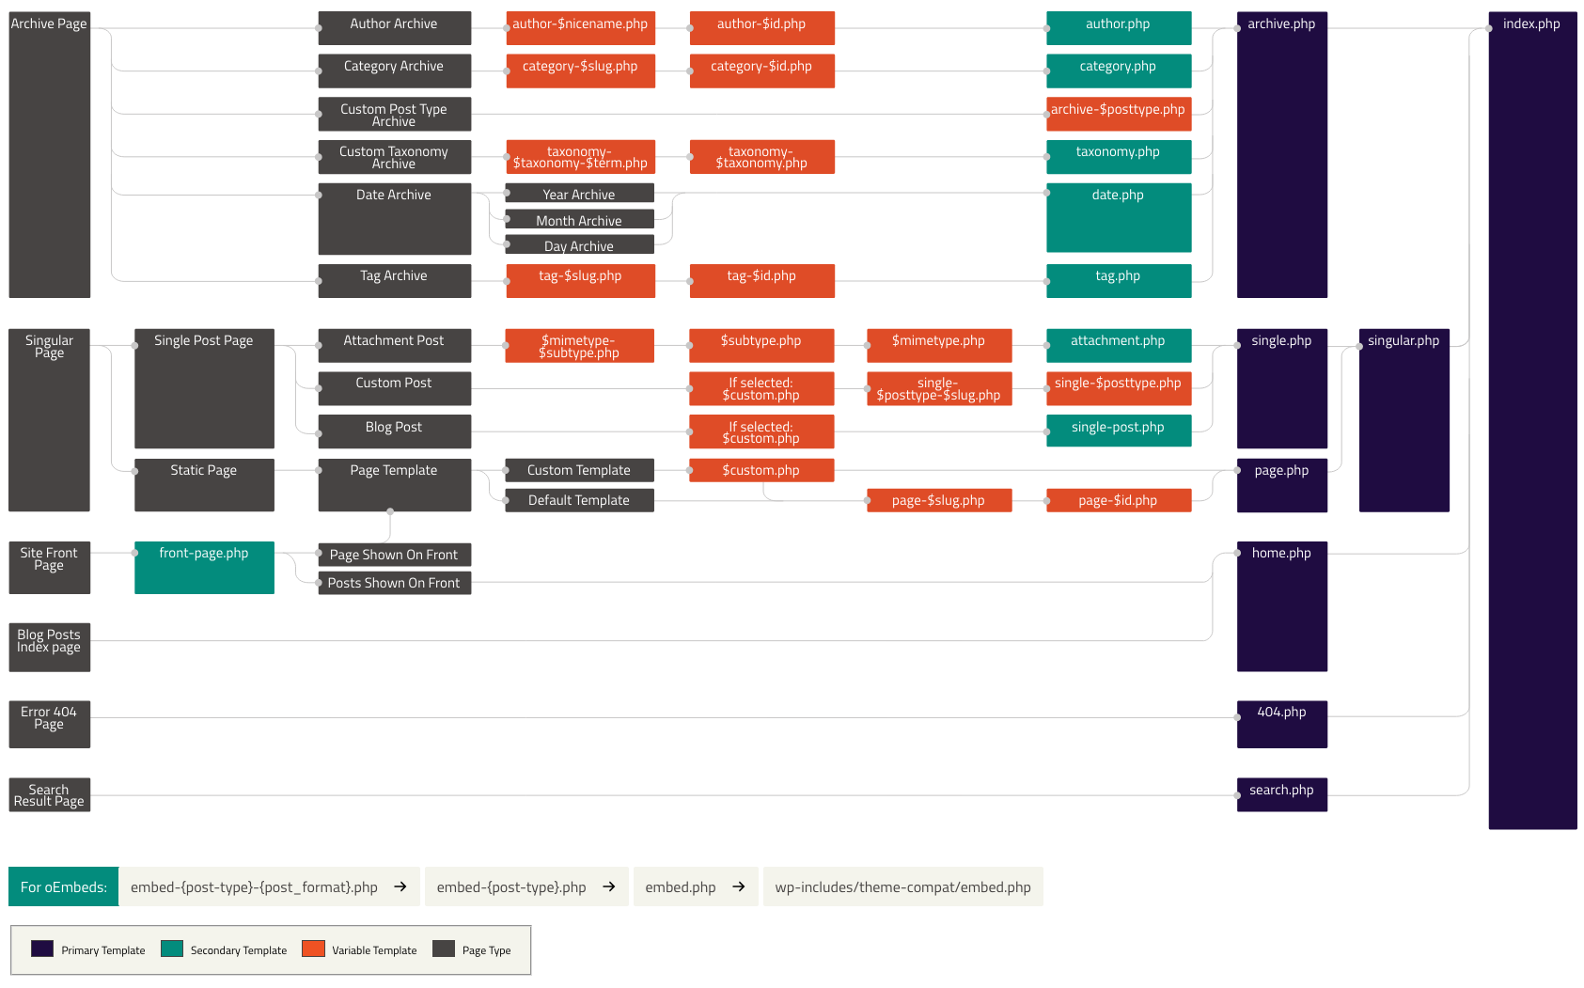
Page Hierarchy

Slide 7
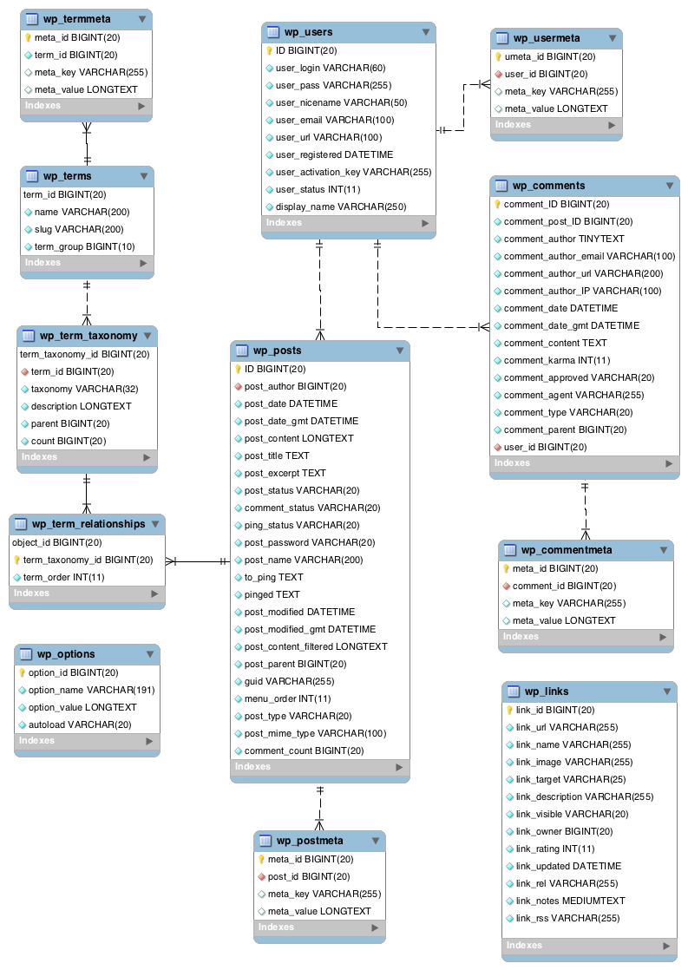
Database Structure

Slide 8
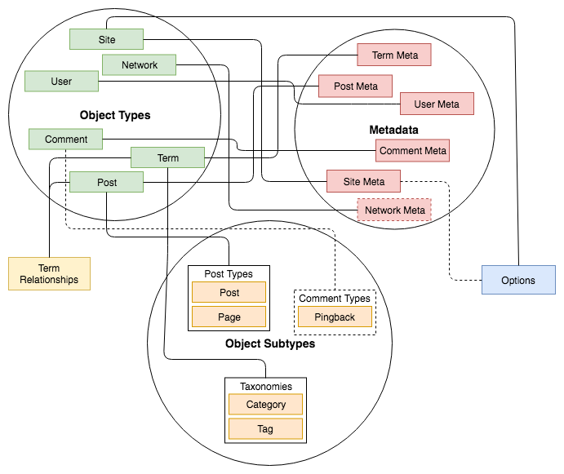
Data Structures Relationships

Slide 9
Types of Action
The WordPress Action Reference page has available actions listed by the following categories:
Actions Run During a Typical Request
Actions Run During an Admin Page Request
Post, Page, Attachment, and Category Actions (Admin)
Comment, Ping, and Trackback Actions
Blogroll Actions
Feed Actions
Template Actions
Administrative Actions
Dashboard “Right Now” Widget Actions

Slide 10
Types of Action
The Codex also has a similar Filter Reference page, which it lists by the following categories:
Post, Page, and Attachment (Upload) Filters
Comment, Trackback, and Ping Filters
Category and Term Filters
Link Filters
Date and Time Filters
Author and User Filters
Blogroll Filters
Blog Information and Option Filters
General Text Filters
Administrative Filters
Rich Text Editor Filters
Template Filters
Registration & Login Filters
Redirect/Rewrite Filters
WP_Query Filters
Media Filters
Advanced WordPress Filters
Widgets
Admin Bar

Slide 11
Basic Theme Folder Strusture

Slide 12
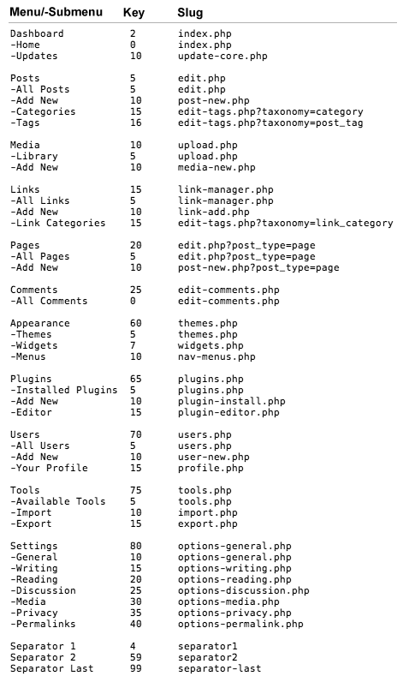

Slide 13
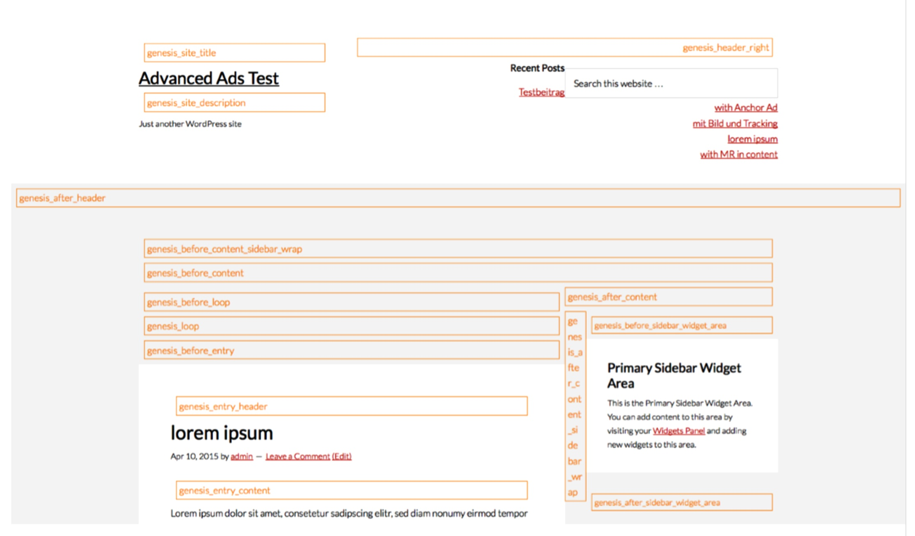
Example For Theme Template Structure

Slide 14
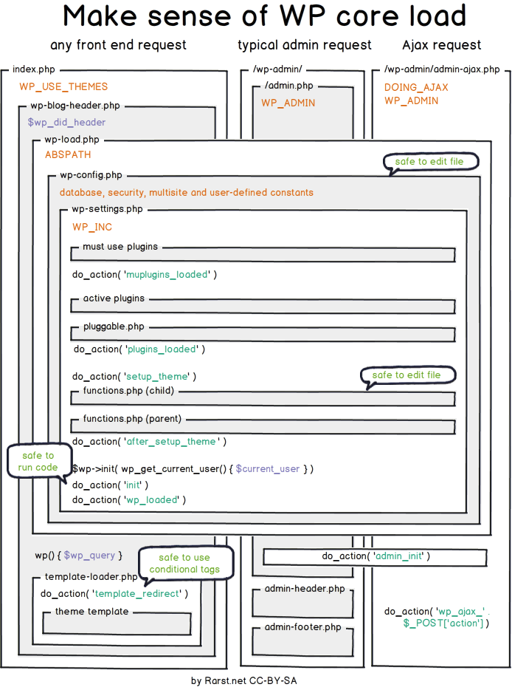
Wp Core Load Structure

Slide 15
Website Reference
https://codex.wordpress.org/
https://wp-a2z.org/sitemap/sites/

