Slide 1
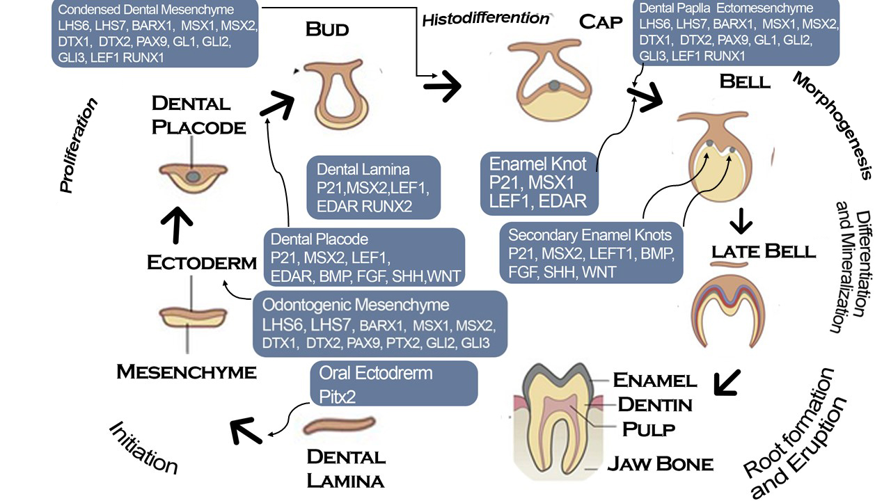
Dhyani Damor( Presenter) Anjali Suthar (Co Presenter) Isha bhadiyadara (Co Presenter)
1st year BDS

