Slide 1

A Friendly Face for Eclipse
Charles Reis, Corky Cartwright
creis@alumni.rice.edu, cork@cs.rice.edu

Slide 2

Java at the Intro Level
Great for OO Concepts
But:
  Tough syntax
  “Magic code” for main, console I/O
  Compile / Run at command line
Notes:
Syntax: semicolons, brace matching
Magic: public static void main(String[] args)

Slide 3
Simplify with IDEs
Syntactic aids
Error highlighting
Avoid the command line
Notes:
Eclipse, like most IDEs, does well

Slide 4
IDE Pitfalls for Novices
No relief from main or console I/O
Overwhelming interface
Heavyweight
Notes:
Eclipse, like most IDEs, does poorly
- 10 large menus, too many toolbar buttons (4 toolbars), 6 available panes

Slide 5
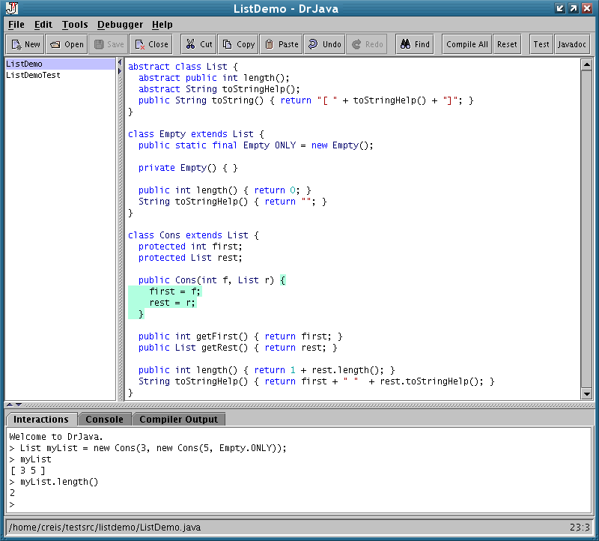
DrJava
Pedagogic IDE
Lightweight
Simple user interface
Notes:
Widespread use in intro courses

Slide 6
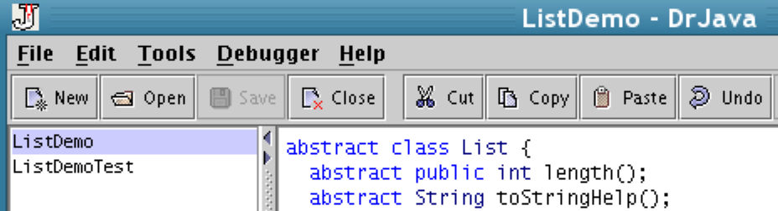
DrJava
Pedagogic IDE
Lightweight
Simple user interface

Slide 7
Interactions Pane
“Read-Eval-Print Loop” (REPL)
Calculator metaphor
Build up state
Good for demos, experiments, etc.
Notes:
Metaphor: clear and consistent with the mental model of a computer
(tell it what to do in steps and it remembers)
State: construct a context between interactions with a clear history

Slide 8
Potential DrJava Drawbacks
No Plug-in Architecture
Limited feature scope
Notes:
Plug-ins: can add educational value
Scope: scales to larger projects, but no exposure to advanced tools (refactoring)
In interest of using same tool across courses, consider a hybrid

Slide 9
DrJava Plug-in for Eclipse
Create a DrJava / Eclipse Hybrid
  Simplify Eclipse’s layout
  Add Interactions Pane
Notes:
Audience:
- Desire to use same IDE across courses
- Ease transition from intro IDE to advanced tools

Slide 10
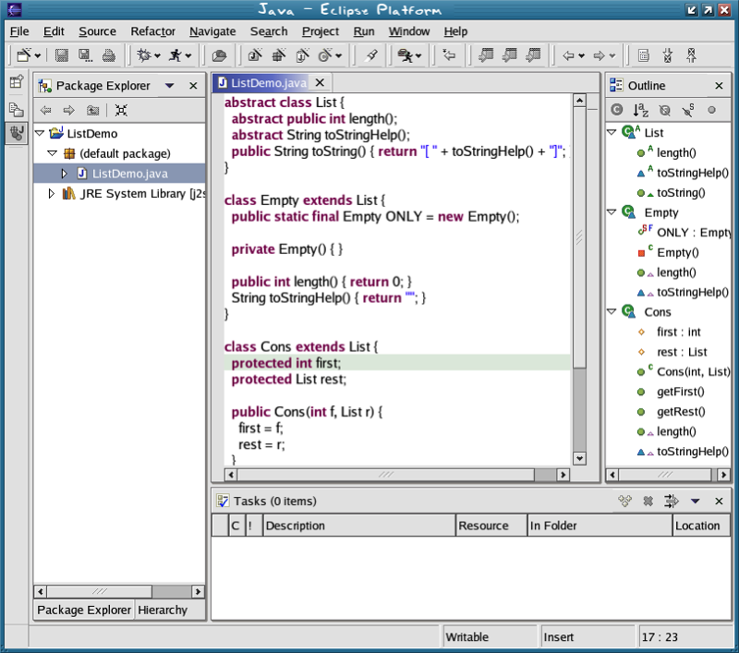
Simplify the Layout
Notes:
Default Java Perspective
(perhaps note the inaccuracy of outline: not using real parse; shows gibberish)

Slide 11
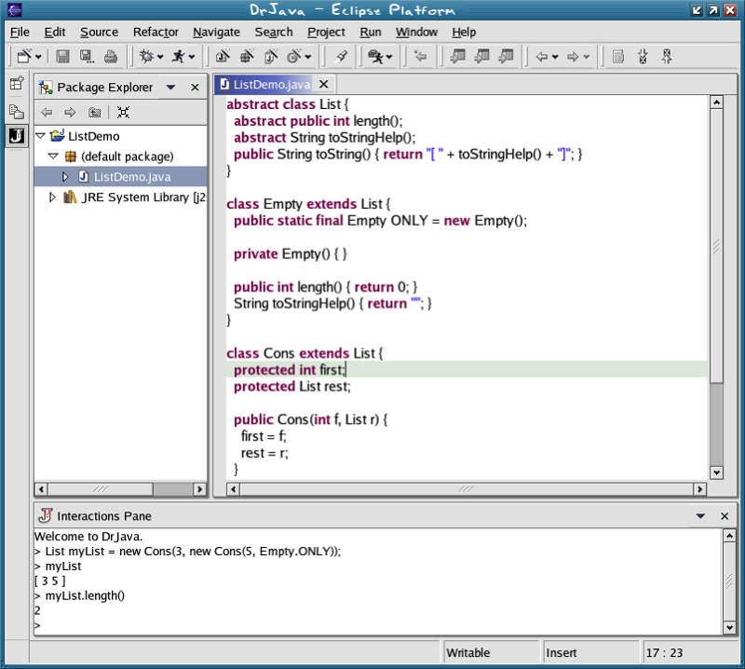
Simplify the Layout
Notes:
Current DrJava Perspective

Slide 12
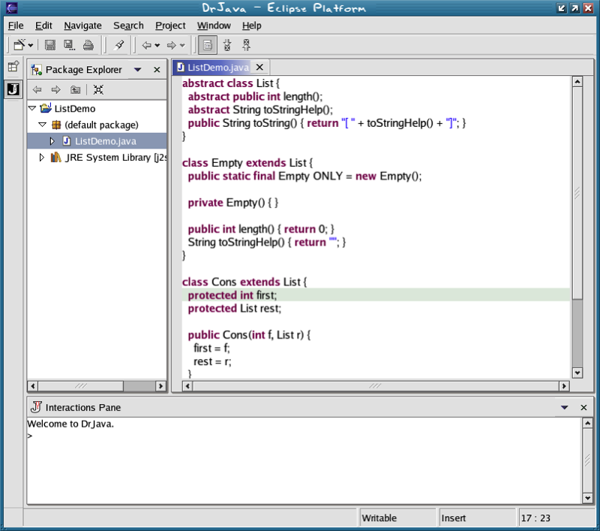
Simplify the Layout
Notes:
Work in progress to further simplify the toolbars and menus

Slide 13
Interactions Pane
Straight from DrJava
REPL vs. Scrapbook Page
  More intuitive metaphor
  Clear, convenient to build up state
Notes:
Code is used straight from DrJava: immediate new features, bug fixes
Metaphor: intelligent paper?
State: history vs. select a block, single mode of eval, output/errors distinct from input

Slide 14
Coming Soon
Debugger Integration
  Interactions during suspension
  More power than just expression eval
Notes:
Power:
- Full generality (eg. anon inner classes allowed)
- Same consistent metaphor, same errors (unlike exp eval in Eclipse)

Slide 15
Conclusion
Eclipse + DrJava: better for novices
  Less daunting UI
  Avoid complexities with REPL
  Ease transition to advanced tools

