Slide 1
A Pedagogic Programming Environment for Java that
Scales to Production Programming
Charles S. Reis
Master’s Thesis Defense
Rice University
April 16, 2003

Slide 2
Pedagogic IDEs
Useful tools in courses
  Simple, easy to learn
  Guiding philosophy for features
Usually limited to intro level
  Lack of powerful features
  Restrictive interfaces (eg. UML)

Slide 3
Professional IDEs
Many advanced features
Large, Cumbersome
  Significant overhead
  Complex user interfaces
  Not designed for students
Avoided by many professionals!

Slide 4
Motivation
Can pedagogic IDEs be useful at the level of production development?

Slide 5
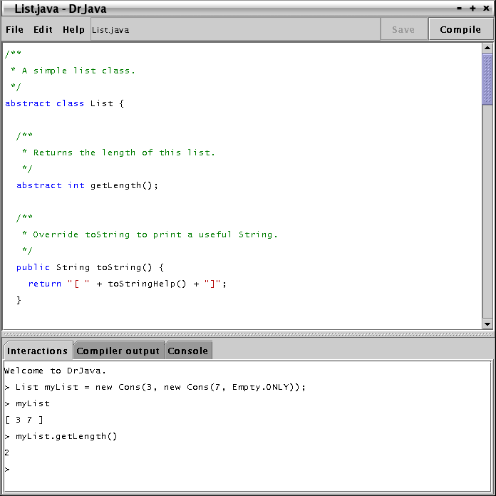
DrJava
Pedagogic IDE for intro level
  Simple, intuitive
  Interactive (REPL)
  Focus on source language
Notes:
Disciplined REPL (separate view of source) (modeled after DrScheme)

Slide 6
DrJava Development
Created by students at Rice
  Object oriented, design patterns
  Extreme Programming (XP)
  Open Source
Customers worldwide
Notes:
Big points of XP
14+ schools, 10+ countries

Slide 7
Goal
Extend DrJava to support production programming
  Small set of new features
  Ease transition to professional IDEs
  Teach production programming with DrJava

Slide 8
Necessary Features
REPL still useful
Easy access to multiple files
Traditional debugger
  Suspend execution, query values
Test-driven development
  Integrated support for unit tests

Slide 9
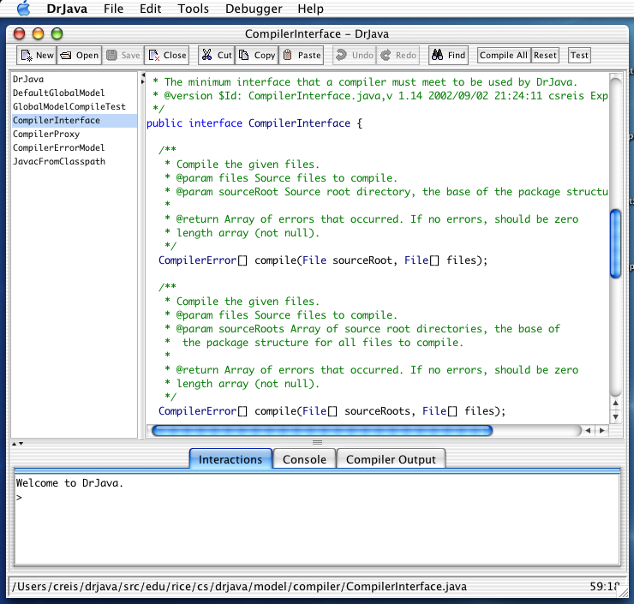
Editing Multiple Files
Java projects span many files
  Need convenient access to many classes at once
Add document selector

Slide 10
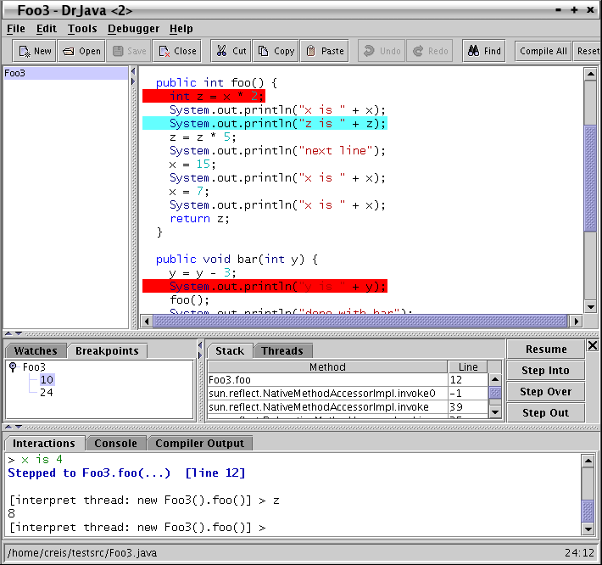
Interactive Debugger
Traditional features
  Breakpoints
  Stepping
  Query values
Integrated with Interactions Pane (REPL)

Slide 11
Debugger + REPL
Flexible Points of Entry
  Not just main method
  Easily repeat experiments
Interact with state in Java
  Query, modify values
  Call methods, etc

Slide 12
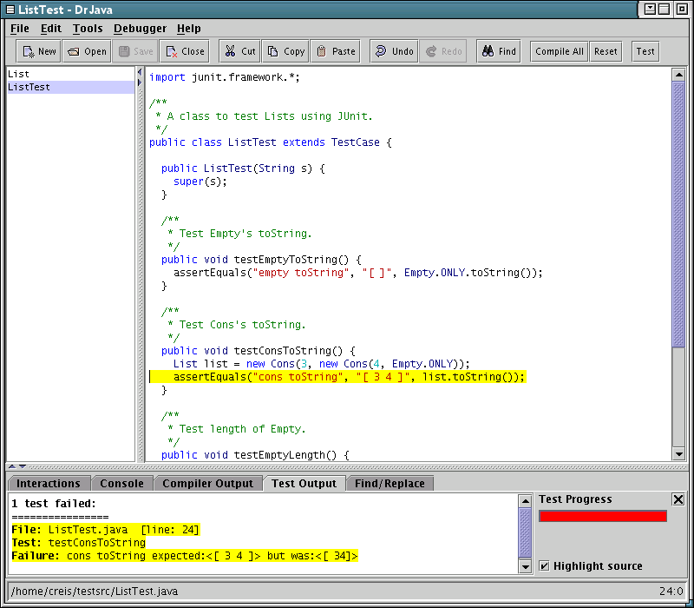
Unit Testing Support
Key to incremental development
Quality Safeguard
Easy to write, run
  JUnit framework
  “Test” button
  Visual feedback

Slide 13
Leveraging Professional IDEs
Occasionally useful
  Powerful refactoring tools
Desire an easier transition from pedagogic IDEs
Notes:
“Escape hatch”

Slide 14
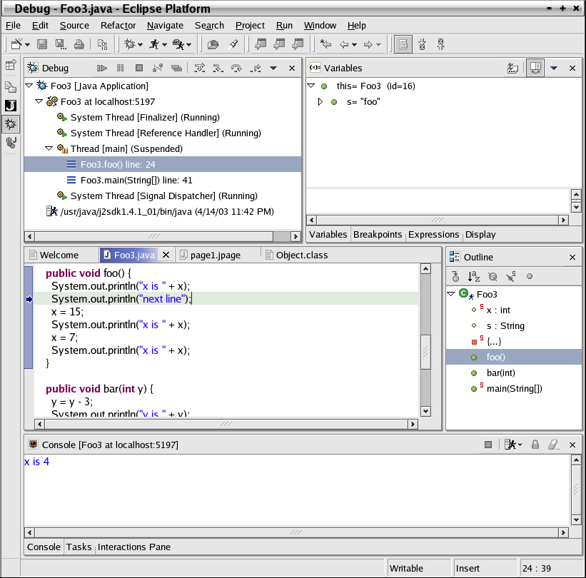
IBM’s Eclipse
Widely used, open source IDE
Everything is a “plug-in”
Many advanced features
Active ties with academia

Slide 15
DrJava Plug-in for Eclipse
Innovation Grant from IBM
Ease transition to Eclipse
  Simplify user interface
  Provide Interactions Pane (REPL)
  Debugger + REPL
REPL also useful for professional developers

Slide 16
Plug-in Development
Code Re-use
  All logic directly from DrJava
  Single point of control for bug fixes, feature improvements
Refactoring DrJava
  More modular design
  Safe and easy: unit tests!

Slide 17
DrJava’s Scalability
DrJava team uses DrJava
  Effective tool for its own development
Scales to Production Programming

Slide 18
Teach Production Programming
Use DrJava to teach production programming skills
  Common, familiar environment
  Select DrJava as course project!

Slide 19
Extend DrJava in a Course
Students can:
  Learn effective practices (XP)
  Join an existing product team
  Maintain a product
  Support customers

Slide 20
Extreme Programming
Expose students to effective development practices
  Ubiquitous unit testing
  Pair programming
  On-site customer
  Incremental releases

Slide 21
Classroom Challenges
Time constraints
Scarce resources
How to:
  Quickly transfer knowledge?
  Adapt Extreme Programming?
  Manage development?

Slide 22
XP: Knowledge Transfer
Pair Programming
  With experienced TAs
  With other students
Unit Tests
  Executable documentation
Notes:
High rate of developer turnover

Slide 23
Adapting XP for Classroom
Pair Programming
  Lab time, students select own pairs
On-site Customers
  Students themselves (using DrJava)
No fixed deadlines
  Require 10 logged hours per week

Slide 24
Managing Development
TA’s as Project Managers
SourceForge.net
  Free open source project hosting
  Professional quality management
    Bug reports
    Feature requests
    Task management

Slide 25
Case Study: COMP 312
Early unit test assignment
Bug fixes
Large features in small tasks
  2002: JUnit support, debugger, configurability
  2003: Interactive debugger, Javadoc, interactions pre-processor

Slide 26
Results
DrJava effective for production programming
  Used in its own development
Eclipse plug-in eases transition
Excellent results from 312
  Many core features implemented
  Students exposed to process

Slide 27
Conclusion
Pedagogic IDEs can scale to production development
  DrJava’s simplicity preserved
  Effective for large projects
  Useful for teaching production programming skills

