Slide 1
Production Programming in the Classroom
Eric Allen, Robert Cartwright, and Charles Reis
Rice University
{eallen, cork, creis}@rice.edu

Slide 2
Missing Part of CS Education
?
Students are not taught to program in a production environment
  Projects written from scratch, then discarded
  No project maintenance
  No real users to consider

Slide 3
Teach Production Programming
Students should:
  Maintain an existing codebase
  Support real customers
  Learn effective methodologies

Slide 4
But…
Where does the project come from?
Who are the customers?
How can an instructor manage all this?

Slide 5
Selecting a Project
On-campus customers
  Ideally, the students themselves
Open Source
  Free, high quality tools
  Easy to gain customers
At least one year old, sustainable

Slide 6
Selecting a Methodology
Extreme Programming! (XP)
Effective methodology in industry
  Leading edge practices
  Rapid development, reliable products
Translates well to classroom
Notes:
Training next generation of project managers…

Slide 7
XP: Pair Programming
Better Design, Fewer Bugs
  Quick development pace
Knowledge Transfer
  Students pair with experienced developers
  Effective against very high turnover
Notes:
Explain Continuous Code Review
Higher turnover than industry

Slide 8
XP: Unit Testing
Unit tests for every non-trivial method!
  Enforce tests are run before committing
Confidence to make changes
  Won’t break old functionality
“Executable Documentation”
  Quickly learn the code

Slide 9
XP: Continuous Refactoring
Let students improve any part of the code
  Collective ownership: sense of pride
  Prevents fragile code
Unit tests provide safeguard
  Always safe to refactor!

Slide 10
XP: Incremental Development
Break down into small tasks
  Estimate time-to-completion
  Keeps codebase stable
Release frequently
  Students get feedback from real users
  Much more powerful than just grades
Notes:
Mention bound on bad estimates (one week tasks)

Slide 11
But… XP in the classroom?
Difficult to apply XP in a course:
  Scheduling pair programming time?
  Maintaining unit test coverage?
  Finding on-site customers?
  Managing a work force?

Slide 12
Applying Pair Programming
Schedule time to pair program in class
  Two lectures, one closed lab per week
Allow students to choose pairs
  Avoid scheduling conflicts

Slide 13
Ensure Unit Tests are Written
Hard to get students in right mindset
  Early assignments for writing tests
  Emphasize the importance of tests!
Test-Driven Development
  Write the test first, then the code

Slide 14
Providing On-site Customers
Students themselves should be customers
  Careful selection of project
Discuss new features, specs in class
Also support off-campus customers

Slide 15
Course Management
Experienced TA’s as Project Managers
  Pair program with new students
  Sustainable
Supervise progress on tasks
  Monitor students like employees
Notes:
Grading: feedback as in a job

Slide 16
SourceForge.net
Free open source project hosting
Professional Management Tools
  Track features/bugs online
  Task management
  Respond to customers

Slide 17
Open Source Tools
JUnit
  Framework for writing unit tests
Ant
  Build tool with XML build scripts
  Enforce all tests pass before committing code

Slide 18
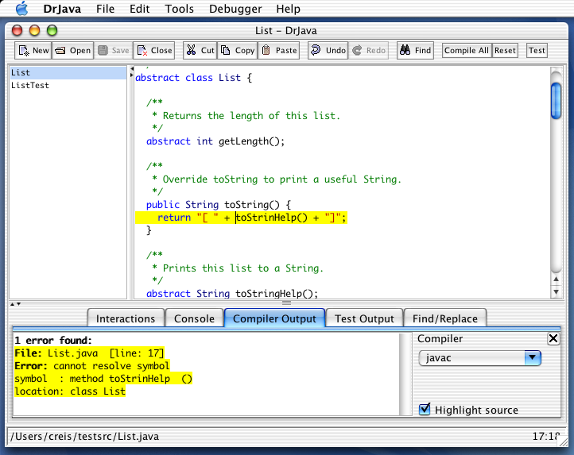
Case Study: DrJava
Pedagogic IDE developed at Rice University
  Used in intro Java courses
  Also useful for advanced developers

Slide 19
DrJava: Ideal Candidate
Open Source
Full unit test coverage
  >35% of codebase is test code
Students can be customers!
Other customers around the world
  14+ schools, 10+ countries

Slide 20
DrJava as Course Project
Many small projects in pairs
  Bug fixes, feature requests from customers
Three major projects
  JUnit Integration
  Configurability
  Integrated Debugger

Slide 21
Results, Spring 2002
Mostly successful
  High quality code
Large projects not completed
  Two unfinished, one had a bug
  Difficult to estimate
  No fixed deadlines: course became low priority
Notes:
Mention projects were completed over summer (not thrown out)

Slide 22
Changes for Spring 2003
Students must log 10 hours per week
Emphasize test-first programming!

Slide 23
Conclusion
You CAN Teach Production Programming
  Extreme Programming works in classroom
  Unit tests are a safeguard
  Open Source tools

