Slide 1

Taming a Professional IDE for the Classroom
Charles Reis, Corky Cartwright
creis@alumni.rice.edu, cork@cs.rice.edu

Slide 2

Java at Intro Level
Widespread, great for OO
But, lots of complexity...
  Syntax
  Command Line, Classpath
  Console I/O
  public static void main(String[] args)

Slide 3
IDEs Can Help
Help with language syntax
Easy compile / run buttons
Notes:
Coloring, indentation, brace matching
Error highlighting, avoid command line

Slide 4
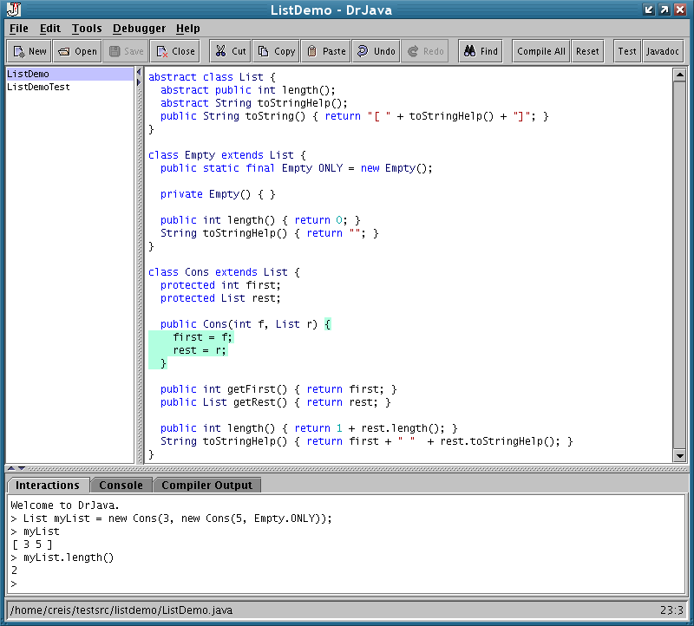
Pedagogic IDEs
Great for Intro:
  Simple and interactive
Limited features
No plug-ins
DrJava

Slide 5
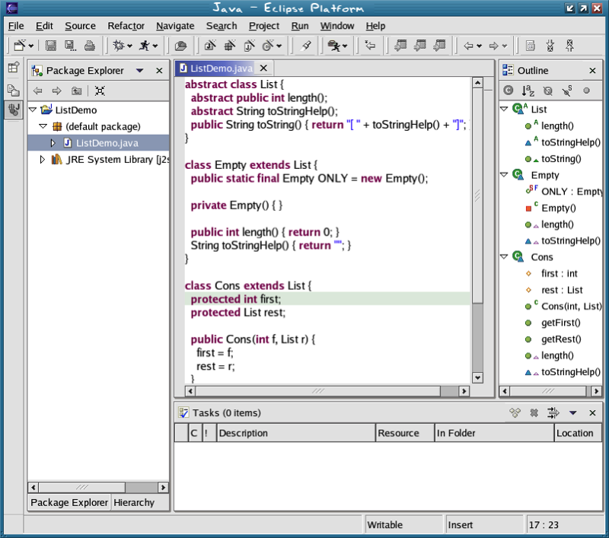
Professional IDEs
Many advanced features
Plug-ins (Eclipse)
Bad for Intro:
  Complex UI
  Console I/O, main
Eclipse
Notes:
Most professional IDEs: no relief from main, console I/O early
Eclipse: a little relief, but not really interactive

Slide 6
Modify Eclipse
Improve for intro level
Why not use a Pedagogic IDE?
  Other educational plug-ins
  Consistent IDE across curriculum
  Easy transition to advanced tools
Notes:
Pedagogic IDEs are perfectly reasonable, often even preferred
There are motivations to use professional IDEs, though

Slide 7
DrJava Plug-in for Eclipse
Simplify Eclipse’s interface
Add Interactions Pane

Slide 8
Interactions Pane
On-the-fly evaluation
No need for main, console I/O
Lecture demos, student tinkering
Notes:
Console style disciplined REPL
(build context with clear history)
Intuitive / clear metaphor (give commands)

Slide 9
Vs. Eclipse Scrapbook
Can evaluate code outside main, but...
All-at-once evaluation
Less convenient, powerful, intuitive
Notes:
Select text to be evaluated, results inserted alongside text
No access to earlier computations
[no clear history, no intuitive metaphor]

Slide 10
Demo

Slide 11
Related Plug-ins
Gild, Penumbra
  Further simplify Eclipse’s interface
  Courseware integration
Notes:
Gild: University of Victoria (simplify interface)
Penumbra: Purdue (courseware integration)

Slide 12
Result
Eclipse + DrJava: ready for Intro Level
  Effective on-the-fly evaluation
  Integrate with other plug-ins
  Easy path for growth

