Slide 1
RTSP – Real Time Streaming Protocol
Presented by
Manoj Sivakumar

Slide 2
Overview
Motivation
RTSP - Architecture
RTSP – Features
Description of Working

Slide 3
Motivation
Internet Video On Demand
  Internet VCR
    Requirements like pause, record etc
Integration with web architecture
A new application level protocol for media files

Slide 4
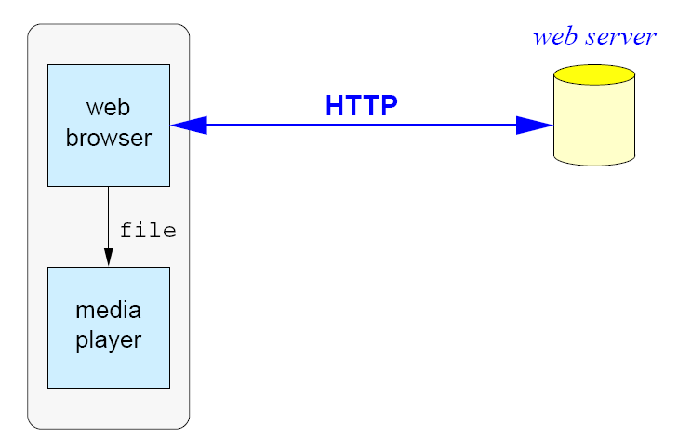
RTSP - Architecture
Media file download

Slide 5
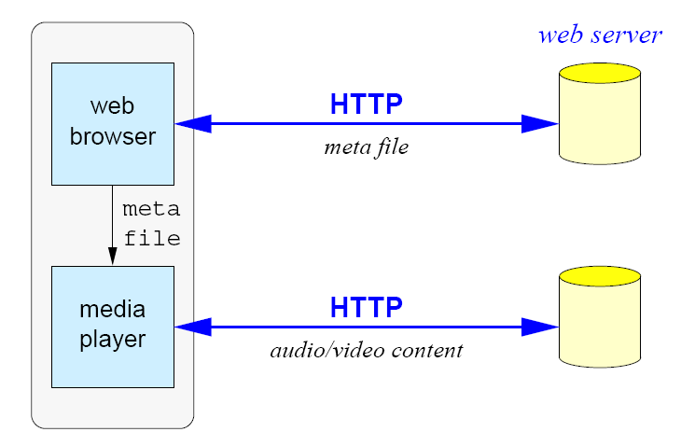
RTSP – Architecture ..contd
Meta Files

Slide 6
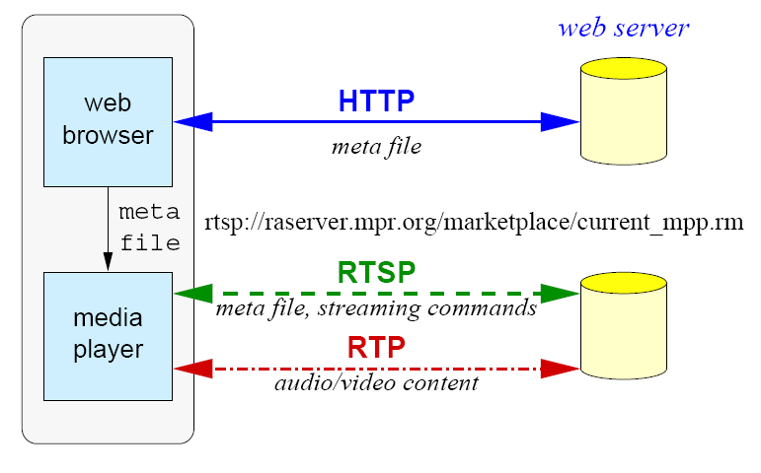
RTSP – Architecture ..contd
RTSP

Slide 7
RTSP - Features
“rough” synchronization (fine-grained)
virtual presentations = synchronized playback from several servers
load balancing using redirection at connect, during stream
supports any session description
device control → camera pan, zoom, tilt
caching: similar to HTTP

Slide 8
RTSP - Features
Retrieval:
  first, get presentation description
  Unicast
  multicast, client chooses address
  multicast, server chooses address (NVOD)
  independent of stream file format

Slide 9
RTSP - Features
Methods
  OPTIONS
  SETUP
  ANNOUNCE
  DESCRIBE
  PLAY
  RECORD
  REDIRECT
  PAUSE
  SET PARAMETER
  TEARDOWN

Slide 10
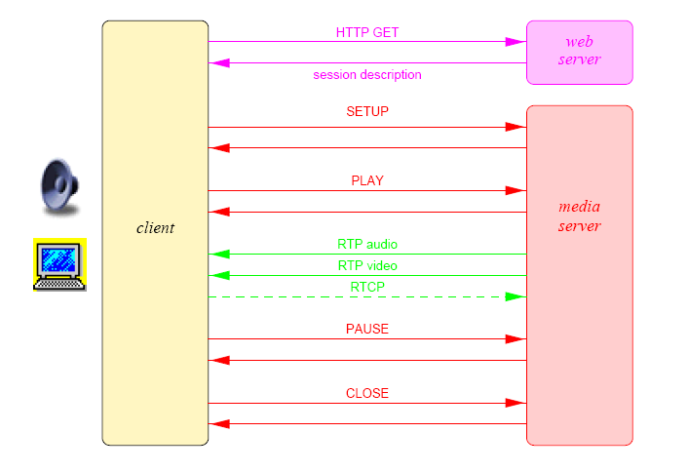
RTSP - Example

Slide 11
RTSP - Time
Normal Play Time (NPT) : seconds, microseconds
SMPTE timestamps: seconds, frames
Absolute time ( for live events)

Slide 12
References
www.cs.columbia.edu/~hgs/teaching/ais/slides/RTSP.pdf

