Slide 1
Kaggle Carvana Image Masking Challenge
Srinesh Shenoi

Slide 2
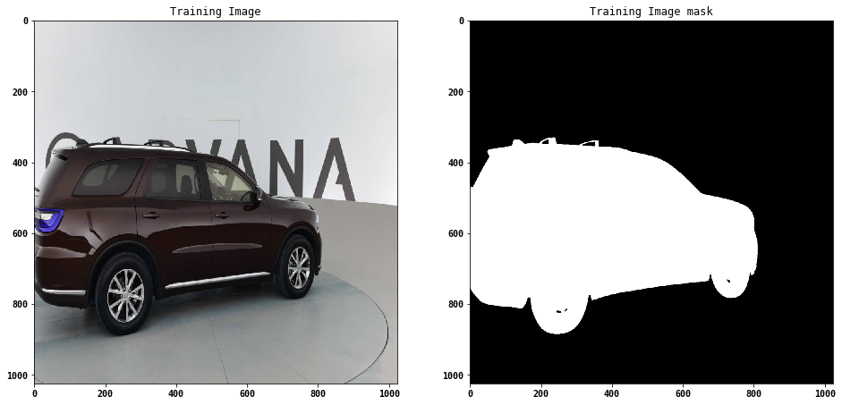
Introduction
Automatically identify the high-quality contours of the car from an image – Semantic segmentation task
Challenge is capturing the sharp boundaries in presence of shadows and light gradients

Slide 3
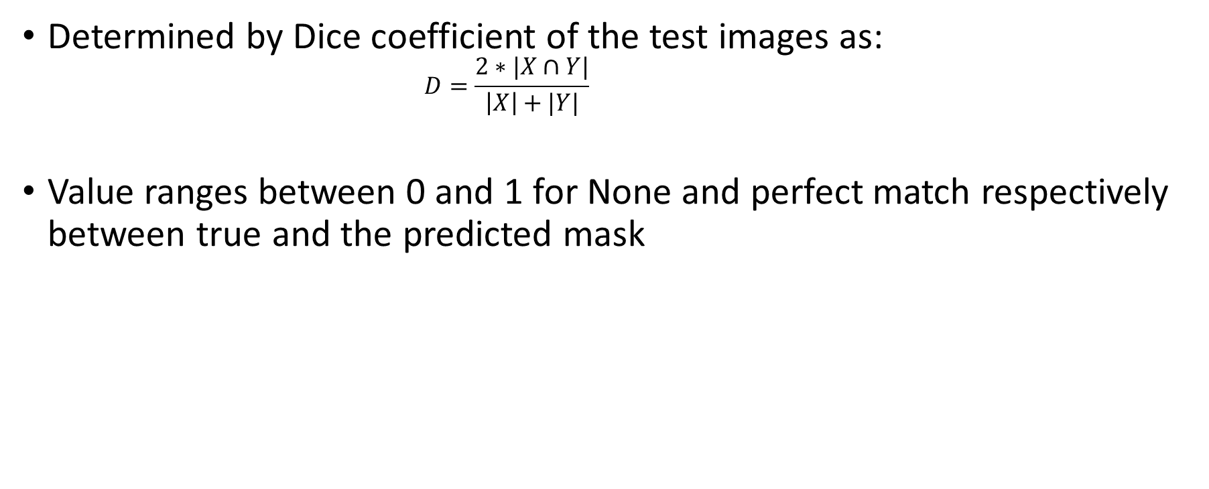
Performance measure
Determined by Dice coefficient of the test images as:
$$D=\frac{2∗|X∩Y|}{\left|X\right|+|Y|}$$
Value ranges between 0 and 1 for None and perfect match respectively between true and the predicted mask

Slide 4
Solution techniques
Model 1:
CNN architecture with encoding-decoding stages without FC layers
Model 2:
Symmetric U-Net architecture

Slide 5
CNN architecture- Model 1
(1024x1024)
Conv
UnPool
Input
MaxPool
Segmented Image
(1024x1024)
Encode
Decode

Slide 6
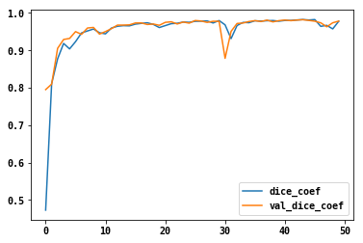
Results
Dice coefficient for the training and validation- highly correlated
Best model returns a validation accuracy of 98.20
Dice Coef
No of epoch

Slide 7
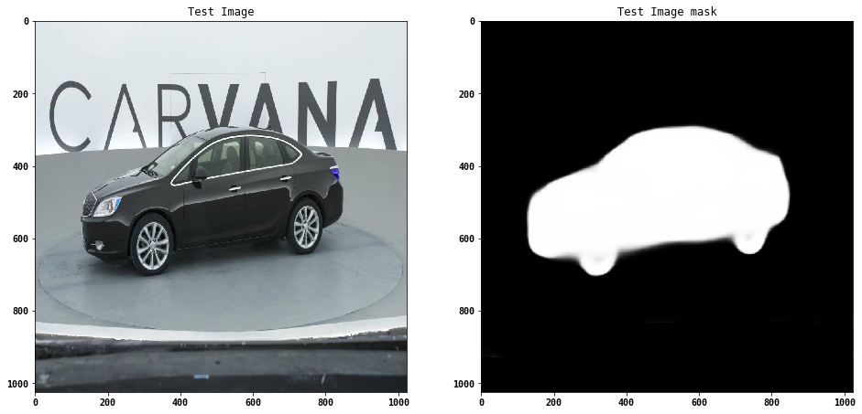
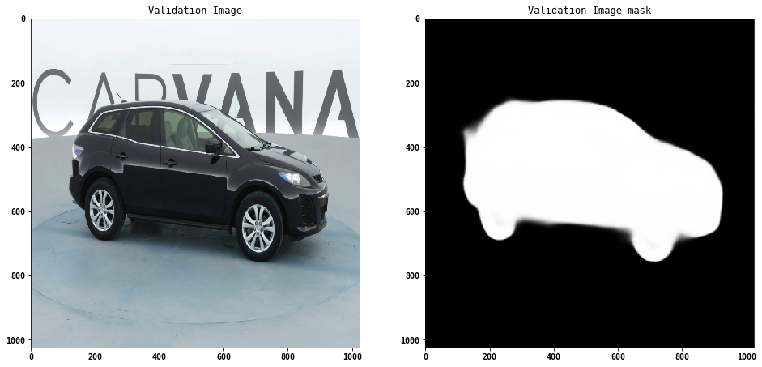
Visualizing the validation and test sets
Overall- Picks up the contours of the car reasonably well
Image is distorted at the bottom due to the shadows present in the original image

Slide 8
CNN architecture- Model 2 (U-Net)
(1024x1024)
Conv
UnPool
Input
MaxPool
Segmented Image
(1024x1024)
Decode
Encode

Slide 9
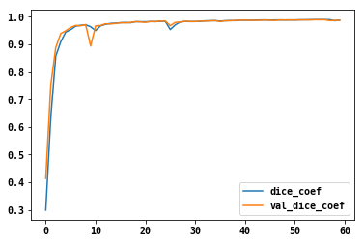
Results
Best model returns a validation accuracy of 98.97
Training time was also lesser
Lesser parameters in the model- ~42% less compared to Model-1
Max-unpooling would be a nice way to decrease the training error
Large image augmentations take longer training
Dice Coef
No of epoch

Slide 10
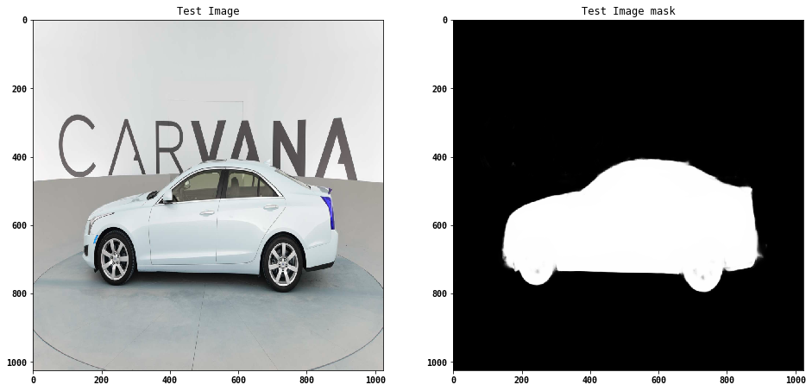
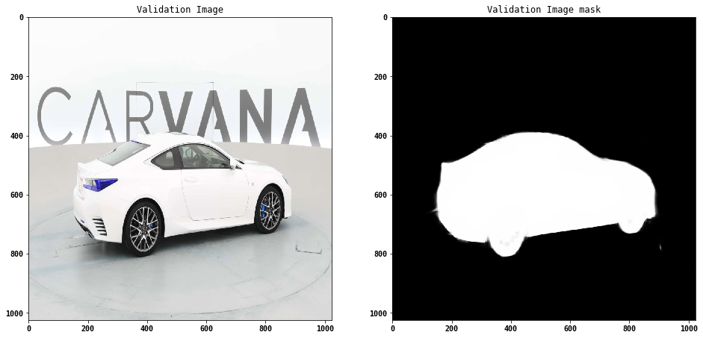
Visualizing the validation and test sets
Overall- Picks up the contours of the car quite well
Able to find the gap between the wheels – Improvement over Model 1

Slide 11
Final comments
The model performance appears to have plateaued out around 99%
Model needs an improvement as the best available solutions have reported scores of over 99.7
Hyperparameter tuning and optimizing the CNN architecture may be the way out
Image augmentation via rotation may not be good as the biggest challenge are the shadows
Ranking for the challenge :
Model 1 | Model 2
98.38 (Final submission score) | 98.97 (Best validation score)

