Slide 1
Conducting project & data management
Émilien Schultz - SICSS Paris 2025

Slide 2
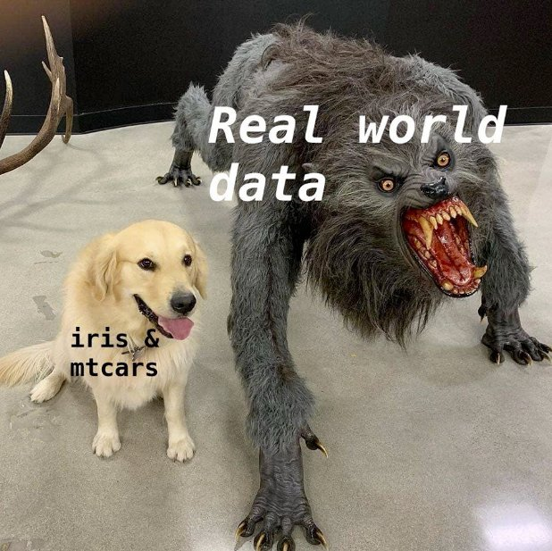
Real data are dangerous

Slide 3
Share your experience
What kind of data do you use ?
how big, kind of format ?
What is your best advice regarding data management you received / you can share ?

Slide 4
Tips from the room
Create intermediate records & backups
Write specific scripts for each step
Chuck your dataset, like on per day if its a continuous
Start clean because even short projet quickly become bigger
Add clear meta data & file names
Ethic is important, know from where your data come from
Not always “the most the better”
Look for dedicated tools rather than write everything by yourself
Version control is useful
Favor open source tools and if you can give back to the community

Slide 5
Focus on data management
Practical skills
Collecting data
Transforming data to digital text
Downsizing large dataset
Design a workflow

Slide 6
So many questions…
How to scrap online data ?
What are the best format to use ?
What is encoding ?
What can I do if my dataset is too large ?
What can I do if my scripts take too much time ?
What if my computer is too old ?
How to manage my scripts ?
…

Slide 7
We can’t discuss all of them
Digitalization of data
Fixing OCR errors
Code optimization / modularization
Version control for code (git, …)
Data legislation …
But we will be here if you have specific questions

Slide 8
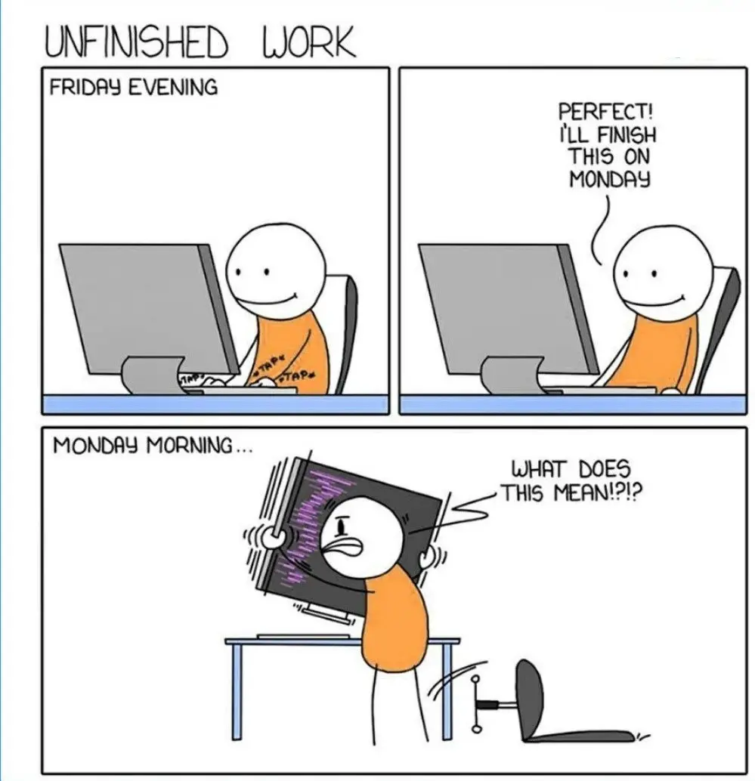
First, document your project

Slide 9
Especially true in collaborative projects

Slide 10
The importance of the filesystem
The ideal file system
project-name/ │ ├── README.md ├── data/ │ ├── raw/ # Unprocessed, original data │ ├── intermediate/ # Data after cleaning │ └── final/ # Cleaned, analysis-ready data ├── src/ │ ├── notebooks/ │ └── scripts/ ├── docs └── outputs/ ├── figures/ ├── tables/ └── reports/

Slide 11
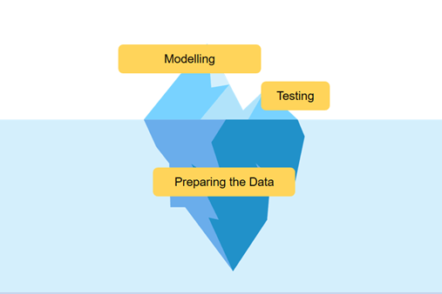
Second, data management
Data architecture : how to organize your data ?

Slide 12
Which data format should you use ?
CSV or Parquet ?
CSV : easy to read by chunck
parquet : optimized and compressed
In all case :
one row per document
clear index

Slide 13
Sizes of dataset for social sciences
Tiny ~ 100 Mb
Small ~ 1 G
Medium ~ 10 G
Large ~ 100 GB
(for CS, < 10G is small dataset)

Slide 14
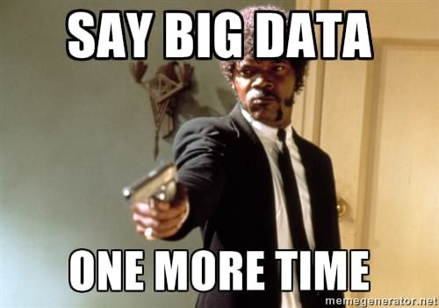
Help yourself : avoid big data
The bigger, the costier (to compute)

Slide 15
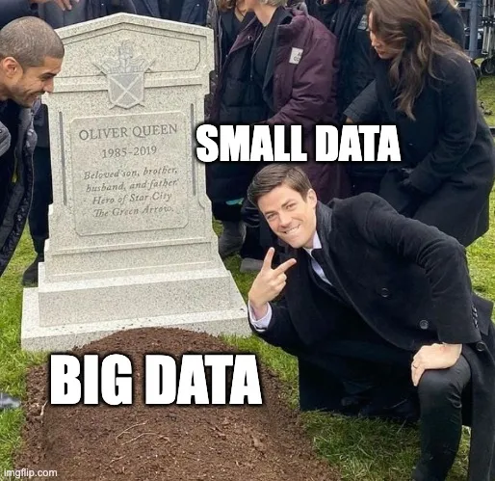
Aim to small data for a start
Data manageable on your computer - for a start

Slide 16
Third, clean your data
Know your data 🤪
yes, read some of them
Fix encoding problems
or unknown characters
Deduplicate / remove empty elements
Remove “noise” : HTML tags, headers
Do you need to remove some elements : emoticons ? stopwords ?

Slide 17
How to do it ?
Dedicated Python scripts
write specific functions to do the cleaning
reminder : regex can be useful
Dedicated tools (Open refine)

Slide 18
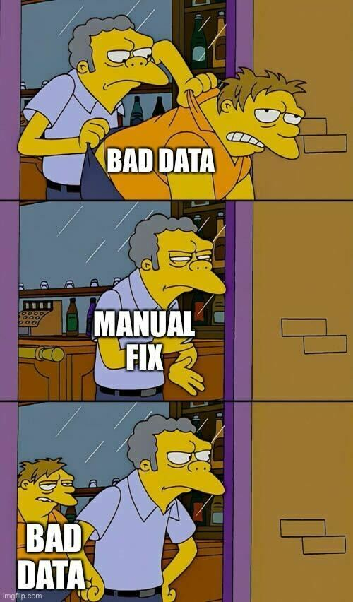
Avoid to correct your data manually
Build a workflow - write some scripts

Slide 19
What if you data is too big ?
Solution 1 : reduce your data
Work on subset
Sample
Batch
Solution 2 : parallelize
Dedicated data architecture
Parallelize (Dask)
Dedicated tools : Xan for csv

Slide 20
How to sample correctly ?
Randomly
Risk to miss rare elements
Stratify for skew data

Slide 21
Do you need all your text ?
Reduce your dataset to optimize treatment
Part that contains specific keywords
Introduction, conclusion, …
The limit of models context windows : 512, 1024, more ?
For instance CamemBERTv2

Slide 22
How to divide a text ?
The different levels of segmentation
Complete document
Paragraph
Sentence
How to do it :
brute force : just cut it :)
intelligent segmentation

Slide 23
Brute force
Rules of thumb : 1 token ~= 4 chars in English
Compute the number of token with a model
Then cut the text
Risk : creating meaningless parts of the text

Slide 24
How to perform intelligent segmentation
Use dedicated models/packages
Generic : SpaCy
Specific : wtpsplit
-> Examples in the notebook

Slide 25
Balance computation cost and model size
Depending on your task, you need to make choices.
Large models are :
powerful / generic
dependant on infrastructures
slower
Small models are :
specific
faster
easy to deploy

Slide 26
How much time will it need to run ?
Have an estimation of your process on a sample
Use time module or %timeit magic
If you use API requests, estimate tokens/cost

Slide 27
How to start ?
Define a small sample dataset that could handle easily
Define a baseline with simple strategy
regex, basic ML, …
Build a first workflow with a simplified question
e.g. dichotomize your classification
Develop your intuition

Slide 28
How to continue ?
Design a annotated test set and a testing workflow
Evaluate the cost expected on the complete dataset
Run your process on the complete dataset

