Slide 1


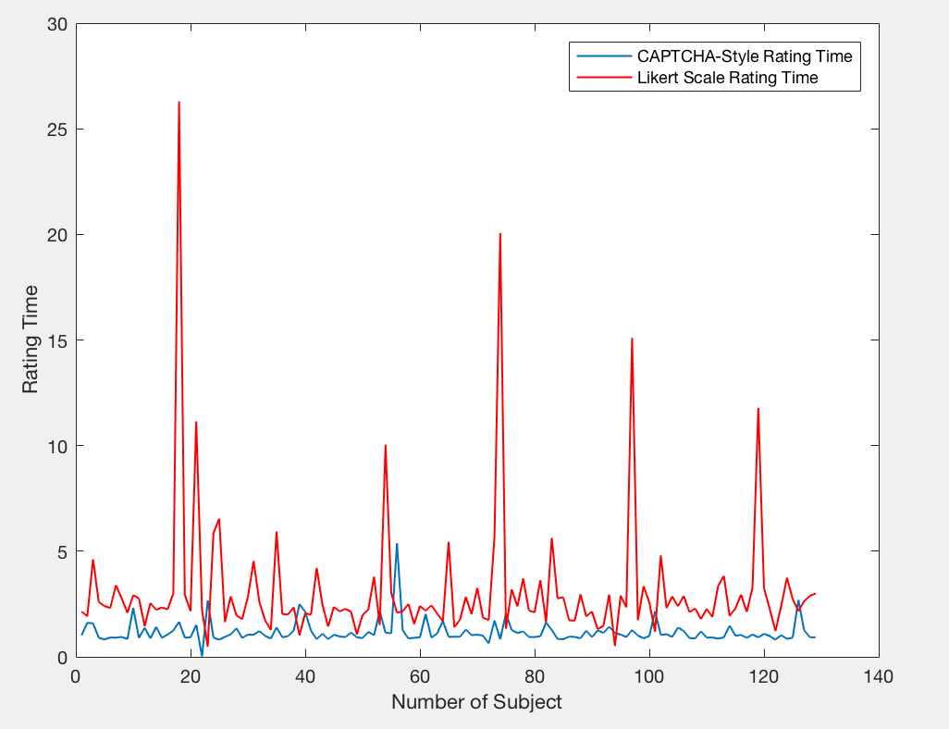
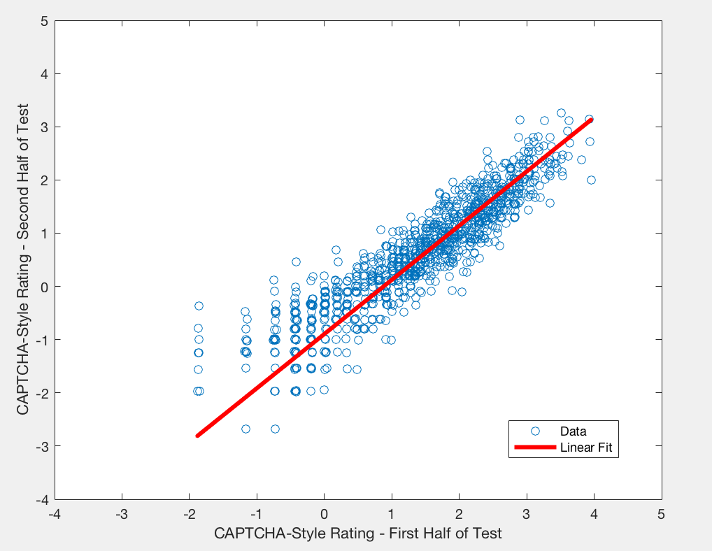
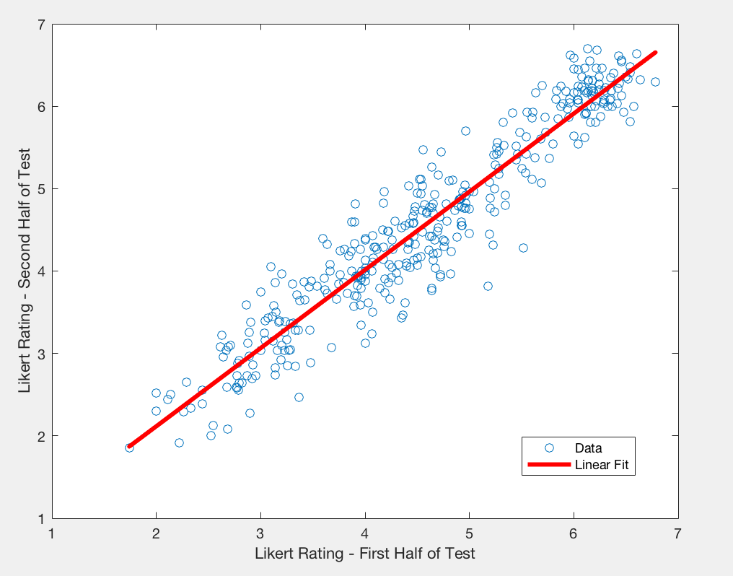
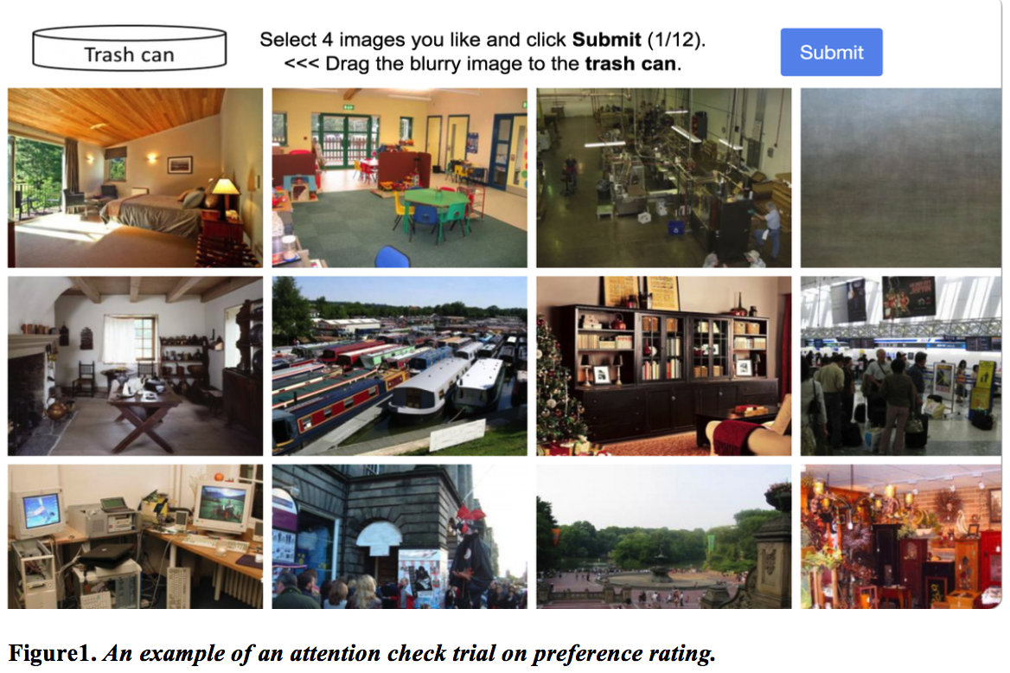
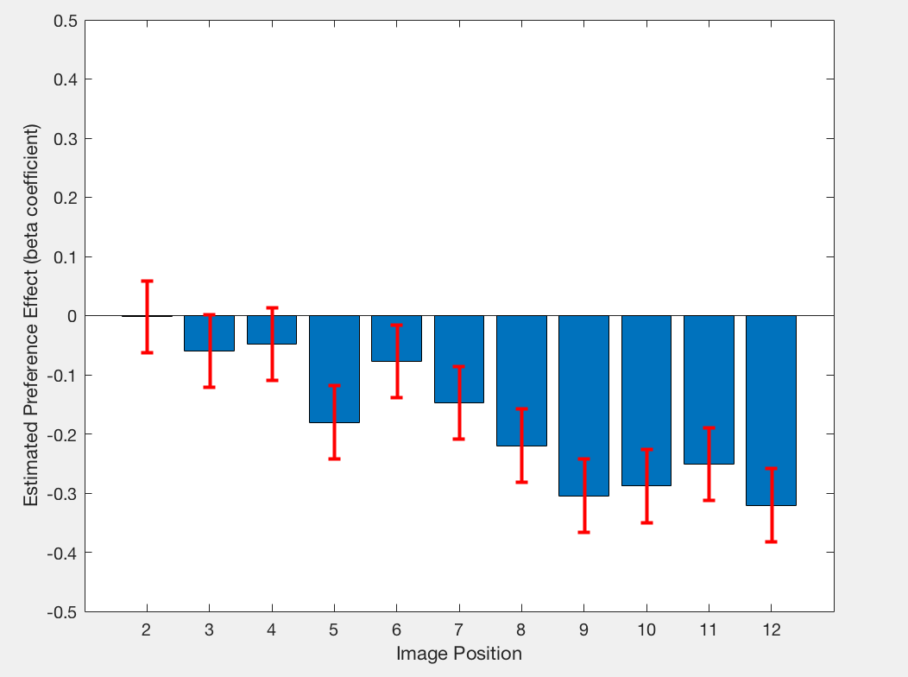
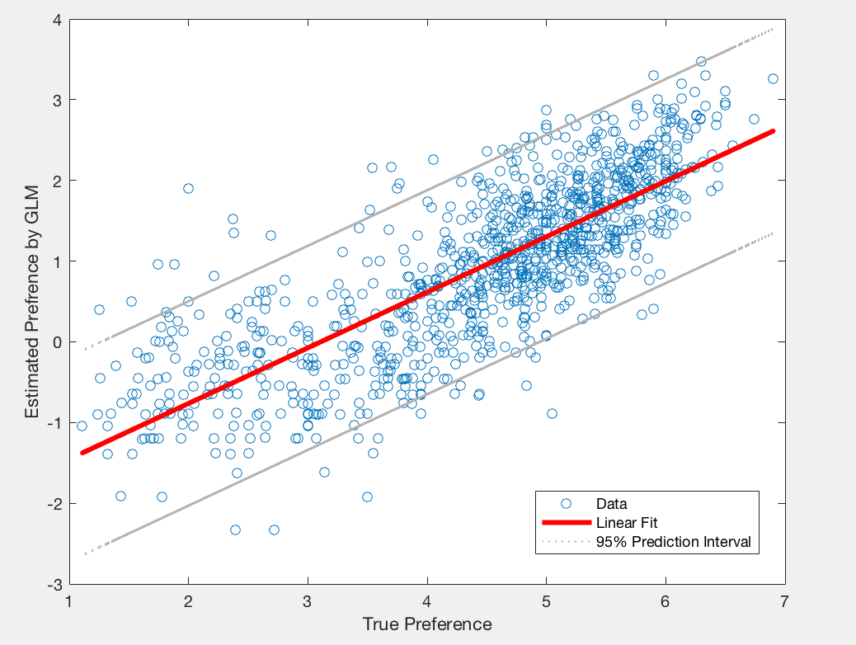
Faster Image Rating Using a CAPTCHA Inspired Task
Siyi Fan & Marc Berman
The Department of Psychology, University of Chicago
Introduction
Result 1
Result 3
Conclusions
Machine learning requires a massive dataset.
The bottleneck to building a supervised image dataset is the high cost of manual labeling.
Traditionally, manual image ratings have only been carried out on Likert scales rating a single image or ranking scales comparing two images at the same time.
Image-based CAPTCHA (Completely Automated Public Turing Test to Tell Computers and Humans Apart) requires users to perform an image recognition task, such as: click all of the images that meet a requirement.
Inspired by the format of CAPTCHA, we propose a new image rating method with participants who view 12 images simultaneously and click on 4 images they prefer most. Once an image gets clicked on, it is assigned 1 point. Otherwise, it is assigned 0 points.
We expect that CAPTCHA-style image rating remains a consistency to the Likert scale rating but with higher speed.
Rating Time
A paired t-test indicated that CAPTCHA-style rating (M = 1.1705, SD = 0.5445) is faster than Likert scale rating (M = 2.8944, SD = 2.0413; t(256) = -9.2677, p < 0.05).
Reliability
Split-half reliability indicated that CAPTCHA-style rating (r = 0.9309, 95% CI [0.9237, 0.9374], p < 0.05) is comparable to the Likert scale rating (r = 0.9311, 95% CI [0.9189, 0.9416], p < 0.05).
CAPTCHA-style image rating is faster than conventional Likert scale rating in terms of preference.
CAPTCHA-style image ratings positively correlate with the Likert scale ratings in terms of preference.
CAPTCHA-style preference rating is as reliable as Likert scale preference rating.
The probability of an image being clicked depends not only on its preference, but on its position on the screen.
Together, the CAPTCHA-style image rating method yields perfect consistency to the Likert scale rating. Therefore, it could be used as an alternative to the Likert scale for image rating.
Result 2
Research Questions
Correlation
Generalized Linear Model (GLM): Click (0 or 1) ~ Image(1, 2, 3,…, 1030) + Image Position (1, 2, 3…, 12)
Position bias: subjects tended to click on the image displayed on the second row and the second column
(position 6) no matter what that image was.
Correlation: correlation value between the estimated ratings (i.e., beta coefficients) generated by GLM and
ratings collected previously by Likert scale was 0.7955 (p < 0.001).
Will CAPTCHA-style image rating be faster than conventional Likert scale rating in terms of preference?
Will CAPTCHA-style image ratings positively correlate with the Likert scale ratings in terms of preference?
Will CAPTCHA-style preference rating be as reliable as Likert scale preference rating?
Future Directions
Future studies may conduct eye-tracking experiments to
get a comprehensive record of the regions of the image that are
being selected and explore the underlying mechanisms
responsible for this tendency. Understanding the nature of this
bias will be an important step to study how to model and correct
for it.
Future studies may also examine the CAPTCHA-style image
ratings in terms of naturalness, habituality, etc.
Methods
Ran simulation to determine the ideal number of subjects (120) to recruit and images to be clicked on (4) during each trial;
Participants (n=126) were recruited from Amazon Mechanical Turk;
1030 scene images in total during 87 trials, including 14 attention check trials;
12 different scene images arranged in 3 discrete rows with random item placement (Figure 1);
Click on the “top 4” images in terms of preference.
Contact
Siyi Fan
T: (217) 979-1560
E: siyifan1@uchicago.edu

