Slide 1
Data and Model: Small or Big
Keunkwan Ryu
Department of Economics
Seoul National University

Slide 2
“A bit is a bit.” -All forms of data look same in the eyes of computer. -Anything can be represented as a sequence of bits. -Numbers, categories, images, voice, texts, … -Revealed preference. Data.

Slide 3
Complementarity between Data and Model - (S, S) - (B, B) - In general, increase model size with data size - Bias vs. variance trade-off

Slide 4
경험적 연구와 심슨의 역설
남성 지원자
총 합격률
약 44%
남성 지원자
2,533명
남성 지원자
5,909명
A 학과
합격률: 23%
B 학과
합격률: 53%
여성 지원자
2,593명
여성 지원자
1,728명
여성 지원자
총 합격률
약 35%

Slide 5
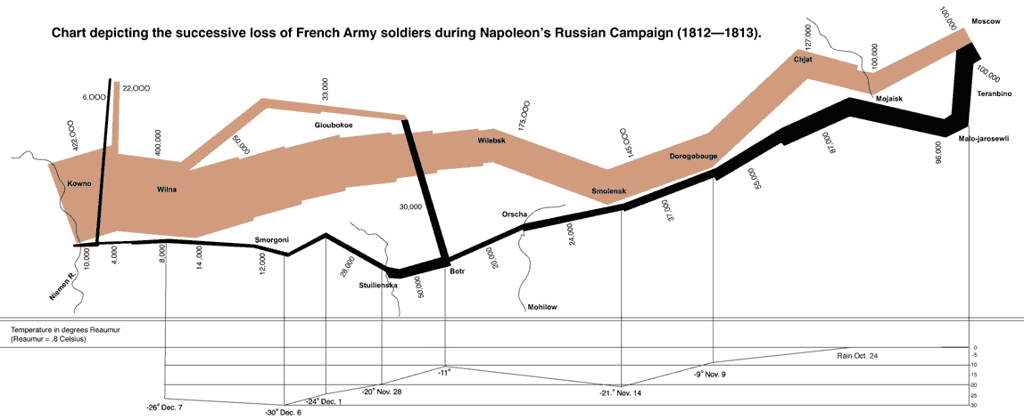
Napoleon Army’s Russian Invasion in 1812

Slide 6
Napoleon Army’s Russian Invasion in 1812

Slide 7
Napoleon Army’s Russian Invasion in 1812

Slide 8
Napoleon Army’s Russian Invasion in 1812
$$\text{Linear} \text{spline} \text{regression} \text{of} \text{ln}\text{ (}\text{y}\text{):}$$
$\text{ln}\left(y\right)=$ 12.783 $−$0.0012$x−$ 0.0019${(x−900)}^{+}$
$$R^{2}=0.98$$

Slide 9
중회귀분석: 결혼시장 분석
국내 모 결혼정보회사의 상세한 개인 프로필 및 선택에 대한 현시 선호 데이터를 사용하여, 우리 나라 중매결혼시장에서 남녀의 배우자 선호의 차이를 비교함
사회 경제적인 조건과 외모 조건에 대한 선호에 있어서 남녀의 차이가 어떻게 드러나는가?

Slide 10
중회귀분석: 결혼시장 분석
사회경제적 위세 지수 (SESI: Socio Economic Status Index)
학력, 학벌, 직업, 소득 등을 포괄하는 지수
신체적 매력 지수(PAI: Physical Attractiveness Index)
키, 체중, 인상등급 등을 포괄하는 지수
가정환경 지수 (FBI: Family Background Index) 부의 학력, 직업, 재산, 양친 생존여부, 부모 이혼여부, 형제관계 등 포괄하는 지수

Slide 11
중회귀분석: 결혼시장 분석
(반응) = α + β₁(상대의SESI) + β₂(상대의PAI) + β₃ (상대의FBI) + ε
반응: 좋다=1, 싫다=0
 | 남자의 반응 |  | 여자의 반응
 | 추정치 | 표준오차 | 추정치 | 표준오차
SESI/100 | 1.23 | 1.30 | 1.91* | 0.14
PAI/100 | 3.19* | 0.34 | 1.18* | 0.27
FBI/100 | 1.39* | 0.53 | 0.29 | 0.87

Slide 12
미국 Yellowstone 국립공원의 간헐천 Old Faithful
미국 Yellowstone 국립공원 내 간헐천 (Geyser)의 분출 지속기간(x) 분포
분출 지속기간의 히스토그램 : 3.2분 기준, 두 개 봉우리 갖는 쌍봉 분포
표본평균: 3.49 (분)
표본표준편차: 1.14 (분)

Slide 13
Old Faithful: One sample analysis (집단 구분 무시)
미국 Yellowstone 국립공원 내 간헐천 (Geyser)의 분출 대기시간 (y) 분포
분출 대기시간의 히스토그램 : 70분 기준, 두 개 봉우리 갖는 쌍봉 분포
쌍봉분포라는 사실 무시하고 단일의 정규분포로 잘못 근사하면 대기시간의 95% 예측구간은 70.99 ± 1.96 ×13.60=(44.33, 97.65). 무용지물의 구간임!
표본평균: 70.99 (분)
표본표준편차: 13.60 (분)

Slide 14
Old Faithful: Two sample analysis (집단 양분)
직전의 분출지속기간(x)이 길고 짧았는지에 따라 대기시간 (y) 자료를 양분
직전 분출이 짧았을 때(x<3.2) 개별 y값의 95% 예측구간
54.64 ± 1.96 ×5.99=(42.90, 66.38)
직전 분출이 길었을 때(x>3.2) 개별 y값의 95% 예측구간
80.05 ± 1.96 ×5.95=(68.39, 91.71)
표본평균: 54.64 (분)
표본표준편차: 5.99 (분)
표본평균: 80.05 (분)
표본표준편차: 5.95 (분)

Slide 15
Old Faithful: Regression analysis (집단 별 분석)
다음 분출까지의 대기시간(y)을 직전 분출의 지속기간(x)에 회귀분석
개별 y값에 대한 95% 예측구간은 33.47+10.73x ± 1.96 ×5.91
(43.35, 66.51) for x=2
(64.81, 87.97) for x=4

Slide 16
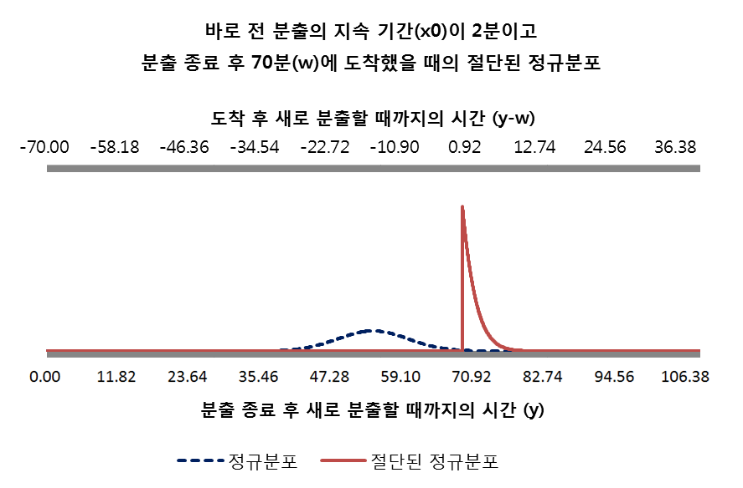
Old Faithful: Regression analysis, Real Time Updating
직전 분출 종료 후 70분만큼 경과한 경우
x = 2 로 주어진 경우 y는 평균이 54.93이고 표준편차가 5.91이므로 이제껏
70분 만큼 경과했다는 조건은 y의 분포를 의미있게 truncate시켜 업데이트함
총 대기시간: (70 , 75.38)
남은 대기시간: (0 , 5.38)

Slide 17
Big Data enables Bottom Up Approach
Voice recognition in Personal Assistant such as Google Home
- Traditional: Small Data, Top Down
Now in practice: Big Data, Bottom Up
Same model for any language
Newly born baby vs. DNN

Slide 18
Big Data
Web data, e-commerce
Purchases at department/grocery stores
Bank/Credit Card transactions
Social Network
Telematics
Wearables

Slide 19
Usage of Big Data
AlphaGo
FinTech
MyData
Autonomous driving
Recommendation system
Amazon
NetFlix
Google

Slide 20
Big Data and Share Economy
“Share rather than own.”
Environmentally friendly
Reduce waste
Increasing utilization rate
Better match demand and supply by ICT and Big Data

Slide 21
Python
High-level programming language: Python
Python supports TensorFlow: deep learning framework

Slide 22
X alone, or (X, Y)
X=features, classifiers, characteristics, covariates
Y=label, category, outcome
Data only on X: unsupervised learning
Data (X, Y): supervised learning
Objective oriented inference: reinforcement learning
- AlphaGo

Slide 23
Unsupervised Learning: X alone
Clustering
K-means algorithm: Repeat until convergence
- computing centroid for each cluster
- and assigning cluster membership
Choose k*=point of diminishing returns

Slide 24
Unsupervised Learning: X alone
Hierarchical agglomerative clustering:
Start with each point forming its own cluster
Repeatedly merge the clusters of the closest two points
Represent the results using dendrogram

Slide 25
Similarity/dissimilarity among documents
“bag of words” => generate X vector
TFIDF (term frequency*inverse document frequency)
- frequent locally (in the document)
- rare globally (in the universe of entire documents)

Slide 26
The federalist problem
Alexander Hamilton vs. James Madison
by Frederick Mosteller (Harvard math. statistician)

Slide 27
Words as discriminators
Madison words: by, also, …
Hamilton words: to, upon, …

Slide 28
Model for word frequency
“Word frequency” per 1,000 words~Poisson or negative binomial
For each (author, word), parameters are taken from those documents whose authors are identified as either Madison or Hamilton

Slide 29
naïve Bayes
Likelihood for frequencies of {word 1, word 2, …} per 1,000 words using naïve Bayes (imposing independence across words) for each author
Posterior odds in favor of Madison for all 12 disputed papers

Slide 30
Supervised Learning: (X, Y)
labeled images (cats, dogs, …)
labeled documents (sports, news, …)

Slide 31
Supervised Learning: Deep Learning
XOR problem

Slide 32
Deep Learning: X and Y
Image Recognition:
X (in ray scale)=28 by 28 matrix of pixel intensities
X (in color) =3 of 28 by 28 (28 by 28 for each of R, G, B)
Y=y1 (dog or not), y2 (cat or not), y3, …

Slide 33
Deep Learning: X and Y
Autonomous driving=real time mapping from X to y
- X=T of 3 by 64 by 64 tensors (time series of images), …
- Y=wheeling angle, acceleration, deceleration (breaking), …

Slide 34
Applications: Credit card usage data
Link with deposit, loan data
Construct real time business cycle indicator
Real-time credit rating update. Improve default prediction

Slide 35
Revealed preference of judges
Political orientation of constitutional court judges in Korea (by S. B. Kim, SNU)
c.f. Clinton, Jackman, and Rivers, 2004, “The Statistical Analysis of Roll Call Data,” American Political Science Review

Slide 36
Data: 4,000 constitutional court cases over 2003~2016
-642 cases remaining after excluding rejection/unanimity
-90 cases remaining after further removing non-political cases
Distribution of 90 cases by year

Slide 37
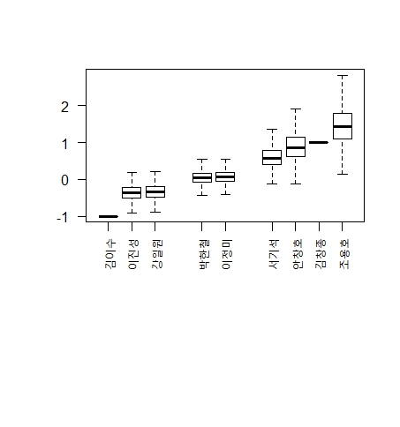
Estimated political orientation of 9 constitutional court judges
Notes:
각 판사들의 ideal point distribution상에서 중앙값을 기준으로 진보부터 보수까지 정렬한 것입니다.

Slide 38
Baseball Case: Pitch by pitch data in KBL

Slide 39
Pitch by pitch data in KBL
(#judged strikes)/(#thrown into the target)
size of target relative to strike zone

Slide 40
Pitch outcome prediction: Deep Learning (Tensorflow, 0.7mil. pitch by pitch observations)
Hidden layer 1
Hidden layer 2
Input layer
Output layer
pitch
game
M1
P_{looking}
M2
pitcher
hitter
…
P_{hit}
M3
Prev. pitching
…
…

Slide 41
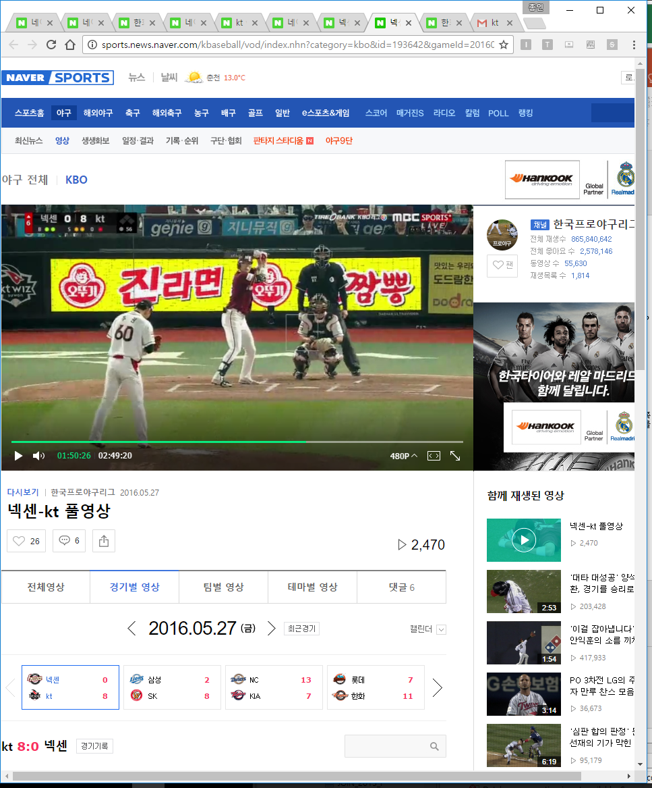
Pitch outcome prediction: Deep Learning
Prediction from Deep Learning NN
Fast ball after fast ball
Slider after fast ball
0.070 | 0.149 | 0.197 | 0.152 | 0.073
0.082 | 0.441 | 0.524 | 0.449 | 0.235
0.039 | 0.531 | 0.642 | 0.432 | 0.249
0.014 | 0.481 | 0.535 | 0.275 | 0.231
0.002 | 0.229 | 0.159 | 0.162 | 0.036
0.087 | 0.141 | 0.109 | 0.085 | 0.039
0.129 | 0.362 | 0.468 | 0.366 | 0.172
0.090 | 0.366 | 0.564 | 0.519 | 0.214
0.045 | 0.286 | 0.447 | 0.460 | 0.233
0.011 | 0.208 | 0.147 | 0.180 | 0.078
Out-corner
Out-corner
In-corner
In-corner
Kt (home) vs. Nexen (away) on May 27, 2016
Joo, Kwon of Kt pitching to Lim, Byungwook
Real pitch: fast ball and being hit
Slider after fast ball recommended!

Slide 42
Other Useful Tools
Bayes rule
Regularization
Sample split
Regression and Classification Tree, Forest
Thompson sampling and recommendation system

Slide 43
Future of data science
Genomics, Drug discovery:
linking school, medical, military, family records using ind. ID
Finance and marketing
Real time business cycle indicators
Behavioral finance/economics: interaction b/w info. and mood

Slide 44
Future of data science
No returning
In growing demand

