Slide 1


Presentation on prediction of bankruptcy of companies
Date- 15/04/2024
Submitted by
Channabasavaradhy Suragimath

Slide 2
Plan of presentation
Problem Statement
Goal and Objectives
Information about data
Data Pre-processing and Feature Extraction
Model Building
Result and Discussion
Conclusions

Slide 3
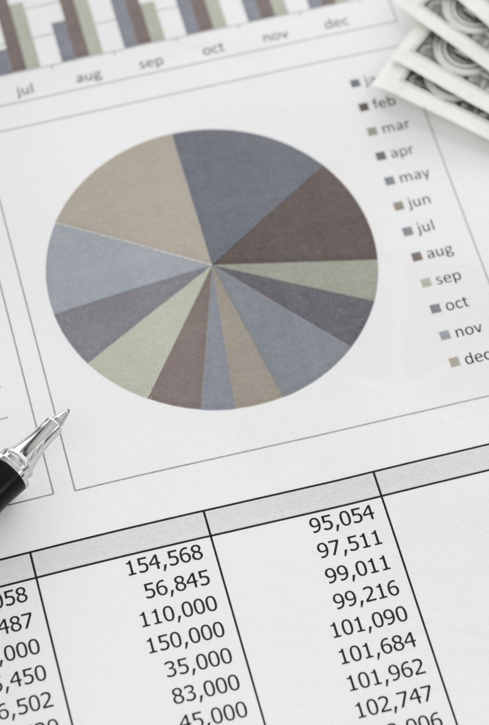
Problem statement
Aim to analyse these financial attributes and build a predictive model that can classify companies as either financially healthy or at risk of bankruptcy.

Slide 4
Goal and objectives
By leveraging historical financial data and company performance metrics, to build model that will help investors, financial analysts, and stakeholders identify early warning signs of financial distress and make informed decisions to mitigate risks of bankruptcy.

Slide 5
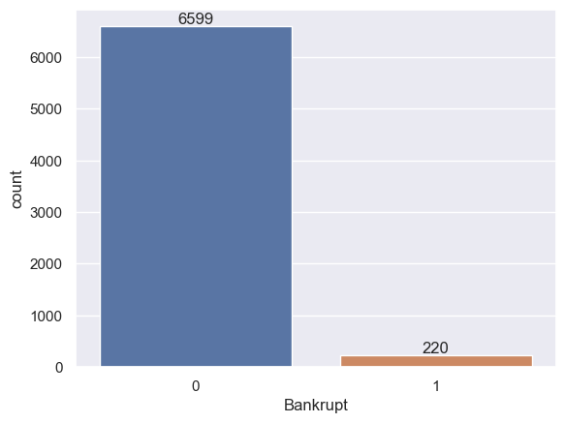
Information about data
Data set contains 6819 Rows, and 95 Columns are present
All attributes or columns are numerical only
There is no missing values present in data set
The data is classification problem
The target variable or dependent variable is ‘Bankruptcy’
0 means ‘No Bankruptcy’ and 1 means ‘Bankruptcy’
Data set is imbalance

Slide 6
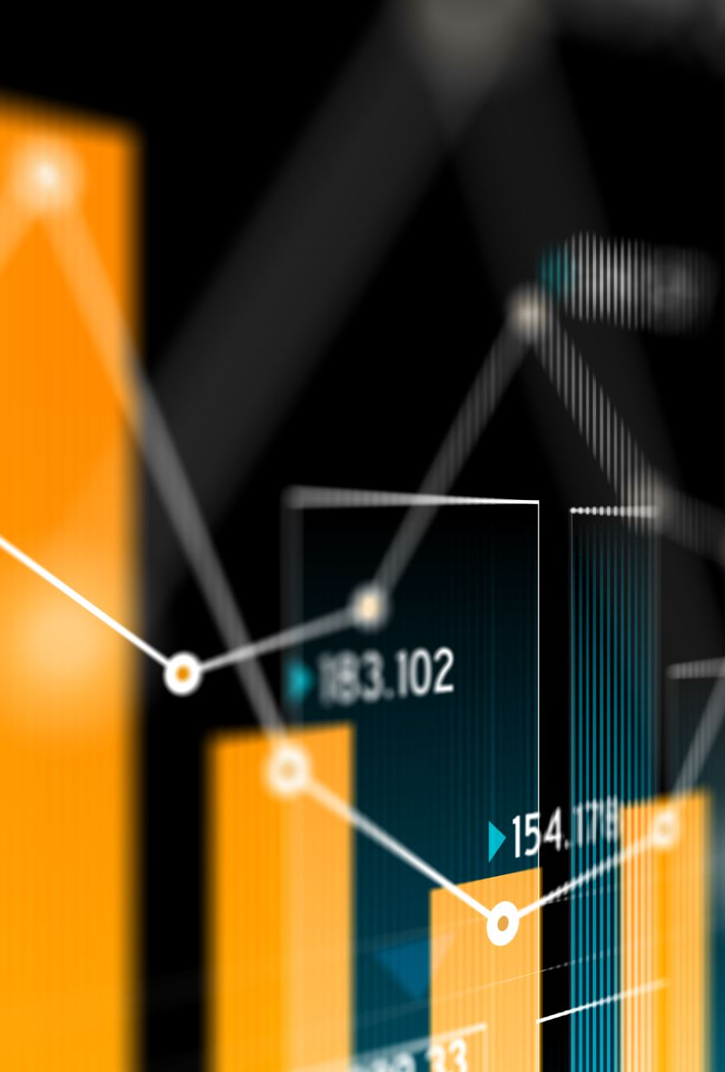
Data pre-processing and feature extraction
I have use Standard scaler for scaling the that some columns have variation in data
By using random forest, decision tree and xgboost model I extracted common main features from data set that are most important
I found that 6 most important features, i.e
Net_Income_to_Stockholder's_Equity
Borrowing_dependency
Net_profit_before_tax/Paidin_capital
Cash/Total_Assets
Nonindustry_income_and_expenditure/revenue
Net_Value_Per_Share_(B)

Slide 7

Model building
Case-1 ( with out treating the Unbalanced data)
I have use 8 algorithms i.e
KNN
Decision tree
Random forest
Xgboosting Classifier
Adboosting Classifier
Logistic regression
Support vector machine
Voting Classifier

Slide 8

continued……
I have use 20% test data and 80% of training data.
I have used 3 performance metric i,.e
Confusion matrix
Classification report
AUC_ROC score

Slide 9

continued……
Case-2 ( Making the data Balancing)
I have used (SMOTE) over sampling technique made unbalanced data into balanced data.
The I use all 8 algorithms
Then find out the best algo, using performance metrics.

Slide 10
continued……
Case-3 ( Making the data Balancing along with using PCA)
Same SOMTE method is used for balancing the data and along with reducing the unwanted attribute by using Principal component analysis.
Then measure performance metrics for all 8 algorithms.
Then find best algorithms among all 8 based on best performance metrics.
Finally build model only 6 attributes or columns find out performance metrics for all 8 algo.

Slide 11
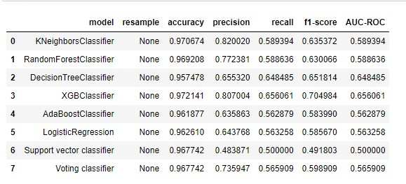
Result and discussion
Case-1 ( with out treating the Unbalanced data)

Slide 12
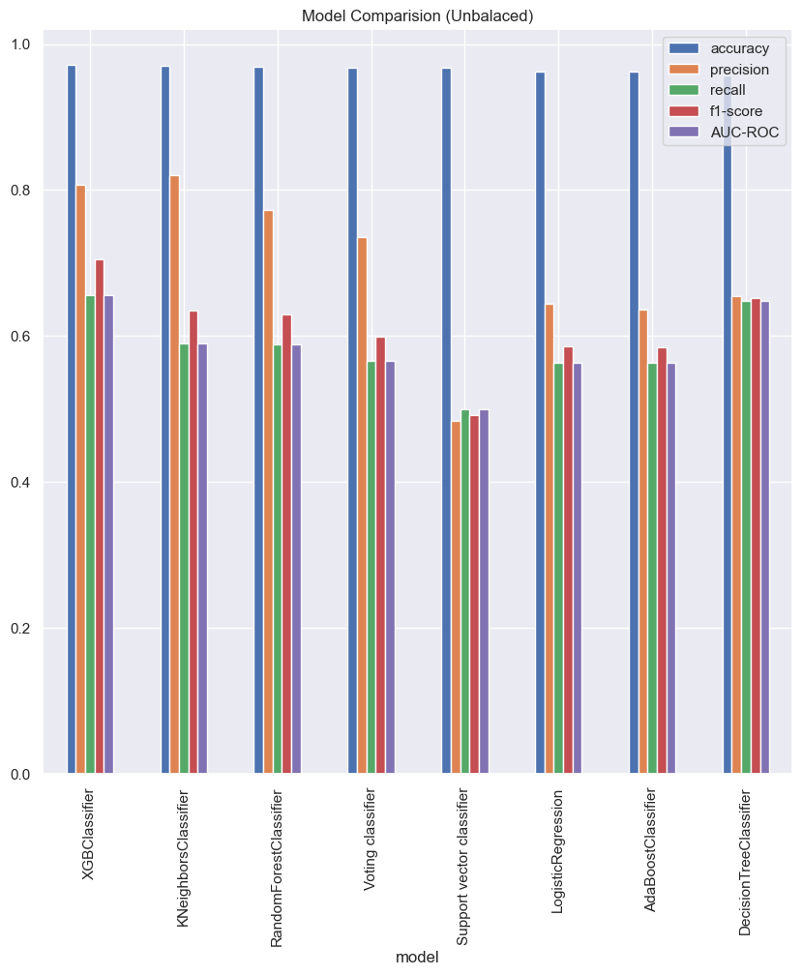
continued……

Slide 13
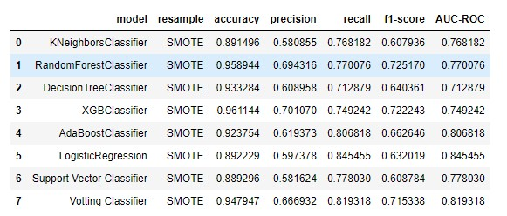
continued……
Case-2 ( Making the data Balancing)

Slide 14
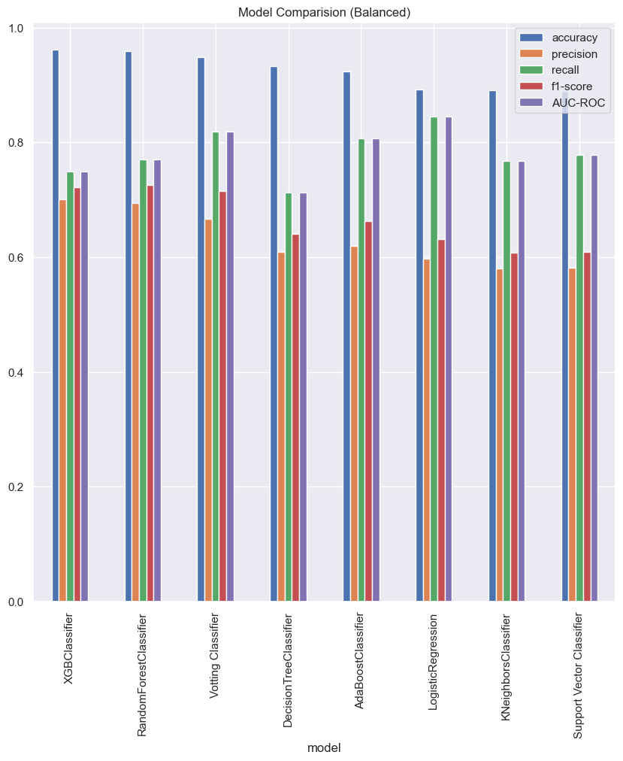
continued……

Slide 15
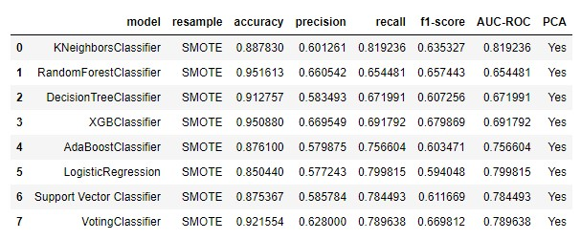
continued……
Case-3 ( Making the data Balancing along with using PCA)

Slide 16
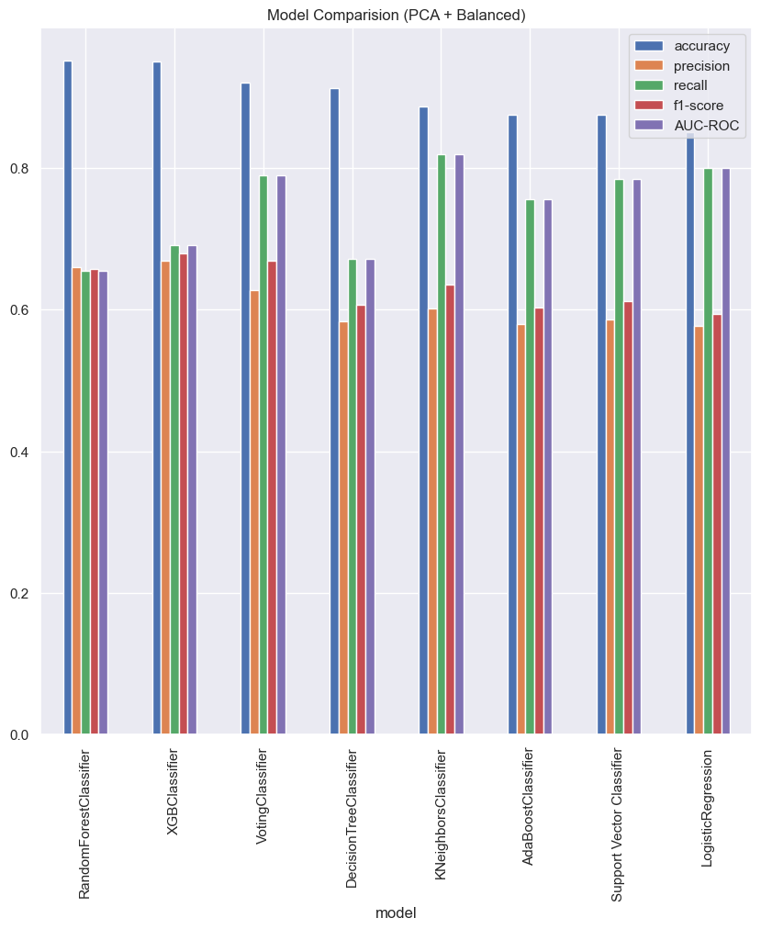
continued……

Slide 17
continued……
Important features only (XGBoost Classifier)
Model | Re Sample | Accuracy | Precision | Recall | F1-score | AUR-ROC | PCA
XGBoost Classifier | SMOTE | 0.93 | 0.64 | 0.78 | 0.68 | 0.78 | No

Slide 18
Conclusions
First, I tried without balancing the set that will give poor results in AUC-ROC score,precision,recall,and f1-score .
From result I found that balancing the data will give better results in AUC-ROC score,precision,recall,and f1-score .
From all 8 algorithms I found that XGBoost classifier will give highest results among all 7 algorithms.
Then I found PCA along with SMOTE this will give better results also in that random forest give highest performance metrics then second one is XGBoost classifier.
Finally, I extracted 6 features using features important technique using DT, RF, XGB.
Then build model on top of 6 features I found 93% of accuracy. Only 6 features give 93% of accuracy this means anyone features variation that will affect the dependent variable(“Bankruptcy”).

Slide 19
continued……
These 6 attributes most significantly affect the companies may go done “Bankruptcy” there is variation in these attributes.
Net Income to Stockholder’s Equity : The net income to stockholders' equity ratio, also known as the return on equity (ROE) ratio.
Borrowing dependency : Cost of Interest-bearing Debt
Net profit before tax / Paid in capital : Pretax Income/Capital (profit obtained by the current core operations)

Slide 20
continued……
Cash / Total Assets : This ratio measures the proportion of a company's total assets that are held in the form of cash.
Non industry income and expenditure/revenue (Net Non-operating Income Ratio):
Net Value Per Share(B) : The ratio of a firm's common equity divided by its number of shares outstanding.

