Slide 1
Shree Shanti Bhagawati Secondary School(Engineering) (Letang ,4 Morang)
Presentation on:
FCA
Submitted by: Submitted to:
Pratik Dahal Sagar Bhandari
Raji BK Department of
Saphal Khatiwada Engineering

Slide 2
Types of computer
Computers are classified on the basis of size, model, brand, etc. Generally we
Classify computer on the following terms:
On the basis of size
On the basis of brand
On the basis of model
On the basis of working principal
On the basis of purpose

Slide 3
On the basis of size
There are four types of computer on the basis of size. they are:
Super Computer
Mainframe Computer
Mini Computer
Micro computer

Slide 4
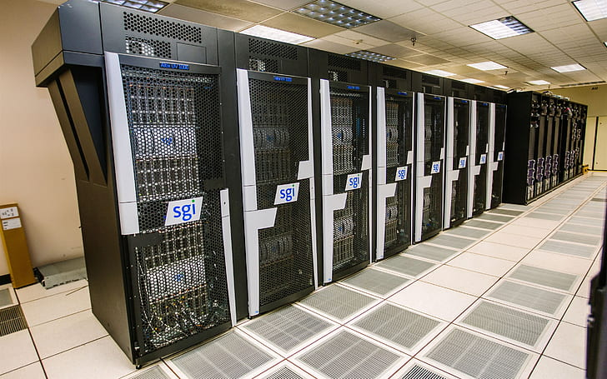
Super Computer
They are fastest, powerful and expensive computer among digital computer.
They are special purpose computer and capable of handling huge amount of calculations and data.
They are highly used for weather forecasting, climate research, molecular modeling, animated graphics, etc.
They aren’t used for transaction processing.
Example: Deep Blue, CM 5, PARAM, AURAG, etc.

Slide 5
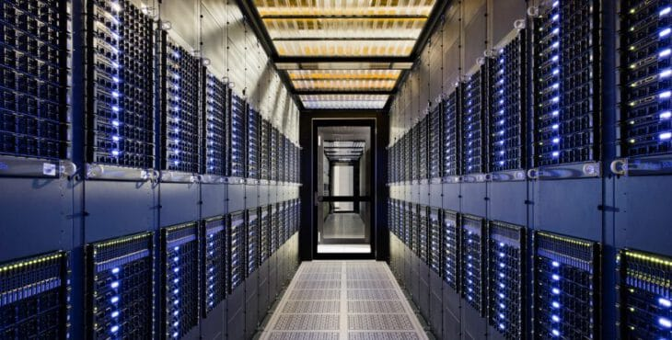
Mainframe Computer
This computer supports about 100 users at a time. Each user could use different application.
Because of single machine used by multiple users, information could be shared among the users conveniently.
Because of central executing station, any problem caused by a user disturbs all the users.
It has massive data storage capacity.
Example: IBM 1401, DEC 10, NEC 610, CYBER, etc.

Slide 6
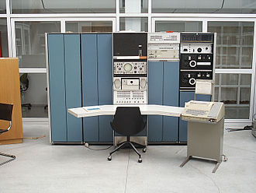
Mini computer
This computer had up to 50 terminals.
This is single administration like mainframe computer.
They were used by mid-range organization, business personnel, universities, etc.
These computers were mainly developed by IBM, DEC, HP, etc.
Example: HCL, VAX series, DEC, PDP series, etc.

Slide 7
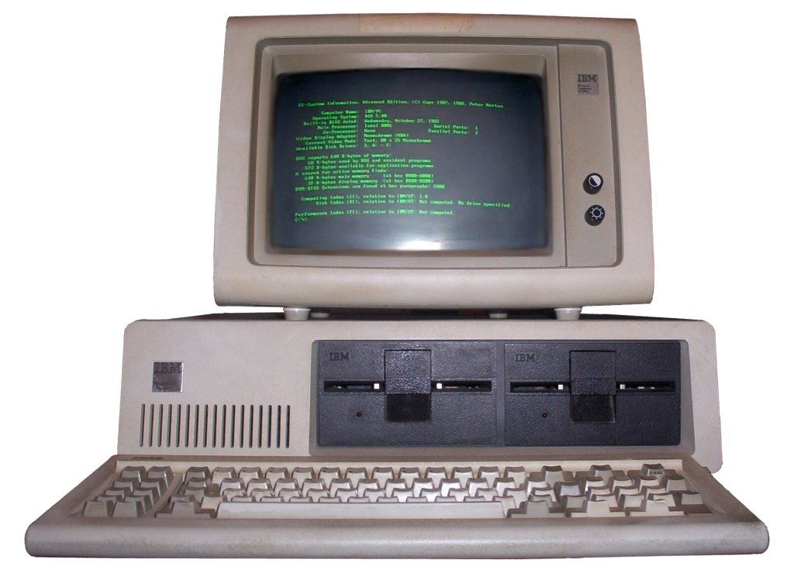
Micro Computer
As it is smaller in size, it could be kept on top of palm, lap or desk.
This type of computers are less expensive so that ordinary people can also afford it.
These computer support multitasking, multimedia and networking.
Due to their low cost they can be used at home, small business, colleges, general stores, etc.
Examples: IBM Pentium Pc, Apple/Macintosh, sun spark work station, etc.

Slide 8
On the basis of brand
There are three types of computer on the basis of brand:
IBM PC
IBM Compatible PC
Apple/Macintosh Computer

Slide 9
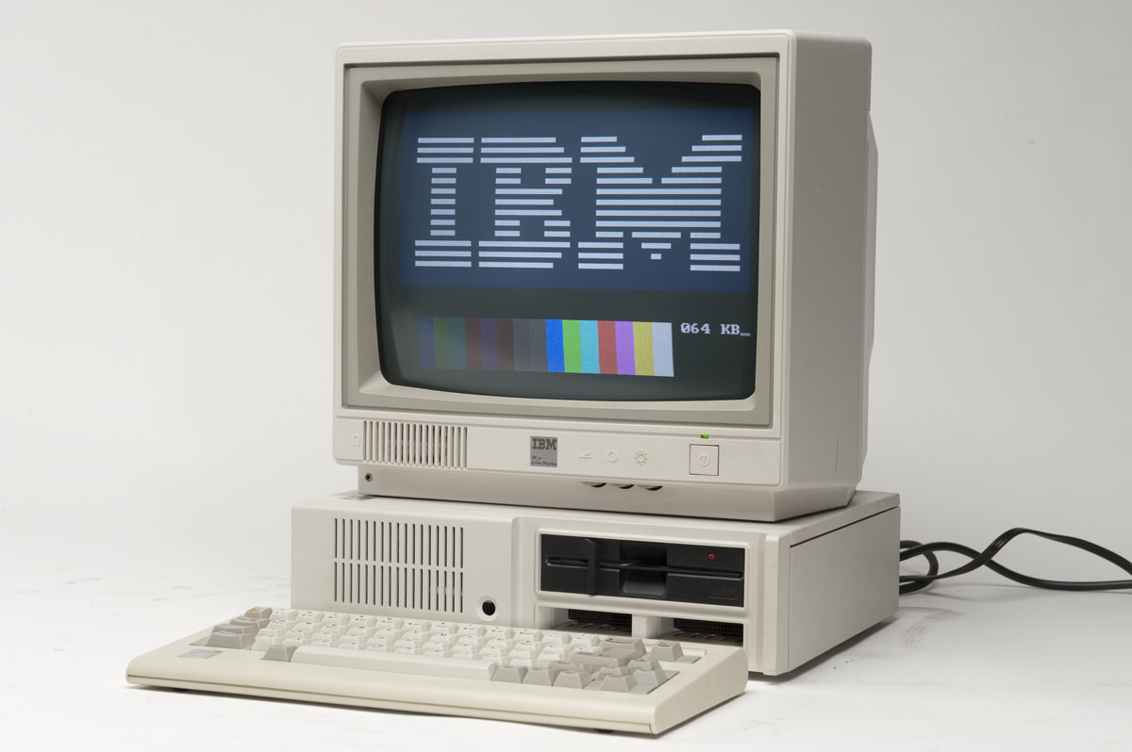
IBM PC
They are also known as original IBM.
It is expensive but more reliable than IBM compatible.
Because it is expensive only large organization.
Example: IBM desktop, IBM 1401, IBM Laptop, etc.

Slide 10
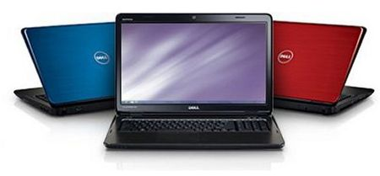
IBM Compatible PC
They are also known as assembled or duplicate IBM.
They are cheaper but less reliable than IBM PC.
Because of low cost it is used by small organization.
Example: HP Laptop, Dell notebooks, etc.

Slide 11
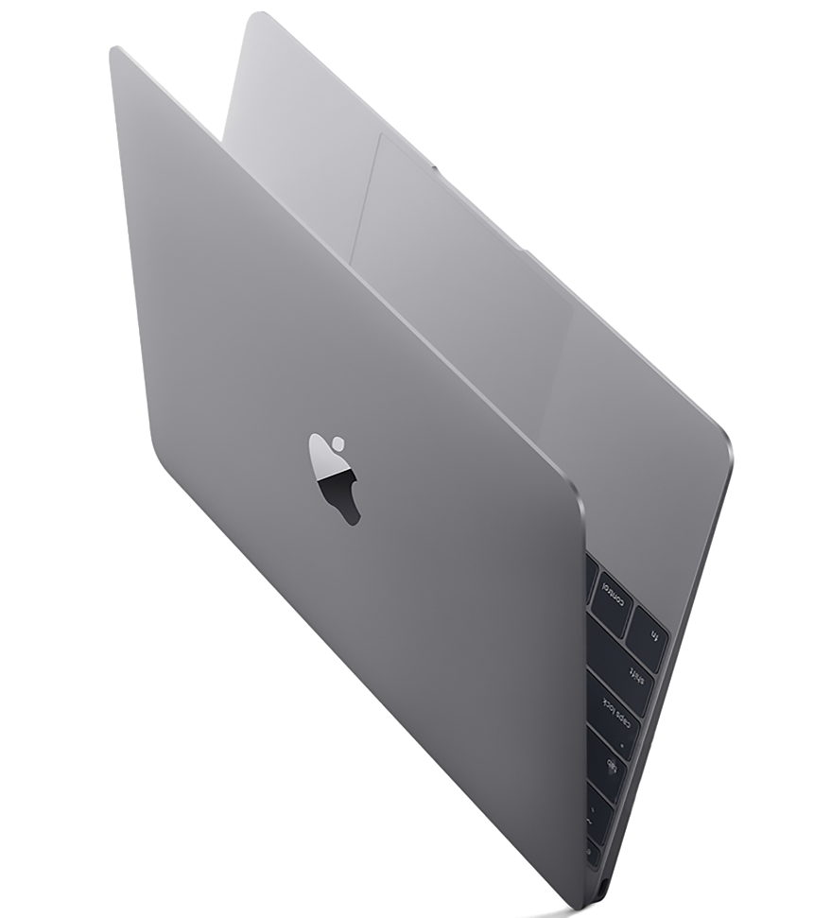
Apple/Macintosh Computer
They are also known as Mac computer.
They have their own Operating system i.e Mac operating system.
It is costlier than IBM Computers.
Example: Mac book

Slide 12
On the basis of model
There are three types of computer on the basis of model:
XT Computer
AT Computer
PS/2 Computer

Slide 13
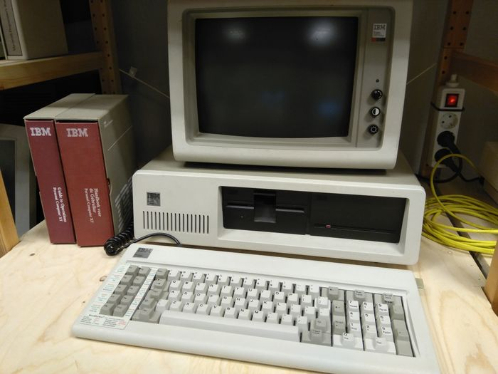
XT Computer
It stands for Extended Technology.
It is an old technology which has slow processing speed.
It was text based system with no GUI.
Processors like intel 8080, 8086,etc use this technology.

Slide 14
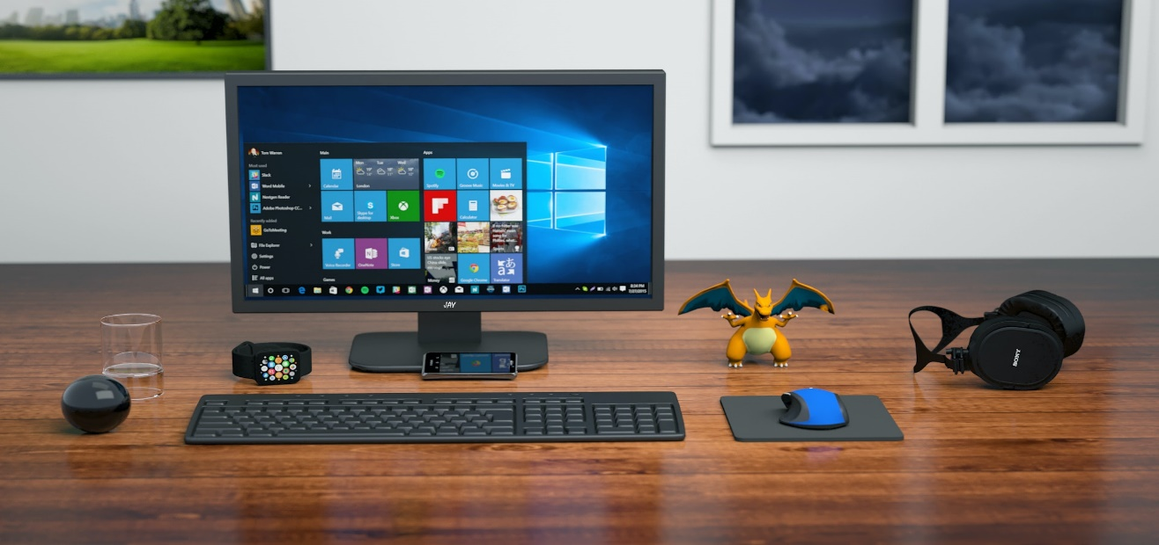
AT Computer
It stands for Advanced Technology.
It is faster and can run both GUI and CUI.
It is a medium speed processing device.
Processors like Intel 80286, 80386,etc use this technology.

Slide 15
PS/2 Computer
It stands for Personal System-2.
It is modification of AT computer, making the computer faster than AT.
It was mostly used in laptops.

Slide 16
On the basis of Working Principal
There are three types of computer on the basis of working principal:
Analog Computer
Digital Computer
Hybrid Computer

Slide 17
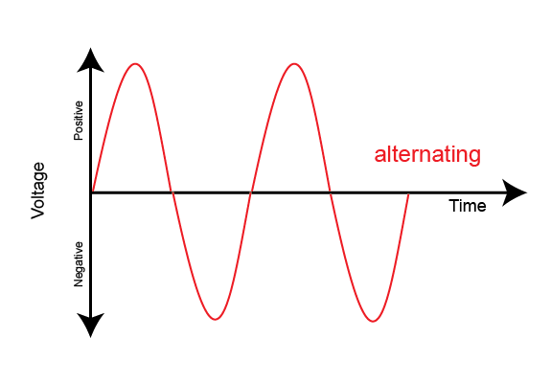
Analog Computer
It can process continuous data.
It is special purpose computer and mainly used for scientific work.
It measure physical values like electric voltage, hydraulic pressure, temperature through analog devices.
It produces analog signal.
Example of analog computer is Presley and example of analog devices are thermometer, barometer, etc.

Slide 18
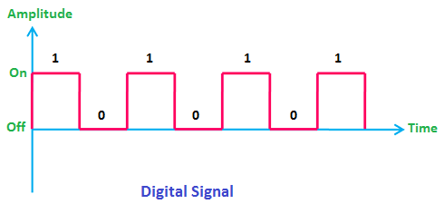
Digital Computer
It works on discrete data.
It is a multipurpose and programmable device.
It is used to run many different things such as Space crafts, Factories, healthcare, etc.
It produces digital signal.
Example: IBM PC, MAC, palmtop, Desktop, mobile, etc.

Slide 19
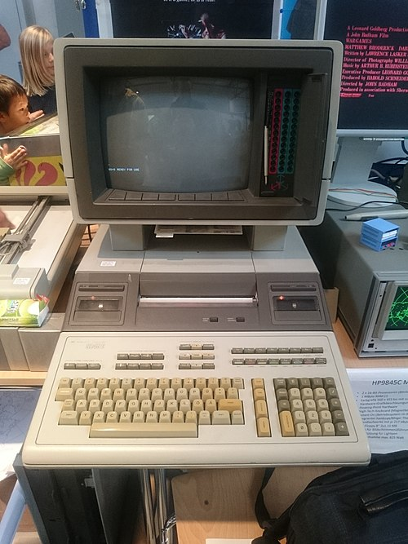
Hybrid Computer
It is a computer which has combined feature of analog and digital computer.
It can convert analog signal into digital signal and digital signal into analog signal.
It is special purpose computer.
It is mostly used in airplane, rocket launching, weather forecasting, etc.

Slide 20
On the basis of Purpose
There are two types of computer on the basis of purpose:
General Purpose Computer
Special Purpose Computer

Slide 21
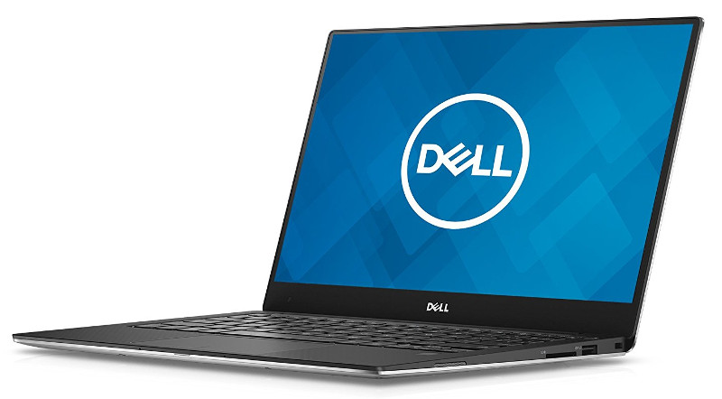
General Purpose Computer
It can be used for multiple tasks.
They are versatile computers.
They are used for different tasks such as preparing document, playing games, watching movies, etc.
Example: Desktop PC, Laptop, Notebook PC, etc.

Slide 22
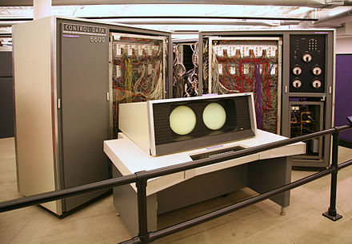
Special Purpose Computer
It is used for particular task only.
They are designed to handle specific problem.
They are used for controlling automated industry, weather forecasting, etc.
Example: Super computer, Presley, etc.

Slide 23
The end

