Slide 1




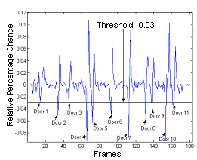
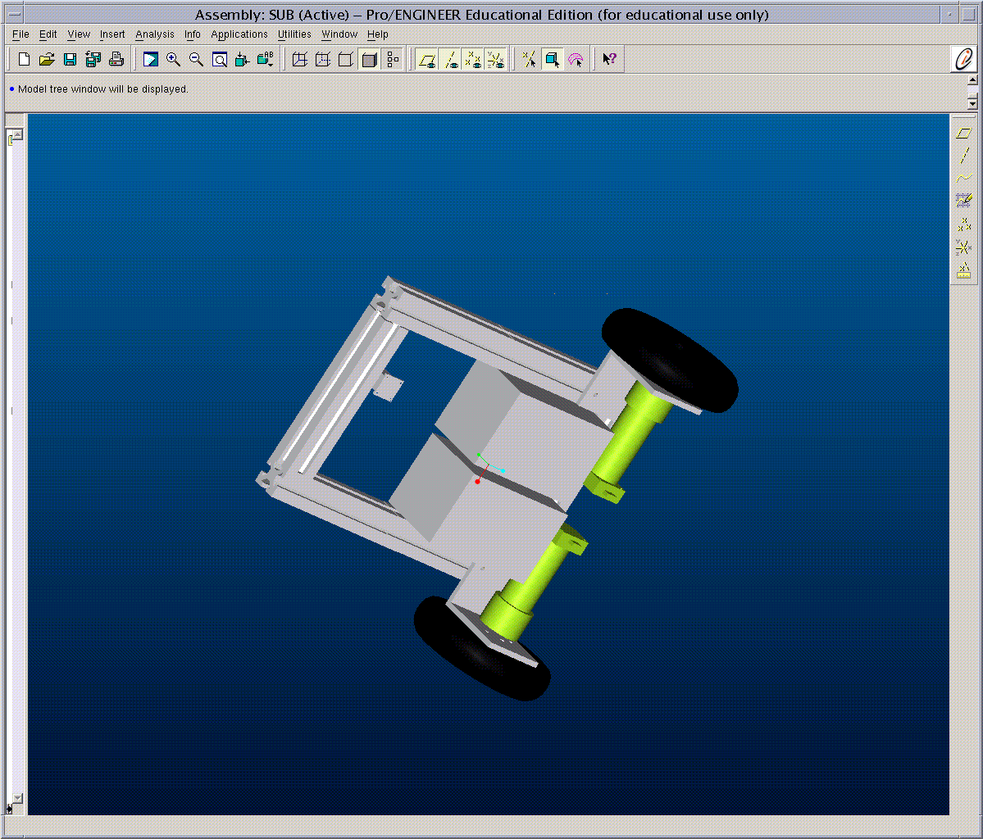
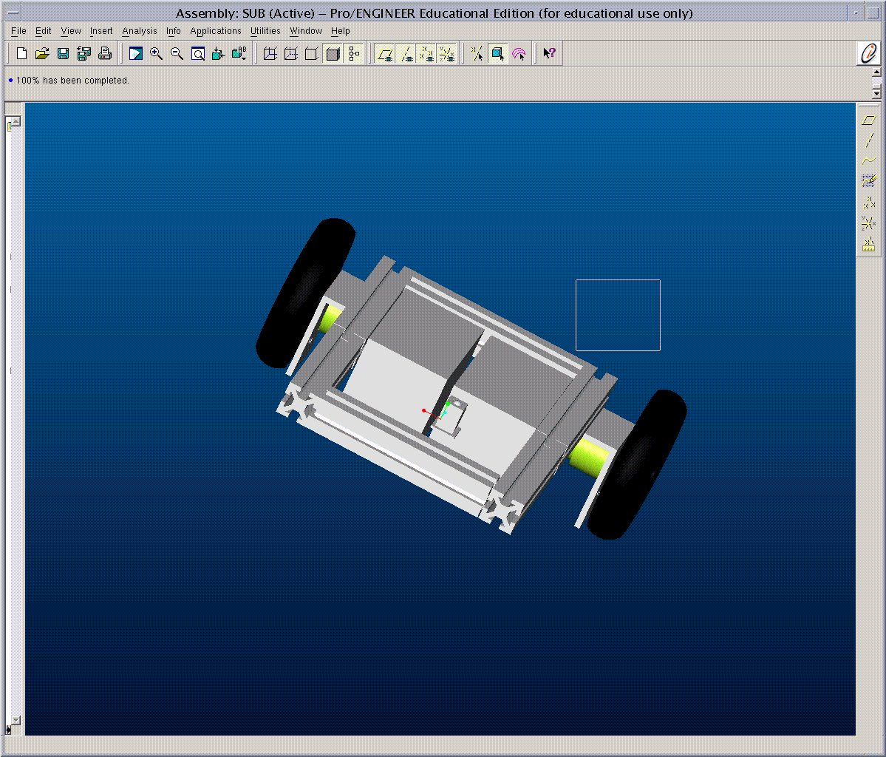
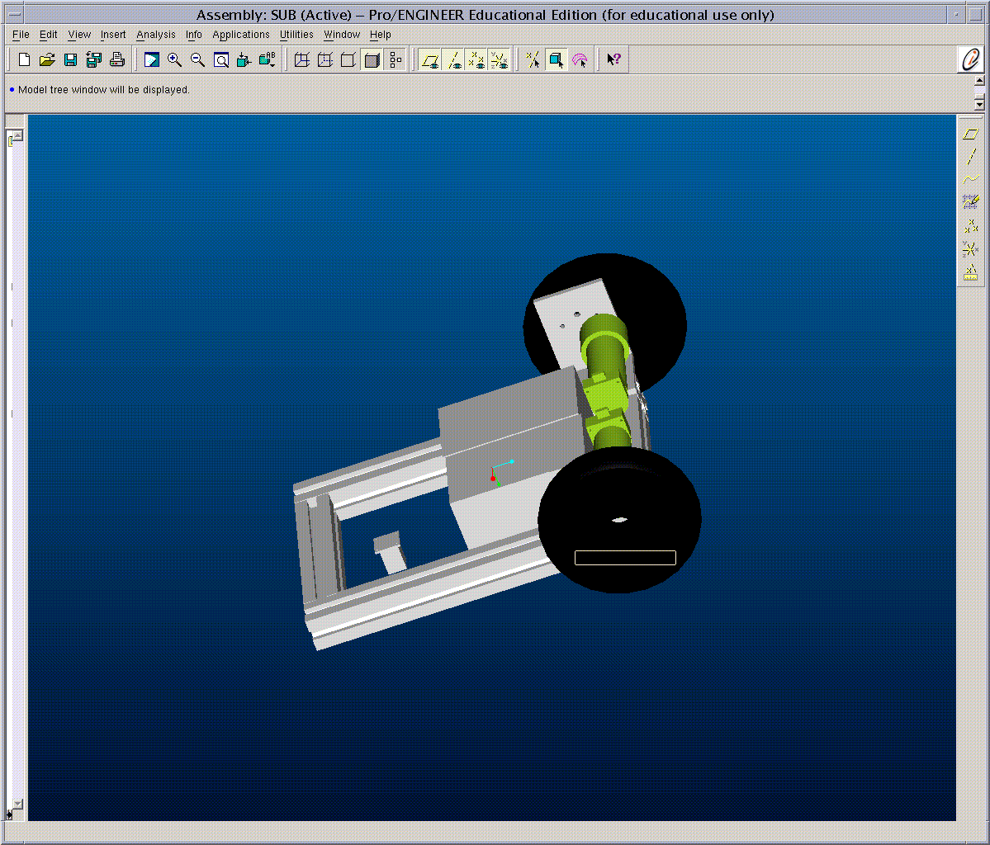
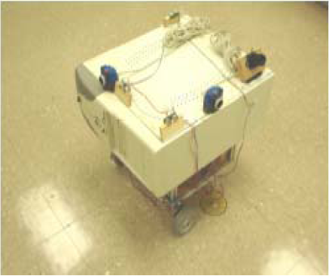
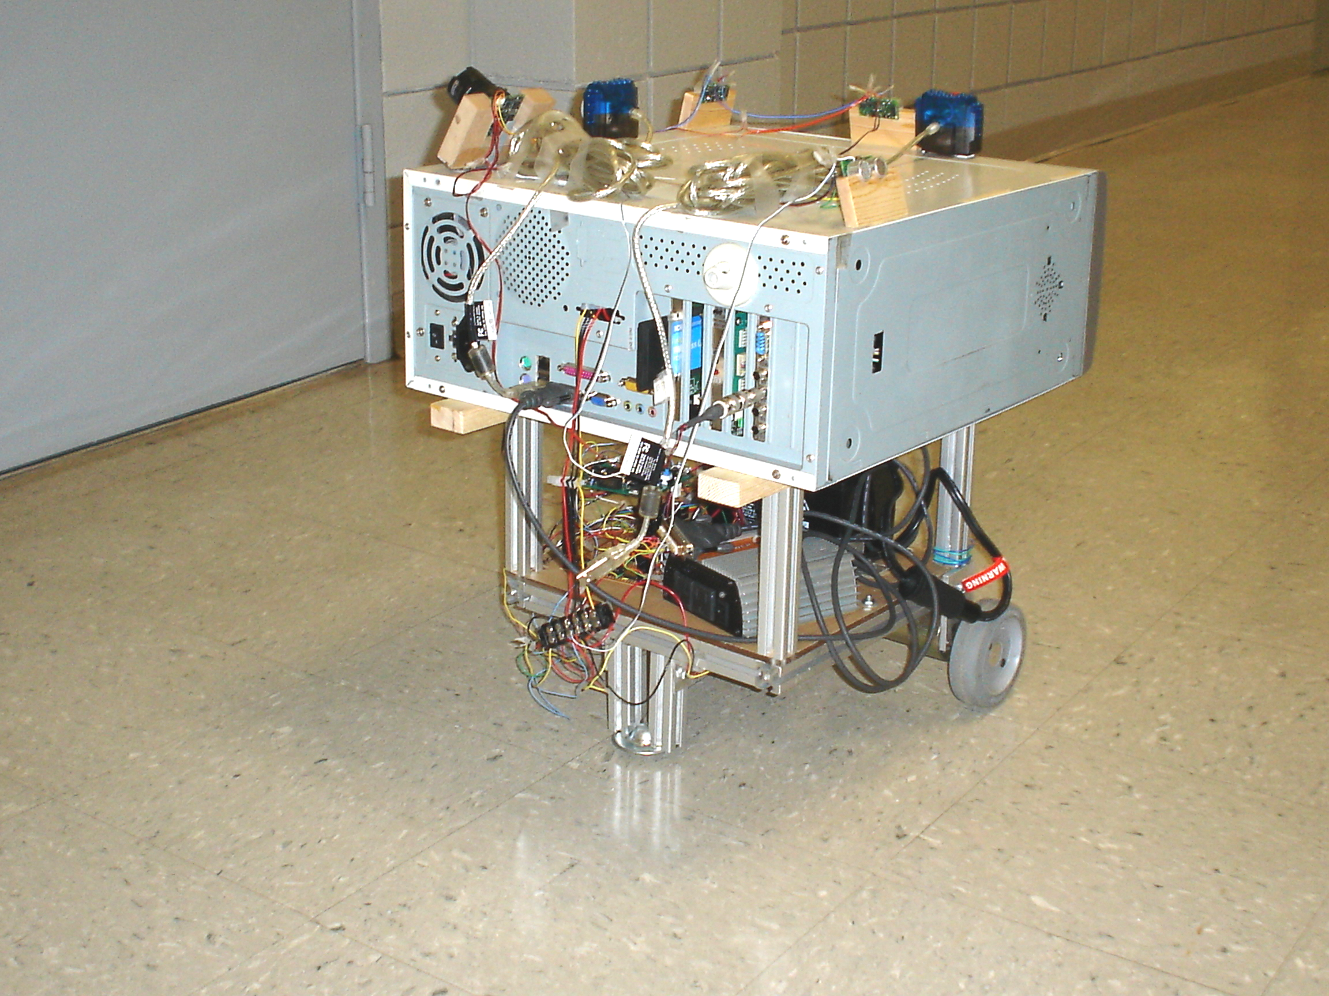
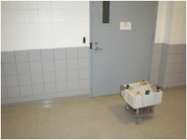
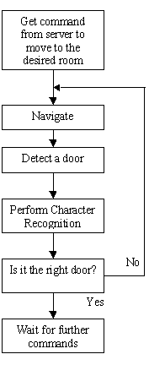
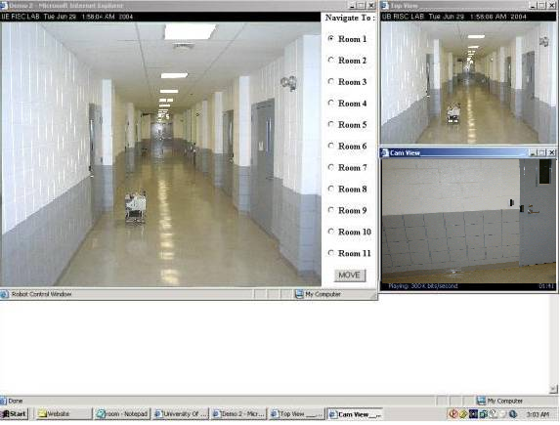
Online Survey System
Roert Johson, YYYYY XXXXX, Advisor: Dr. Wook-Sung Yoo
Division of Computer Science, Marshall University, WV.
Abstract
Image Processing Module
This paper describes RISCBOT an experimental 802.11b - enabled mobile autonomous robot built at the RISC Lab of the University of Bridgeport. RISCBOT localizes itself and successfully fulfills www - enabled online user requests and navigates to various rooms, employing a visual recognition algorithm. This article describes the mechanical design, hardware and software algorithms of the robot, and the web - based interface for communicating with the robot.
The door recognition algorithm is computationally fast, so that doors can be recognized in real time and appropriate commands can be sent to the Navigation module to stop the robot in front of the desired door. Our algorithm employs edge detection to differentiate between the wall and the door. As the walls are rougher, the edges can be easily detected by selecting an appropriate order for the filter.
We used various filtering techniques for edge detection. Best results were obtained using a Gaussian – Laplacian filter also commonly known as the Log filter, with an order of 1.7. The order of the filter should be carefully selected, since with the increase in order of the filter, undesired and very minute edges show up.
This module is programmed in MATLAB. Images from the camera are captured on the run using the vcapg2 utility, since MATLAB 6 does not have native support for the USB port. Images are captured at a resolution of 352 x 288 pixels. The auto gain for the camera is turned off so that all the images are captured with a constant gain.
Introduction
Telerobotics (controlling robotic devices from a distance) has enjoyed a rich history. It has led to many practical applications and to a broad vision of interacting with environments far removed from the user. With the advent of the Internet, telerobotics has received a major boost.
A number of mobile robots exist in the world today, catering to online requests to navigate to a desired location. Xavier can accept commands to travel to different offices within a CMU building, broadcasting camera images as it travels. Minerva is an interactive autonomous robot that moves daily through crowds at the Smithsonian's National Museum of American History. Rhino has been deployed as a tour guide robot at Deutsches Museum in Bonn, Germany.
Theexperimental online robot we built, RISCBOT, utilizes visual room identification for localization. RISCBOT was built with the purpose of operating in a commercial office environment. RISCBOT navigates the second floor of the University of Bridgeport (UB) Technology (TECH) building and can identify eleven rooms. A network camera (AXIS) is installed at the ceiling of the second floor of the TECH building, providing the online user with a view of the robot and the different rooms. The installed wireless access point has a range of 50 feet.
Figure 7-11: Images captured by the Robot.
Mechanical Construction
Figure 12-16: Images after Edge Detection.
The initial design of the robot was implemented using Pro Engineer (ProE). The robot frame is built with T slotted aluminum extrusion rods to allow for a modular structure. A differential drive mechanism has been implemented with two 4” wheels and a caster wheel for support.
Figures 7 – 11 show a set of images captured by the camera and Figures 12 – 16 some results of the edge based door recognition algorithm. These images are converted to gray scale and then filtered to recover the edges.
A better strategy to recognize a door is to monitor the relative percentage change in the edges. When there is a drop in the relative percentage, below a particular threshold, the robot is assumed to have encountered a door. Sharp negative peaks below a threshold of 0.03 indicate doors. Figure 17 shows a plot of recognized doors. The program maintains an internal count for the doors encountered, to utilize if the door recognition algorithm fails.
Figure 1-3: Different ProE design views of RISCBOT
Two 12 V dc servo-motors (Pittman) drive the wheels. An ATM 103 MCU, inverter (purchased off the shelf) and a 12 V Panasonic SLA battery are mounted on a ¼” acrylic sheet. The PC cabinet housing the WLAN card and an NM 6403 DSP board is mounted on top of the base. Three ultrasonic sensors, two Logitech cameras and an NTSC camera are mounted on the PC cabinet. The ATM 103 MCU controls the ultrasonic sensors and the two motors.
The PC sends commands to the MCU through a serial port at 9600 bps baud rate. A MATLAB program that checks for doors runs on the PC continuously. The NM6403 DSP board performs a visual recognition algorithm when signaled by the PC. Figures 4 and 5 show different views of the mobile robot platform. Figure 6 shows a sample task performed by RISCBOT.
Figure 17: Plot showing the doors recognized.
Character Recognition
As the robot passes a door, it scans images for locating the door plate. The door images are acquired using the NTSC camera mounted on the side. Once the door plate has been located, the numeral character is extracted. The extracted character is then scaled to a standard size and topological features of the character are calculated and compared with elements of a library (trained set of features). A match of a library bit string against an input string results in the corresponding digit class being assigned to the input digit. If this digit is same as the desired door number the robot stops or else continues to move towards the desired door.
Web Interface
The web interface is an integral part of the mobile navigation and identification process. The robot can be controlled and viewed from the internet, through its website: www.bridgeport.edu/sed/risc/html/proj/RISCBOT/index.htm
Figure 4: Top view (front).
Figure 5:Top view (Back).
Figure 6: RISCBOT
accomplishes its task.
The web interface for the robot is simple, consisting of three windows: the control window, top view window and the camera view window. Figure 18 shows a view of the web interface while the robot is navigating. Once logged on, any user can send a request to move the robot to a particular door by selecting the appropriate door ID on the control window. A real time video feedback is provided as the robot broadcasts video while moving.
Navigation Module
The robot waits till it receives information from the server. Once it receives a command from the server it starts searching for the requested room.
The robot navigates along the wall to the left side of the corridor. With the help of the onboard ultrasonic sensors the robot maintains a safe distance of 45-50 cm from the wall. If the robot gets closer to the wall, it turns right, if it gets further away it turns to the left and if the distance from the wall is within 45 - 50 cm the robot continues to move straight. If the robot encounters a wall right in front of it (example, at corners), it takes a right turn.
The image processing program checks for doors continuously. Once the program detects a door, it signals the NM6403 DSP board to check for the room ID. If the room ID matches the requested ID, the robot stops. If not, the robot continues moving till it finds the desired room. Figure 7 shows the control flow diagram of RISCBOT
Figure 18: RISCBOT web interface.
Future Work
Potential future enhancements to this project include:
Designing and building pan – tilt units for the cameras.
Implementing a dc – dc (ATX power supply) converter circuit that will increase the power conversion efficiency and thereby the operational time for the robot.
Permitting the robot to recharge itself by plugging into wall outlets.
Mounting a manipulator on the mobile platform for implementing mobile
Figure 7: Control Flow Diagram

