Slide 1
Group Exercise

Slide 2
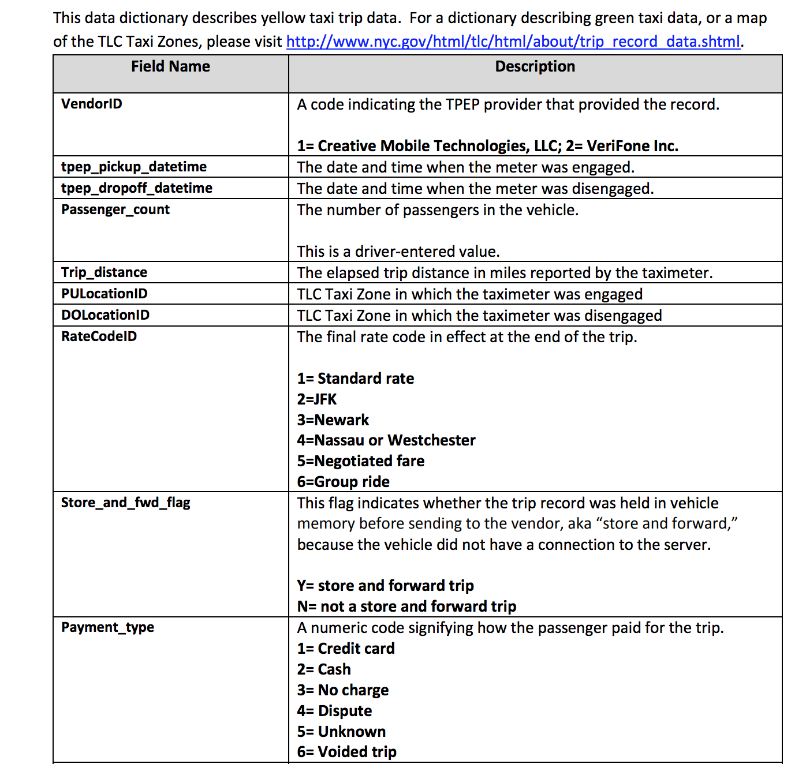

Slide 3
Assume you get
Start and end position
Distance travelled
Start and end time
Taxi identifier
Driver identifier
Fare + Tip
For all cities in the US

Slide 4
Design a system to receive these events in real time
What architecture would you use to handle the data, to support:
Building dashboards to provide both real-time and historical views
Graphical views of high-level analysis
Reports on whether drivers are exceeding hours or speed limits
A tool to help drivers find popular areas based on time of day and current location
Etc etc..

