Slide 1
Cloud Computing and Big Data NoSQL databases
Oxford University
Software Engineering Programme
July 2019

Slide 2
Contents
Why NoSQL?
ReCAP
BigTable and Dynamo
A summary of a few NoSQL databases
MongoDB, Cassandra, Couchbase,

Slide 3
Why NoSQL?
Availability
Need better scaling capabilities
Elasticity
Different schema approaches
Graphs, Key Values, Document, Sparse Columns, etc
More appropriate balance in read/write performance
Better integration with REST/SOA/Cloud

Slide 4
NoSQL history
Not just a recent thing ☺
IBM IMS (Information Management System)
Launched in 1968
Used to store the bill of materials for the Saturn V rocket
Hierarchical model
Still in widespread use today

Slide 5
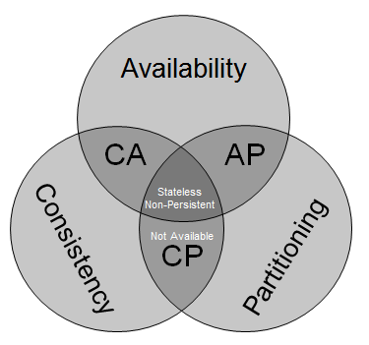
ReCAP
You can have 2 out of three:
Consistent
ACID
Available
HA / Accessible 24x7
Partitioned
Able to split into different datacentres
Survive network down
http://blog.mccrory.me/2010/11/03/cap-theorem-and-the-clouds/

Slide 6
NoSQL parents
Amazon Dynamo
Eventually consisten
Google BigTable
Supporting very large rows
LDM
Graph database

Slide 7
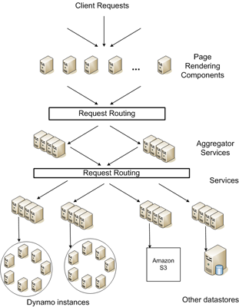
Dynamo

Slide 8
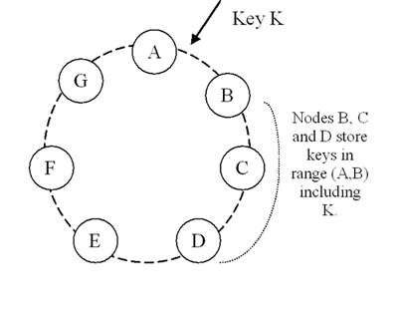
Dynamo Model
http://www.allthingsdistributed.com/2007/10/amazons_dynamo.html

Slide 9
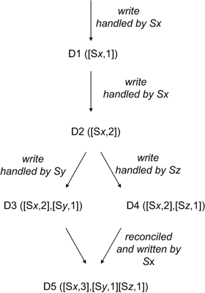
Reconciliation / Eventual Consistency
http://www.allthingsdistributed.com/2007/10/amazons_dynamo.html

Slide 10
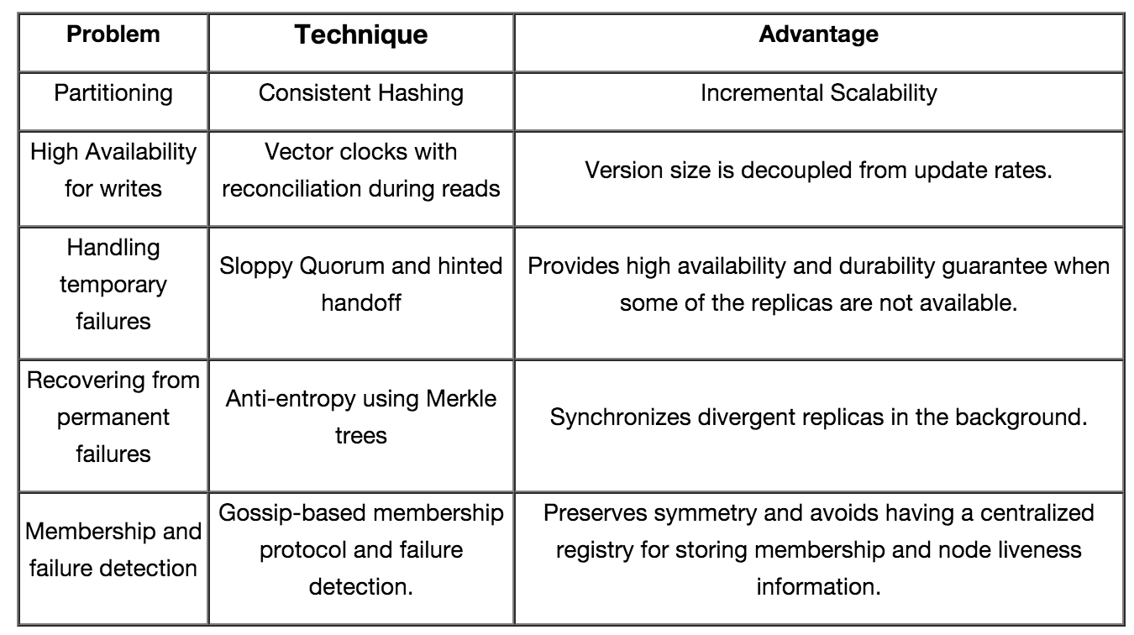
Dynamo Techniques

Slide 11
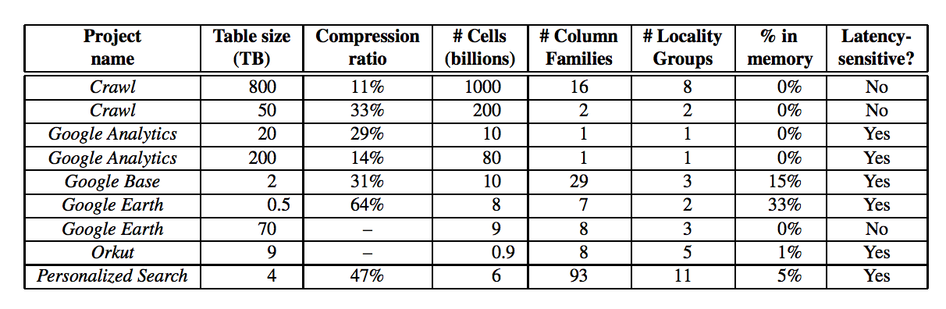
Google BigTable
Optimized to support very large data
Not just many rows, but rows that cannot fit into the memory of a single server
Column Families allow each row to live across servers
This table dates back to 2005

Slide 12
Current NoSQL Databases
Too many to list!
Popular databases include:
MongoDB
Couchbase
Apache Cassandra
Apache HBase
Voldemort
Redis
Riak
Etc, etc

Slide 13
“NewSQL”
ACID databases that aim to provide HA and Partition safety
VoltDB
NuoDB
Google Spanner
MemSQL
SAP HANA
Also there are some backend engines for MySQL that aim to provide this:
MySQL Cluster
TokuDB

Slide 14
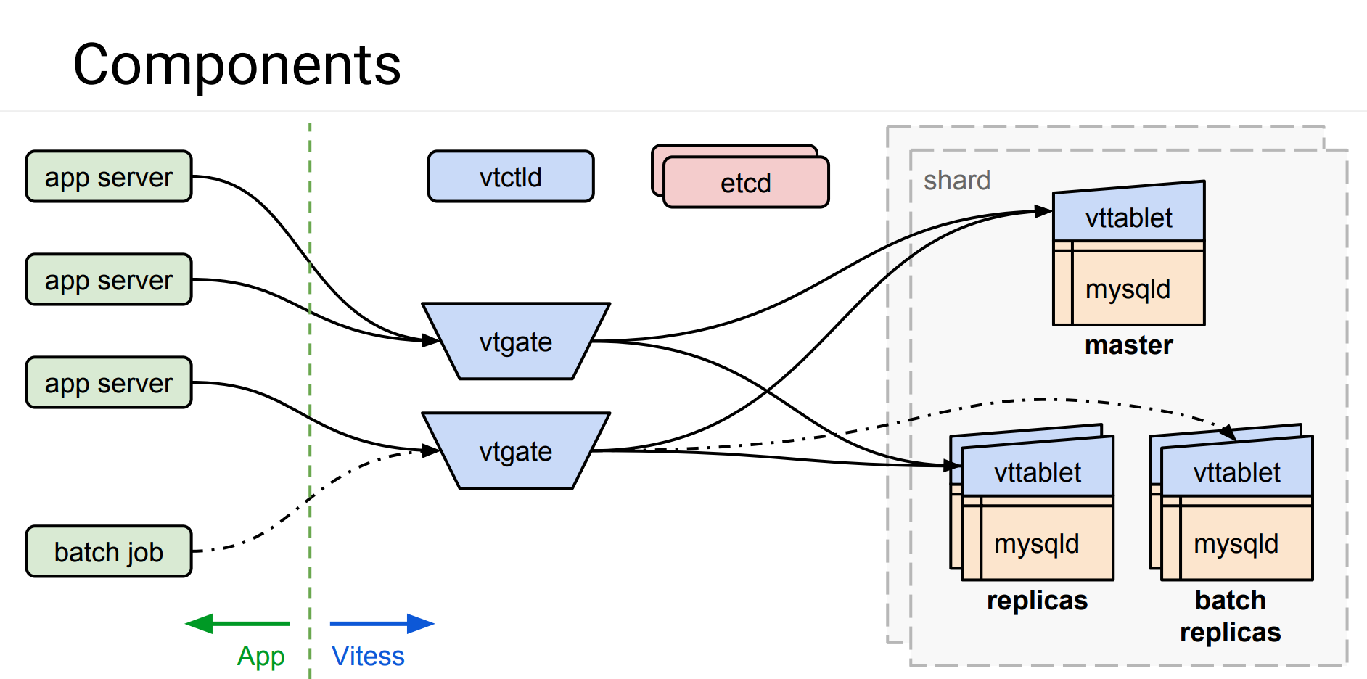
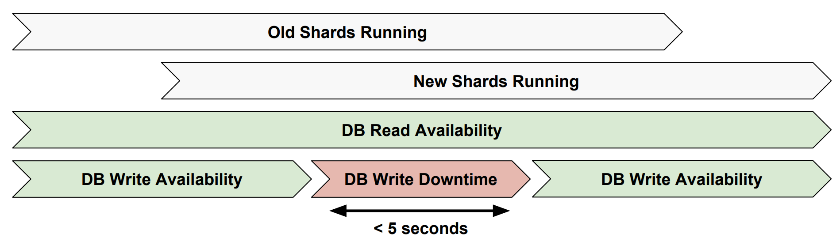
Vitess https://github.com/youtube/vitess
https://freo.me/vitess-pres

Slide 15
In Memory Databases
Memory is relatively much cheaper than it used to be
Uses snapshots or transaction logs to ensure durability
Some NoSQL, some NewSQL
SAP Hana
Redis
VoltDB
MemSQL
Apache Geode

Slide 16
Key Value databases
A persistent associative array or dictionary
Simple access and fits well with programming models (especially MR)
Indexing on other data is not often possible and can be slow

Slide 17
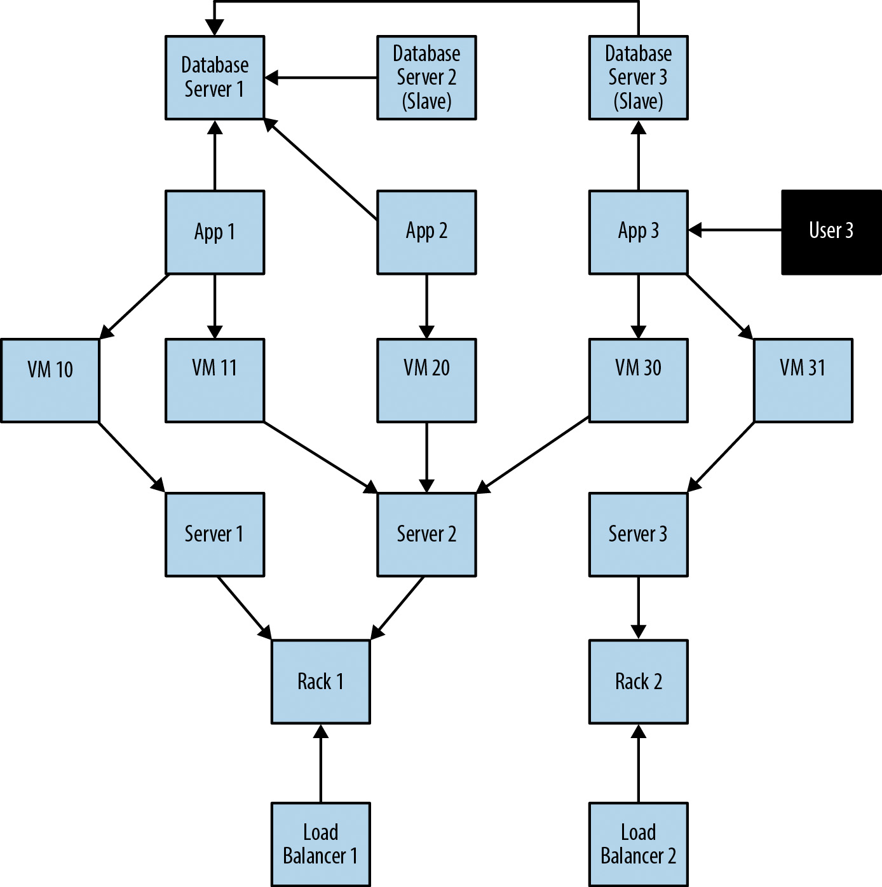
Graph Databases
Source: neo4j

Slide 18
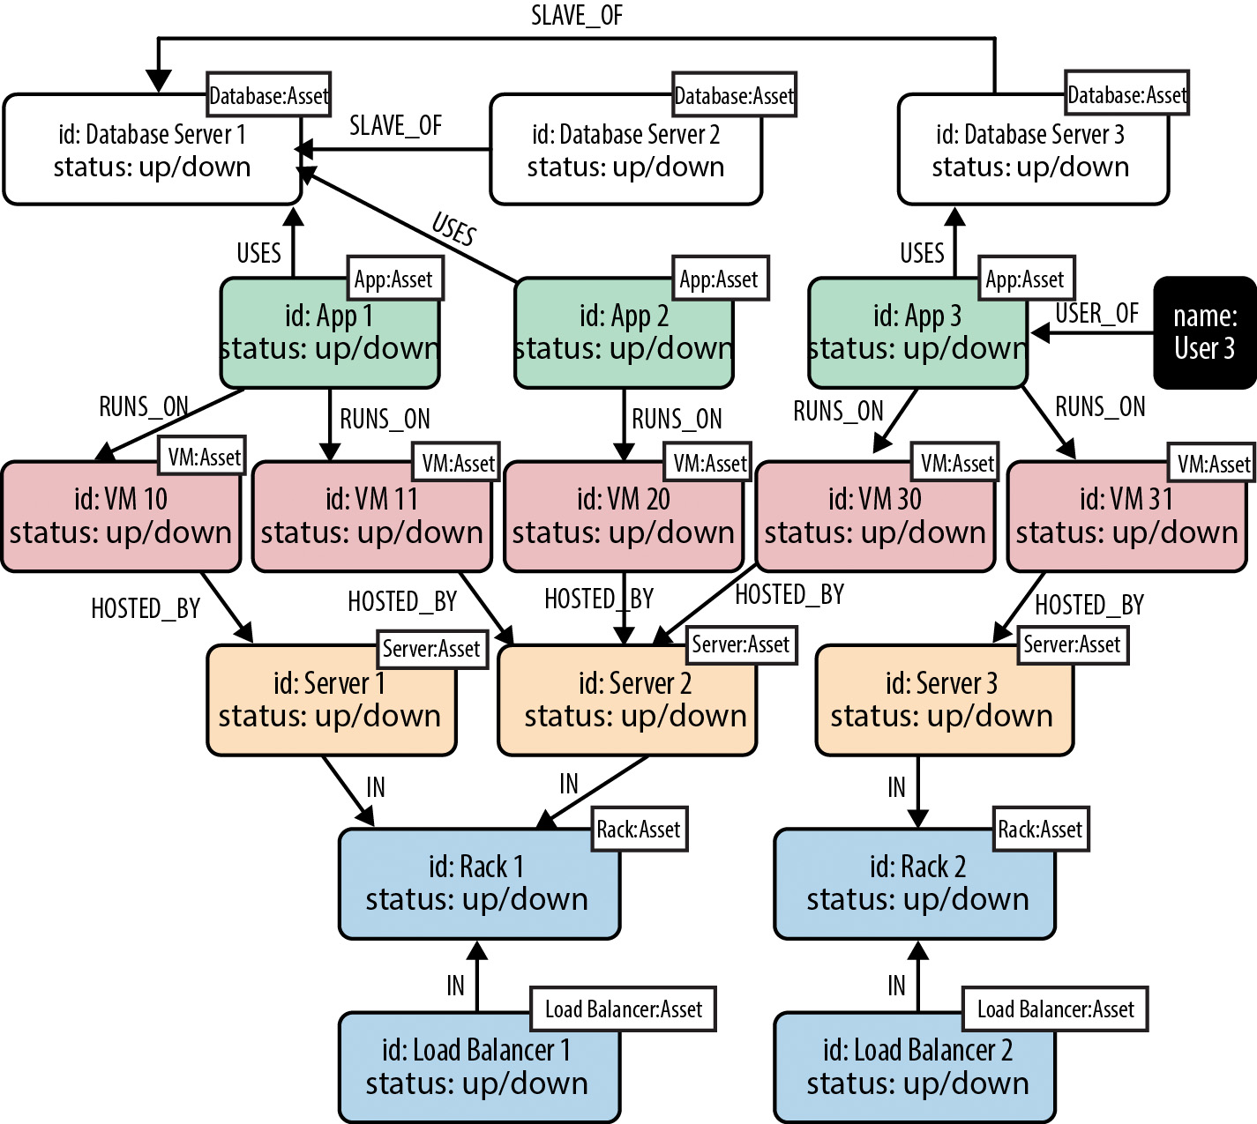
Graph Database mapping
Source: neo4j

Slide 19
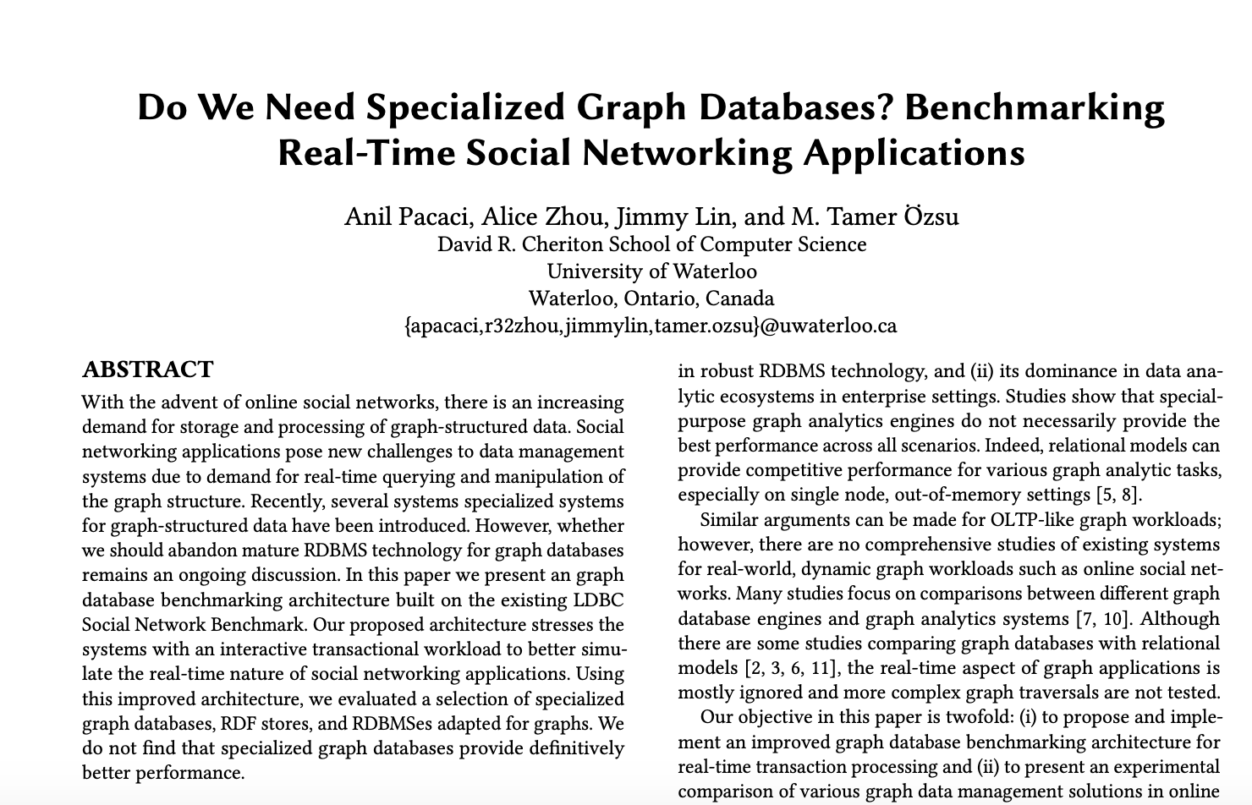

Slide 20
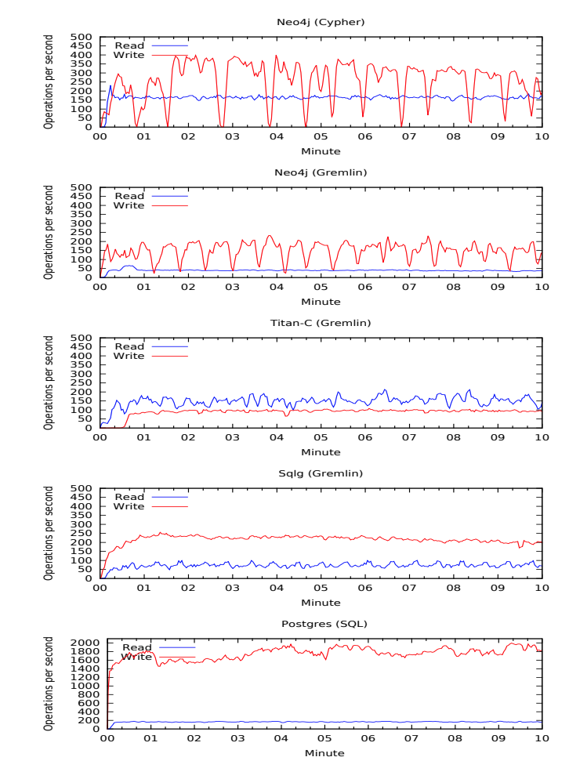
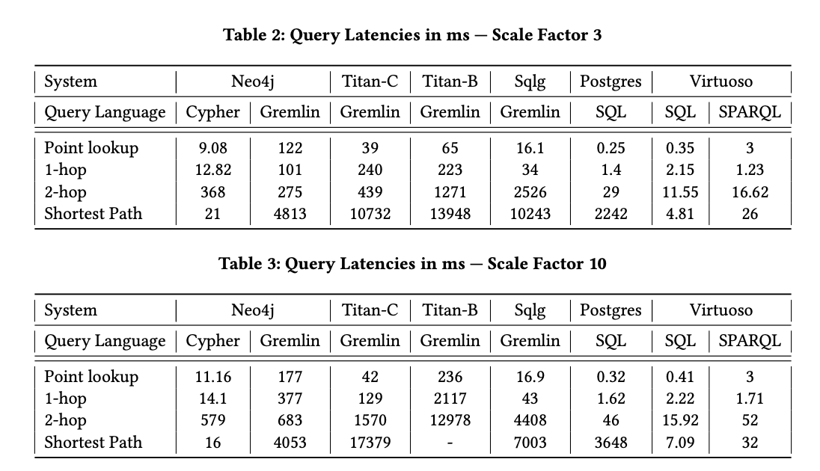

Slide 21
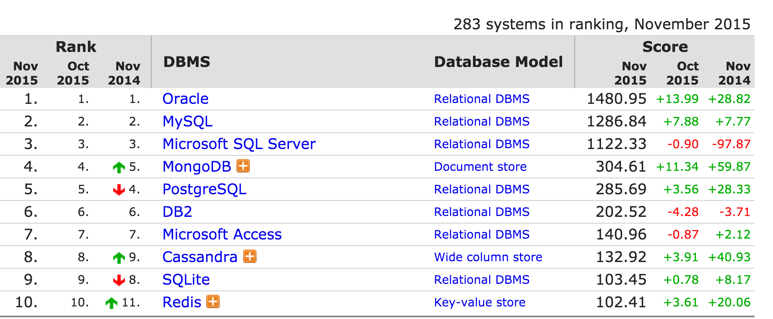
Top ten databases
http://db-engines.com/en/ranking

Slide 22
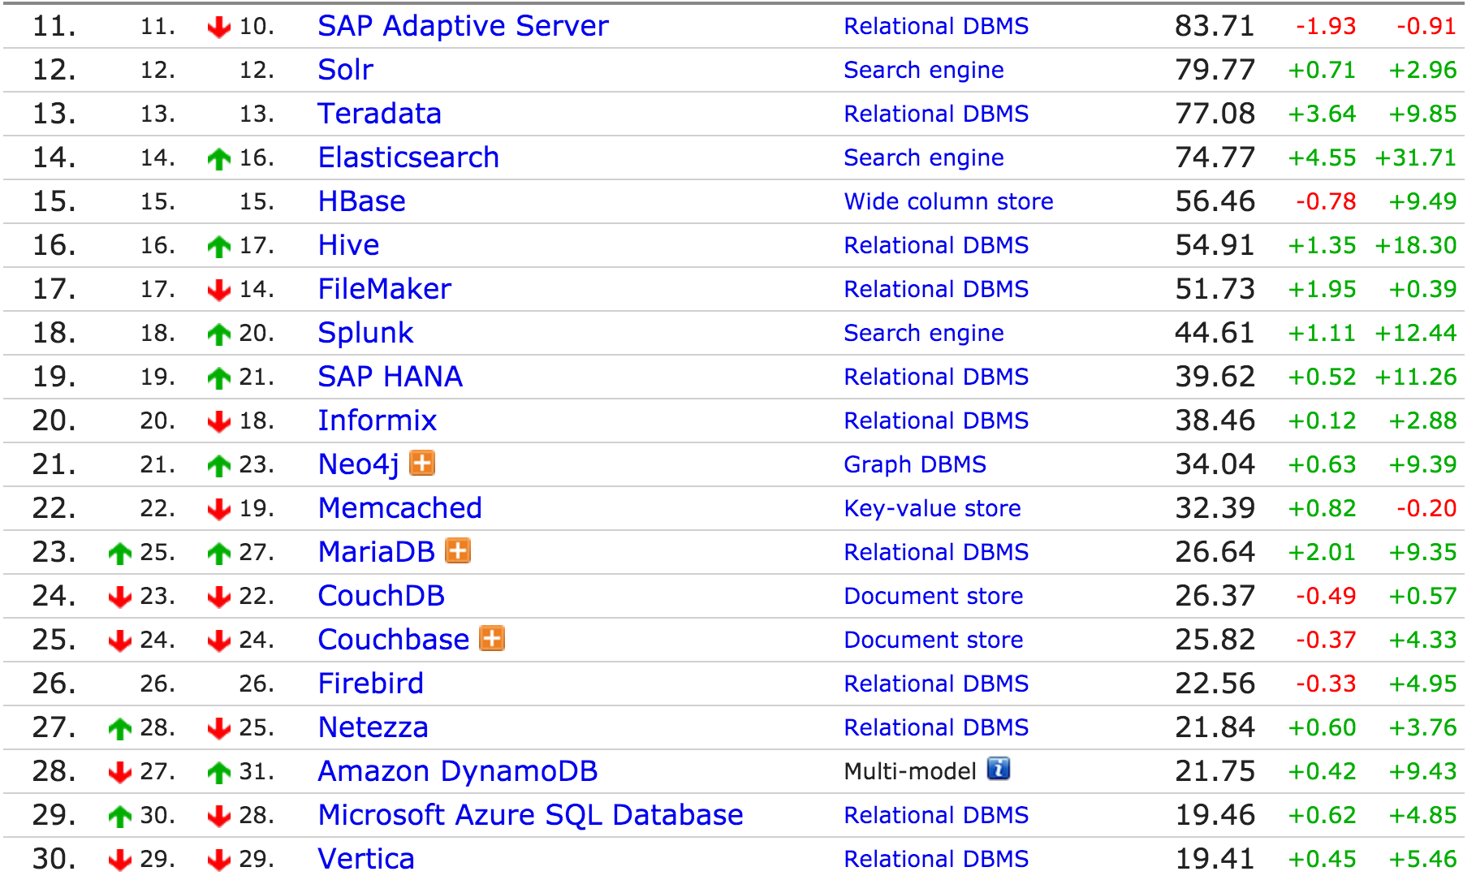
Next 20

Slide 23
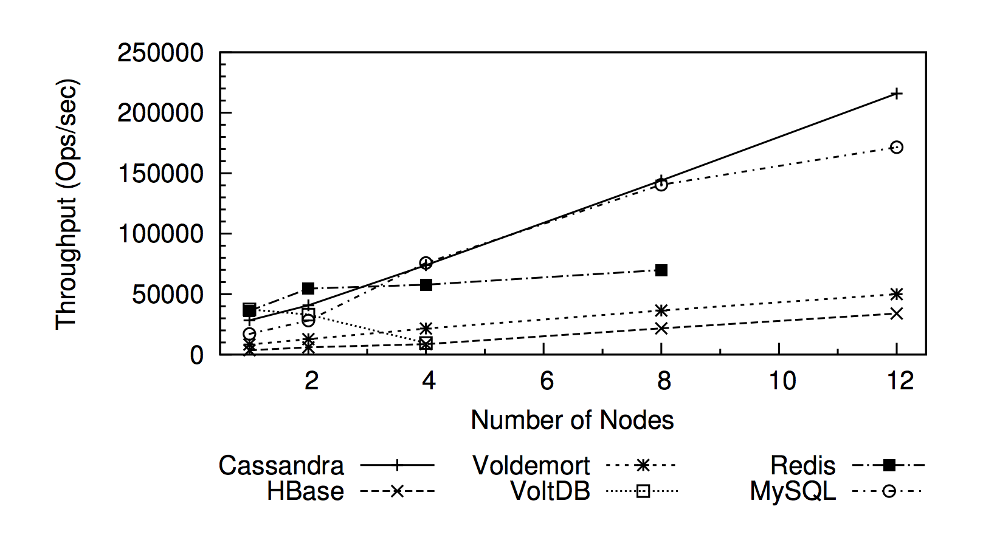
Performance (2012) 50%/50% reads/writes
Rabl, Tilmann, et al. "Solving big data challenges for enterprise application performance management." Proceedings of the VLDB Endowment 5.12 (2012): 1724-1735.

Slide 24
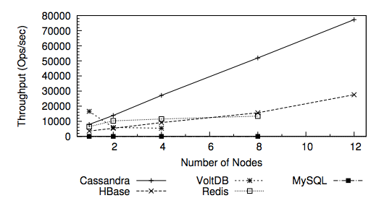
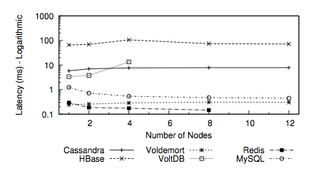
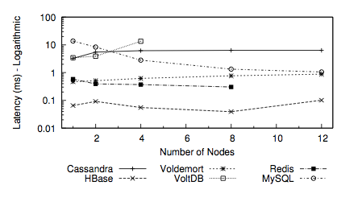
More performance (2012) Read/Scan/Write workload
Throughput
Read Latency
Write Latency

Slide 25
Summary of Performance benchmark (2012)
Cassandra had the best throughput but high latency
Voldemort had the best and most stable latency but lower throughput
HBase had low performance per node but scaled well
Low write latency
Redis, MySQL and VoltDB did not scale as well in multi-node setups

Slide 26
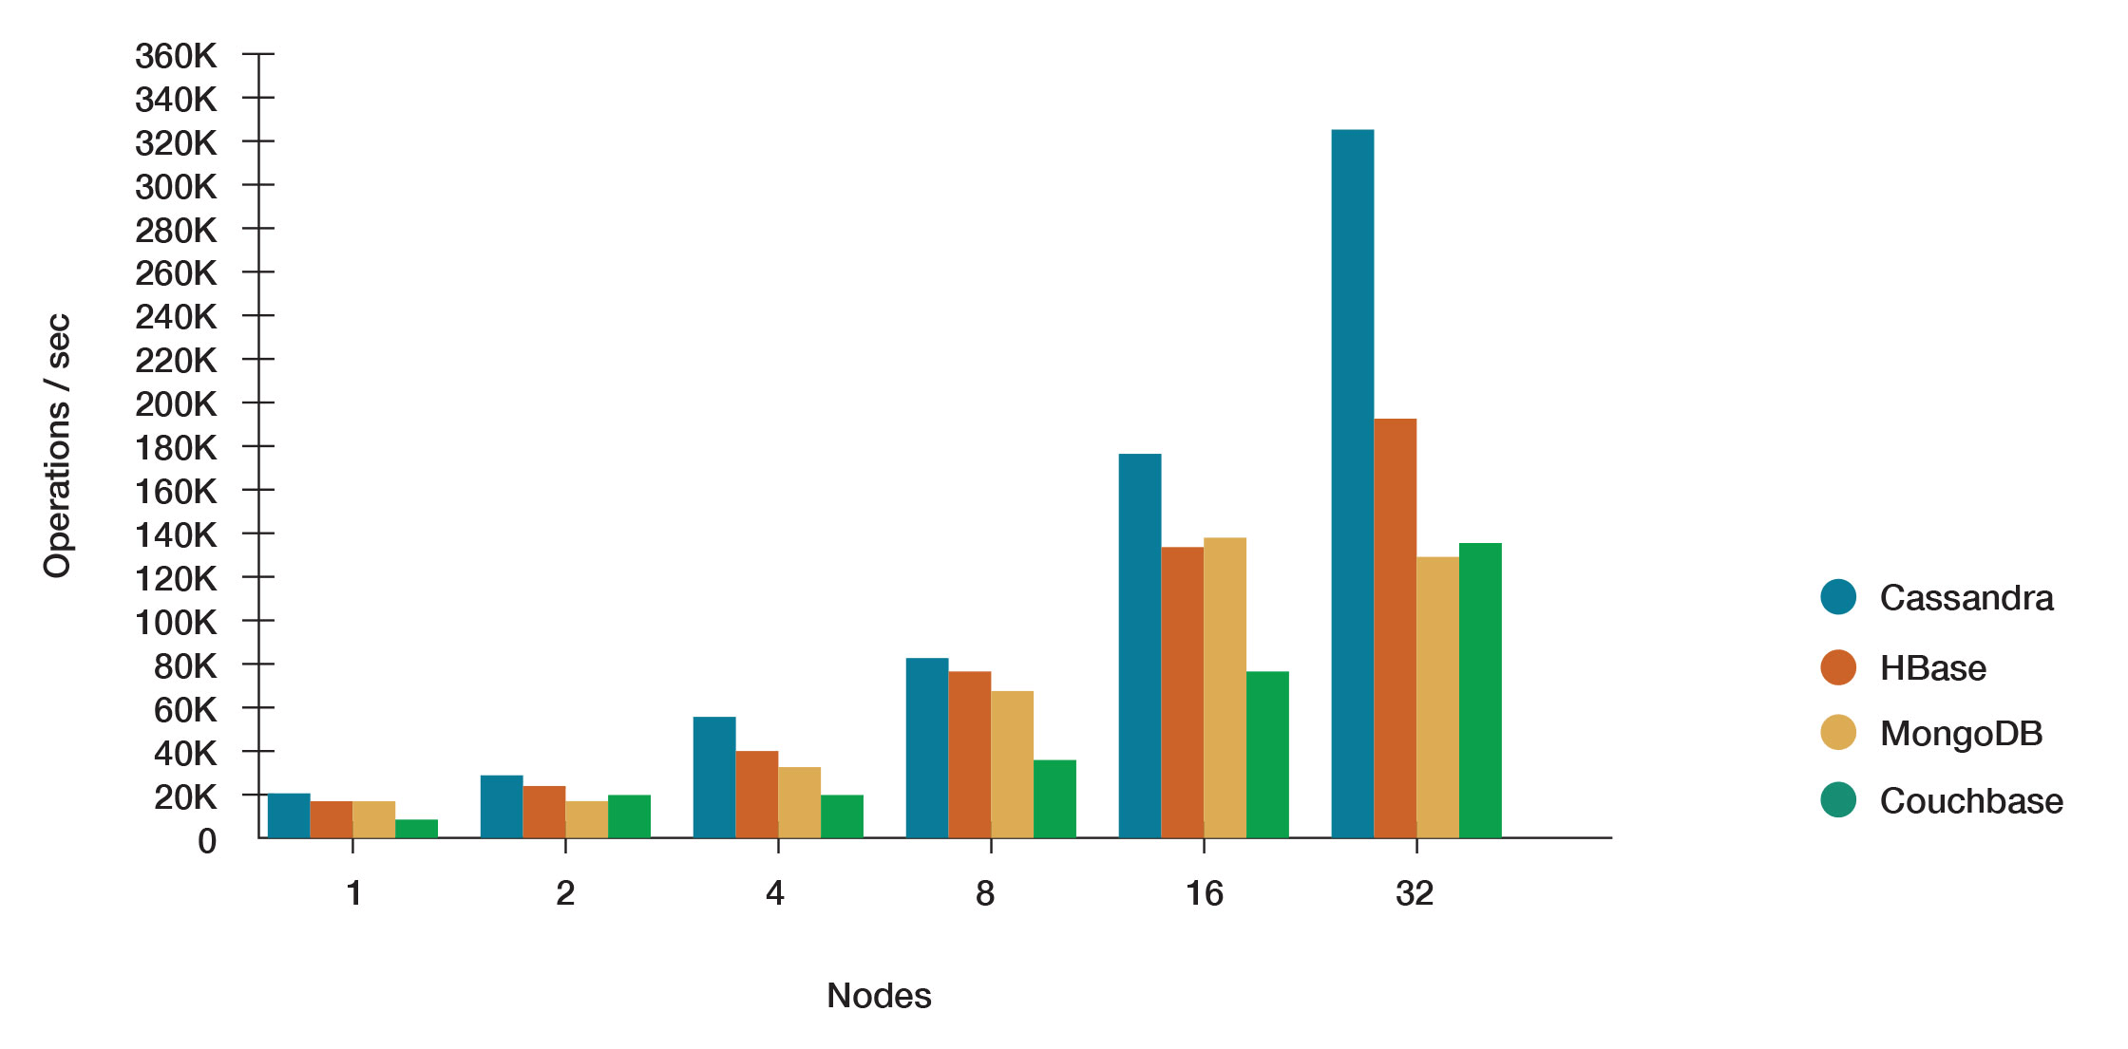
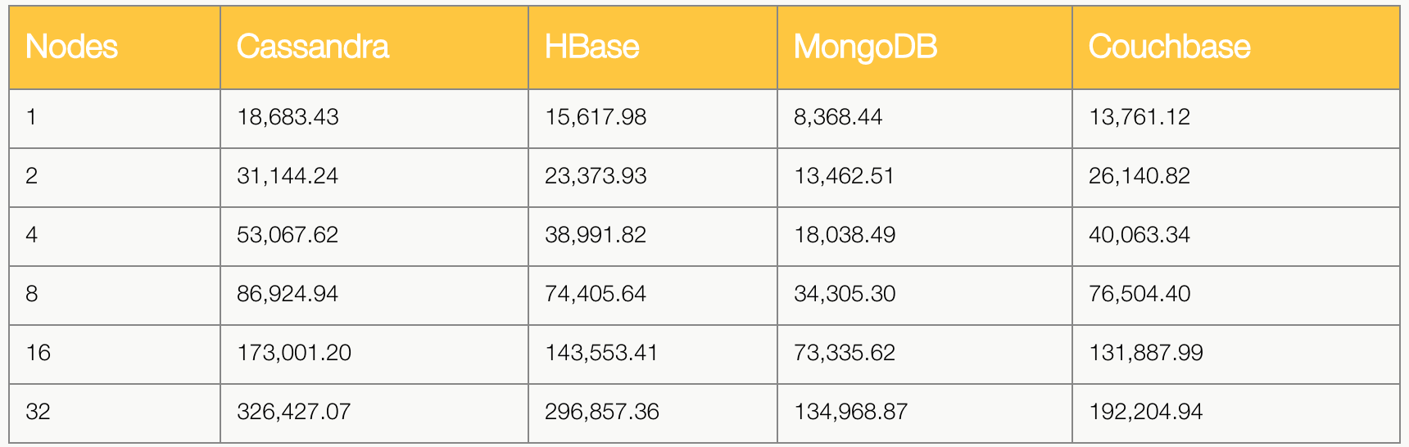
https://www.datastax.com/nosql-databases/benchmarks-cassandra-vs-mongodb-vs-Hbase

Slide 27
Questions?

