Slide 1
Course Introduction Cloud Computing and Big Data (CLO)
Oxford University
Software Engineering Programme
July 2018

Slide 2
Introduction
Aims
Pre-requisites
Contents
Objectives
Resources
Rules of Engagement
Introductions

Slide 3
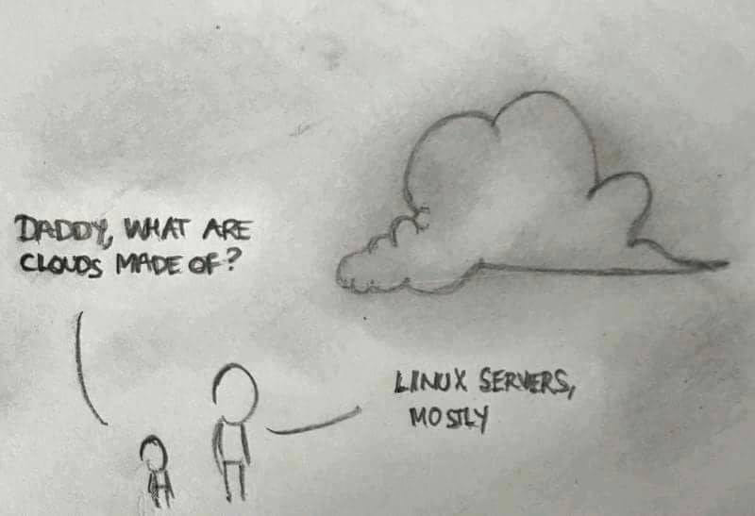

Slide 4
Aims
Understanding of Principles of Cloud Computing and Big Data
Theoretical background and origins
Practical experience of different technologies
Architecture and Design
Wider context

Slide 5
Pre-requisites
Covered by the Pre-Study Guide
Command line tooling and Unix commands
Some Python programming and text editors
SQL and data manipulation
Understanding of networking, servers and distributed computing

Slide 6
Format
A mixture of lectures and practical labs
Lectures aim to provide the wider context and background
Independent of specific technologies
Labs are based on specific technologies
Designed to demonstrate the principles

Slide 7
Lab model
Local Virtual Machine
Ubuntu
Pre-installed big data software
E.g. Apache Hadoop and Spark, Docker, etc
Amazon Web Services
Virtual machines in the cloud

Slide 8
Contents
Overview and Introduction
Cloud Computing
Introduction and Case Studies
Cloud Computing Theory and Background
Containers and Docker
Big Data
Introduction and Case Studies
Map Reduce and Hadoop
Apache Spark and in-memory big data
Realtime
Visualisation
NoSQL
Cassandra

Slide 9
Practicals
Using Cloud Services
Elastic scaling
Hadoop and Map Reduce
Python Big Data, Pandas
Spark, SparkSQL
Cassandra and NoSQL
Spark and Cassandra together
Realtime big data
Containers

Slide 10
Specific Objectives
Understand the principles of cloud computing
Theory of scalability
Including scalability and deployment
IaaS frameworks, PaaS, containers
Understand Big Data approaches, technologies and techniques
Theoretical background and approaches
Including Map Reduce, NoSQL, Realtime
Be able to design and implement scalable cloud and big data systems
Understand and implement effective Open Source systems on Amazon EC2

Slide 11
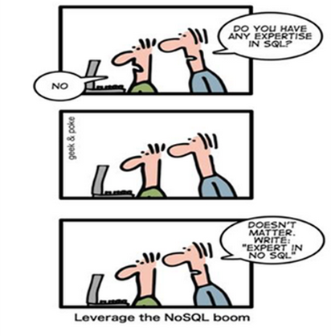
Improve your CV?

Slide 12
Beyond the scope of this course
Detailed Data Science techniques
Implementing a private cloud
Although we will look at technologies for private cloud
Understanding all of Hadoop, Spark, Kubernetes, Mesos, CoreOS, etc

Slide 13
Rules of Engagement
Ask questions as we go along
We will “park” any that are better answered later
Don’t wait till the end to ask or raise concerns
If you don’t ask we can’t help you

Slide 14

There might will be bugs!
Please help out:
Create new issues on the Github repository
https://github.com/pzfreo/ox-clo/issues/new

Slide 15
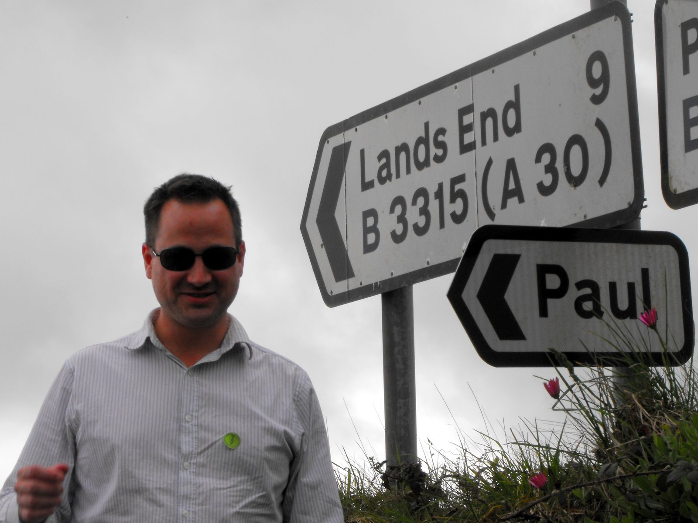
Paul Fremantle
CTO and Co-Founder of WSO2
Previously Senior Technical Staff Member, IBM WebSphere architecture
VP, Apache Synapse and Member of ASF
BA in Maths and Philosophy
MSc in Computation (1995)
PhD in Computing (2017)
IoT security and privacy
Also teaches SOA module

Slide 16
You?

Slide 17
Approximate Schedule
Monday | Tuesday | Wednesday | Thursday | Friday
Overall Introductions First Cloud lab exercise | Introduction to Big Data and case studies Data processing in Python | Spark and SQL SparkSQL Lab | Cassandra details Cassandra Lab2 | Overview and Recap Presentation Group Exercise
Cloud Overview and case studies Elastic Cloud Lab | Hadoop Lab 1 Hadoop details, Map-Reduce Hadoop Extras | Spark Lab continued | Containers Docker Lab | Final Thoughts and Assignment
Cloud Theory Platform-as-a-Service, scaling Further Cloud Lab | Intro to Spark | Storage and NoSQL Cassandra Lab | Realtime Big Data Realtime Lab

Slide 18

Let’s get started

