Slide 1
Cloud Computing and Big Data Hadoop and Map-Reduce
Oxford University
Software Engineering Programme
July 2018

Slide 2
Contents
Understanding Map Reduce
Functional programming patterns applied for scalability
Hadoop
Map-reduce in Hadoop
Python
Java
HDFS
Yarn
Pig and Hive
Further reading

Slide 3
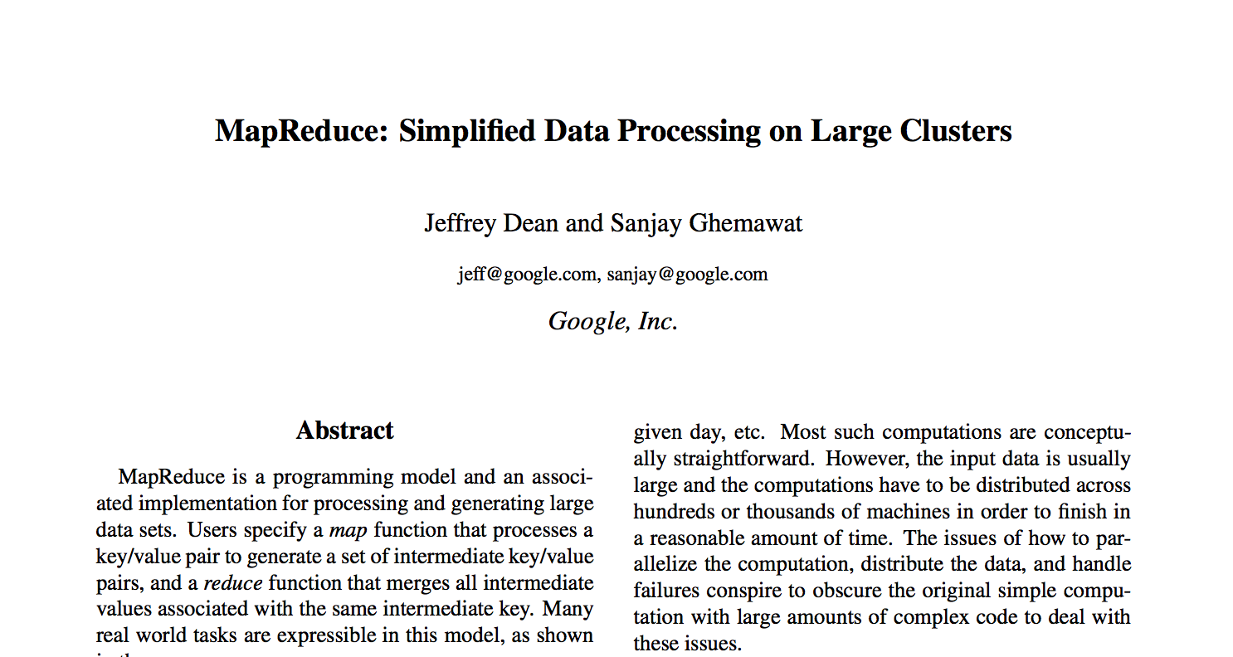
Original 2008 Google Paper

Slide 4
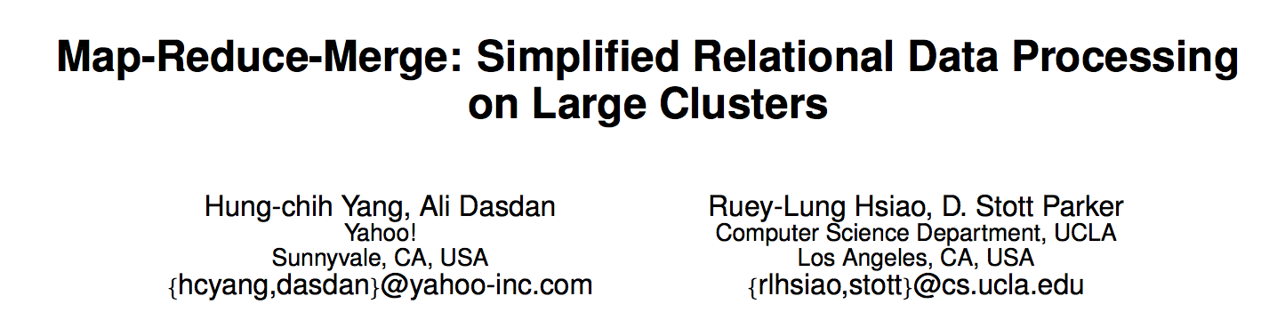
Yahoo 2007

Slide 5
Programming Model
Input & Output: each a set of key/value pairs
map (in_key, in_value) -> list(out_key, intermediate_value)
Processes input key/value pair
Produces set of intermediate pairs
reduce (out_key, list(intermediate_value)) -> list(out_value)
Combines all intermediate values for a particular key
Produces a set of merged output values (usually just one)
Inspired by similar primitives in LISP and other languages

Slide 6
Class Exercise
Find two pieces of paper and write your name and day/month of birth on one.
You don’t need to divulge the year!
Paul 5 December

Slide 7
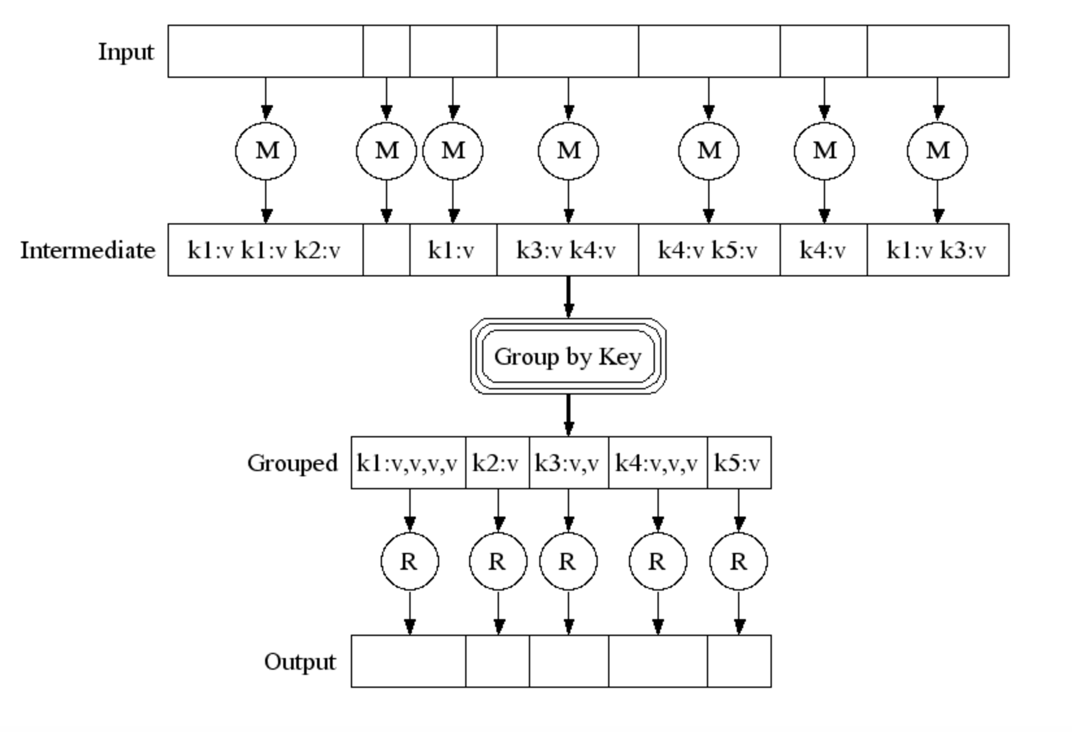
Pictorially

Slide 8
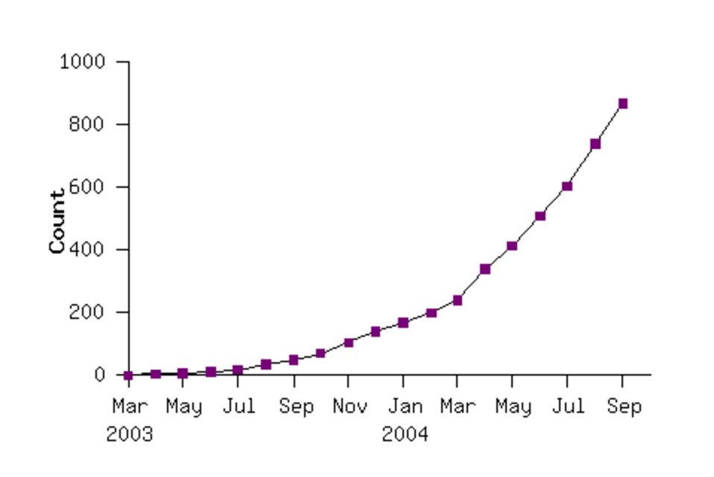
Google’s early use of MR Map Reduce programs in their code repository

Slide 9
Map Reduce example #1 Java
// some input
Integer array[] = {1,2,3,4,5};
// make a Stream of it
Stream<Integer> stream = Arrays.stream(array);
// map then reduce
Integer map_reduced = stream .map(x -> x*x) .reduce(0, (a, b)->a+b);
// should print 55
System.out.println(map_reduced);

Slide 10
Notice how
We could have squared each number in the stream at the same time
Adding them up needed all the results available

Slide 11
Map Reduce example #2 in words
Do a word count on 1000 books:
First count each book (map wc onto book)
Then reduce the outputs to a global wordcount across all books

Slide 12
Efficiency
Reduce phase:
We can theoretically process each word in parallel
How?
Shuffle / Sort the results from the map phase by key (word)
Partition by keys
Parallelize the reduce phase

Slide 13
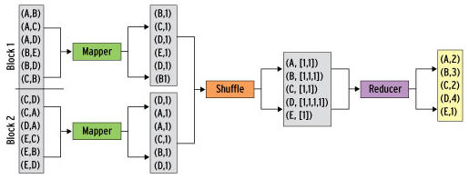
Map/Shuffle/Reduce

Slide 14
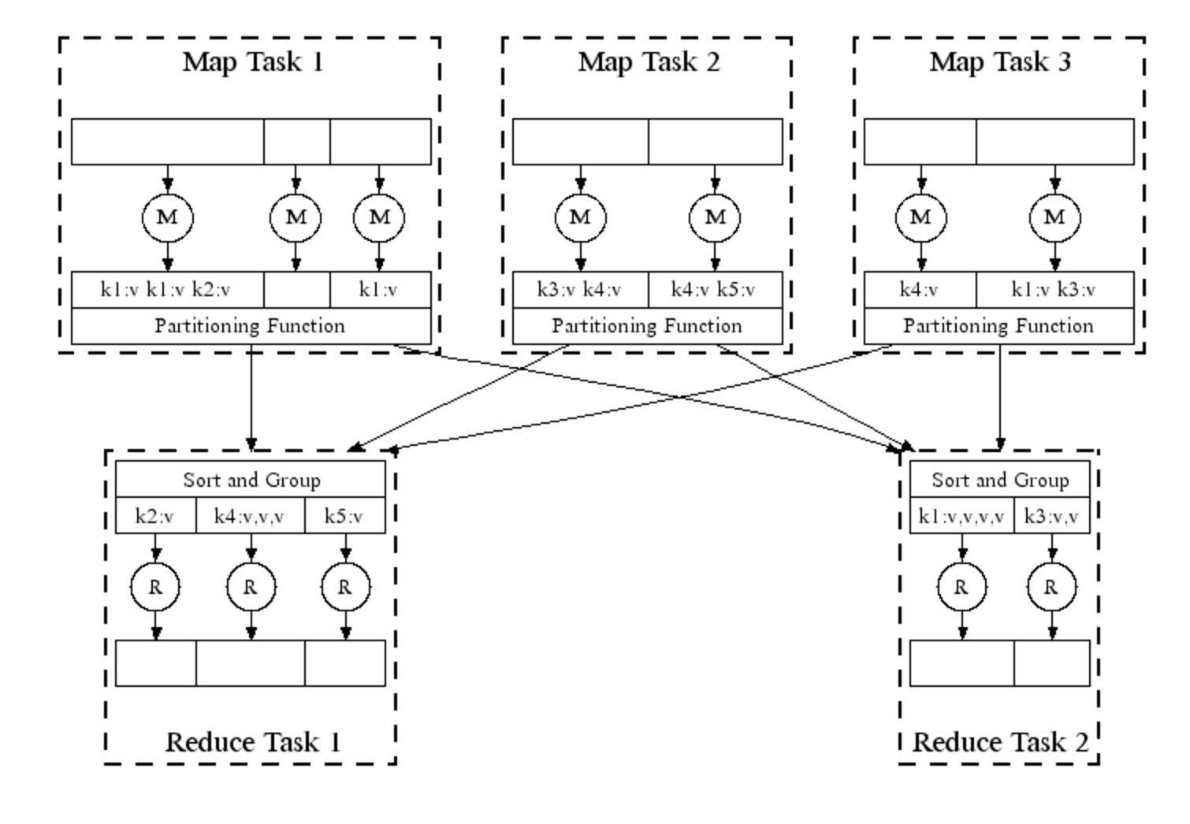

Slide 15
Map Reduce in Real Life
Analysing web logs
Summarise by user / cookie
Then aggregate to identify who did what
Analysing twitter data
Who retweeted
Who was retweeted the most
Almost all big data problems can be re-factored into Map Reduce
Some more efficiently than others

Slide 16
Tuning
Fault tolerance
Simply re-execute work that fails
Performance:
Partitioning the data
Moving the work to near the data

Slide 17
Apache Hadoop
The most famous and popular Map Reduce framework
Open Source
Written in Java, but supports other languages
Runs Map Reduce workloads across a cloud or cluster of machines
Supports a distributed filesystem to store data for these jobs
Provides reliability when servers in the cluster fail

Slide 18
Components of Hadoop
Map Reduce or Other Workloads
Java, Scala, Python, Apache Pig, Apache Hive, etc
YARN (Yet Another Resource Negotiator)
Cluster Resource Management
Hadoop Distributed File System (HDFS)
Redundant Reliable Distributed File System

Slide 19
HDFS in a nutshell
Client
NameNode
Secondary
NameNode
metadata
checkpoint
Data access
DataNode
DataNode
DataNode
DataNode

Slide 20
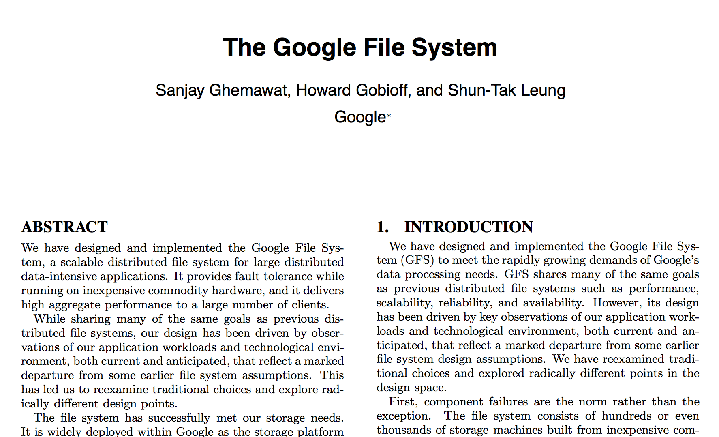
HDFS inspiration
Google File System
Sanjay Ghemawat, Howard Gobioff, and Shun-Tak Leung. 2003. The Google file system. In Proceedings of the nineteenth ACM symposium on Operating systems principles (SOSP '03). ACM, New York, NY, USA, 29-43.

Slide 21
HDFS overview
Good for streaming access to large files, reliability, scale
Not good for random access, small files
Blocks of data 64Mb in size (configurable)
Each block can be replicated across multiple data nodes for High Availability (HA)

Slide 22
HDFS commands
start-dfs.sh
stop-dfs.sh
hadoop fs <command>
e.g. hadoop fs cat /user/hduser/file
hadoop fs mkdir –p /user/hduser/
hadoop fs put localfile /user/hduser/remotefile
hadoop fs get /user/hduser/remotefile localfile

Slide 23
HDFS Usage
Spotify has 1600+ nodes, storing 60+ petabytes of data
https://www.usenix.org/system/files/conference/fast17/fast17-niazi.pdf
One of the Facebook's largest clusters (based on HDFS) holds more than 100 PB of data, processing more than 60,000 Hive queries a day
https://www.facebook.com/notes/facebook-engineering/under-the-hood-scheduling-mapreduce-jobs-more-efficiently-with-corona/

Slide 24
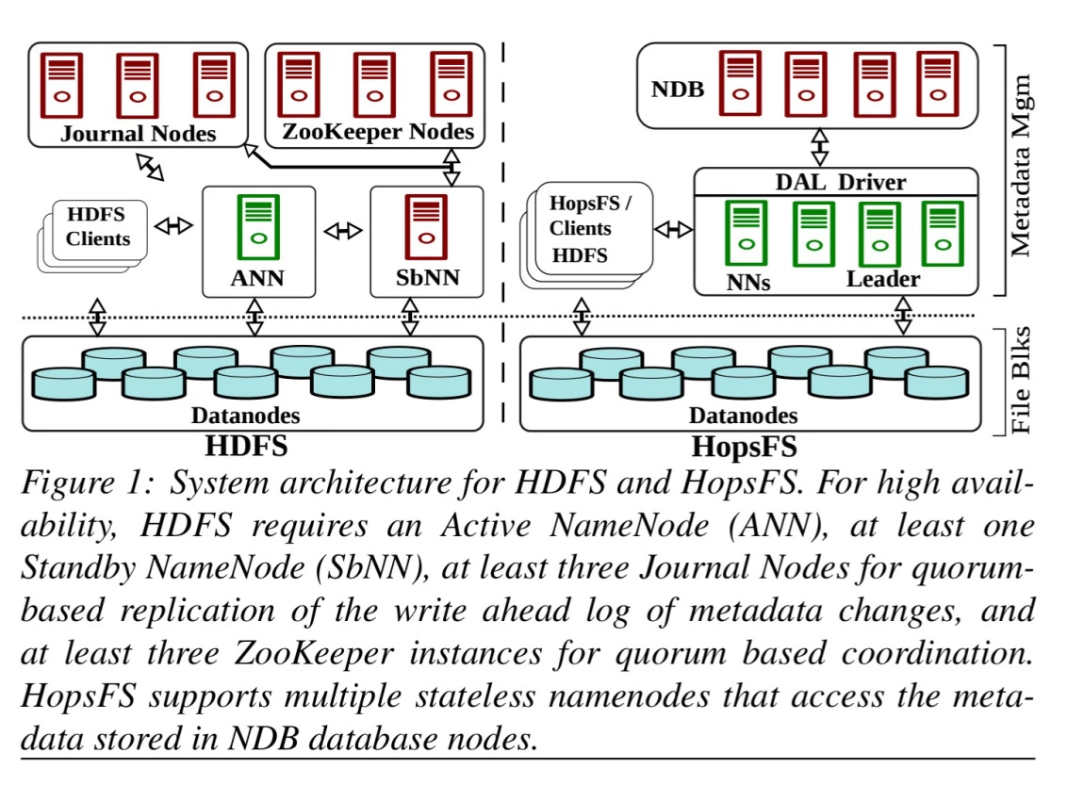
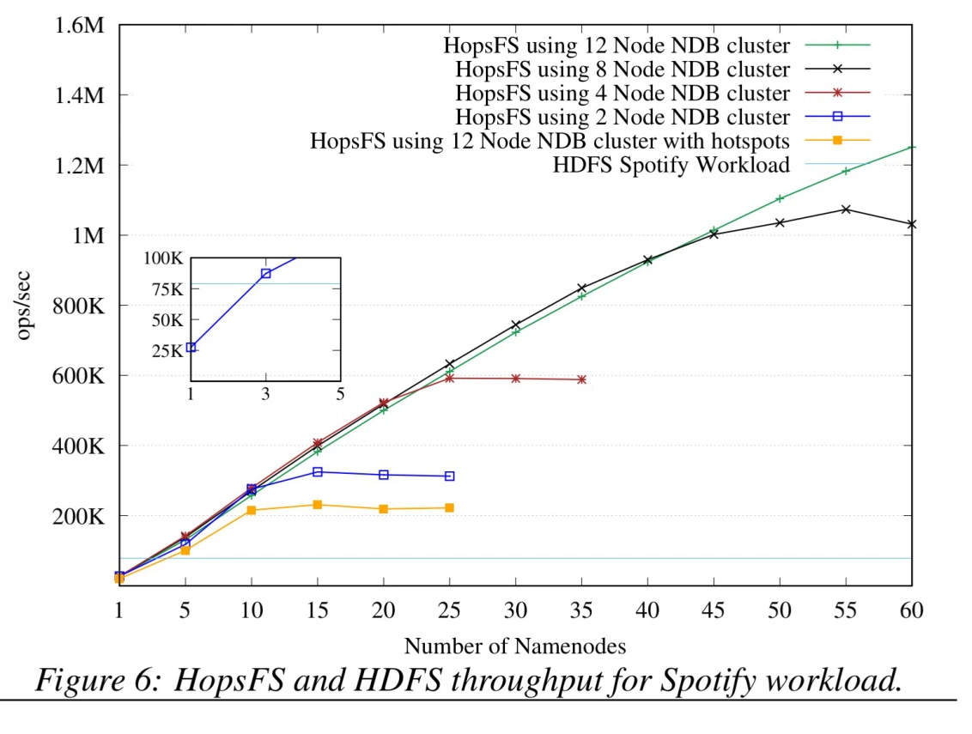
HopFS
HopFS is a drop-in replacement for HDFS, based on HDFS v2.0.4.

Slide 25
What is YARN?
YARN is the system that runs your code on multiple nodes
Hadoop 2.0 replacement for the cluster manager
Basically a model to distribute and manage workloads
Not just MapReduce but supports other workloads

Slide 26
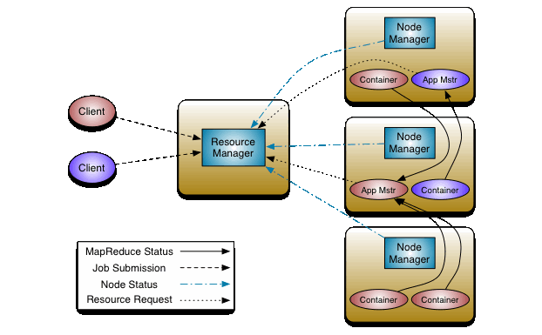
YARN architecture

Slide 27
Map Reduce in Hadoop
Map reduce in Hadoop actually consists of multiple steps
Mapper
Works on a single file, line by line
Combiner
Like a reducer, but still on a single system taking the output of the mapper
Reducer
Takes the outputs of multiple mapper/combiners

Slide 28
The general flow
On the whole, we expect to produce key-value <K,V> pairs from any mapper or reducer
In some cases we may produce <K,<V1,V2,..>>
The results are stored to file and then read from file

Slide 29
Mappers
Take input files and produce <K,V> pairs
Each mapper gets a complete file
Each mapper runs on a single system

Slide 30
Combiners
The combiner function must take the <K,V> output of the mapper
Produce the same format <K,V>
Must be associative and commutative
Runs on the same node as the mapper
May actually be the reducer function if the reducer follows the rules above

Slide 31
Reducers
The reducers get the <K,V> pairs output from the mappers/combiners
The output is first sorted/partitioned
The reducers produce the final expected output, usually in the form of <K,V> pairs

Slide 32
Map Reduce in Python A mapper
#!/usr/bin/env python
import sys
# input comes from STDIN (standard input)
for line in sys.stdin:
# remove leading and trailing whitespace
line = line.strip()
# split the line into words
words = line.split()
# increase counters
for word in words:
# write the results to STDOUT (standard output);
# what we output here will be the input for the
# Reduce step, i.e. the input for reducer.py
#
# tab-delimited; the trivial word count is 1
print '%s\t%s' % (word, 1)

Slide 33
Map Reduce in Python A reducer
#!/usr/bin/env python
import sys
current_word = None
current_count = 0
word = None
# input comes from STDIN
for line in sys.stdin:
# remove leading and trailing whitespace
line = line.strip()
# parse the input we got from mapper.py
word, count = line.split('\t', 1)
# convert count (currently a string) to int
try:
count = int(count)
except ValueError:
continue
# this IF-switch only works because Hadoop sorts map output by key
if current_word == word:
current_count += count
else:
if current_word:
# write result to STDOUT
print '%s\t%s' % (current_word, current_count)
current_count = count
current_word = word
# do not forget to output the last word if needed!
if current_word == word:
print '%s\t%s' % (current_word, current_count)

Slide 34
Executing this on a set of files
yarn jar /usr/…./lib/hadoop-streaming-2.7.1.jar
-input /user/hduser/books -output /user/hduser/output -mapper ./mapper.py -reducer ./reducer.py

Slide 35
Efficiency
Please note this is not the most efficient way of coding Python
But the simplest and easiest to explain

Slide 36
Map Reduce in Java
public static void main(String[] args) throws Exception {
Configuration conf = new Configuration();
Job job = Job.getInstance(conf, "word count");
job.setJarByClass(WordCount.class);
job.setMapperClass(TokenizerMapper.class);
job.setCombinerClass(IntSumReducer.class);
job.setReducerClass(IntSumReducer.class);
job.setOutputKeyClass(Text.class);
job.setOutputValueClass(IntWritable.class);
FileInputFormat.addInputPath(job, new Path(args[0]));
FileOutputFormat.setOutputPath(job, new Path(args[1]));
System.exit(job.waitForCompletion(true) ? 0 : 1);
}
}

Slide 37
Map Reduce in Java cont
$ yarn jar wc.jar
WordCount
/user/joe/wordcount/input
/user/joe/wordcount/output

Slide 38
Summary
Understanding the Map Reduce Model
How is it implemented in Hadoop
HDFS
Yarn
Running jobs

Slide 39
Questions?

