Slide 1
[[1. 0.24453833 0.06069799]
[0.24453833 1. 0.24087844]
[0.06069799 0.24087844 1. ]]

Slide 2
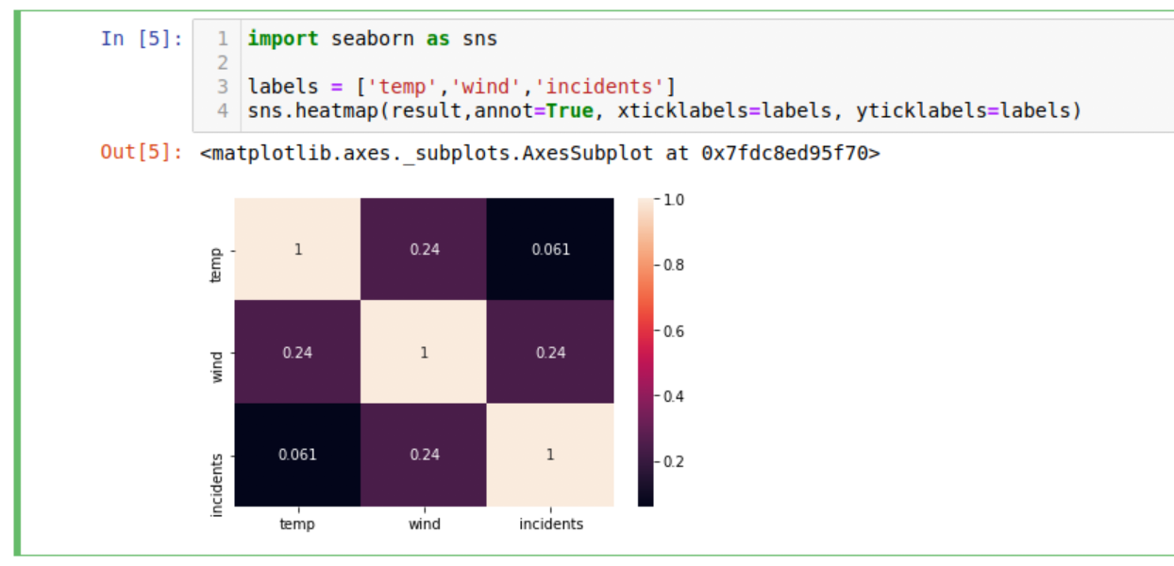
Nicely formatted (Thanks Bushra!)

