Slide 1
10 Bat Algorithms
Xin-She Yang, Nature-Inspired Optimization Algorithms, Elsevier, 2014

Slide 2
The bat algorithm(BA) is a bio-inspired algorithm developed by Xin-She Yang in 2010 that has been found very efficient.

Slide 3
10.1 Echolocation of Bats

Slide 4
10.1.1 Behavior of Microbats
Microbats use a type of sonar, called echolocation, to detect prey, avoid obstacles, and locate their roosting crevices in the dark.
These bats emit a very loud sound pulse and listen for the echo that bounces back from the surrounding objects.

Slide 5
Studies show that microbats use the time delay from the emission and detection of the echo, the time difference between their two ears, and the loudness variations of the echoes to build up a three-dimensional scenario of the surrounding.
They can detect the distance and orientation of the target, the type of prey, and even the moving speed of the prey, such as small insects.

Slide 6
10.1.2 Acoustics of Echolocation
Each ultrasonic burst may last typically 5 to 20 ms.
Microbats emit about 10 to 20 such sound bursts every second.
The typical range of frequencies for most bat species is in the region between 25 kHz and 100 kHz.
When they are hunting for prey, the rate of pulse emission can be sped up to about 200 pulses per second when they fly near their prey.

Slide 7
The wavelength λ of the ultrasonic sound bursts with a constant frequency f is given by λ = v/ f , which is in the range of 2 mm to 14 mm.
Amazingly, the emitted pulse could be as loud as 110 dB, and, fortunately, they are in the ultrasonic region.
The loudness also varies from the loudest when searching for prey to a quieter base when homing toward the prey.

Slide 8
The echolocation behavior of microbats can be formulated in such a way that it can be associated with the objective function to be optimized, and this makes it possible to formulate new optimization algorithms.

Slide 9
10.2 Bat Algorithms
For simplicity, we now use the following approximate or idealized rules:
All bats use echolocation to sense distance, and they also “know” the difference between food/prey and background barriers.
Bats fly randomly with velocity v_{i} at position x_{i}. They can automatically adjust the frequency (or wavelength) of their emitted pulses and adjust the rate of pulse emission r ∈ [0, 1], depending on the proximity of their target.

Slide 10
Although the loudness can vary in many ways, we assume that the loudness varies from a large (positive) A₀ to a minimum value A_{min}.

Slide 11
In general, the frequency f in a range [ f_{min}, f_{max}] corresponds to a range of wavelengths [λ_{min}, λ_{max}]. For example, a frequency range of [20 kHz, 500 kHz] corresponds to a range of wavelengths from 0.7 mm to 17 mm.
The detectable range (or the largest wavelength) should be chosen such that it is comparable to the size of the domain of interest, then toned down to smaller ranges.

Slide 12
For simplicity, we can assume f ∈ [0, f_{max}].We know that higher frequencies have short wavelengths and travel a shorter distance. For bats, the typical ranges are a few meters.
The rate of pulse can simply be in the range of [0,1], where 0 means no pulses at all and 1 means the maximum rate of pulse emission.

Slide 13
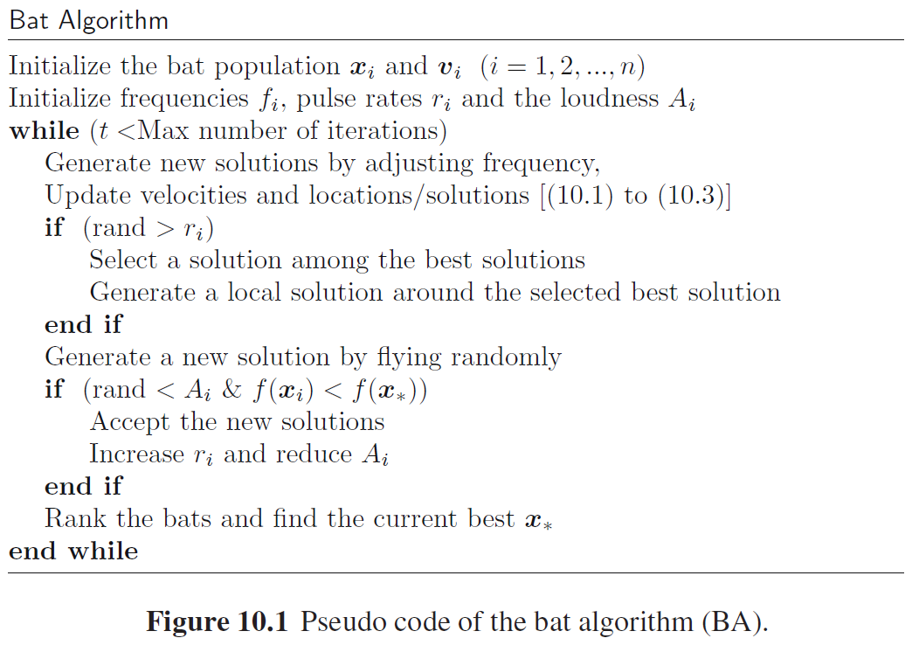

Slide 14
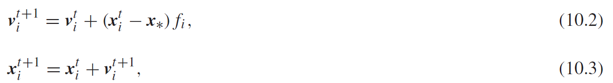
10.2.1 Movement of Virtual Bats
where β ∈ [0, 1] is a random vector drawn from a uniform distribution. Here x∗ is the current global best location. In our implementation, we use f_{min} = 0 and f_{max} = O(1), depending on the domain size of the problem of interest. Initially, each bat is randomly assigned a frequency that is drawn uniformly from [ f_{min}, f_{max}].

Slide 15
For the local search part, once a solution is selected among the current best solutions, a new solution for each bat is generated locally using random walk
where A^{(t)} = <A^{t}_{i}> is the average loudness of all the bats at this time step. ϵ_{t} is now drawn from a Gaussian normal distribution N(0, 1), and σ is a scaling factor.

Slide 16
The update of the velocities and positions of bats may have some similarity to the procedure in the standard particle swarm optimization, since f_{i} essentially controls the pace and range of the movement of the swarming particles.
However, BA can be more effective because it uses frequency tuning and parameter control to influence exploration and exploitation.

Slide 17
10.2.2 Loudness and Pulse Emission
Furthermore, the loudness A_{i} and the rate r_{i} of pulse emission have to be updated accordingly as the iterations proceed.
Because the loudness usually decreases once a bat has found its prey, whereas the rate of pulse emission increases.

Slide 18
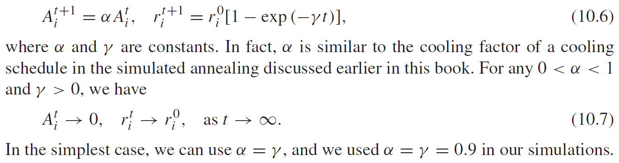
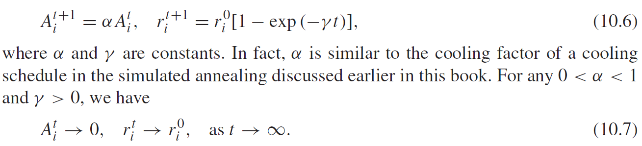

Slide 19
The choice of parameters requires some experimentation.
Initially, each bat should have different values of loudness and pulse emission rate; this can be achieved by randomization.

Slide 20
For example, the initial loudness A⁰_{i} can typically be taken as 1,whereas the initial emission rate r ⁰_{i} can be around zero or any value r ⁰_{i} ∈ (0, 1] if using (10.6).
Their loudness and emission rates will be updated only if the new solutions are improved, which means that these bats are moving toward the optimal solution.

Slide 21
In other words, HS and PSO can be considered the special cases of BA. Therefore, it is no surprise that BA is efficient.

Slide 22
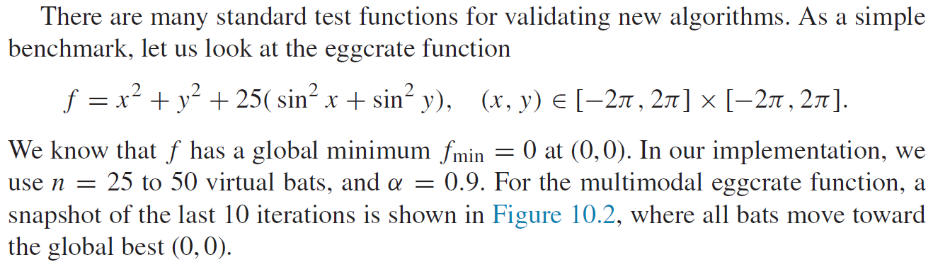
10.3 Implementation

Slide 23
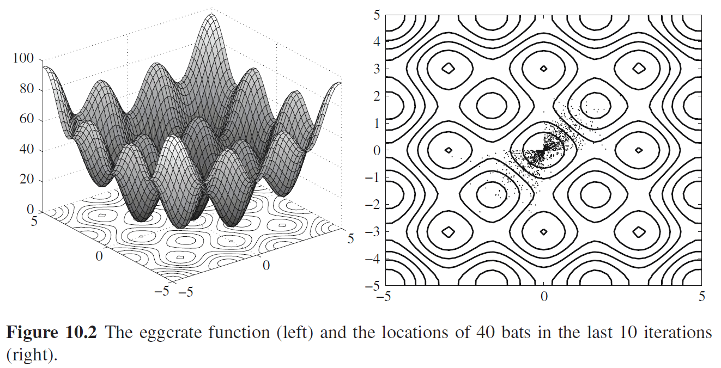

Slide 24
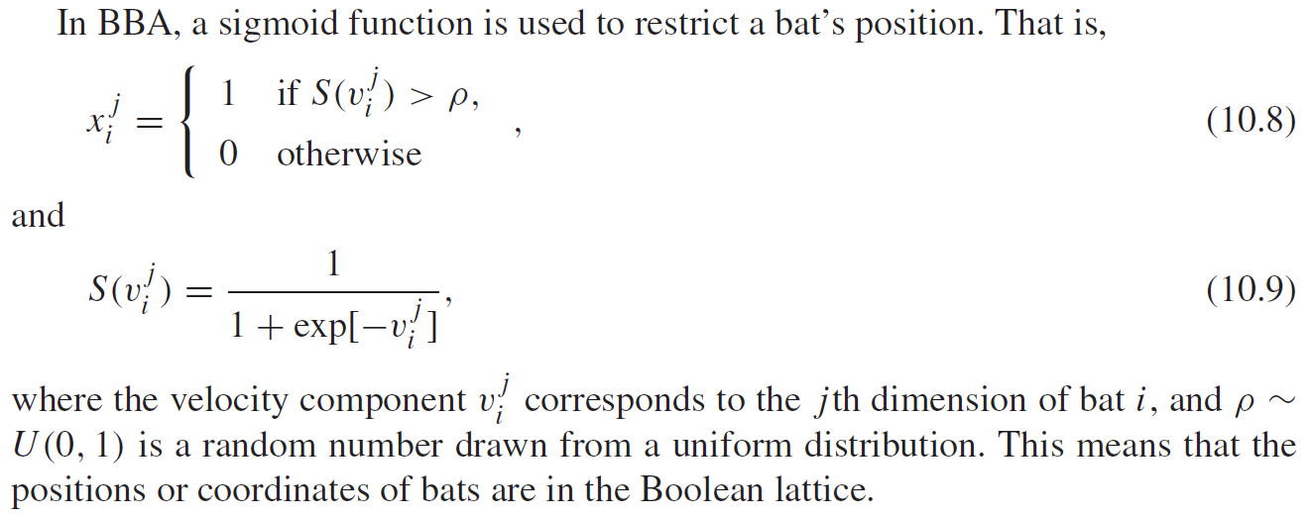
10.4 Binary Bat Algorithms

Slide 25
10.5 Variants of the Bat Algorithm
Fuzzy logic bat algorithm (FLBA)
Multi-objective bat algorithm (MOBA)
K-means bat algorithm (KMBA)
Chaotic bat algorithm (CBA)
Binary bat algorithm (BBA)
Improved bat algorithm(IBA)
Modified bat algorithm (MBA)

Slide 26
10.7 Why the Bat Algorithm is Efficient
Frequency tuning.
BA uses echolocation and frequency tuning to solve problems.
Though echolocation is not directly used to mimic the true function in reality, frequency variations are used.
This capability can provide some functionality that may be similar to the key feature used in PSO, SA, and HS. Therefore, BA possesses the advantages of other swarm-intelligence-based algorithms.

Slide 27
Automatic zooming.
BA has a distinct advantage over other metaheuristic algorithms. That is, BA has a capability of automatically zooming into a region where promising solutions have been found.
This zooming is accompanied by the automatic switch from explorative moves to local intensive exploitation. As a result, BA has a quick convergence rate, at least at early stages of the iterations, compared with other algorithms.

Slide 28
Parameter control
Many metaheuristic algorithms used fixed parameters by using some pre-tuned algorithm-dependent parameters.
In contrast, BA uses parameter control, which can vary the values of parameters (A and r ) as the iterations proceed.
This provides a way to automatically switch from exploration to exploitation when the optimal solution is approaching. This gives another advantage of BA over other metaheuristic algorithms.

Slide 29
10.8 Applications
10.8.1 Continuous Optimization
10.8.2 Combinatorial Optimization and Scheduling
10.8.3 Inverse Problems and Parameter Estimation

Slide 30
10.8.4 Classifications, Clustering, and Data Mining
10.8.5 Image Processing
10.8.6 Fuzzy Logic and Other Applications

