Slide 1
Heuristic Optimization Methods
Calculus and Optimization
Chin-Shiuh Shieh

Slide 2
Gradient
In vector calculus, the gradient (梯度) of a scalar field is a vector field that points in the direction of the greatest rate of increase of the scalar field, and whose magnitude is that rate of increase.

Slide 3
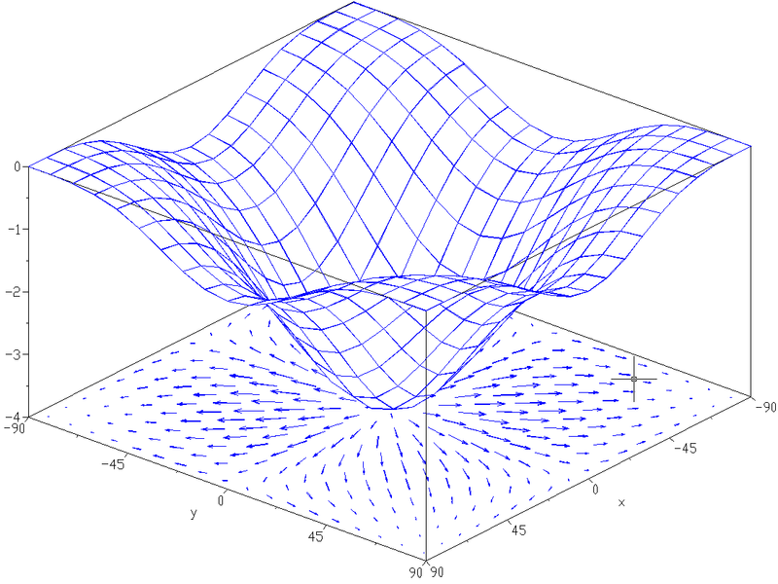
Gradient (cont)

Slide 4
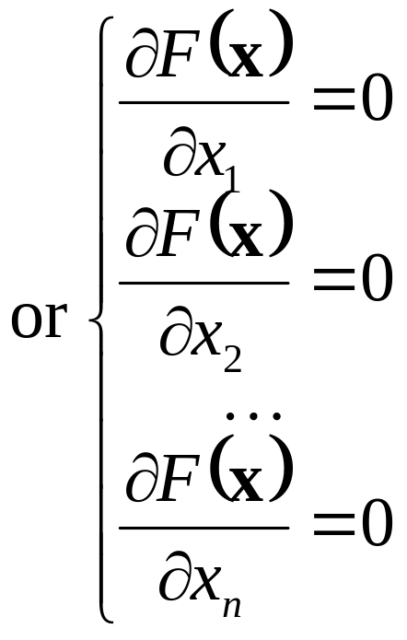
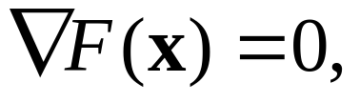
Gradient and Optima
Local optima (or saddle point) occur at points with zero gradient, that is

Slide 5
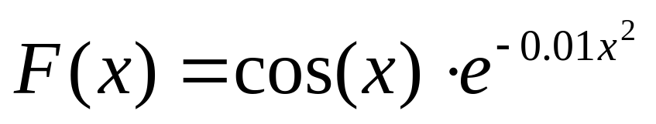
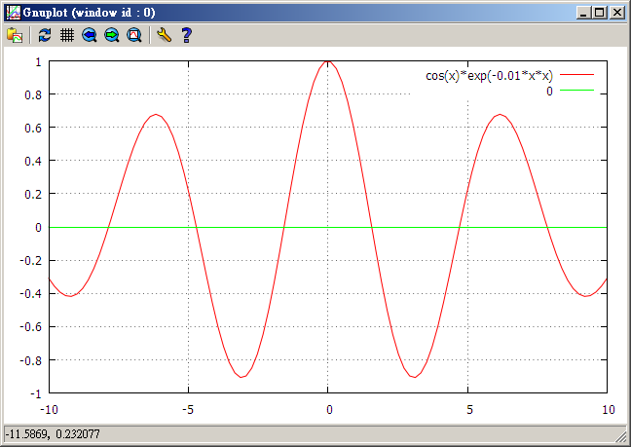
Example

Slide 6
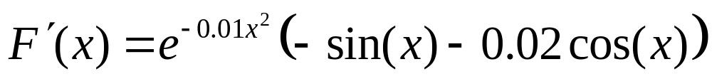
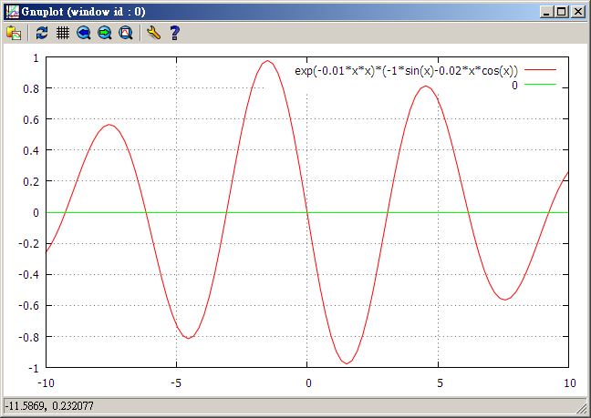
Example (cont)

Slide 7
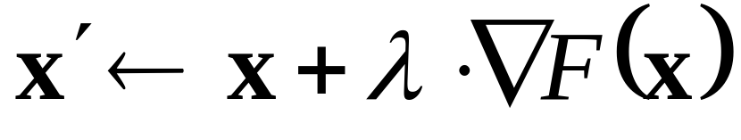
Gradient-Ascent Method
Greedy method
Hill-climbing
“Direction” and “Step Size”

Slide 8
Gradient-Ascent Method (cont)
Direction
  Gradient give the direction of search
Step Size
  By heuristic
  Adaptive step size
    λ ← λ*2 if F(x’) is better than F(x)
    λ ← λ*0.5 otherwise

Slide 9
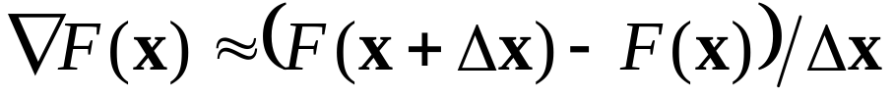
Limitations
Can be trapped in local optima
Object function is not differentiable
Gradient is complicate, or not available
  By approximation
Typical usages
  Coarse-grain grid method for locating near optima, and hill-climbing for pinpointing the global optimum
  Refine candidate solutions for heuristic methods

Slide 10
def F1(x,y):
return(4/((x-2)*(x-2)+(y-2)*(y-2)+1)+3/((x-2)*(x-2)+(y+2)*(y+2)+1)+2/((x+2)*(x+2)+(y-2)*(y-2)+1))
delta=0.01
step_size=0.01
#x=2;y=2
x=2;y=-2
#x=-2;y=2
#x=-2;y=-2
step=0

Slide 11
while step_size>0.0001:
step+=1
nx=x+step_size*(F1(x+delta,y)-F1(x,y))/delta
ny=y+step_size*(F1(x,y+delta)-F1(x,y))/delta
f=F1(x,y);nf=F1(nx,ny)
if nf>f:
x=nx;y=ny
step_size*=2
else:
step_size*=0.5
print(x,y,f,step)

