Slide 1
Heuristic Optimization Methods
A Tutorial on Meta-Heuristics for Optimization
Chin-Shiuh Shieh
Spring, 2013
C.-S. Shieh, EC, KUAS, Taiwan

Slide 2
Abstract
Nature has inspired computing and engineering researchers in many different ways.
Natural processes have been emulated through a variety of techniques including genetic algorithms, ant systems and particle swarm optimization, as computational models for optimization.
Spring, 2013
C.-S. Shieh, EC, KUAS, Taiwan

Slide 3
Introduction
Optimization problems arise from almost every field ranging from academic research to industrial application.
Meta-heuristics, such as genetic algorithms, particle swarm optimization and ant colony systems, have received increasing attention in recent years for their interesting characteristics and their success in solving problems in a number of realms.
Detailed implementations in C are given.
Spring, 2013
C.-S. Shieh, EC, KUAS, Taiwan

Slide 4
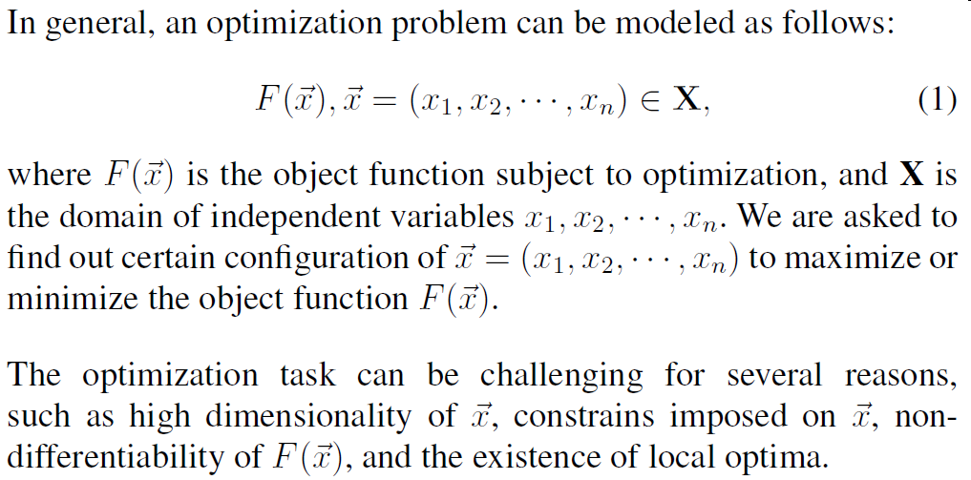
Introduction (cont)
Spring, 2013
C.-S. Shieh, EC, KUAS, Taiwan

Slide 5
Genetic Algorithms
Darwin's theory of natural evolution
  Creatures compete with each other for limited resources.
  Those individuals that survive in the competition have the opportunity to reproduce and generate descendants.
  Exchange of genes by mating may result in superior or inferior descendants.
  The process of natural selection eventually filtering out inferior individuals and retain those adapted best to their environment.
Spring, 2013
C.-S. Shieh, EC, KUAS, Taiwan

Slide 6

Genetic Algorithms (cont)
Genetic algorithms
  introduced by J. Holland in 1975
  work on a population of potential solutions, in the form of chromosomes (染色體),
  try to locate a best solution through the process of artificial evolution, which consist of repeated artificial genetic operations, namely
    Evaluation
    Selection
    Crossover and mutation
Spring, 2013
C.-S. Shieh, EC, KUAS, Taiwan

Slide 7
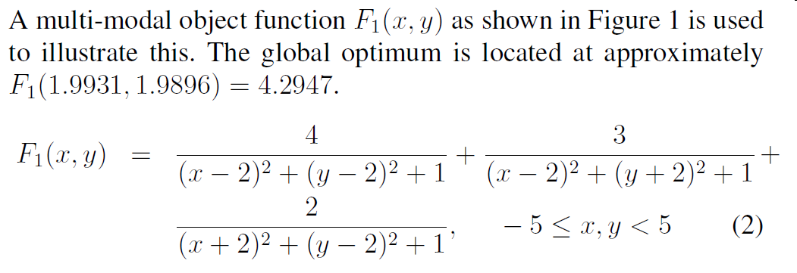
Test Function
Spring, 2013
C.-S. Shieh, EC, KUAS, Taiwan

Slide 8
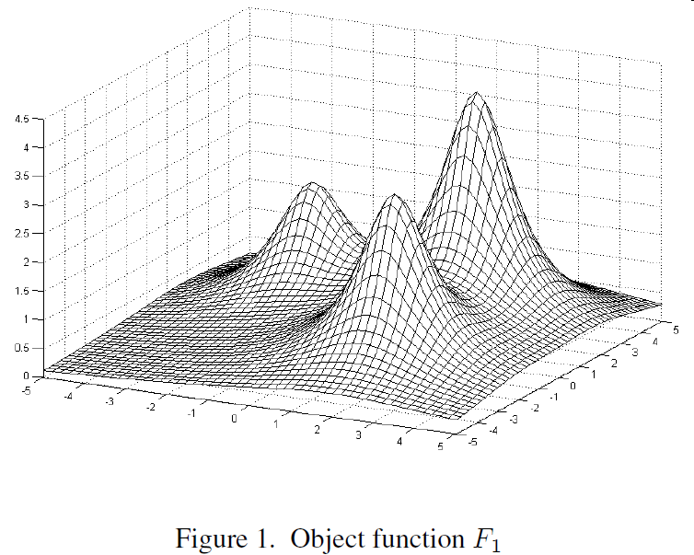
Test Function (cont)
Spring, 2013
C.-S. Shieh, EC, KUAS, Taiwan

Slide 9
Representation
Select an adequate coding scheme to represent potential solutions in the search space in the form of chromosomes.
  binary string coding for numerical optimization
  expression trees for genetic programming
  city index permutation for the travelling salesperson problem
Spring, 2013
C.-S. Shieh, EC, KUAS, Taiwan

Slide 10
Representation (cont)
We use a typical binary string coding for the test function F₁
  Each genotype has 16 bits to encode an independent variable.
  A decoding function maps the 65536 possible combinations of b₁₅ … b₀ onto the range [-5,5) linearly.
  A chromosome is then formed by cascading genotypes for each variable.
  With this coding scheme, any 32 bit binary string stands for a legal point in the problem domain.
Spring, 2013
C.-S. Shieh, EC, KUAS, Taiwan

Slide 11
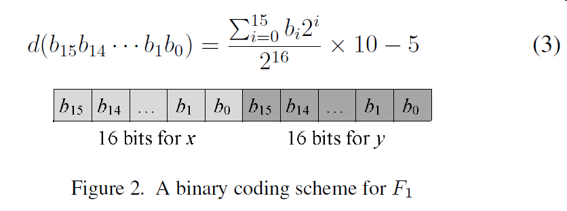
Representation (cont)
Spring, 2013
C.-S. Shieh, EC, KUAS, Taiwan

Slide 12
Representation (cont)
1110101110110011| 0010110011111010
(1110101110110011)₂=(60339)₁₀
x = 60339/2¹⁶*10-5=4.207000732421875
(0010110011111010)₂=(11514)₁₀
y = 11514/2¹⁶*10-5=-3.24310302734375
Spring, 2013
C.-S. Shieh, EC, KUAS, Taiwan

Slide 13
Population Size
The choice of population size, N, is a tradeoff between solution quality and computation cost.
A larger population size will maintain higher genetic diversity and therefore a higher possibility of locating global optimum, however, at a higher computational cost.
Spring, 2013
C.-S. Shieh, EC, KUAS, Taiwan

Slide 14
Operation of Genetic Algorithms
Step 1 Initialization
Step 2 Evaluation
Step 3 Selection
Step 4 Crossover
Step 5 Mutation
Step 6 Termination Checking
Go to Step 2 if not terminated
Spring, 2013
C.-S. Shieh, EC, KUAS, Taiwan

Slide 15
Step 1 Initialization
Each bit of all N chromosomes in the population is randomly set to 0 or 1.
This operation in effect spreads chromosomes randomly into the problem domains.
Whenever possible, it is suggested to incorporate any a priori knowledge of the search space into the initialization process to endow the genetic algorithm with a better starting point.
Spring, 2013
C.-S. Shieh, EC, KUAS, Taiwan

Slide 16
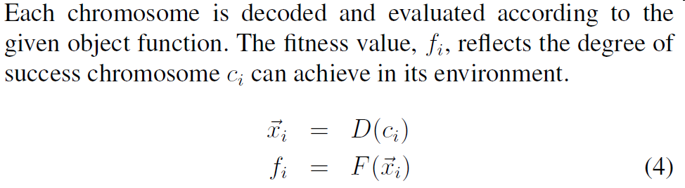
Step 2 Evaluation
Spring, 2013
C.-S. Shieh, EC, KUAS, Taiwan

Slide 17
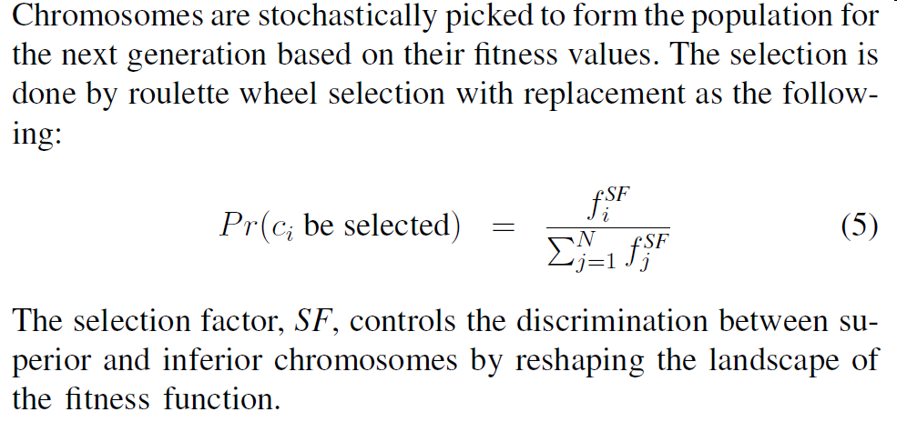
Step 3 Selection
Spring, 2013
C.-S. Shieh, EC, KUAS, Taiwan

Slide 18
f₁=1, f₂=2, f₃=3
For SF=1, P_{r}(c₂ be selected) =2/(1+2+3)=0.33
For SF=3, P_{r}(c₂ be selected) =2³/(1³+2³+3³)=0.22
Spring, 2013
C.-S. Shieh, EC, KUAS, Taiwan

Slide 19
f1=1, f2=2,f3=3,f4=4,f5=5
SF=1
p1=1/(1+2+3+4+5)=1/15=0.067
p2=2/15=0.133
p3=3/15=0.200
p4=4/15=0.267
p5=5/15=0.333
p1+p2+p3+p4+p5=1
Spring, 2013
C.-S. Shieh, EC, KUAS, Taiwan

Slide 20
tmpf=0.642
p1+p2+…+pn>0.642
Spring, 2013
C.-S. Shieh, EC, KUAS, Taiwan

Slide 21
Step 3 Selection (cont)
As a result, better chromosomes will have more copies in the new population, mimicking the process of natural selection.
In some applications, the best chromosome found is always retained in the next generation to ensure its genetic material remains in the gene pool.
Spring, 2013
C.-S. Shieh, EC, KUAS, Taiwan

Slide 22
Step 4 Crossover
Pairs of chromosomes in the newly generated population are subject to a crossover (or swap) operation with probability P_{C}, called Crossover Rate.
The crossover operator generates new chromosomes by exchanging genetic material of pair of chromosomes across randomly selected sites, as depicted in Figure 3.
Spring, 2013
C.-S. Shieh, EC, KUAS, Taiwan

Slide 23
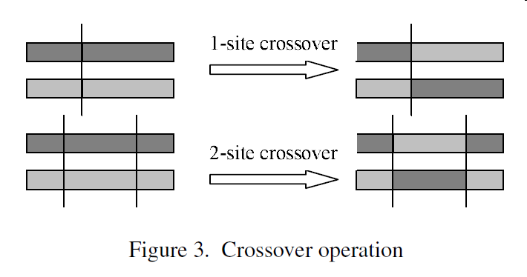
Step 4 Crossover (cont)
Spring, 2013
C.-S. Shieh, EC, KUAS, Taiwan

Slide 24
Step 4 Crossover (cont)
Similar to the process of natural breeding, the newly generated chromosomes can be better or worse than their parents. They will be tested in the subsequent selection process, and only those which are an improvement will thrive.
Spring, 2013
C.-S. Shieh, EC, KUAS, Taiwan

Slide 25
Step 5 Mutation
After the crossover operation, each bit of all chromosomes are subjected to mutation with probability P_{M}, called the Mutation Rate.
Mutation flips bit values and introduces new genetic material into the gene pool.
Spring, 2013
C.-S. Shieh, EC, KUAS, Taiwan

Slide 26
Step 5 Mutation (cont)
This operation is essential to avoid the entire population converging to a single instance of a chromosome, since crossover becomes ineffective in such situations.
In most applications, the mutation rate should be kept low and acts as a background operator to prevent genetic algorithms from random walking.
Spring, 2013
C.-S. Shieh, EC, KUAS, Taiwan

Slide 27
Step 6 Termination Checking
Genetic algorithms repeat Step 2 to Step 5 until a given termination criterion is met, such as pre-defined number of generations or quality improvement has failed to have progressed for a given
number of generations.
Once terminated, the algorithm reports the best chromosome it found.
Spring, 2013
C.-S. Shieh, EC, KUAS, Taiwan

Slide 28
Experiment Results
The global optimum is located at approximately F₁(1.9931,1.9896) = 4.2947.
With a population of size 10, after 20 generations, the genetic algorithm was capable of locating a near optimal solution at F₁(1.9853,1.9810) = 4.2942.
Due to the stochastic nature of genetic algorithms, the same program may produce a different results on different machines.
Spring, 2013
C.-S. Shieh, EC, KUAS, Taiwan

Slide 29
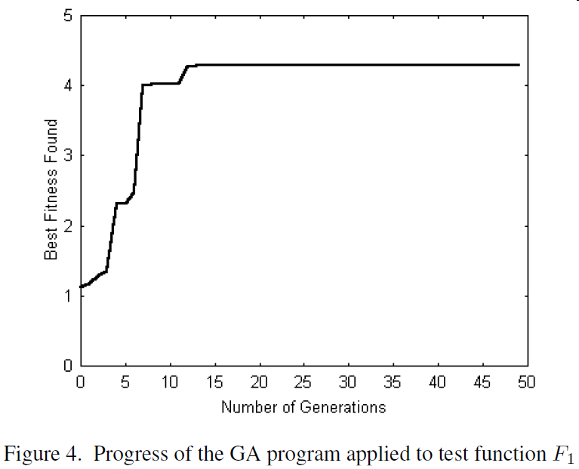
Experiment Results (cont)
Spring, 2013
C.-S. Shieh, EC, KUAS, Taiwan

Slide 30
Discussions
Important characteristics providing robustness
  They search from a population of points rather than a single point.
  The use the object function directly, not their derivative.
  They use probabilistic transition rules, not deterministic ones, to guide the search toward promising region.
Spring, 2013
C.-S. Shieh, EC, KUAS, Taiwan

Slide 31
Discussions (cont)
In effect, genetic algorithms maintain a population of candidate solutions and conduct stochastic searches via information selection and exchange.
It is well recognized that, with genetic algorithms, near-optimal solutions can be obtained within justified computation cost.
Spring, 2013
C.-S. Shieh, EC, KUAS, Taiwan

Slide 32
Discussions (cont)
However, it is difficult for genetic algorithms to pin point the global optimum.
In practice, a hybrid approach is recommended by incorporating gradient-based or local greedy optimization techniques.
In such integration, genetic algorithms act as course-grain optimizers and gradient-based method as fine-grain ones.
Spring, 2013
C.-S. Shieh, EC, KUAS, Taiwan

Slide 33
Discussions (cont)
The power of genetic algorithms originates from the chromosome coding and associated genetic operators.
It is worth paying attention to these issues so that genetic algorithms can explore the search space more efficiently.
Spring, 2013
C.-S. Shieh, EC, KUAS, Taiwan

Slide 34
Discussions (cont)
The selection factor controls the discrimination between superior and inferior chromosomes.
In some applications, more sophisticated reshaping of the fitness landscape may be required.
Other selection schemes (Whitley 1993), such as rank-based selection, or tournament selection are possible alternatives for the controlling of discrimination.
Spring, 2013
C.-S. Shieh, EC, KUAS, Taiwan

Slide 35
Variants
Parallel genetic algorithms
Island-model genetic algorithms
  maintain genetic diversity by splitting a population into several sub-populations, each of them evolves independently and occasionally exchanges information with each other
Spring, 2013
C.-S. Shieh, EC, KUAS, Taiwan

Slide 36
Variants (cont)
Multiple-objective genetic algorithms
  attempt to locate all near-optimal solutions by careful controlling the number of copies of superior chromosomes such that the population will not be dominated by the single best chromosome
Spring, 2013
C.-S. Shieh, EC, KUAS, Taiwan

Slide 37
Variants (cont)
Co-evolutionary systems
  have two or more independently evolved populations. The object function for each population is not static, but a dynamic function depends on the current states of other populations.
  This architecture vividly models interaction systems, such as prey and predator, virus and immune system.
Spring, 2013
C.-S. Shieh, EC, KUAS, Taiwan

Slide 38
Particle Swarm Optimization
Some social systems of natural species, such as flocks of birds and schools of fish, possess interesting collective behavior.
In these systems, globally sophisticated behavior emerges from local, indirect communication amongst simple agents with only limited capabilities.
Spring, 2013
C.-S. Shieh, EC, KUAS, Taiwan

Slide 39
Particle Swarm Optimization (cont)
Kennedy and Eberthart (1995) realized that an optimization problem can be formulated as that of a flock of birds flying across an area seeking a location with abundant food.
This observation, together with some abstraction and modification techniques, led to the development of a novel optimization technique – particle swarm optimization.
Spring, 2013
C.-S. Shieh, EC, KUAS, Taiwan

Slide 40
Particle Swarm Optimization (cont)
Particle swarm optimization optimizes an object function by conducting a population-based search.
The population consists of potential solutions, called particles, which are a metaphor of birds in flocks.
These particles are randomly initialized and freely fly across the multi-dimensional search space.
Spring, 2013
C.-S. Shieh, EC, KUAS, Taiwan

Slide 41
Particle Swarm Optimization (cont)
During flight, each particle updates its velocity and position based on the best experience of its own and the entire population.
The updating policy will drive the particle swarm to move toward region with higher object value, and eventually all particles will gather around the point with highest object value.
Spring, 2013
C.-S. Shieh, EC, KUAS, Taiwan

Slide 42
Step 1 Initialization
The velocity and position of all particles are randomly set to within pre-specified or legal range.
Spring, 2013
C.-S. Shieh, EC, KUAS, Taiwan

Slide 43
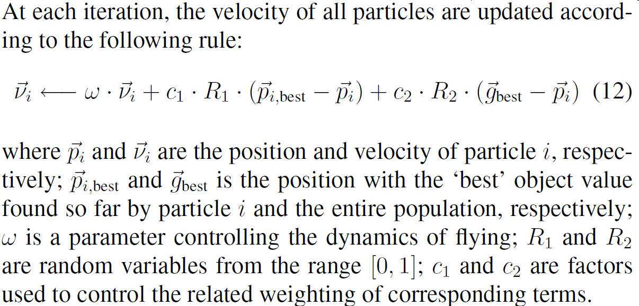
Step 2 Velocity Updating
Spring, 2013
C.-S. Shieh, EC, KUAS, Taiwan

Slide 44
Step 2 Velocity Updating (cont)
The inclusion of random variables endows the particle swarm optimization with the ability of stochastic searching.
The weighting factors, c₁ and c₂, compromises the inevitable tradeoff between exploration and exploitation.
After the updating, v_{i} should be checked and clamped to pre-specified range to avoid violent random walking.
Spring, 2013
C.-S. Shieh, EC, KUAS, Taiwan

Slide 45
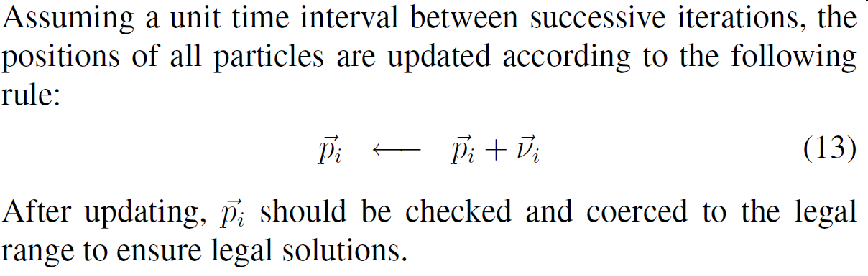
Step 3 Position Updating
Spring, 2013
C.-S. Shieh, EC, KUAS, Taiwan

Slide 46
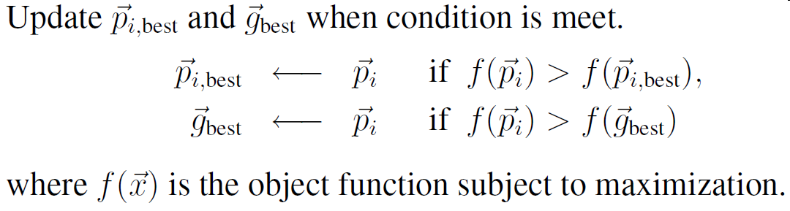
Step 4 Memory Updating
Spring, 2013
C.-S. Shieh, EC, KUAS, Taiwan

Slide 47
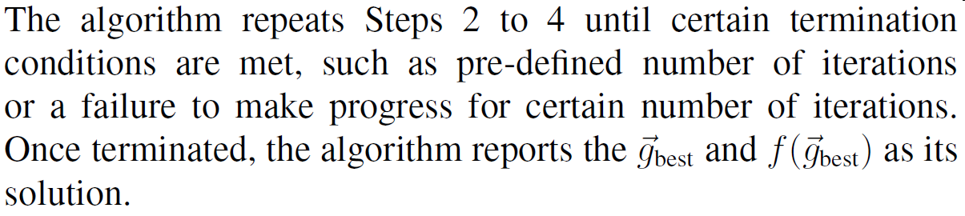
Step 5 Termination Checking
Spring, 2013
C.-S. Shieh, EC, KUAS, Taiwan

Slide 48
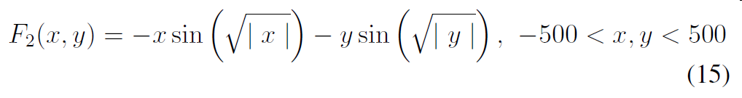
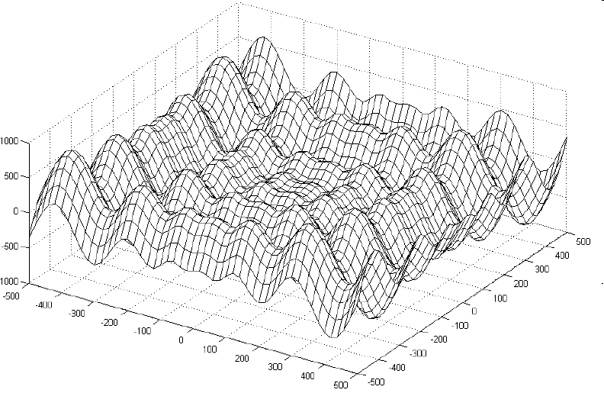
Test Function
Spring, 2013
C.-S. Shieh, EC, KUAS, Taiwan

Slide 49
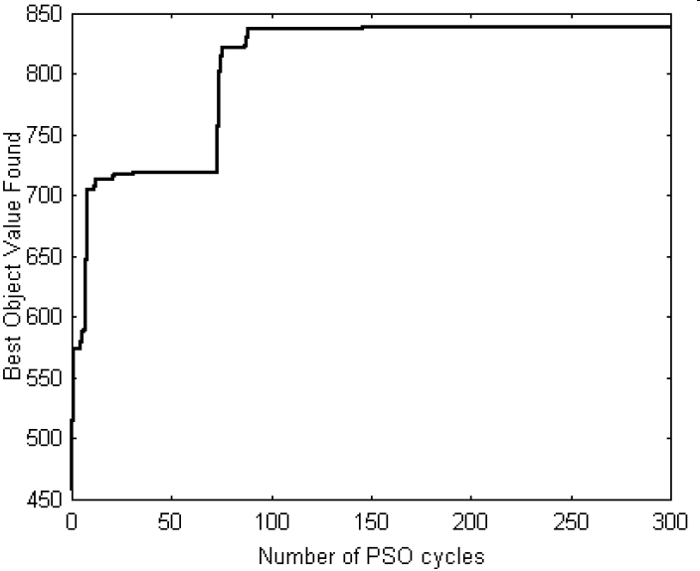
Experiment Results
Spring, 2013
C.-S. Shieh, EC, KUAS, Taiwan

Slide 50
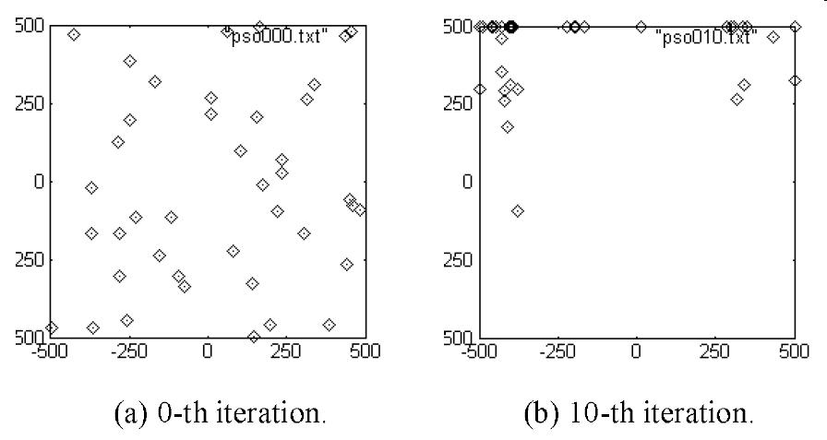
Distribution of Particles
Spring, 2013
C.-S. Shieh, EC, KUAS, Taiwan

Slide 51
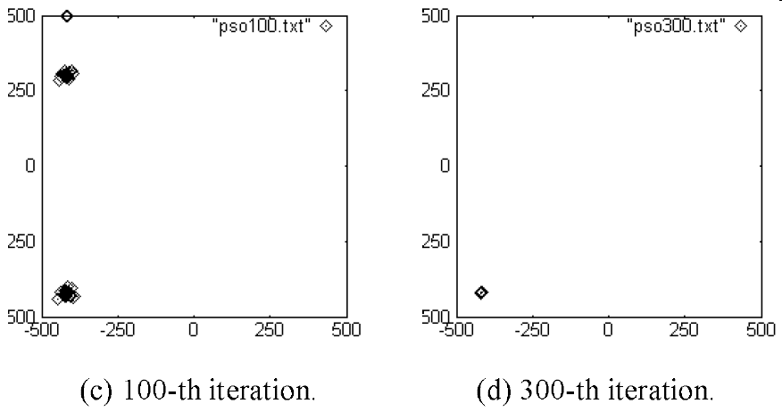
Distribution of Particles (cont)
Spring, 2013
C.-S. Shieh, EC, KUAS, Taiwan

Slide 52
Variants
A discrete binary version of the particle swarm optimization algorithm was proposed by Kennedy and Eberhart (1997).
Shi and Eberhart (2001) applied fuzzy theory to particle swarm optimization algorithm.
Successfully incorporated the concept of co-evolution in solving min-max problems (Shi and Krohling 2002).
(Chu et al. 2003) have proposed a parallel architecture with communication mechanisms for information exchange among independent particle groups, in which solution quality can be significantly improved.
Spring, 2013
C.-S. Shieh, EC, KUAS, Taiwan

Slide 53
Ant System
Inspired by the food-seeking behavior of real ants, Ant Systems, attributable to Dorigo et al. (Dorigo et al. 1996), has demonstrated itself to be an efficient, effective tool for combinatorial optimization problems.
Spring, 2013
C.-S. Shieh, EC, KUAS, Taiwan

Slide 54
Ant System (cont)
In nature, a real ant wandering in its surrounding environment will leave a biological trace, called pheromone, on its path.
The intensity of left pheromone will bias the path-taking decision of subsequent ants.
A shorter path will possess higher pheromone concentration and therefore encourage subsequent ants to follow it.
As a result, an initially irregular path from nest to food will eventually contract to a shorter path.
Spring, 2013
C.-S. Shieh, EC, KUAS, Taiwan

Slide 55
Ant System (cont)
With appropriate abstraction and modification, this observation has led to a number of successful computational models for combinatorial optimization.
Spring, 2013
C.-S. Shieh, EC, KUAS, Taiwan

Slide 56
Test Problem
Travelling Salesman Problem
In the TSP, a travelling salesman problem is looking for a route which covers all cities with minimal total distance.
Spring, 2013
C.-S. Shieh, EC, KUAS, Taiwan

Slide 57
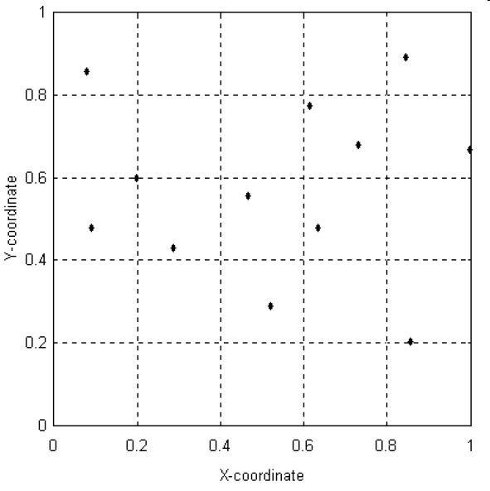
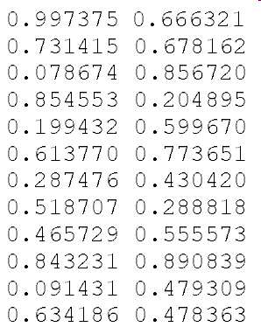
Test Problem (cont)
Spring, 2013
C.-S. Shieh, EC, KUAS, Taiwan

Slide 58
Operation
Suppose there are n cities and m ants.
The entire algorithm starts with initial pheromone intensity set to τ₀ on all edges.
In every subsequent ant system cycle, or episode, each ant begins its trip from a randomly selected starting city and is required to visit every city exactly once (a Hamiltonian Circuit).
The experience gained in this phase is then used to update the pheromone intensity on all edges.
Spring, 2013
C.-S. Shieh, EC, KUAS, Taiwan

Slide 59
Step 1 Initialization
Initial pheromone intensities on all edges are set to τ₀.
Spring, 2013
C.-S. Shieh, EC, KUAS, Taiwan

Slide 60
Step 2 Walking phase
In this phase, each ant begins its trip from a randomly selected starting city and is required to visit every city exactly once.
When an ant, the k-th ant for example, is located at city r and needs to decide the next city s, the path-taking decision is made stochastically based on the following probability function:
Spring, 2013
C.-S. Shieh, EC, KUAS, Taiwan

Slide 61
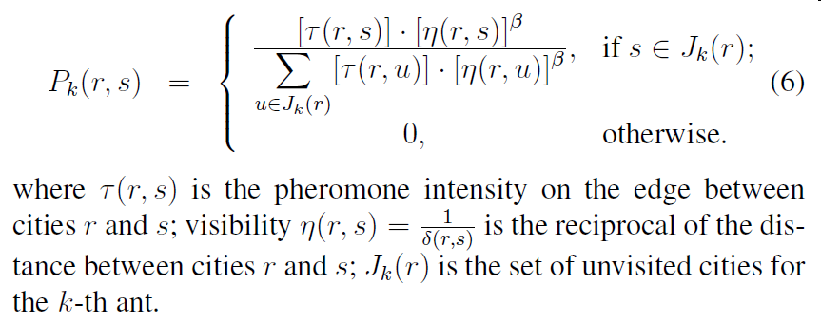
Step 2 Walking phase (cont)
Spring, 2013
C.-S. Shieh, EC, KUAS, Taiwan

Slide 62
Step 2 Walking phase (cont)
According to Equation 6, an ant will favor a nearer city or a path with higher pheromone intensity.
β is parameter used to control the relative weighting of these two factors.
During the circuit, the route made by each ant is recorded for pheromone updating in step 3.
The best route found so far is also tracked.
Spring, 2013
C.-S. Shieh, EC, KUAS, Taiwan

Slide 63
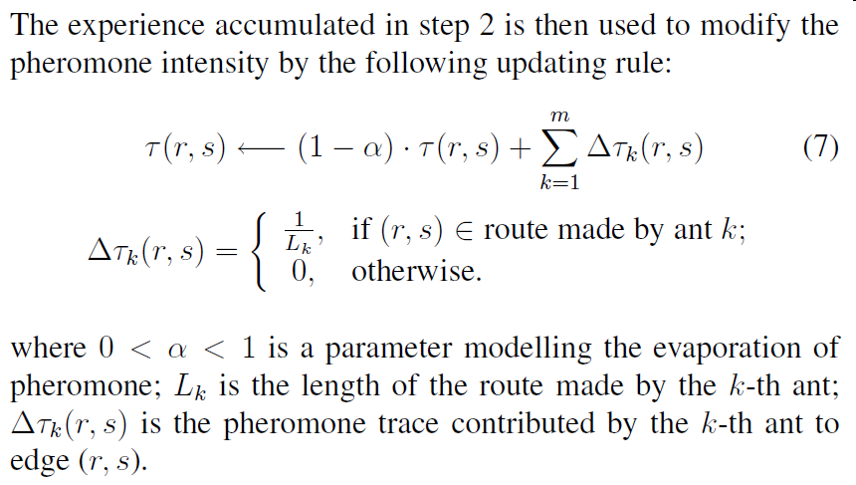
Step 3 Updating phase
Spring, 2013
C.-S. Shieh, EC, KUAS, Taiwan

Slide 64

Step 3 Updating phase (cont)
The updated pheromone intensities are then used to guide the path-taking decision in the next ant system cycle.
It can be expected that, as the ant system cycle proceeds, the pheromone intensities on the edges will converge to values reflecting their potential for being components of the shortest route.
The higher the intensity, the more chance of being a link in the shortest route, and vice visa.
Spring, 2013
C.-S. Shieh, EC, KUAS, Taiwan

Slide 65
Step 4 Termination Checking
Ant systems repeat Step 2 to Step 3 until certain termination criteria are met
  A pre-defined number of episodes is performed
  the algorithm has failed to make improvements for certain number of episodes.
Once terminated, ant system reports the shortest route found.
Spring, 2013
C.-S. Shieh, EC, KUAS, Taiwan

Slide 66
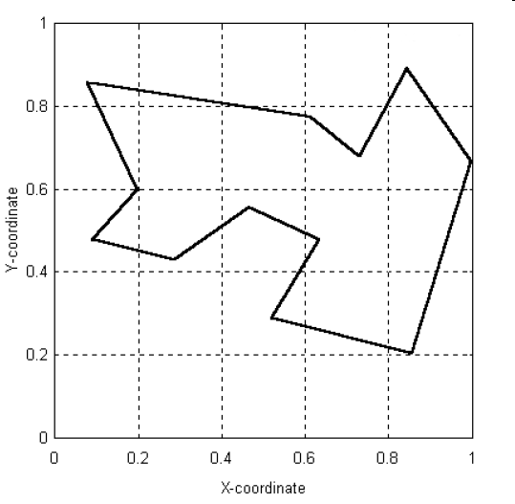
Experiment Results
Figure 6 reports a found shortest route of length 3.308, which is the truly shortest route validated by exhaustive search.
Spring, 2013
C.-S. Shieh, EC, KUAS, Taiwan

Slide 67
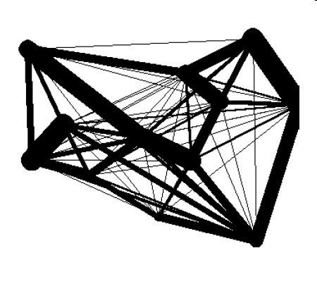
Experiment Results (cont)
Spring, 2013
C.-S. Shieh, EC, KUAS, Taiwan

Slide 68
Ant Colony System
A close inspection on the ant system reveals that the heavy computation required may make it prohibitive in certain applications.
Ant Colony Systems was introduced by Dorigo et al. (Dorigo and Gambardella 1997) to remedy this difficulty.
Spring, 2013
C.-S. Shieh, EC, KUAS, Taiwan

Slide 69
Ant Colony System (cont)
Ant colony systems differ from the simpler ant system in the following ways:
  Explicit control on exploration and exploitation
  Local updating
  Count only the shortest route in global updating
Spring, 2013
C.-S. Shieh, EC, KUAS, Taiwan

Slide 70
Explicit control on exploration and exploitation
When an ant is located at city r and needs to decide the next city s, there are two modes for the path-taking decision, namely exploitation and biased exploration.
Which mode to be used is governed by a random variable 0 < q < 1,
Spring, 2013
C.-S. Shieh, EC, KUAS, Taiwan

Slide 71
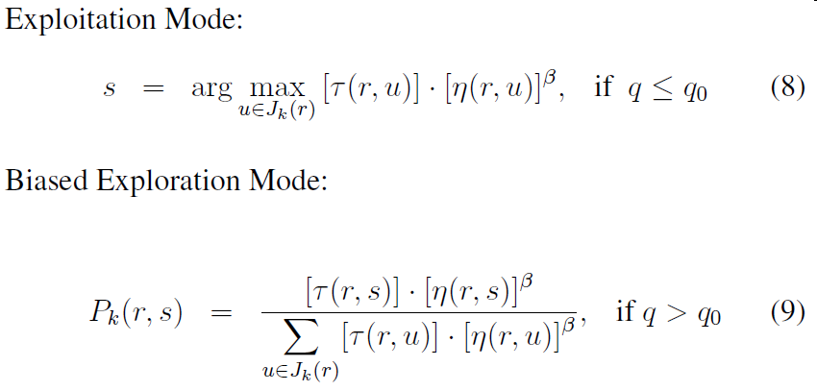
Explicit control on exploration and exploitation (cont)
Spring, 2013
C.-S. Shieh, EC, KUAS, Taiwan

Slide 72
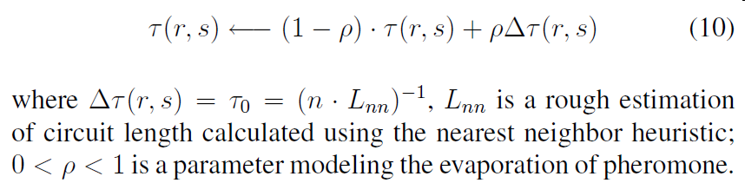
Local updating
A local updating rule is applied whenever a edge from city r to city s is taken:
Spring, 2013
C.-S. Shieh, EC, KUAS, Taiwan

Slide 73
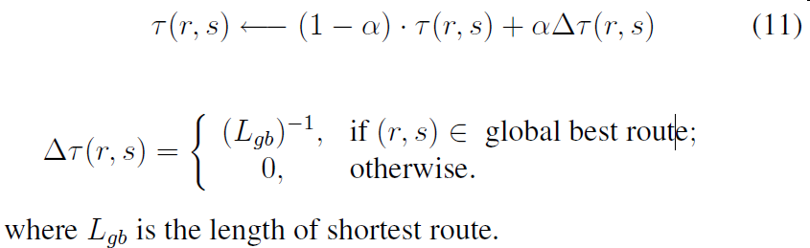
Count only the shortest route in global updating
As all ants complete their circuits, the shortest route found in the current episode is used in the global updating rule:
Spring, 2013
C.-S. Shieh, EC, KUAS, Taiwan

Slide 74
Discussion
In some respects, the ant system has implemented the idea of emergent computation – a global solution emerges as distributed agents performing local transactions, which is the working paradigm of real ants.
The success of ant systems in combinatorial optimization makes it a promising tool for dealing with a large set of problems in the NP-complete class (Papadimitriou and Steiglitz 1982).
Spring, 2013
C.-S. Shieh, EC, KUAS, Taiwan

Slide 75
Variants
In addition, the work of Wang and Wu (Wang and Wu 2001) has extended the applicability of ant systems further into continuous search space.
Chu et al. (2003) have proposed a parallel ant colony system, in which groups of ant colonies explore the search space independently and exchange their experiences at certain time intervals.
Spring, 2013
C.-S. Shieh, EC, KUAS, Taiwan

