Slide 1
4 Simulated Annealing
Xin-She Yang, Nature-Inspired Optimization Algorithms, Elsevier, 2014

Slide 2
Simulated annealing (SA) is a trajectory-based, random search technique for global optimization.
It mimics the annealing process in materials processing when a metal cools and freezes into a crystalline state with the minimum energy and larger crystal sizes so as to reduce the defects in metallic structures.

Slide 3
The annealing process involves the careful control of temperature and its cooling rate, often called the annealing schedule.

Slide 4
4.1 Annealing and Boltzmann Distribution
Simulated annealing was proposed by Kirkpatrick et al. in 1983.
The metaphor of SA came from the annealing characteristics in metal processing.

Slide 5
Unlike the gradient-based methods and other deterministic search methods that have the disadvantage of being trapped into local minima, SA’s main advantage is its ability to avoid being trapped in local minima.
In fact, it has been proved that simulated annealing will converge to its global optimality if enough randomness is used in combination with very slow cooling.

Slide 6
Metaphorically speaking, this is equivalent to dropping some bouncing balls over a landscape, and as the balls bounce and lose energy, they settle down to some local minima.
If the balls are allowed to bounce enough times and lose energy slowly enough, some of the balls will eventually fall into the globally lowest locations; hence the global minimum can be reached.

Slide 7
The basic idea of the SA algorithm is to use random search in terms of a Markov chain, which not only accepts changes that improve the objective function but also keeps some changes that are not ideal.
In a minimization problem, for example, any better moves or changes that decrease the value of the objective function f will be accepted; however, some changes that increase f will also be accepted with a probability p.

Slide 8
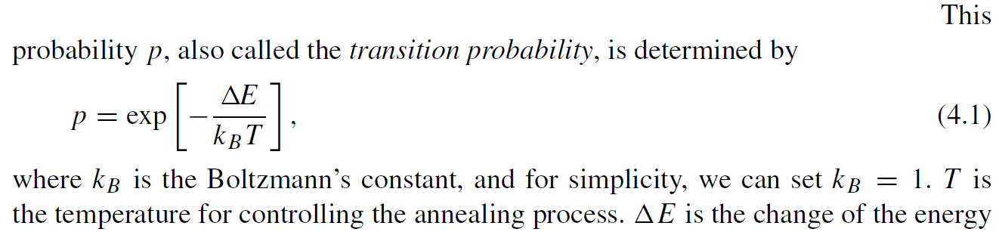

Slide 9
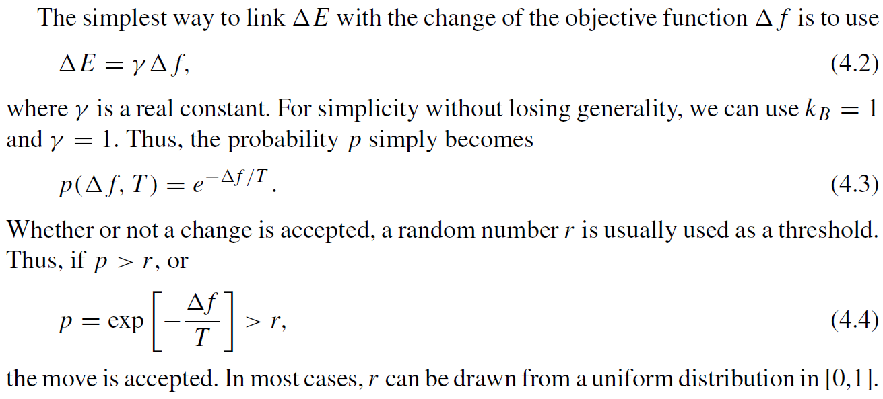

Slide 10
4.2 Parameters
Here the choice of the right initial temperature is crucially important.
For a given change Δf , if T is too high (T → ∞), then p → 1, which means almost all the changes will be accepted.
Random walk
If T is too low (T → 0), then any Δ f > 0 (worse solution) will rarely be accepted as p → 0.
Gradient-based method

Slide 11
If T is too high, the system is at a high energy state on the topological landscape, and the minima are not easily reached.
If T is too low, the system may be trapped in a local minimum (not necessarily the global minimum), and there is not enough energy for the system to jump out the local minimum to explore other minima, including the global minimum.
So, a proper initial temperature should be calculated.

Slide 12
Another important issue is how to control the annealing or cooling process so that the system cools down gradually from a higher temperature to ultimately freeze to a global minimum state.
There are many ways of controlling the cooling rate or the decrease of the temperature.

Slide 13
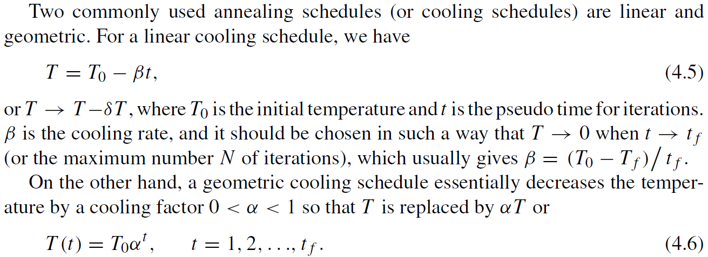

Slide 14
In addition, for a given temperature, multiple evaluations of the objective function are needed.
If there are too few evaluations, there is a danger that the system will not stabilize and subsequently will not converge to its global optimality.
If there are too many evaluations, it is time-consuming, and the system will usually converge too slowly.

Slide 15
There are two major ways to set the number of iterations: fixed or varied.
The first uses a fixed number of iterations at each temperature.
The second intends to increase the number of iterations at lower temperatures so that the local minima can be fully explored.

Slide 16
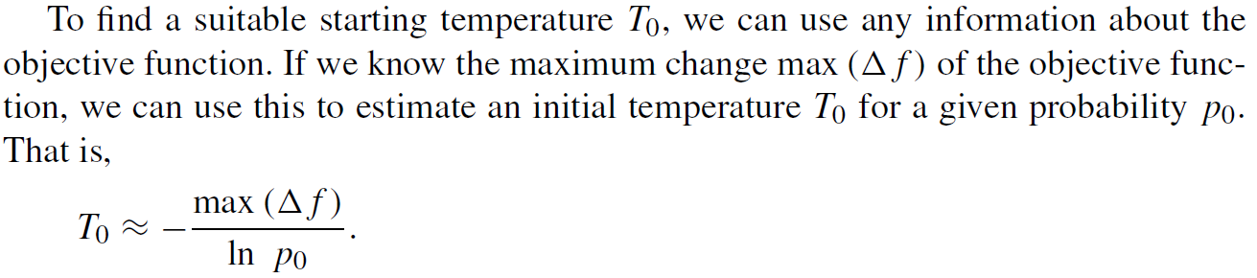
4.3 SA Algorithm

Slide 17
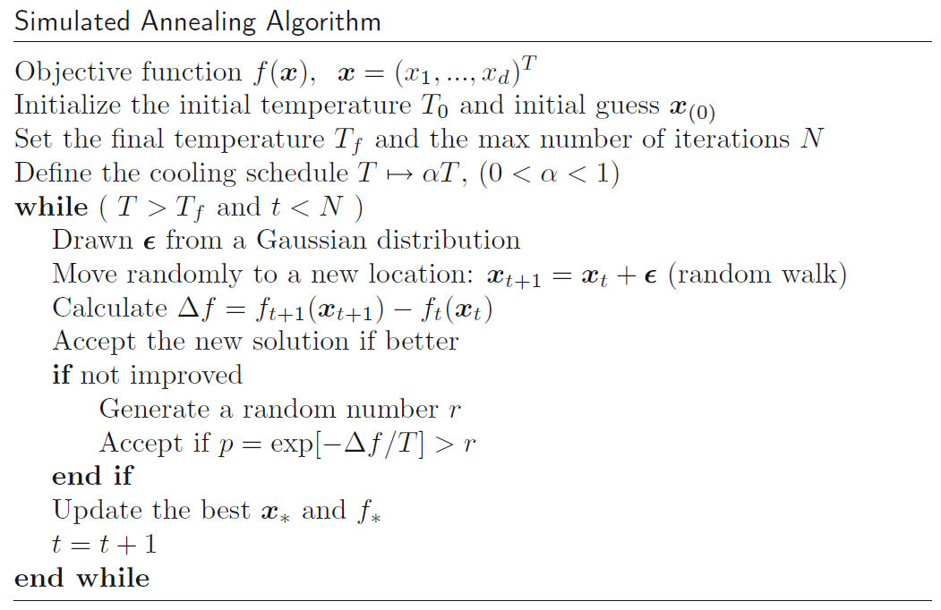

Slide 18
Pseudo code appears not entirely correct. There should be multiple evaluations for a particular temperature.

Slide 19
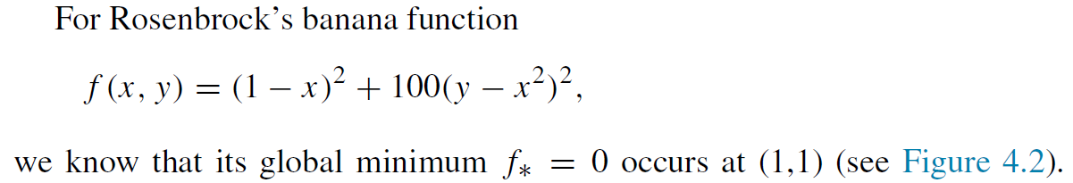

Slide 20
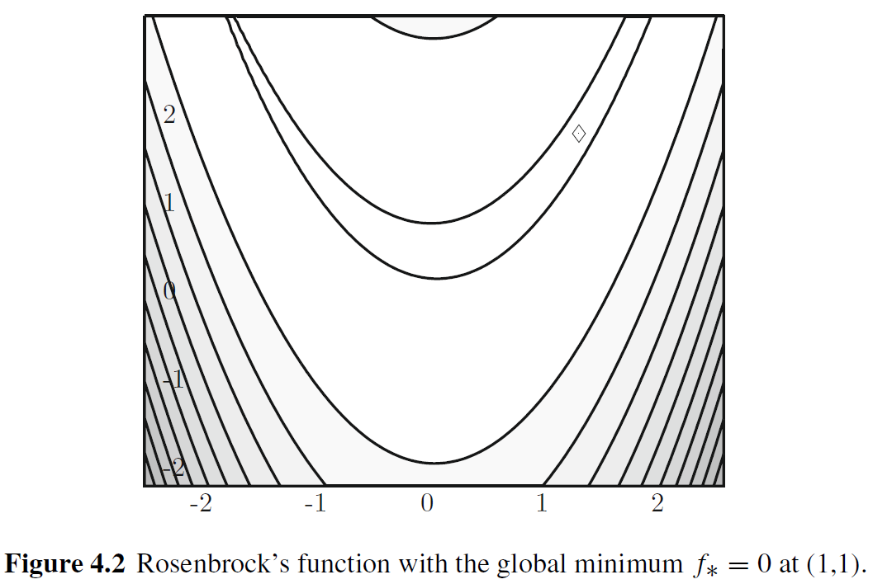

Slide 21
