Slide 1
6 Differential Evolution
Xin-She Yang, Nature-Inspired Optimization Algorithms, Elsevier, 2014.

Slide 2
Differential evolution (DE) is a vector-based metaheuristic algorithm that has good convergence properties.
This chapter provides a brief introduction to the basic differential evolution and its main implementation details and variants.

Slide 3
6.1 Introduction
Differential evolution, or DE, was developed in R. Storn and K. Price in their nominal papers in 1996 and 1997 [7,8].
DE is a vector-based metaheuristic algorithm, which has some similarity to pattern search and genetic algorithms due to its use of crossover and mutation with explicit updating equations.
DE uses real numbers as solution strings, so no encoding and decoding is needed.

Slide 4
Differential evolution carries out operations over each component.
Almost everything is done in terms of vectors.
Mutation: A difference vector of two randomly chosen population vectors is used to perturb an existing vector.
Crossover: A vector-based, component-wise exchange of chromosomes or vector segments.
Explicit updating equations.

Slide 5
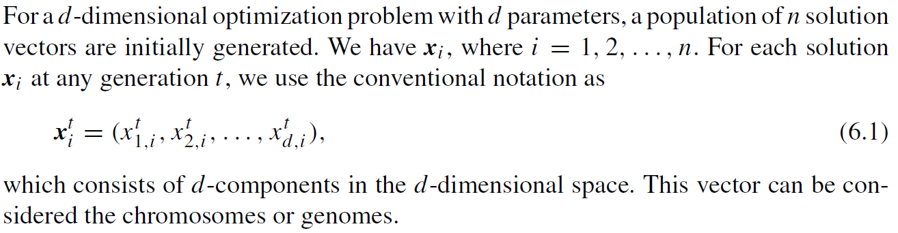
6.2 Differential Evolution

Slide 6
Differential evolution consists of three main steps: mutation, crossover, and selection.

Slide 7
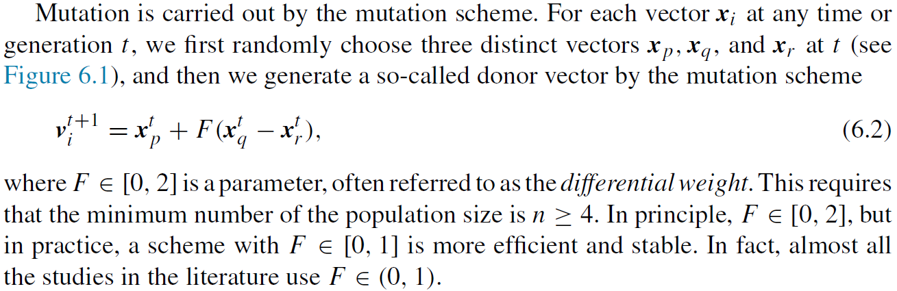

Slide 8
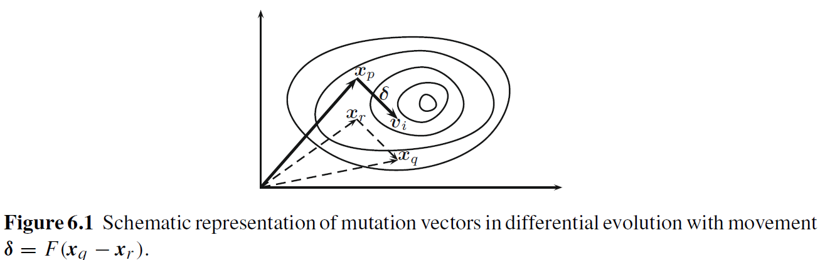

Slide 9
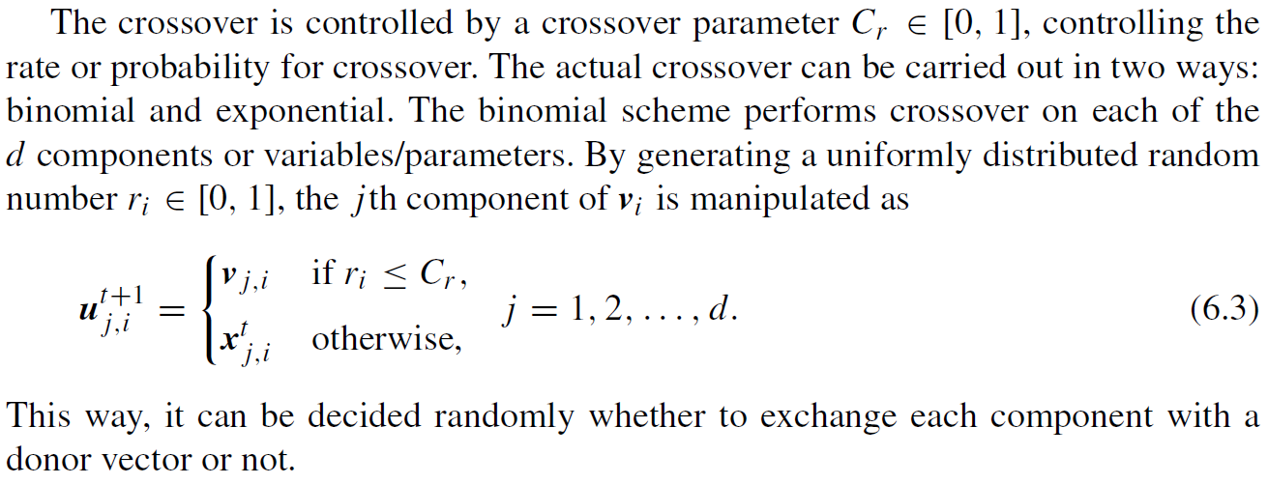

Slide 10
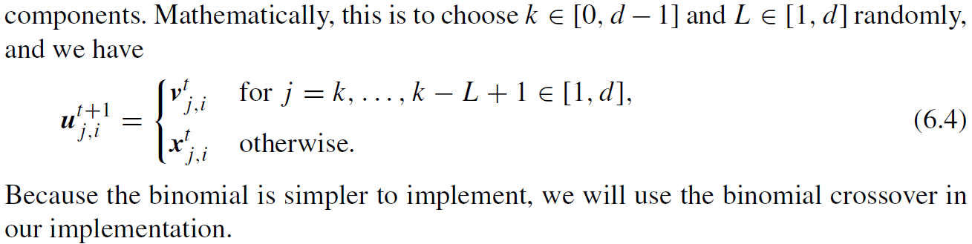

Slide 11
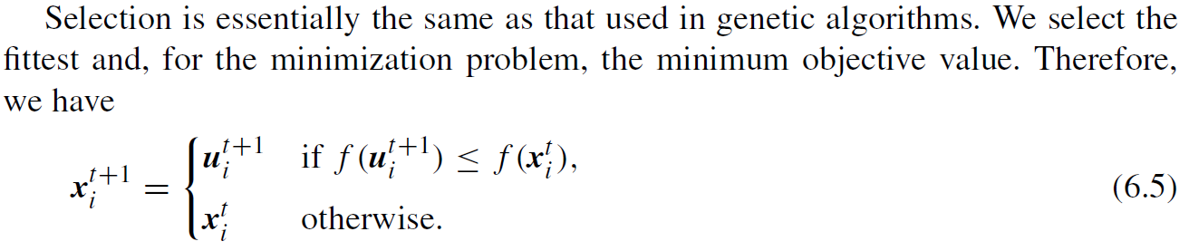

Slide 12
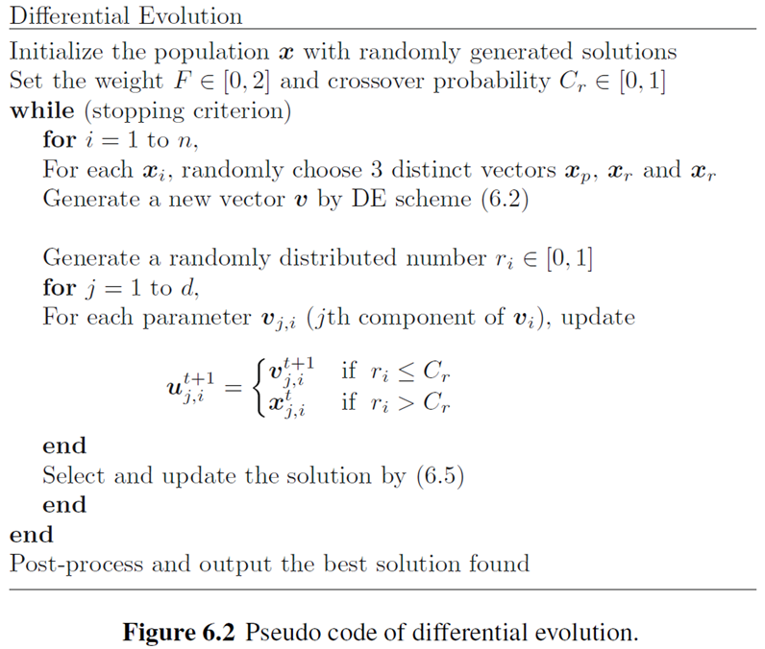

Slide 13
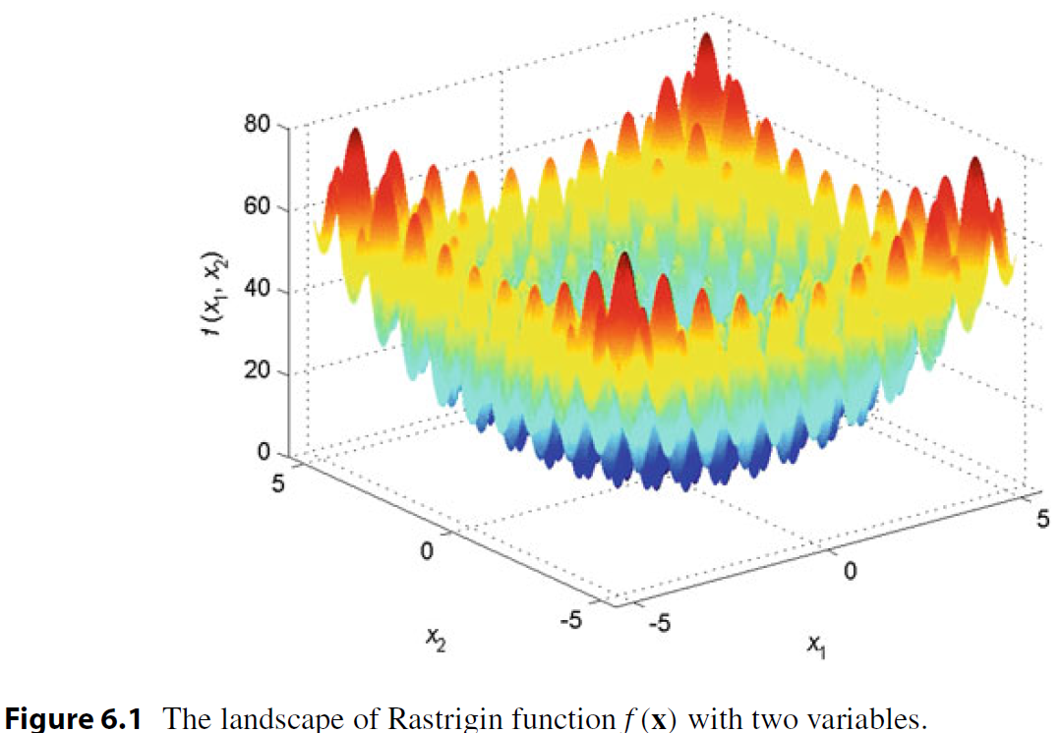
Ke-Lin Du and M.N.S. Swamy, Search and Optimization by Metaheuristics - Techniques and Algorithms Inspired by Nature, Springer, 2016.

Slide 14
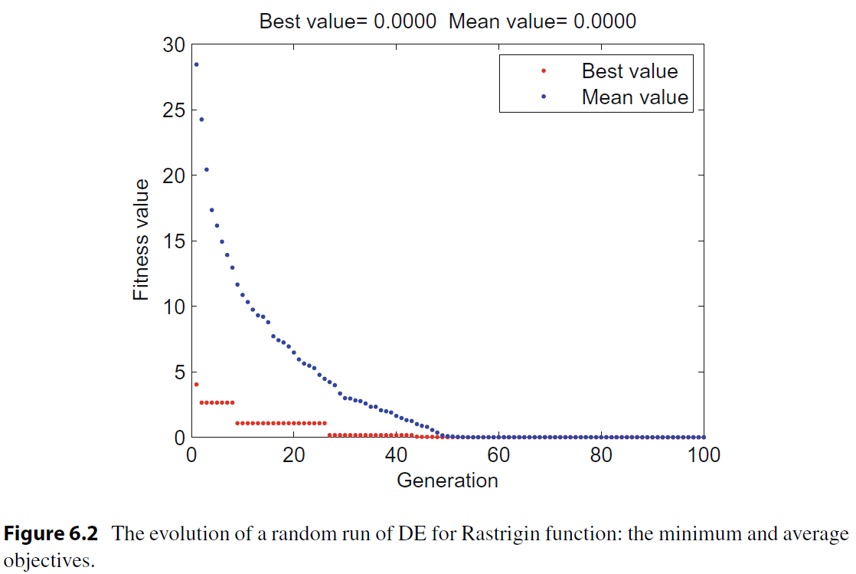

Slide 15
6.3 Variants

Slide 16
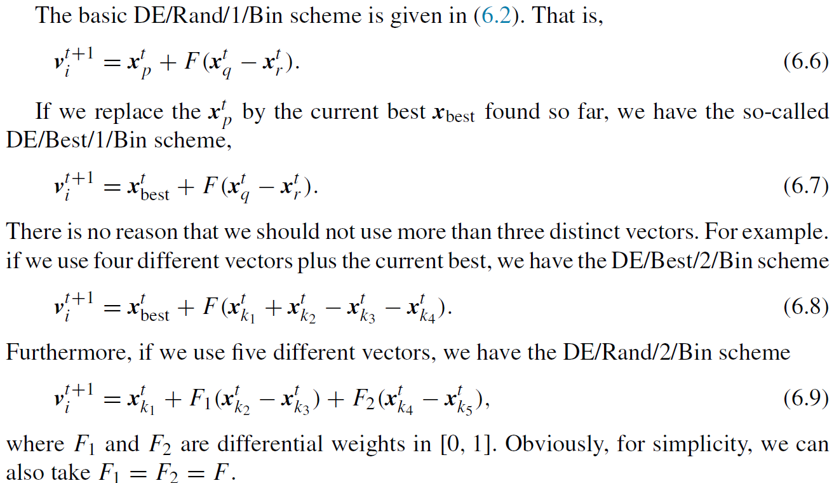
6.3 Variants

Slide 17
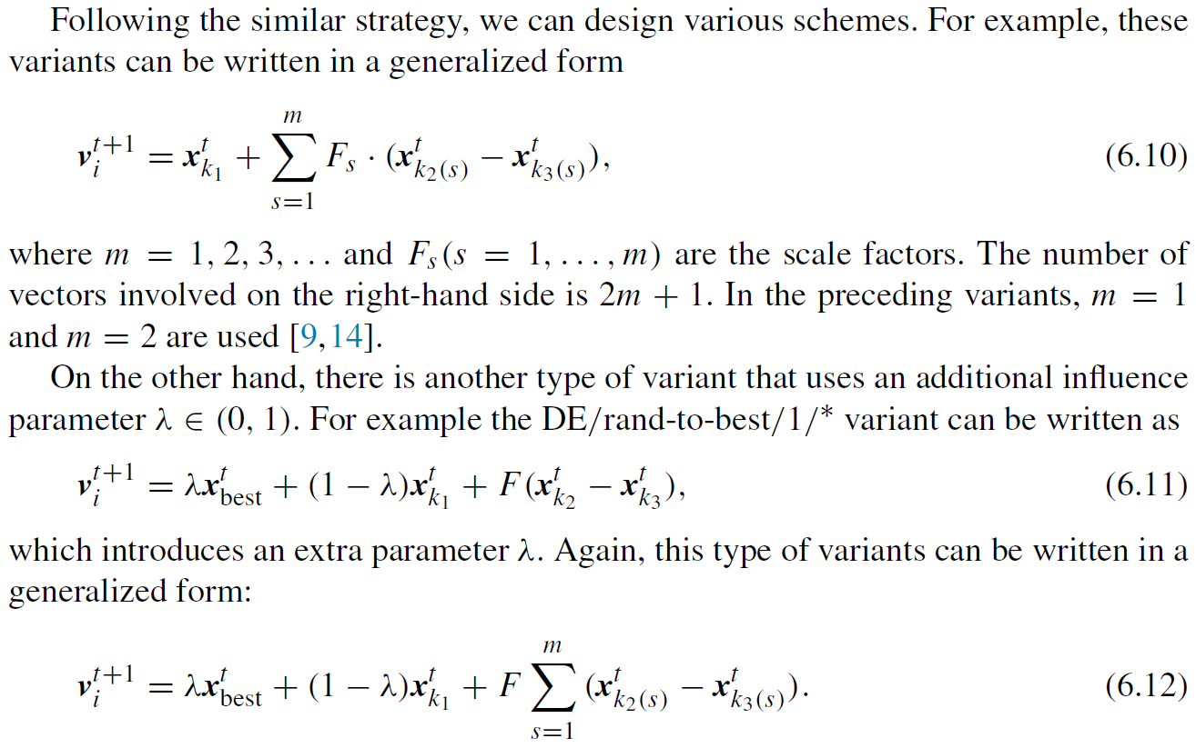

Slide 18
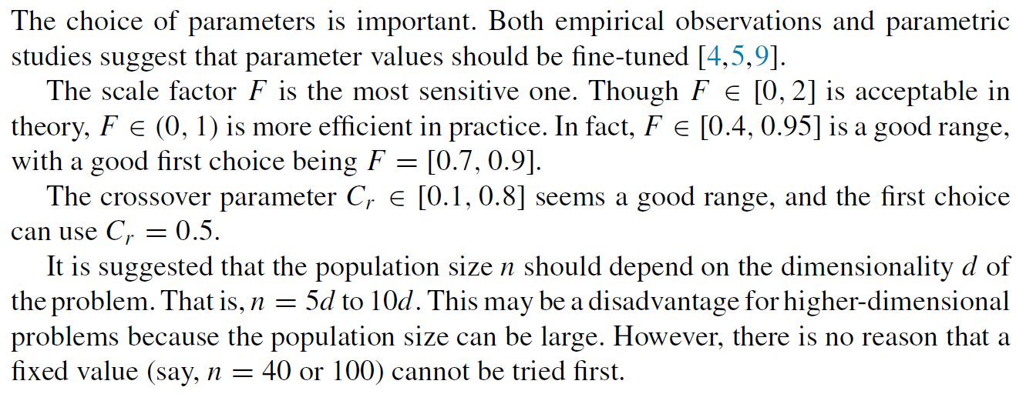
6.4 Choice of Parameters

