Slide 1
8 Firefly Algorithms
Xin-She Yang, Nature-Inspired Optimization Algorithms, Elsevier, 2014.

Slide 2
8.1 The Firefly Algorithm
FA was first developed by Xin-She Yang in late 2007 and published in 2008.
FA was based on the flashing patterns and behavior of fireflies.

Slide 3
8.1.1 Firefly Behavior
Two fundamental functions of such flashes
Attract mating partners
Attract potential prey
Two combined factors make most fireflies visible to a limit distance
The light intensity I decreases as the distance r increases in terms of I ∝ 1/r².
The air absorbs light, which becomes weaker and weaker as the distance increases.

Slide 4
8.1.2 Standard Firefly Algorithm
Three idealized rules
All fireflies are unisex
One firefly will be attracted to other fireflies regardless of their sex.
Attractiveness is proportional to a firefly’s brightness.
For any two flashing fireflies, the less brighter one will move toward the brighter one.
The attractiveness is proportional to the brightness, both of which decrease as their distance increases.
If there is no brighter one than a particular firefly, it will move randomly.

Slide 5
8.1.2 Standard Firefly Algorithm
The brightness of a firefly is affected or determined by the landscape of the objective function.

Slide 6
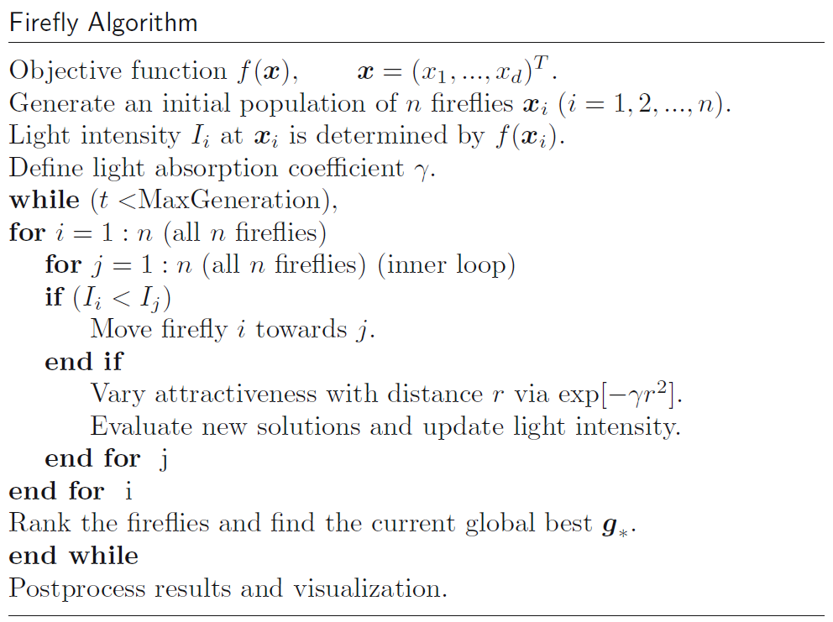

Slide 7
8.1.3 Variations of Light Intensity and Attractiveness
There are two important issues
Variation of light intensity
The brightness I of a firefly at a particular location x can be chosen as I(x) ∝ f(x)
Formulation of the attractiveness
The attractiveness β is relative; it should be seen in the eyes of the beholder or judged by the other fireflies.
Light attenuation
Light absorption

Slide 8
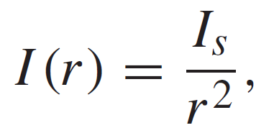
The light intensity I (r ) varies according to the inverse square law
where I_{s} is the intensity at the source.

Slide 9
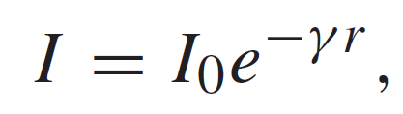
For a given medium with a fixed light absorption coefficient γ , the light intensity I varies with the distance r . That is,
where I₀ is the original light intensity at zero
distance r = 0

Slide 10
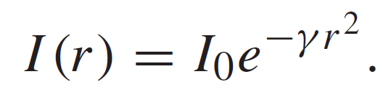
The combined effect of both the inverse-square law and absorption can be approximated as the following Gaussian form:

Slide 11
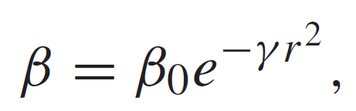
Because a firefly’s attractiveness is proportional to the light intensity seen by adjacent fireflies, we can now define the attractiveness β of a firefly by
where β0 is the attractiveness at r = 0.

Slide 12
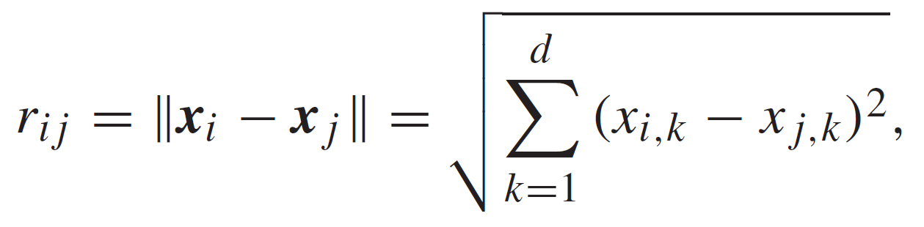
The distance between any two fireflies i and j at xi and xj , respectively, is the Cartesian distance
where xi,k is the kth component of the spatial
coordinate xi of i th firefly.

Slide 13
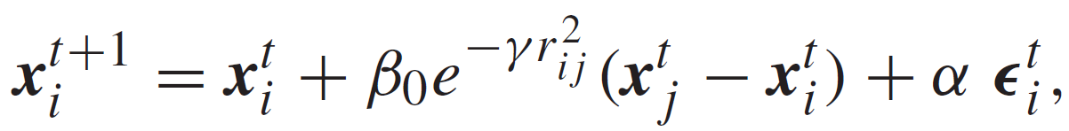
The movement of a firefly i attracted to another, more attractive (brighter) firefly j is determined by
where the second term is due to the attraction.
The third term is randomization, with α being the randomization parameter, and ϵ_{i} is a vector of random numbers drawn from a Gaussian distribution or uniform distribution.

Slide 14
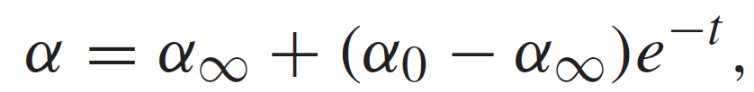

8.1.4 Controlling Randomization
A further improvement on the convergence of the algorithm is to vary the randomization parameter α so that it decreases gradually as the optima are approaching
or
where θ ∈ (0, 1]

Slide 15
Simulations indicated that the efficiency may improve if we add an extra term λ ϵ_{i} (g∗−xi ) to the updating formula, where g∗ is the current global optimum.

Slide 16
8.2 Algorithm Analysis

Slide 17
8.2.1 Scalings and Limiting Cases
In fact, any measure that can effectively characterize the quantities of interest in the optimization problem can be used as the “distance” r .
The initial locations of these n fireflies distribute relatively uniformly over the entire search space. As the iterations proceed, the fireflies would converge into all the local optima (including the global ones).

Slide 18
For γ → 0, the attractiveness is constant β = β_{0,} ➔ FA → Particle Swarm Optimization.
For γ → ∞, the attractiveness is zero in the sight of other fireflies ➔ FA → Simulated Annealing
Because the firefly algorithm is usually a case between these two extremes, it is possible to adjust the parameter γ and α so that it can outperform both simulated annealing and PSO.

Slide 19
A further advantage of FA is that different fireflies will work almost independently. It is thus particularly suitable for parallel implementation.

Slide 20
8.2.3 Special Cases of FA
DE, APSO, SA, and HS are special cases of FA.

Slide 21
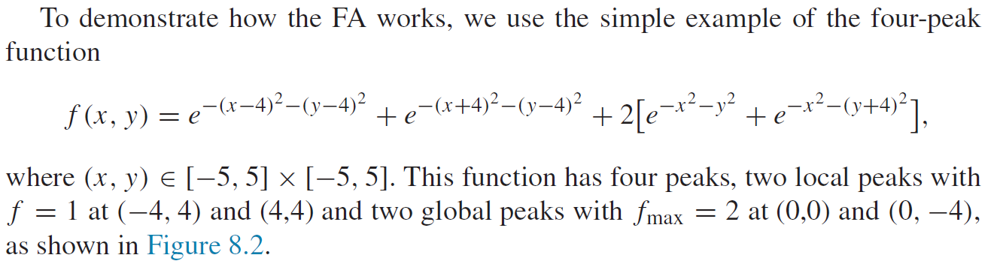
8.3 Implementation

Slide 22
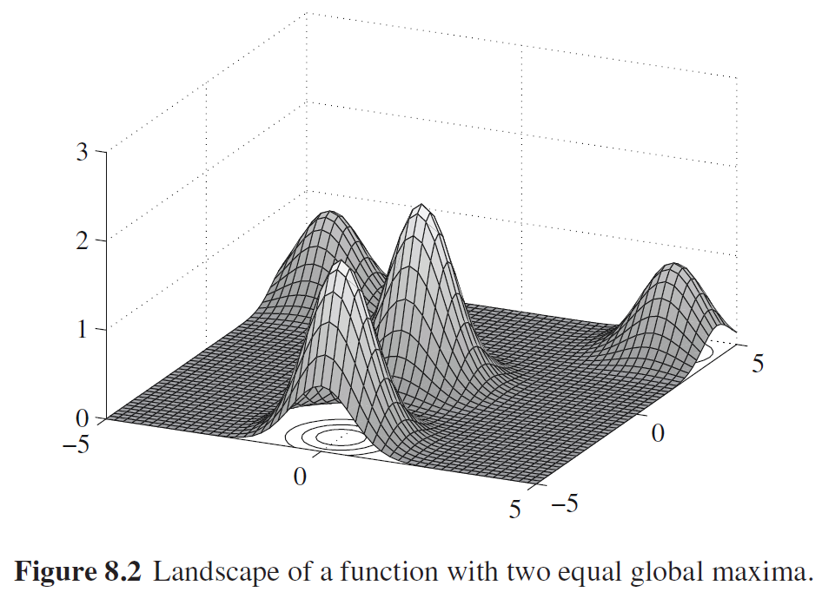

Slide 23
α₀ = 0.5, γ = 1 and β₀ = 1
25 fireflies in 20 generations

Slide 24
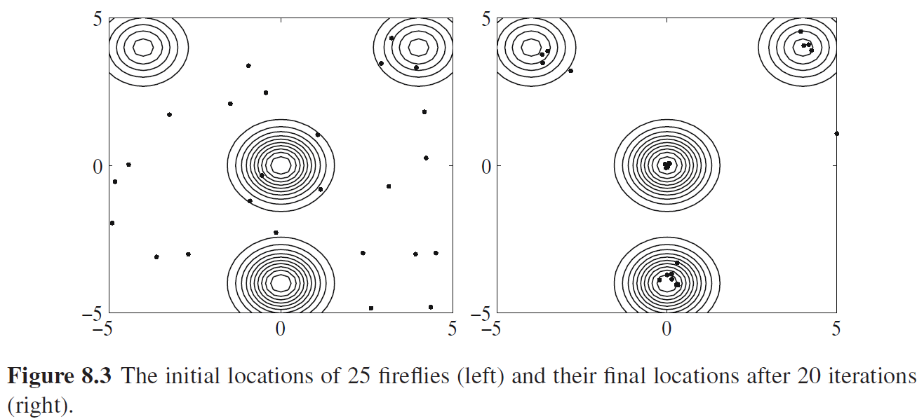

Slide 25
8.4 Variants of the Firefly Algorithm

Slide 26
8.4.1 FA Variants
Discrete firefly algorithm (DFA)
Chaotic firefly algorithm (CFA)
Lagrangian firefly algorithm (LFA)
Memetic firefly algorithm (MFA)
Multiobjective discrete firefly algorithm (MDFA)
Mulitobjective firefly algorithm (MOFA)
Multi-objective enhanced firefly algorithm (MOEFA)
Hybrid firefly algorithms (HFA)
Parallel firefly algorithm with predation (pFAP)

Slide 27
8.5 Firefly Algorithms in Applications
Digital image compression
Highly nonlinear, multimodal design problems
Antenna design optimization
Discrete version of FA that can efficiently solve NP-hard scheduling problems
Multi-objective load dispatch problems
Classifications and clustering

Slide 28
Non-convex economic dispatch problem with valve-loading effect
Economic load dispatch problems with reduced power losses
Traveling salesman problem by discrete FA
Scheduling jobs on grid computing
Mixed integer programming and load dispatch problems

Slide 29
Training neural networks
Isospectral spring-mass systems
Support vector regression with the chaos-based FA for stock market price forecasting

Slide 30
8.6 Why the Firefly Algorithm is Efficient
FA has two major advantages over other algorithms:
Automatic subdivision
Ability to deal with multimodality

Slide 31
First, FA is based on attraction and attractiveness. This leads to the fact that the whole population can automatically subdivide into subgroups, and each group can swarm around each mode or local optimum.

Slide 32
Second, this subdivision allows the fireflies to be able to find all optima simultaneously if the population size is sufficiently higher than the number of modes.
This automatic subdivision ability makes FA particularly suitable for highly nonlinear, multimodal optimization problems.

