Slide 1
Heuristic Optimization Methods
Introduction to Evolutionary Computation
David B. Fogel

Slide 2
1.1 Introduction
Darwinian evolution is intrinsically a robust search and optimization mechanism.
Inspired by natural evolution, (artificial) evolutionary computation can be an effective solution to difficult optimization problems when classical approaches are infeasible.
Evolutional computation is simple, robust, flexible, …

Slide 3
1.2 Advantages of Evolutionary Computation (Heuristic Methods)
Conceptual Simplicity
Broad Applicability
Outperform Classic Methods on Real Problems
Potential to Use Knowledge and Hybridize with Other Methods
Parallelism
Robust to Dynamic Changes
Capability for Self-Optimization
Able to Solve Problems That Have No Known Solutions

Slide 4
Limitation of EC
No guarantee on the solution quality
No guarantee on the convergence speed
Fine-tuning of control parameters

Slide 5
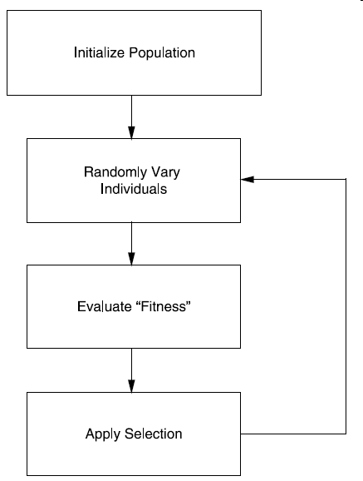
1.2.1 Conceptual Simplicity
EC is conceptually simple.
  Initialization
  Iterating
    Candidate generation
    Fitness evaluation
    Survival selection

Slide 6
1.2.1 Conceptual Simplicity (cont)
Regard the evolution as an iterative process: x[t+1]←s(v(x[t])
  x[]: representation of candidate solutions
    Binary string, list of floating-point numbers, solution tree, …
  v(): evolutionary operators for generating new candidate solutions
    Crossover, mutation, local search, …
  s(): selection schemes pick up survivals according to certain performance index, i.e. fitness function
    Tournament, truncation, linear ranking, exponential ranking, elitist, proportional, ...

Slide 7
1.2.2 Broad Applicability
Evolutionary algorithms can be applied to virtually any problem that can be formulated as a function optimization task.
  Discrete combinatorial problems, continuous-valued parameter optimization problems, mixed-integer problems, …
Representation, operators, and selection schemes are closely related, and ought to be carefully designed.

Slide 8
1.2.3 Outperform Classic Methods on Real Problems
Classical approaches fail at many real-world optimization problems with
  nonlinear constraints,
  non-stationary conditions,
  noisy observations or random processing,
  other vagaries,
  local optima or saddle points,
  non-differentiable,
  …
EC plays its role when classical methods fail.

Slide 9
1.2.4 Potential to Use Knowledge and Hybridize with Other Methods
It is always reasonable to incorporate domain-specific knowledge into an algorithm when addressing particular real-world problems.
Evolutionary algorithms offer a framework such that it is comparably easy to incorporate such knowledge.
Incorporating such information focuses the evolutionary search, yielding a more efficient exploration of the state space of possible solutions.
Evolutionary algorithms can also be combined with more traditional optimization techniques.

Slide 10
1.2.5 Parallelism
Evolution is a highly parallel process.
The evaluation of each solution can be handled in parallel, and only selection requires some serial processing.

Slide 11
1.2.6 Robust to Dynamic Changes
The ability to adapt on the fly to changing circumstance is of critical importance to practical problem solving.
Evolutionary algorithms can be used to adapt solutions to changing circumstance.

Slide 12
1.2.7 Capability for Self-Optimization
Most classic optimization techniques require appropriate settings of exogenous variables. This is true of evolutionary algorithms as well.
However, there is a long history of using the evolutionary process itself to optimize these parameters as part of the search for optimal solutions.

Slide 13
1.2.8 Able to Solve Problems That Have No Known Solutions
Perhaps the greatest advantage of evolutionary algorithms comes from the ability to address problems for which there are no human experts.

Slide 14
1.3 Current Developments
The same framework of initially different works
  genetic algorithm
  evolution strategies
  evolutionary programming
  …

Slide 15
1.3.1 Review of Some Historical Theory in Evolutionary Computation
1.3.2 No Free Lunch Theorem
1.3.3 Computational Equivalence of Representations
1.3.4 Schema Theorem in the Presence of Random Variation
1.3.5 Two-Armed Bandits and the Optimal Allocation of Trials

Slide 16
1.4 Conclusions
The flexibility of evolutionary algorithms to address general optimization problems using
  virtually any reasonable representation and performance index,
  with variation operators that can be tailored for the problem at hand and
  selection mechanisms tuned for the appropriate level of stringency,
gives these techniques an advantage over classic numerical optimization procedures.

