Slide 1
2 Fundamentals of Genetic Algorithms
Alexandre P. Alves da Silva and Djalma M. Falca˜o

Slide 2
2.1 Introduction
Main design issues in tailoring GAs to large-scale optimization problems
  Encoding schemes
  Selection procedures
  Self-adaptive and knowledge-based operators

Slide 3
2.2 Modern Heuristic Search Techniques
Traditional optimization techniques begin with a single candidate and search iteratively for the optimal solution by applying static heuristics.
On the other hand, the GA approach uses a population of candidates to search several areas of a solution space, simultaneously and adaptively.

Slide 4
2.2 Modern Heuristic Search Techniques (cont)
With GAs
  No need for explicit objective function (can be a black box)
  Object functions need not to be differentiable
  Good at combinatorial optimization problems, achieving high-quality solutions within reasonable run time
Heuristic optimization accepts inferior candidate solution “occasionally” in order to escape from local optima.

Slide 5
2.2 Modern Heuristic Search Techniques (cont)
The choice of representation for a GA is fundamental to achieving good results.
Hybrid methods have been proposed in order to improve the robustness of the search.
  Heuristic method as coarse-grain optimizer
  Local search as fine-grain optimizer

Slide 6
2.3 Introduction to GAs
Genetic algorithms operate on a population of individuals. Each individual is a potential solution to a given problem.
After an initial population is randomly or heuristically generated, the algorithm evolves the population through sequential and iterative application of three operators: selection, crossover, and mutation.

Slide 7
2.3 Introduction to GAs (cont)
Incorporate prior knowledge whenever possible, but not restrict the population diversity.
The population size an inevitable tradeoff between computational cost and solution quality.
The coding scheme and the fitness function are the most important aspects of any GA, because they are problem dependent.

Slide 8
2.4 Encoding
A decision must be taken on how the parameters of the problem will be mapped into a finite string of symbols, known as genes (with constant or dynamic length), encoding a possible solution in a given problem space.
The symbol alphabet used is often binary, though other representations have also been used, including character-based and real-valued encodings.
Design GA operators to effectively operate on the representation.

Slide 9
2.5 Fitness Function
It is useful to distinguish between the objective function and the fitness function used by a GA.
The specification of an appropriate fitness function is crucial for the correct operation of a GA.
Reshaping is applied if needed.

Slide 10
2.5 Fitness Function (cont)
Four basic techniques for handling constraints when using GAs.
  Discard infeasible chromosomes
  Repair infeasible chromosomes
  Problem-specific GA operators
  Penalty functions

Slide 11
2.5 Fitness Function (cont)
Some problems associated with the fitness function specification are the following:
  Dependence on whether the problem is related to maximization or minimization;
  When the fitness function is noisy for a nondeterministic environment;
  The fitness function may change dynamically as the GA is executed;
  The fitness function evaluation can be so time consuming that only approximations to fitness values can be computed;
  The fitness function should allocate very different values to strings in order to make the selection operator work easier;
  It must consider the constraints of the problem; and
  It could incorporate different sub-objectives.

Slide 12
2.5 Fitness Function (cont)
The fitness function is a black box for the GA. Internally, this may be achieved by a mathematical function, a simulator program, or a human expert that decides the quality of a string.

Slide 13
2.5.1 Premature Convergence
Once the population has converged, the ability of the GA to continue searching for better solutions is nearly eliminated.
Crossover of almost identical chromosomes generally produces similar offspring. Only mutation, with its random perturbation mechanism, remains to explore new regions of the search space.

Slide 14
2.5.1 Premature Convergence (cont)
Control the number of reproductive opportunities each individual gets.
The strategy is to compress the range of fitness, without loosing selection pressure, and avoid any super-fit individual from suddenly dominating the population.

Slide 15
2.5.2 Slow Finishing
This is the opposite problem of premature convergence.
After many generations, the average fitness is high, and the difference between the best and the average individuals is small. Therefore, there is insufficient variance in the fitness function values to localize the maxima.
An expansion of the range of population fitness is produced, instead of a compression.

Slide 16
2.6 Basic Operators
Several important design issues for the selection, crossover, and mutation operators are presented
  Selection implements the survival of the fittest according to some predefined fitness function
  Crossover is likely to create even better individuals by recombining portions of good individuals
  Mutation operator is to maintain diversity within the population and inhibit premature convergence to local optima by randomly sampling new points in the search space

Slide 17
2.6.1 Selection
Selection pressure is the degree to which the best individuals are favored.
The convergence rate of a GA is determined largely by the magnitude of the selection pressure.
Reshaping of fitness functions to control the selection pressure
  compression or expansion

Slide 18
2.6.1 Selection (cont)
Two classes of selection schemes
  Proportionate-based schemes select individuals based on their fitness values relative to the fitness of the other individuals in the population.
  Ordinal-based schemes select individuals not based on their fitness but based on their rank within the population.

Slide 19
Objective values: 1,2,10,99,100
Proportionate-based: 1,2,10,99,100
Ordinal-based: 1,2,3,4,5
Exponential ranking: 1,4,9,16,25

Slide 20
2.6.1.1 Tournament Selection
This selection scheme is implemented by choosing some number of individuals randomly from the population, copying the best individual from this group into the intermediate population, and repeating it until the mating pool is complete.
By adjusting the tournament size, the selection pressure can be made arbitrarily large or small. Bigger tournaments have the effect of increasing the selection pressure.

Slide 21
2.6.1.2 Truncation Selection
In truncation selection, only a subset of the best individuals is chosen to be possibly selected, with the same probability.

Slide 22
2.6.1.3 Linear Ranking Selection
The individuals are sorted according to their fitness values.
The selection probability is linearly assigned to the individuals according to their ranks.

Slide 23
2.6.1.4 Exponential Ranking Selection
Exponential ranking selection differs from linear ranking selection only in that the probabilities of the ranked individuals are exponentially weighted.

Slide 24
2.6.1.5 Elitist Selection
Preservation of the elite solutions from the preceding generation ensures that the best solutions known so far will remain in the population and have more opportunities to produce offspring.
Elitist selection is used in combination with other selection strategies.

Slide 25
2.6.1.6 Proportional Selection
The probability that an individual will be selected is simply proportionate to its fitness value.
The selection probabilities strongly depend on the scaling of the fitness function.
There are different scaling operators that help in separating the fitness values in order to improve the work of the proportional selection mechanism. The most common ones are linear scaling, sigma truncation, and power scaling.

Slide 26
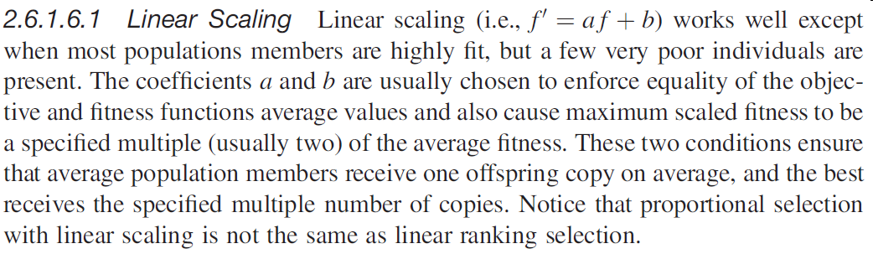
2.6.1.6.1 Linear Scaling

Slide 27
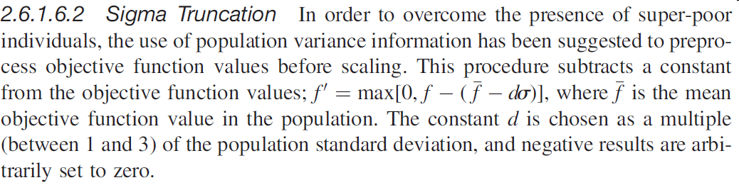
2.6.1.6.2 Sigma Truncation

Slide 28
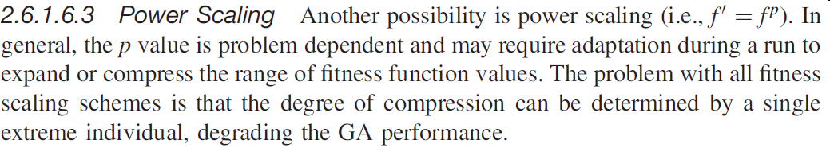
2.6.1.6.3 Power Scaling

Slide 29
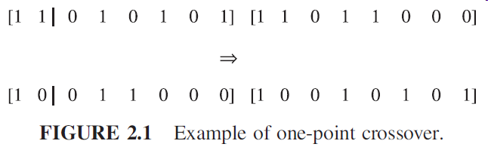
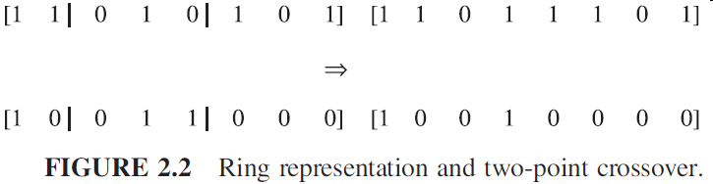
2.6.2 Crossover
Crossover exchanges genes of two chromosomes.

Slide 30
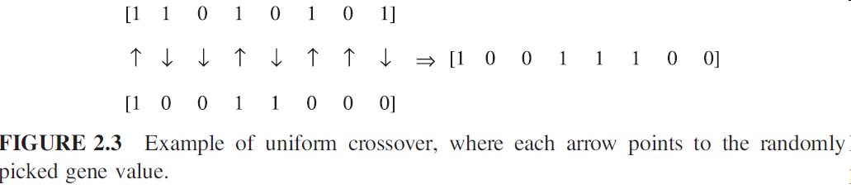
2.6.2 Crossover (cont)
Uniform crossover is another important recombination mechanism [25]. Offspring is created by randomly picking each bit from either of the two parent strings (Fig. 2.3).

Slide 31
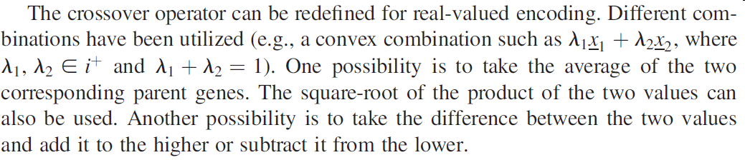
2.6.2 Crossover (cont)
Crossover is a very controversial operator due to its disruptive nature (i.e., it can split important information).

Slide 32
2.6.3 Mutation
The GA literature has reflected a growing recognition of the importance of mutation in contrast with viewing it as responsible for reintroducing inadvertently lost gene values.
The mutation operator is more important at the final generations when the majority of the individuals present similar quality.
As is shown in Section 2.6.4, a variable mutation rate is very important for the search efficiency. Its setting is much more critical than that of crossover rate.

Slide 33
2.6.3 Mutation (cont)
In the case of binary encoding, mutation is carried out by flipping bits at random, with some small probability (usually in the range [0.001; 0.05]).
For real-valued encoding, the mutation operator can be implemented by random replacement (i.e., replace the value with a random one).
Another possibility is to add/subtract (or multiply by) a random (e.g., uniformily or Gaussian distributed) amount.
Mutation can also be used as a hill-climbing mechanism.

Slide 34
2.6.4 Control Parameters Estimation
Typical values for the population size, crossover, and mutation rates have been selected in the intervals [30, 200], [0.5, 1.0], and [0.001, 0.05], respectively.
Tuning parameters manually is common practice in GA design.
The GA search technique is an adaptive process, which requires continuous tracking of the search dynamics. Therefore, the use of constant parameters leads to inferior performance.

Slide 35
2.7 Niching Methods
The identification of multiple optima is beneficial for the GA performance.
Niching methods extend standard GAs by creating stable subpopulations around global and local optimal solutions.
Niching methods maintain population diversity and allow GAs to explore many peaks simultaneously. They are based on either fitness sharing or crowding schemes.

Slide 36
2.7 Niching Methods (cont)
Fitness sharing decreases each element’s fitness proportionately to the number of similar individuals in the population (i.e., in the same niche). The similarity measure is based on either the genotype (e.g., Hamming distance) or the phenotype (e.g., Euclidian distance).

Slide 37
2.7 Niching Methods (cont)
Crowding implicitly defines neighborhood by the application of tournament rules. It can be implemented as follows. When an offspring is created, one individual is chosen, from a random subset of the population, to disappear. The chosen one is the element that most closely resembles the new offspring.

Slide 38
2.7 Niching Methods (cont)
Another idea used by niching methods is restricted mating. This mechanism avoids the recombination of individuals that do not belong to the same niche.
Highly fit, but not similar, parents can produce highly unfit offspring. Restricted mating is based on the assumption that if similar parents (i.e., from the same niche) are mated, then offspring will be similar to them.

Slide 39
2.8 Parallel Genetic Algorithms
In several cases, the application of GAs to actual problems in business, engineering, and science requires long processing time (hours, days). Most of this time is usually spent in thousands of fitness function evaluations that may involve long calculations.
Fortunately, these evaluations can be performed quite independently of each other, which makes GAs very adequate for parallel processing.

Slide 40
2.8 Parallel Genetic Algorithms (cont)
The usual classification of parallel GAs found in the literature is
  Single-population master–slave GAs: One master node executes the basic GA operations (selection, crossover, and mutation), and the fitness evaluations are distributed among several slave processors.
  Multiple-population GAs: This type of GA consists of several subpopulations that exchange individuals occasionally.

Slide 41
2.8 Parallel Genetic Algorithms (cont)
  Fine-grained GAs: These consist of a single spatially structured population, usually in a two-dimensional rectangular grid, with one individual per grid point. The fitness evaluation is performed simultaneously for all the individuals, and selection and mating are usually restricted to a small neighborhood around each individual. This type of parallel GA is well suited for massively parallel multiple instruction, multiple data (MIMD) computers.

