Slide 1
4 Fundamentals of Particle Swarm Optimization Techniques
Yoshikazu Fukuyama

Slide 2








4.1 Introduction
Eberhart and Kennedy developed particle swarm optimization (PSO) based on the analogy of swarms of birds and fish schooling.
Each individual exchanges previous experiences in PSO.
These research efforts are called swarm intelligence.

Slide 3
4.2 Basic Particle Swarm Optimization

Slide 4

4.2.1 Background of Particle Swarm Optimization
Swarm behavior can be modeled with a few simple rules.
Schools of fishes and swarms of birds can be modeled with such simple models.
Even if the behavior rules of each individual (agent) are simple, the behavior of the swarm can be complicated.

Slide 5





4.2.1 Background of Particle Swarm Optimization (cont)
Boyd and Richerson examined the decision process of humans and developed the concept of individual learning and cultural transmission.
People utilize two important kinds of information in decision process: their own experience and other people’s experiences.

Slide 6
4.2.2 Original PSO
Kennedy and Eberhart developed PSO through simulation of bird flocking in a two-dimensional space.
Bird flocking optimizes a certain objective function.
Each agent knows its best value so far (pbest) and its x, y position. This information is an analogy of the personal experiences of each agent.

Slide 7

4.2.2 Original PSO (cont)
each agent knows the best value so far in the group (gbest) among pbests. This information is an analogy of the knowledge of how the other agents around them have performed.

Slide 8
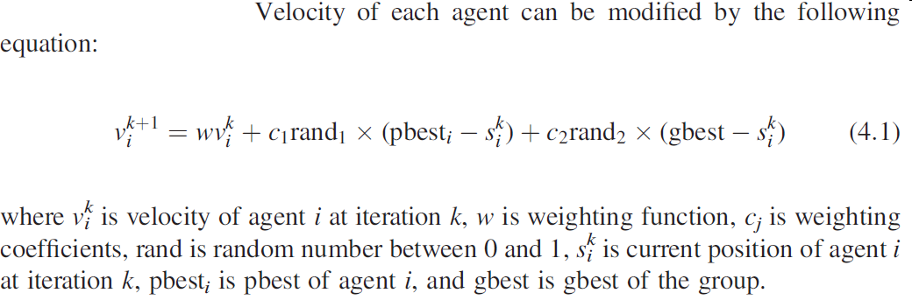















4.2.2 Original PSO (cont)
First term in (4.1) is for exploration, the 2nd and 3rd terms are for exploitation.

Slide 9
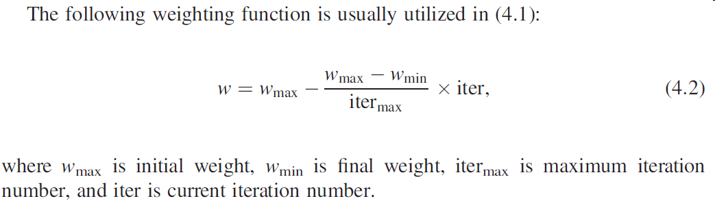









4.2.2 Original PSO (cont)
At the beginning of the search procedure, diversification is heavily weighted, while intensification is heavily weighted at the end of the search procedure.

Slide 10

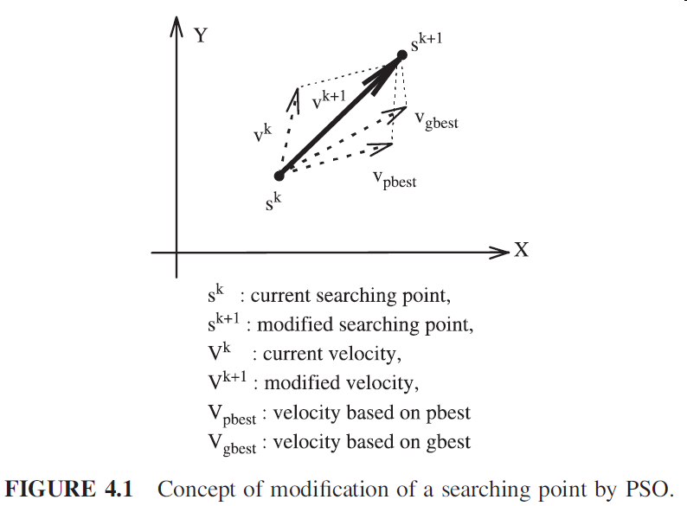















4.2.2 Original PSO (cont)

Slide 11

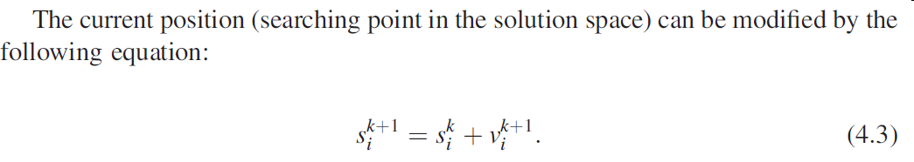

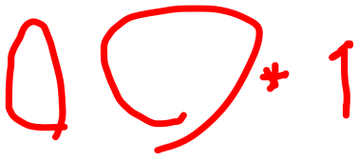
4.2.2 Original PSO (cont)

Slide 12
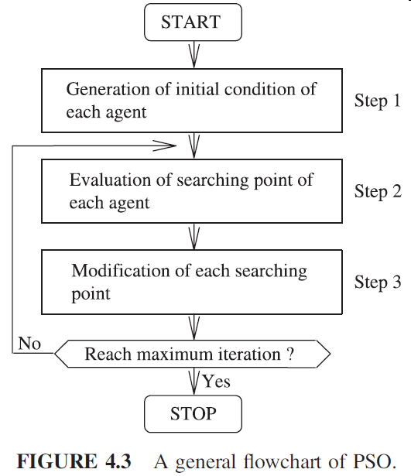



4.2.2 Original PSO (cont)

Slide 13
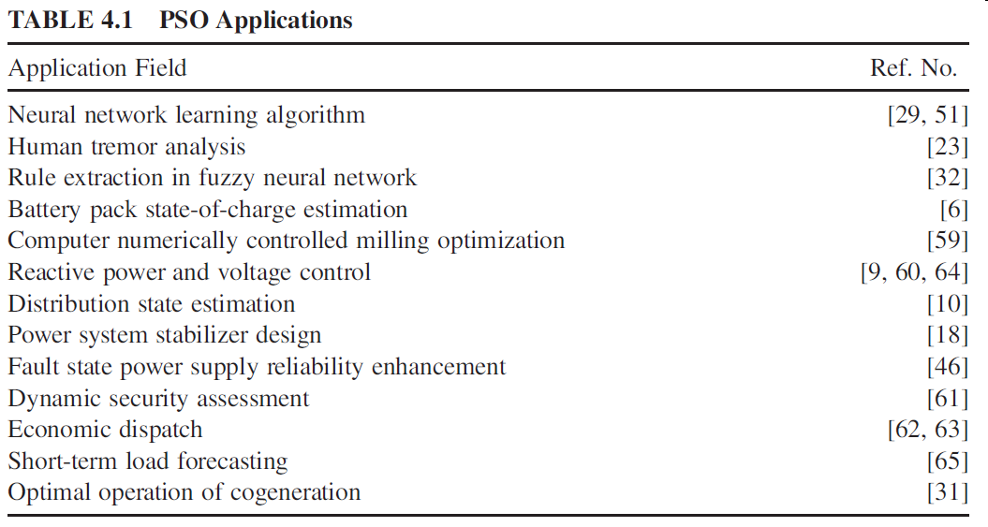
4.4 Research Areas and Applications

Slide 14
4.5 Conclusions
PSO can be an efficient optimization tool for nonlinear continuous optimization problems, combinatorial optimization problems, and mixed-integer nonlinear optimization problems (MINLPs).

