Slide 1
5 Fundamentals of Ant Colony Search Algorithms
Yong-Hua Song, Haiyan Lu, Kwang Y. Lee, and I. K. Yu

Slide 2
5.1 Introduction
The ant colony optimization (ACO) is a meta-heuristic approach for combinatorial optimization problems.
Inspired by the foraging behavior of the social insects, especially the ants.
ACO algorithms belong to the class of model-based search (MBS) algorithm.

Slide 3
5.1 Introduction (cont)
An MBS algorithm is characterized by the use of a (parameterized) probabilistic model that is used to generate solutions to the problem under consideration.
At run-time, ACO algorithms will update the parameters’ values of the probabilistic model in such a way that there will be more chances to generate high-quality solutions over time.

Slide 4
5.2 Ant Colony Search Algorithm
The ACS belongs to biologically inspired heuristic algorithms. It was developed mainly based on the observation of the foraging behavior of a real ant.
It will be useful to understand how ants, which are almost blind animals with very simple individual capacities acting together in a colony, can find the shortest route between the ant nest and a source of food.

Slide 5
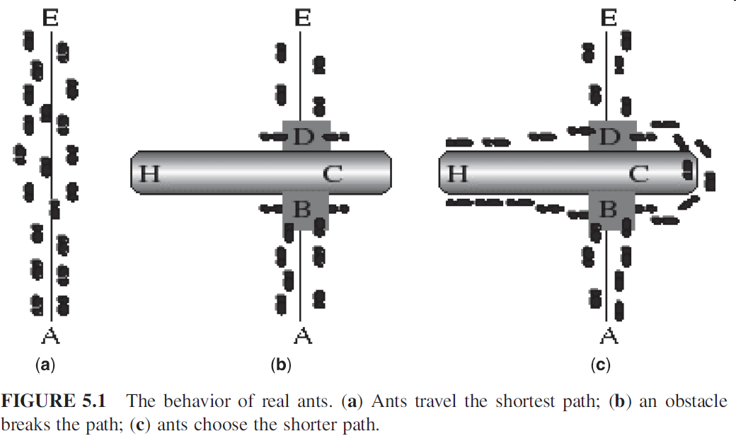
5.2.1 Behavior of Real Ants

Slide 6
5.2.1 Behavior of Real Ants (cont)
While it is walking, the ant deposits a chemical pheromone trail on the ground.
The pheromone trails deposited on the ground will guide other ants to the food source.
Each ant probabilistically prefers to follow a direction rich in pheromone rather than a poorer one.
The indirect communication between the ants via the pheromone trails allows them to find the shortest paths between their nest and food sources.

Slide 7
5.2.1 Behavior of Real Ants (cont)
In Fig. 5.1c, those ants that choose by chance the shorter path around the obstacle will more rapidly establish the interrupted pheromone trail compared with those that choose the longer path as there are more ants walking along the shorter path at each time unit.

Slide 8
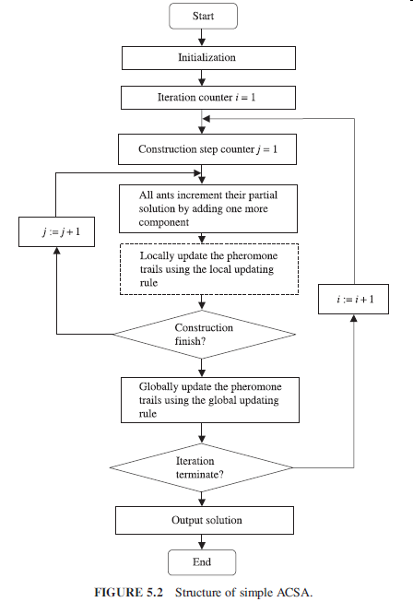
5.2.2 Ant Colony Algorithms

Slide 9
5.2.2 Ant Colony Algorithms (cont)
Transition Rule
Pheromone Updating

Slide 10
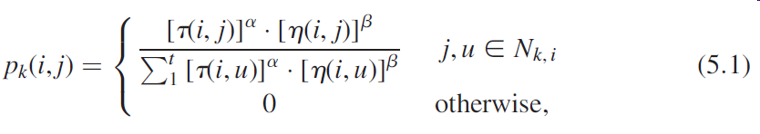
5.2.2.1 The Ant System

Slide 11
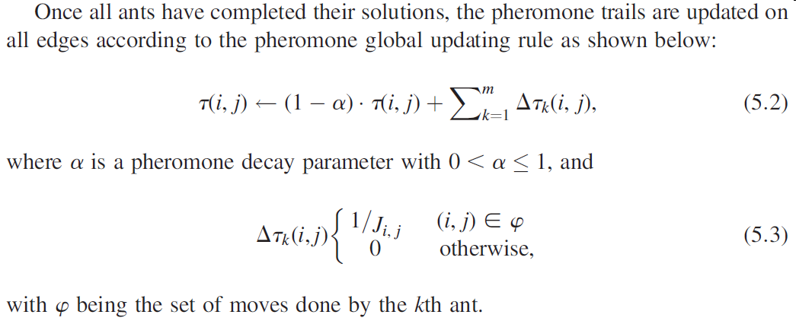
5.2.2.1 The Ant System (cont)

Slide 12
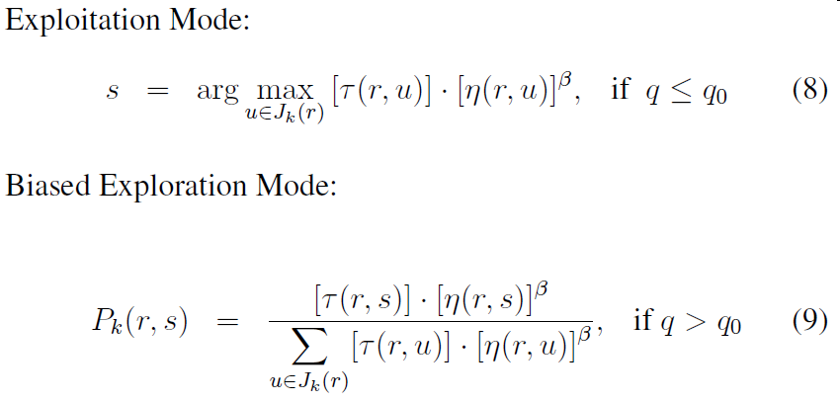
5.2.2.2 The Ant Colony System

Slide 13
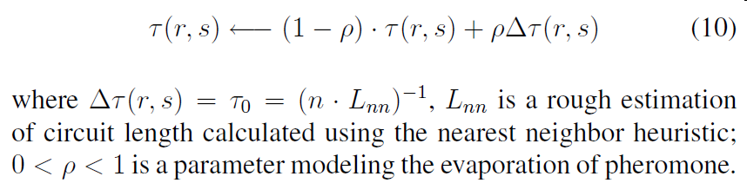
5.2.2.2 The Ant Colony System (cont)
A local updating rule is applied whenever a edge from city r to city s is taken:

Slide 14
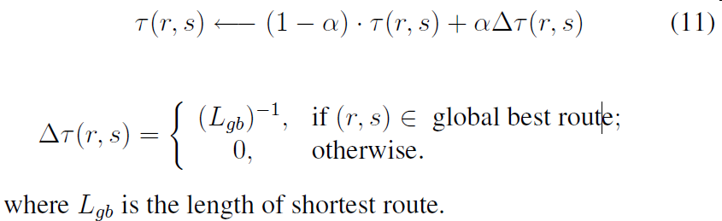
5.2.2.2 The Ant Colony System (cont)
As all ants complete their circuits, the shortest route found in the current episode is used in the global updating rule:

Slide 15
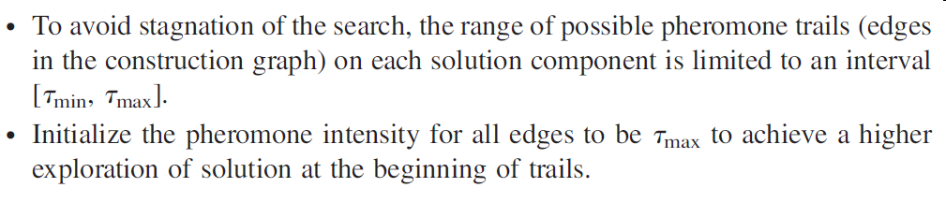
5.2.2.3 The Max-Min Ant System

Slide 16
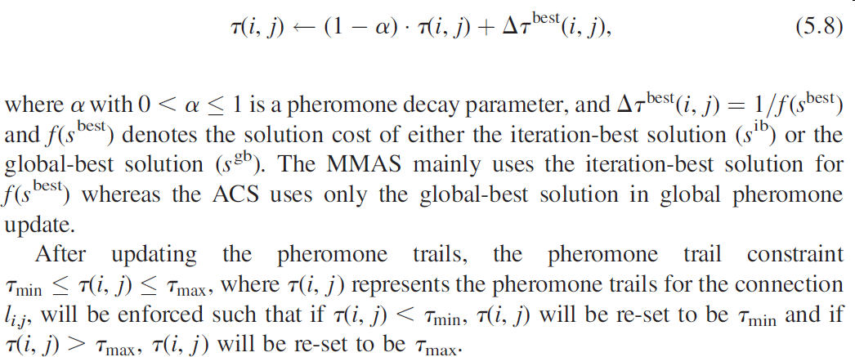
5.2.2.3 The Max-Min Ant System (cont)

Slide 17
5.2.3 Major Characteristics of Ant Colony Search
Distributed Computation: Avoid Premature Convergence
Positive Feedback: Rapid Discovery of Good Solution
Use of Greedy Search and Constructive Heuristic Information: Find Acceptable Solutions in the Early Stage of the Process

