Slide 1
Heuristic Optimization Methods
Pareto Multiobjective Optimization
Patrick N. Ngatchou, Anahita Zarei, Warren L. J. Fox, and
Mohamed A. El-Sharkawi

Slide 2
10.1 Introduction
The solution to multiobjective (MO) problems consists of sets of tradeoffs between objectives.
The goal of multiobjective optimization (MOO) algorithms is to generate these tradeoffs.
Exploring all these trade-offs is particularly important because it provides the system designer/operator with the ability to understand and weigh the different choices available to them.

Slide 3
10.1 Introduction (cont)
Solving MO problems has traditionally consisted of converting all objectives into a SO function.
This simple optimization process is no longer acceptable for systems with multiple conflicting objectives: System engineers may desire to know all possible optimized solutions of all objectives simultaneously. In the business world, it is known as a trade-off analysis.

Slide 4
10.1 Introduction (cont)
This chapter focuses on heuristic multiobjective optimization, particularly with population-based stochastic algorithms such as evolutionary algorithms.

Slide 5
10.2 Basic Principles
For illustration purposes, consider the hypothetical problem of determining, given a choice of transportation means, the most efficient of them based on distance covered in a day and energy used in the process.

Slide 6
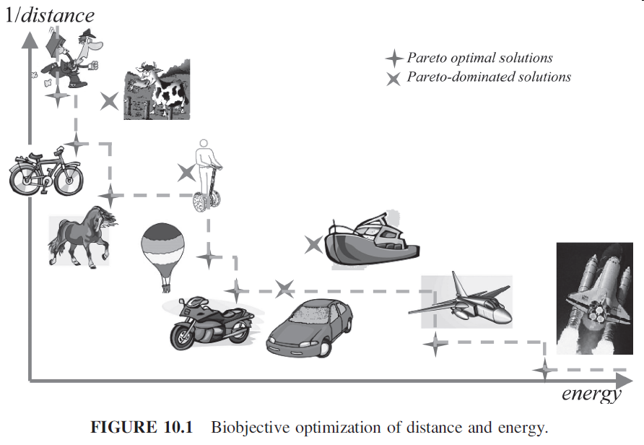
10.2 Basic Principles (cont)

Slide 7
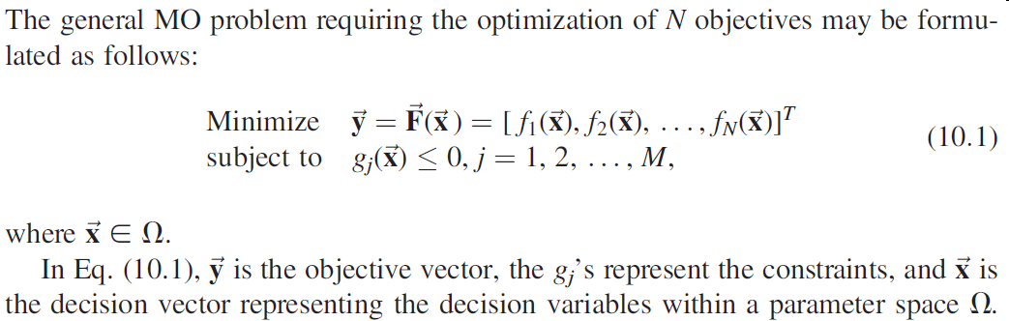
10.2.1 Generic Formulation of MO Problems

Slide 8
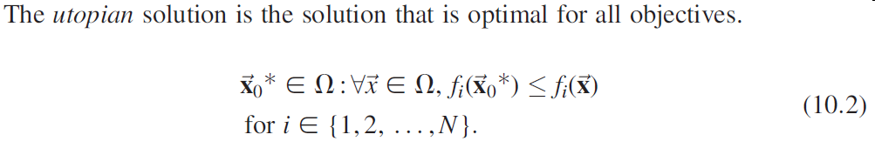
10.2.1 Generic Formulation of MO Problems (cont)

Slide 9
10.2.2 Pareto Optimality Concepts
The concepts of Pareto dominance and Pareto optimality.
A solution belongs to the Pareto set if there is no other solution that can improve at least one of the objectives without degrading any other objective.

Slide 10
10.2.2 Pareto Optimality Concepts (cont)
In the context of MOO, Pareto dominance is used to compare and rank decision vectors.
u dominating v in the Pareto sense means that F(u) is either better than or the same as F(v) for all objectives, and there is at least one objective function for which F(u) is strictly better than F(v).

Slide 11

10.2.2 Pareto Optimality Concepts (cont)
A solution a is said to be Pareto optimal if and only if there does not exist another solution that dominates it.
The set of all Pareto optimal solutions is called the Pareto optimal set.

Slide 12
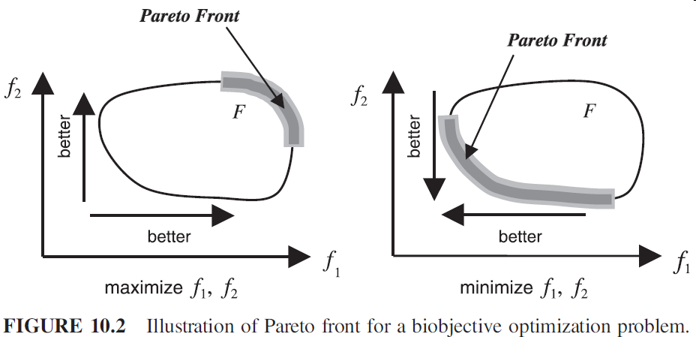
10.2.2 Pareto Optimality Concepts (cont)

Slide 13
10.2.3 Objectives of Multiobjective Optimization
MOO consists of determining all solutions to the MO problem that are optimal in the Pareto sense.
Good solutions to a MO problem
  (a) Minimize the distance between the approximation set generated by the algorithm and the Pareto front;
  (b) Ensure a good distribution of solutions along the approximation set (uniform if possible);
  (c) Maximize the range covered by solutions along each of the objectives.

Slide 14
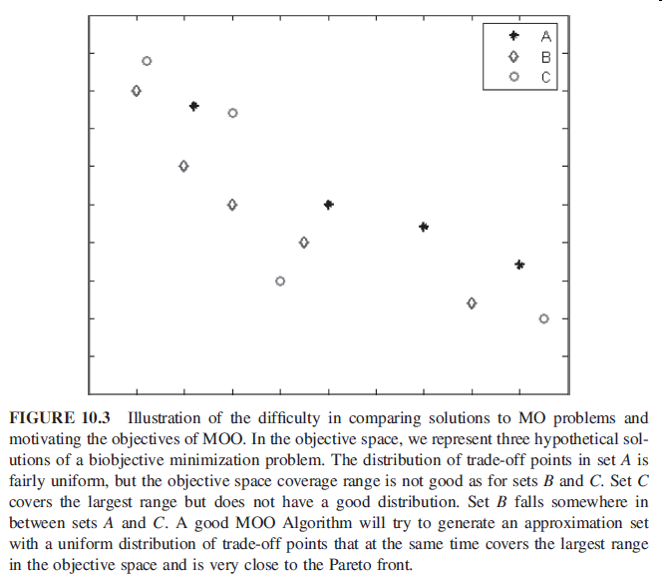
10.2.3 Objectives of Multiobjective Optimization (cont)

Slide 15
10.3 Solution Approaches
Classic approaches, which have roots in the operations research and optimization theory fields, essentially consist of converting the MO problem into a SO problem, which then can be solved using traditional scalar optimization techniques.

Slide 16
10.3 Solution Approaches (cont)
Population-based algorithms such as evolutionary algorithms, particle swarm optimization, or ant colony optimization allow direct generation of trade-off curves in a single run.

Slide 17
10.3.1 Classic Methods
Classic methods were essentially techniques developed by the operations research community to address the problem of multicriteria decision making (MCDM).

Slide 18
10.3.1 Classic Methods (cont)
Given multiple objectives and preferential information about these objectives, the MO problem is converted into an SO problem by either aggregating the objective functions or optimizing the most important objective and treating the others as constraints.

Slide 19
10.3.1 Classic Methods (cont)
In the general case, and in order to generate an approximation to the nondominated front, all that is needed is to modify the aggregation parameters and solve the newly created SO problem.

Slide 20
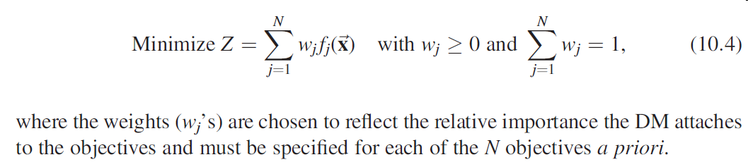
10.3.1.1 Weighted Aggregation

Slide 21
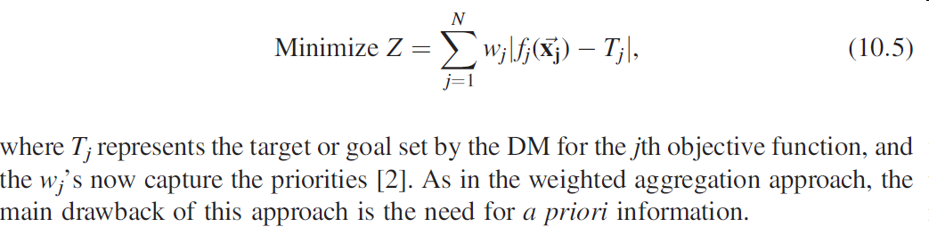
10.3.1.2 Goal Programming

Slide 22
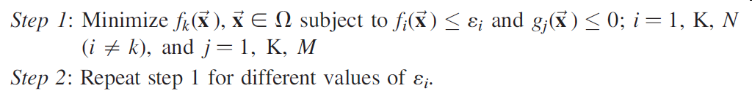
10.3.1.3 e-Constraint

Slide 23
10.3.1.4 Discussion on Classic Methods
Classic methods attempt to ease the decision-making process by incorporating a priori preferential information from the DM and are geared toward finding the single solution representing the best compromise solution.

Slide 24
10.3.2 Intelligent Methods

Slide 25
10.3.2.1 Background
Meta-heuristics are a practical way to generate acceptable solutions, even though they cannot guarantee optimality.
Another advantage is the ability to incorporate problem-specific knowledge to improve the quality of the solutions.

Slide 26
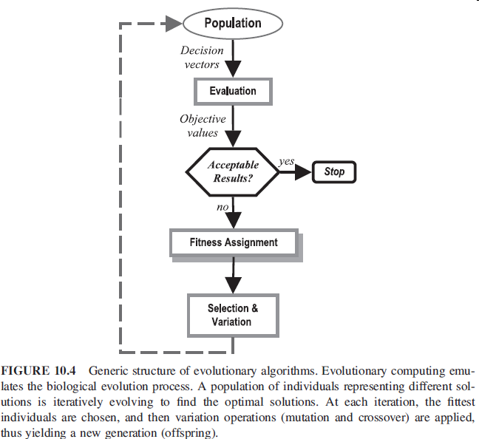
10.3.2.1 Background (cont)

Slide 27
10.3.2.2 Structure of Population-Based MOO Solvers
The general structure of EA-based MO solvers is similar to the one used for SOO.
Fitness assignment controls convergence (i.e., how to guide the population to nondominated solutions).
To prevent premature convergence to a region of the front, diversity mechanisms such as niching are included in the determination of an individual’s fitness.

Slide 28
10.3.2.2 Structure of Population-Based MOO Solvers (cont)
A form of elitism is applied to prevent the deterioration problem whereby nondominated solutions may disappear from one generation to the next.

Slide 29
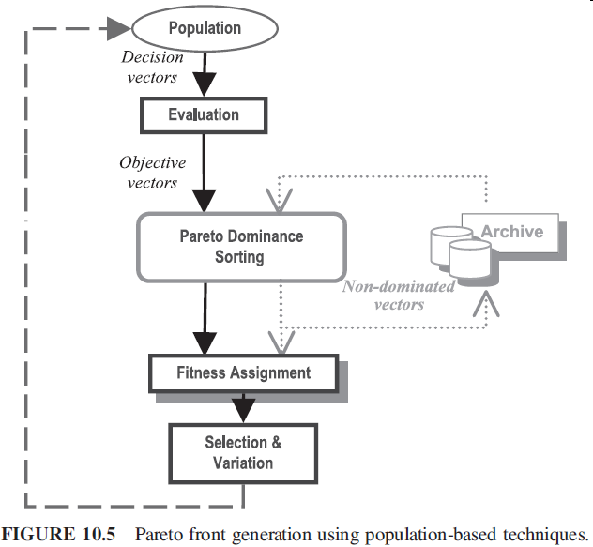
10.3.2.2 Structure of Population-Based MOO Solvers (cont)

Slide 30
10.3.2.2.1 Fitness Assignment
There are three methods of fitness assignment: aggregation-based, criterion-based, and Pareto-based.
Aggregation-based assignment consists in evaluating the fitness of each individual based on a weighted aggregation of the objectives.

Slide 31
10.3.2.2.1 Fitness Assignment (cont)
  To explore the different parts of the Pareto front, they apply systematic variation of the aggregation weights.
An example of criterion-based assignment is Schaffer’s vector-evaluated genetic algorithm (VEGA).
  At each generation, the population is divided into as many equal-size subgroups as there are objectives, and the fittest individuals for each objective function are selected

Slide 32
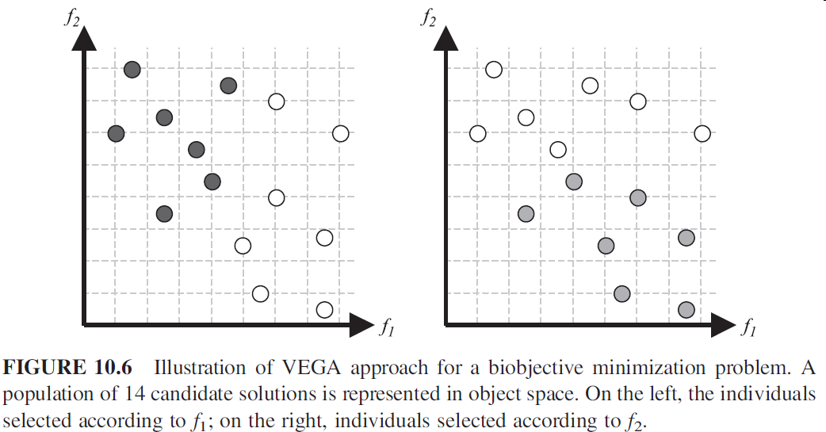
10.3.2.2.1 Fitness Assignment (cont)

Slide 33
10.3.2.2.1 Fitness Assignment (cont)
Pareto-based fitness assignment is the most popular and efficient technique. Here, Pareto-dominance is explicitly applied in order to determine the probability of replication of an individual.
The multiobjective genetic algorithm (MOGA) is an algorithm implementing Pareto-based fitness assignment

Slide 34
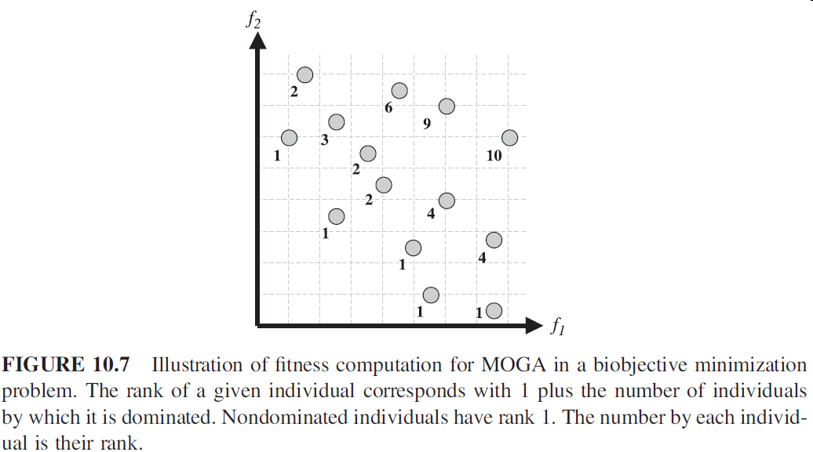
10.3.2.2.1 Fitness Assignment (cont)

Slide 35
10.3.2.2.2 Diversity
In conjunction with fitness assignment mechanism, an appropriate niching mechanism is necessary to prevent the algorithm from converging to a single region of the Pareto front
In the MOGA algorithm discussed earlier, an objective space density-based fitness sharing is applied after population ranking

Slide 36
10.3.2.2.3 Elitism
In EA-based solvers, an elitist strategy refers to a mechanism by which the fittest individuals found during the evolutionary search are always copied to the next generation.

Slide 37
10.3.2.2.3 Elitism (cont)
In SPEA, a repository or external archive is used to maintain nondominated solutions and is updated at each generation if better nondominated solutions are found.

Slide 38
10.3.2.3 Common Population-Based MO Algorithms

Slide 39
10.3.2.4 Discussion on Modern Methods

Slide 40
10.4 Performance Analysis

Slide 41
10.4.1 Objective of Performance Assessment

Slide 42
10.4.2 Comparison Methodologies

Slide 43
10.4.2.1 Quality Indicators

Slide 44
10.4.2.2 Attainment Function Method

Slide 45
10.4.2.3 Dominance Ranking

Slide 46
10.5 Conclusions

