Slide 1
Charting a Path Forward: Insights from a CSSI PI Survey
Fred Hansen, Nexight Group

Slide 2
Survey Purpose & Design
Two primary purposes for the survey:
Inform decisions about changes to be made to the National Science Foundation (NSF) Cyberinfrastructure for Sustained Scientific Innovation (CSSI) solicitation.
Inform decisions about the future direction and focus of the NSF CSSI umbrella program.
Three phases of design:
Determine the nature of the decisions to be made
Determine the information needed to inform the decisions (Who needs to say what about what?)
Write survey items

Slide 3
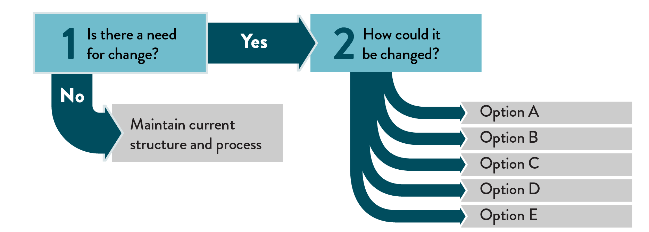
Survey Purpose & Design
Decision makers used a two-stage decision-making process:

Slide 4
Survey Purpose & Design
Survey design parameters:
PI input is critical and valued
CSSI wants to maximize PI ability to write effective proposals
CSSI seeks to engage the passion and creativity of PIs as well as their expertise and capability
PI time is valuable
Minimize time required to complete survey
Only questions that directly tied to the decisions were included in the survey
Questions that were of interest to the decision makers but not directly tied to a decision were excluded

Slide 5
Survey Respondents
251 respondents:
97% were PIs or co-PIs
55% had served as a proposal reviewer in the past year
98% had previously submitted a proposal to NSF, 73% of whom received funding
90% listed universities as their primary organization
Respondents were representative of the target population and comparable to the respondents of other NSF surveys.

Slide 6
Need for Change – Solicitation
The survey results clearly identify four aspects of the solicitation where change is needed and would make the most difference:
Types of awards – the two classes of CSSI awards and the size, duration, and timing of the funding associated with each type.
Combined software/data umbrella – the inclusion of both software and data perspectives under a single umbrella scope
Presentation of domain-specific interests – the number of areas, the clarity of the descriptions, and the level of specificity and amount of detail provided
Solicitation-specific criteria – the appropriateness and number of additional solicitation-specific review criteria and the clarity and detail with which they are described

Slide 7
How to Change – Solicitation
Types of awards:
All change options were selected by a significant portion of respondents. The top two were:
Add an award category for exploratory research
Distinguish between data and software awards
Combined software/data umbrella:
The top change option selected:
Create separate software and data solicitations
Respondents also selected:
Require more integration across data and software services
Require collaboration across data and software developers

Slide 8
How to Change – Solicitation
Presentation of domain-specific interests:
Respondents advocated for increasing clarity and simplicity in the presentation of domain-specific interests:
Eliminate the redundancy across the domain specific interests
Focus on smaller numbers of topics in each solicitation
Decrease the number and complexity of the domain-specific interest areas
Solicitation-specific criteria:
Respondents are advocating for more help on how to meet the criteria:
Provide more guidance on how to meet the criteria
Identify best practices to be incorporated into a proposal

Slide 9
Need for Change – CSSI Direction & Focus
The need for change was assessed from three perspectives:
Relevance of program assumptions for the next 1–5 years
CSSI success in achieving its objectives
CSSI success in implementing its guiding principles

Slide 10
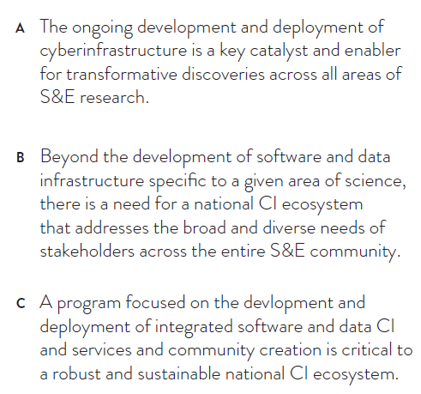
Need for Change – CSSI Direction & Focus
1. Program Assumptions (1–5 years):
There was a high level of agreement for each of the three assumptions.
This indicates that the rationale for the CSSI Program is still valid and there is no need for change in terms of the overall direction and focus of the program.
NSF CSSI Program Assumptions:

Slide 11
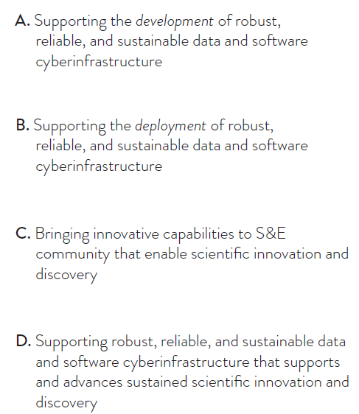
Need for Change – CSSI Direction & Focus
2. Success in Meeting Objectives:
Some need for change was indicated:
The majority of respondents indicated that the CSSI program has been successful in achieving each of the four objectives
Success in supporting the development of CI rated higher than deployment of CI
Slightly lower ratings also given for supporting CI capabilities, data, and software that enable scientific innovation and discovery
NSF CSSI Program Objectives:

Slide 12
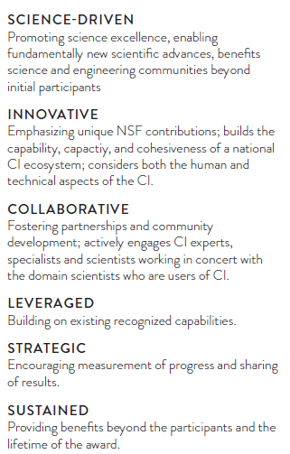
Need for Change – CSSI Direction & Focus
NSF CSSI Program Guiding Principles:
3. Success in Implementing Guiding Principles:
Some need for change was indicated:
The majority of respondents indicated that the CSSI program has been successful in implementing all guiding principles, except for Sustained
The most success was indicated in meeting the Science-Driven and Innovative principles

Slide 13
How to Change – CSSI Direction & Focus
This area was assessed by having respondents indicate what they think CSSI’s investment priorities should be for the next 1–5 years.
Based on a thematic analysis, the rank order for the top investment priorities was:
Data
Software
Learning/Workforce Development
Networking
AI/Machine Learning
Security/Resilience
Collaborations
Additional investment priorities identified by respondents included:
Simulation/Modeling
Metrics (to assess CI impact and effectiveness)
CI Community Development
Domain-specific CI Investment (e.g., CI for Chemistry, Physics, Sociology)

