Slide 1
System Programming in C coding part
2022.10.09

Slide 2
Project initializing
Choose the programming IDE
Create a project and fill in the indispensable configurations
The type of the project
The location of the project
The language standard of the project(C99)

Slide 3
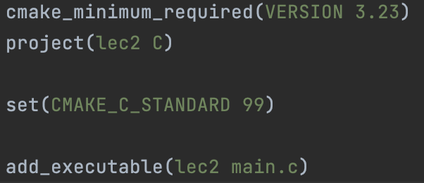
Project infrastructure
So far, we have a few files after initializing the project
main.c
CMakeLists.txt
cmake version
project type
C standard
project name
related files

Slide 4
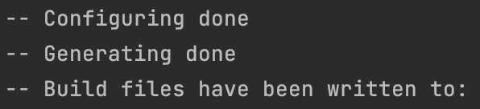
Project infrastructure
Something happened behind the automated building
Configure – CMakeLists.txt
Generates the Makefile
Compile – main.c.obj(on win) / main.o(on linux)
#include<stdio.h> (fixed path)
#include "aaa.h"
Link
under the file folder "lib"
in binary form " xxx.o", neither " stdio.c " nor " printf.c " (for source code is not open source)
Generates the executable file

Slide 5
Some key points for C programming
Have a general understanding of difference between compiler and linker
Compiler
C compiler targets at single file when compiling
Key words like extern
include behavior
Linker
Links xxx.o files and generates xxx.out file
Does some checkings
The implementations of functions in xxx.h files
Definitions or declarations of variables from source files

Slide 6
Some key points for C programming
CDT
The structure is defined in header files
Users can directly interact with the components of the structure
Sometimes unsafe
Sometimes flexible
ADT
The structure is defined in XXX.c files
Users are unable to interact with the components of the structure
Often use pointers of the structure type
Safer than CDT but less flexible

Slide 7
Some key points for C programming
In retrospect, open source means what ?
CLion provides readable XXX.h under fixed path
CLion provides XXX.o and XXX.a files under fixed path
CLion does not provide XXX.c files at all
Code is not open source
We can do this either
Generates the xxx.o files
Deletes the xxx.c files
Modifies the CMakeLists.txt
ADT & CDT Have Their Own Advantages And Disadvantages

Slide 8
Assignment 1
We have 3 exercise and 1 challenge in lab1
The constructor of each AST node
Print AST
Run command
Implement the input redirection (challenge)

Slide 9
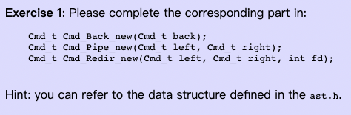
Assignment 1
The constructor of each AST node

Slide 10
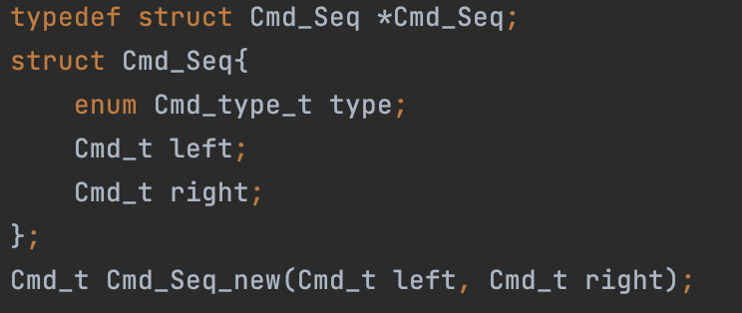
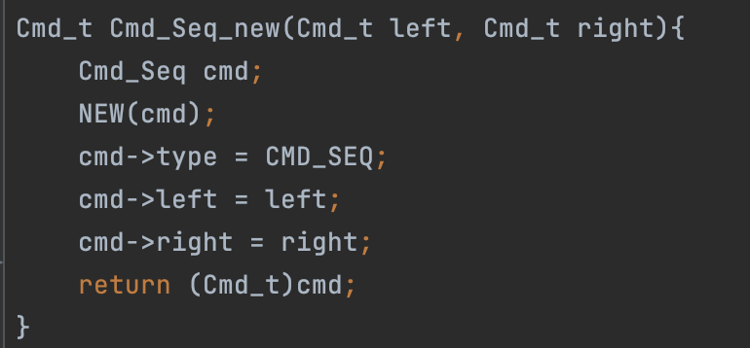
Assignment 1
The constructor of each AST node

Slide 11
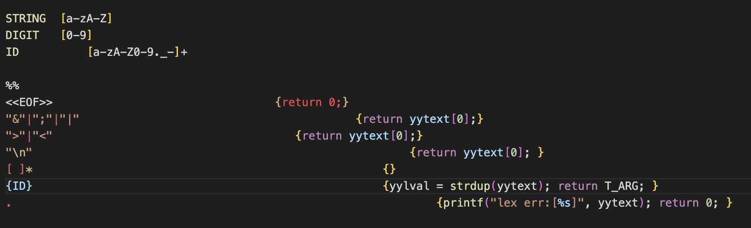
Assignment 1
scanner.l is a flex file which is used as lexical analyzer

Slide 12
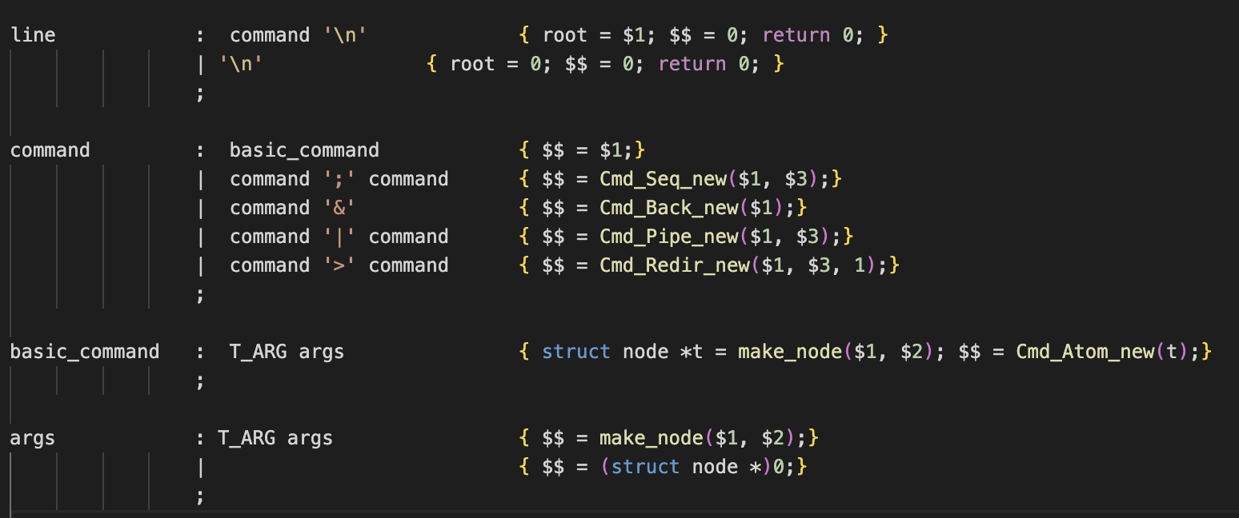
Assignment 1
The constructor of each AST node called by bison
parser.y is a bison file which is used as syntax analyzer

Slide 13
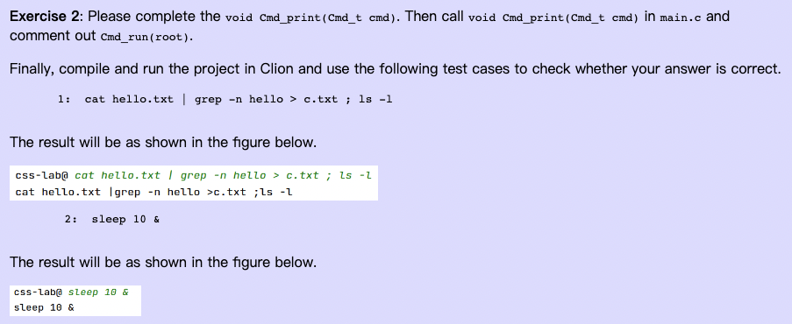
Assignment 1
Print AST

Slide 14
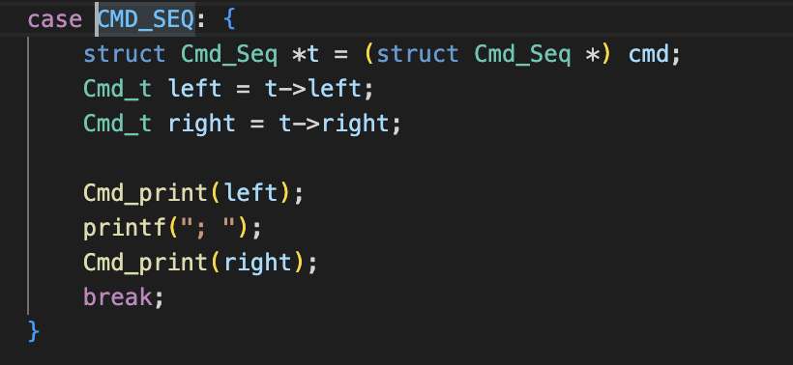
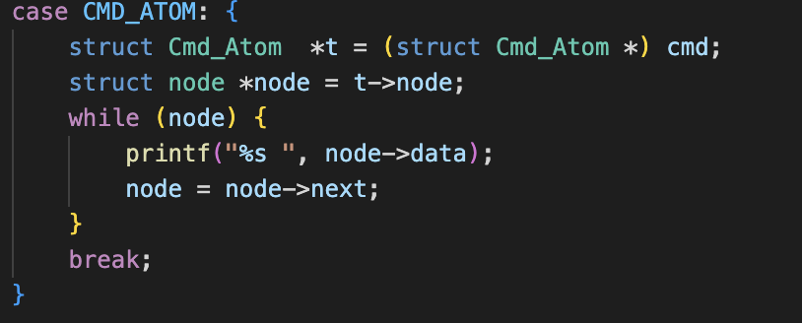
Assignment 1
Print AST
We need to recursively traverse the AST

Slide 15
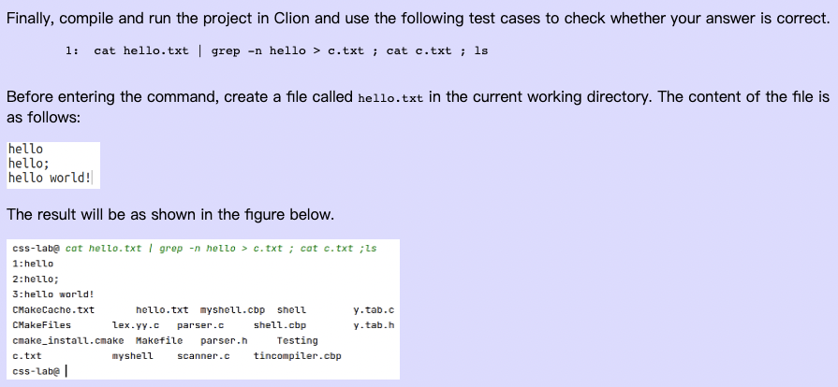
Assignment 1
Run Command

Slide 16
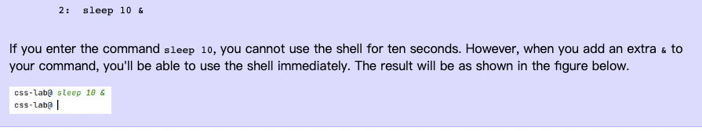
Assignment 1
Run Command

Slide 17
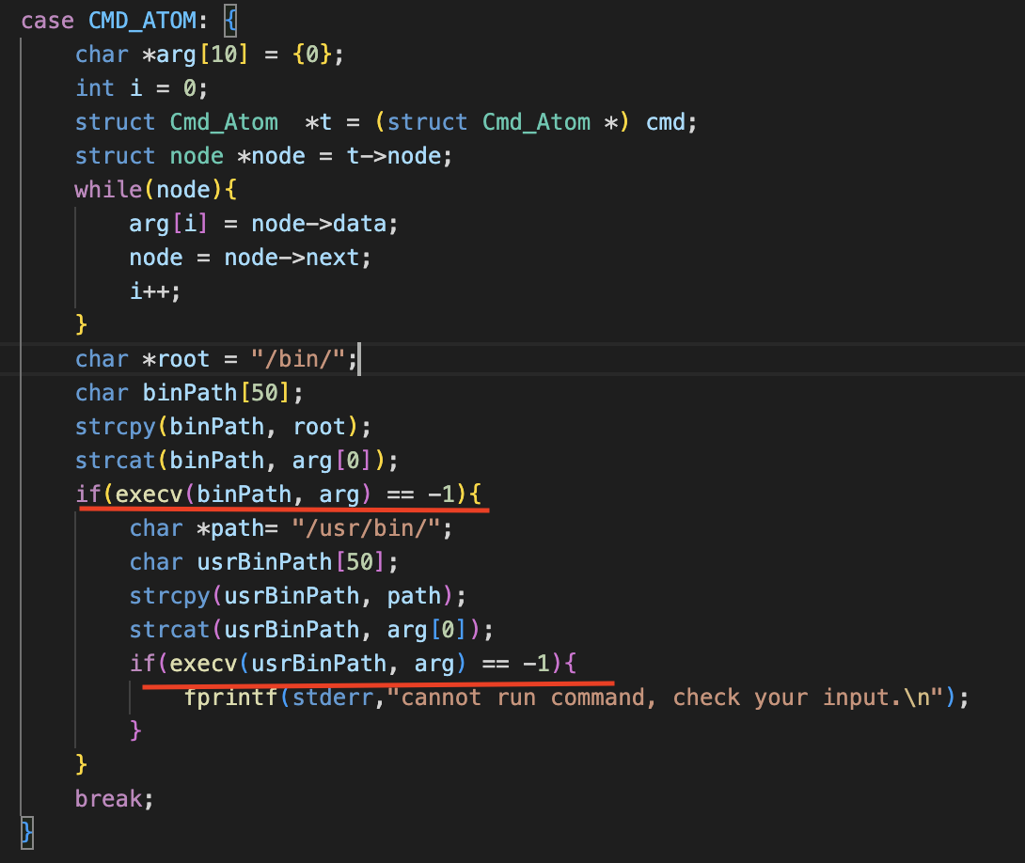
Assignment 1
Run Command – single command

Slide 18
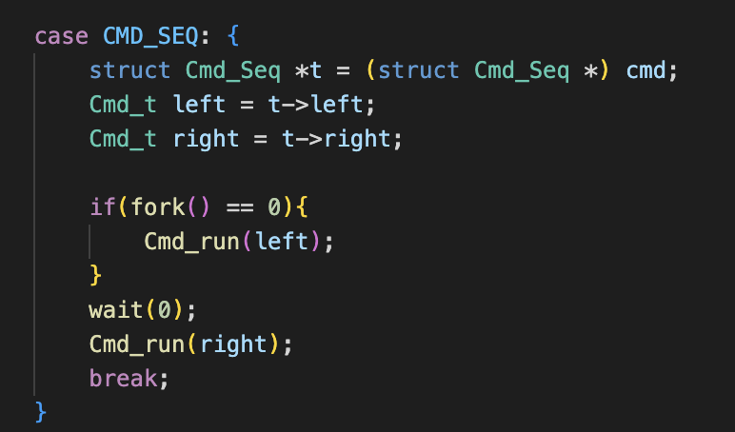
Assignment 1
Run Command – compound command - sequence

Slide 19
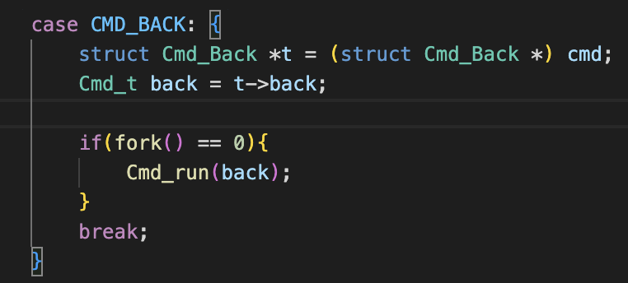
Assignment 1
Run Command – compound command -back

Slide 20
其他
Piazza： https://piazza.com/class/l7zru7adpy5ph
提问、讨论、答疑
课程主页：https://csslab-ustc.github.io/courses/sysprog/index.html
更新：课程资源、作业、课程安排
QQ群 ：366321234
仅作通知用

Slide 21
Have a nice day!

