Slide 1
Mathematical foundation
Formal Methods Foundation
Baojian Hua
bjhua@ustc.edu.cn

Slide 2
Goals
We review some of the key results from basic mathematics
Set, relation, and function
Basic computation complexity results
Context free grammar
Induction
We assume you have learned some of this from elementary math course
We just give a quick review, to make this course self-contained

Slide 3
Set, Relation, and Function

Slide 4
Sets
Set: a group of (infinite) elements
{x₁, x₂, …, x_{n}}
or predicated form:
{x | P(x)}
e.g.:
{x | x>0 is an integer}

Slide 5
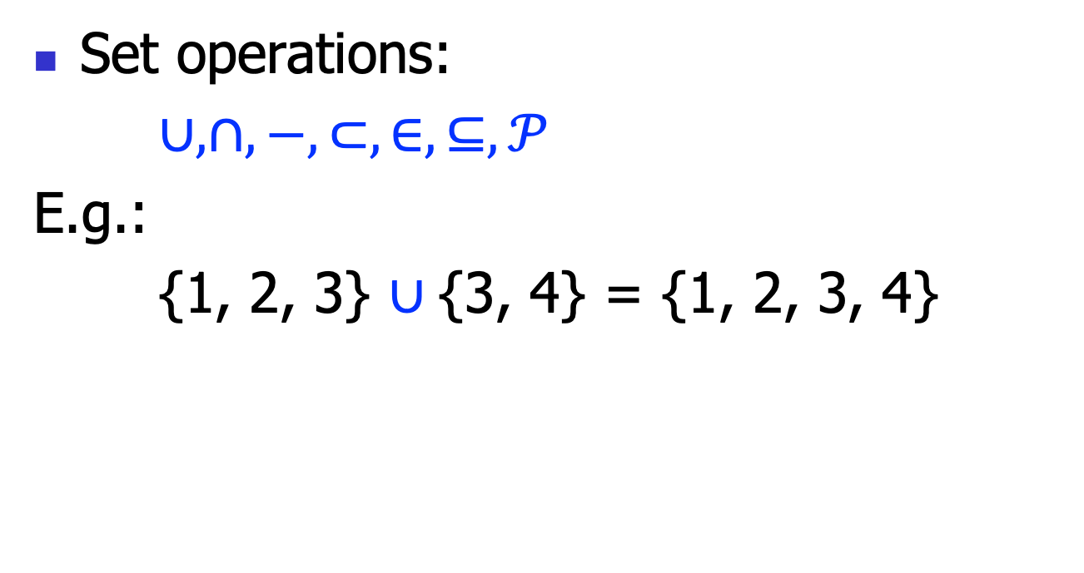
Set Operations
Set operations:
$∪, ∩,−,⊂, ∈,⊆,𝒫$
E.g.:
{1, 2, 3} $∪${3, 4} = {1, 2, 3, 4}

Slide 6
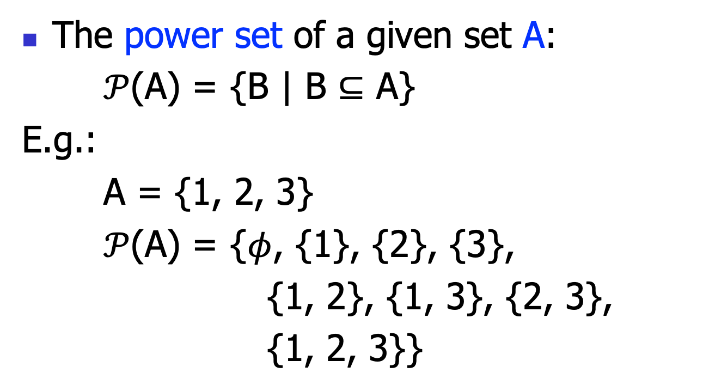
Power Set
The power set of a given set A:
$𝒫$(A) = {B | B $⊆$ A}
E.g.:
A = {1, 2, 3}
$𝒫$(A) = {$φ$, {1}, {2}, {3},
{1, 2}, {1, 3}, {2, 3},
{1, 2, 3}}

Slide 7
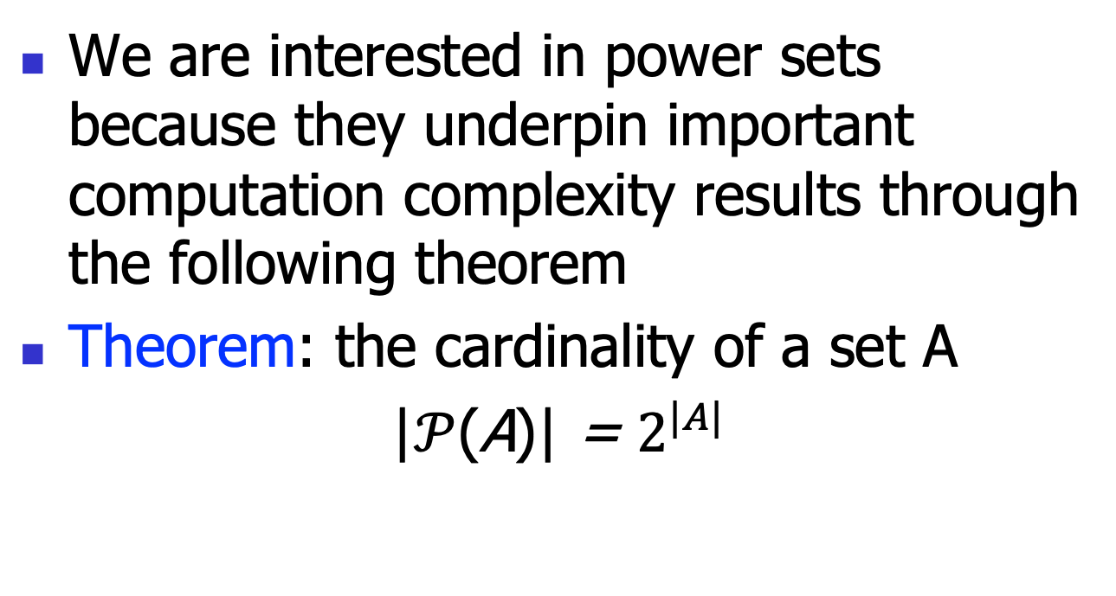
Power Set
We are interested in power sets because they underpin important computation complexity results through the following theorem
Theorem: the cardinality of a set A
|$𝒫$(A)| = $2^{|A|}$

Slide 8
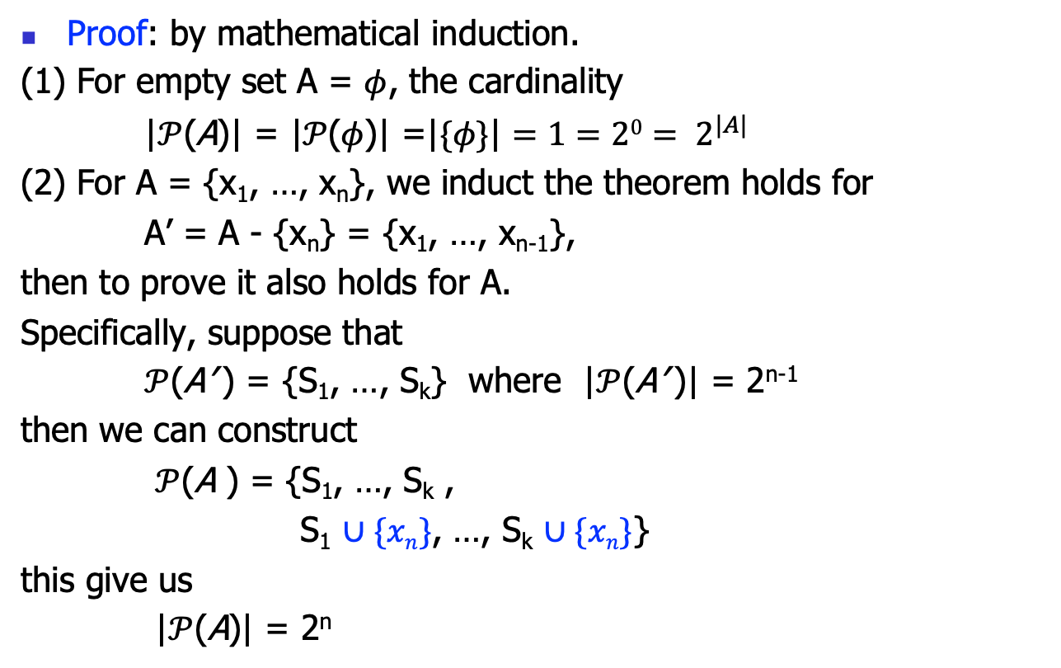
Power Set
Proof: by mathematical induction.
(1) For empty set A = $φ$, the cardinality
|$𝒫$(A)| = ${\text{|}𝒫\text{(}φ\text{)|} \text{=}\text{|}\{φ\text{\}}\text{|}=1=20= 2}^{|A|}$
(2) For A = {x₁, …, x_{n}}, we induct the theorem holds for
A’ = A - {x_{n}} = {x₁, …, x_{n-1}},
then to prove it also holds for A.
Specifically, suppose that
$𝒫$(A’ ) = {S₁, …, S_{k}} where |$𝒫$(A’ )| = 2^{n-1}
then we can construct
$𝒫$(A ) = {S₁, …, S_{k} ,
S₁ $∪\{xn\}$, …, S_{k} $∪\{xn\}$}
this give us
|$𝒫$(A)| = 2^{n}

Slide 9
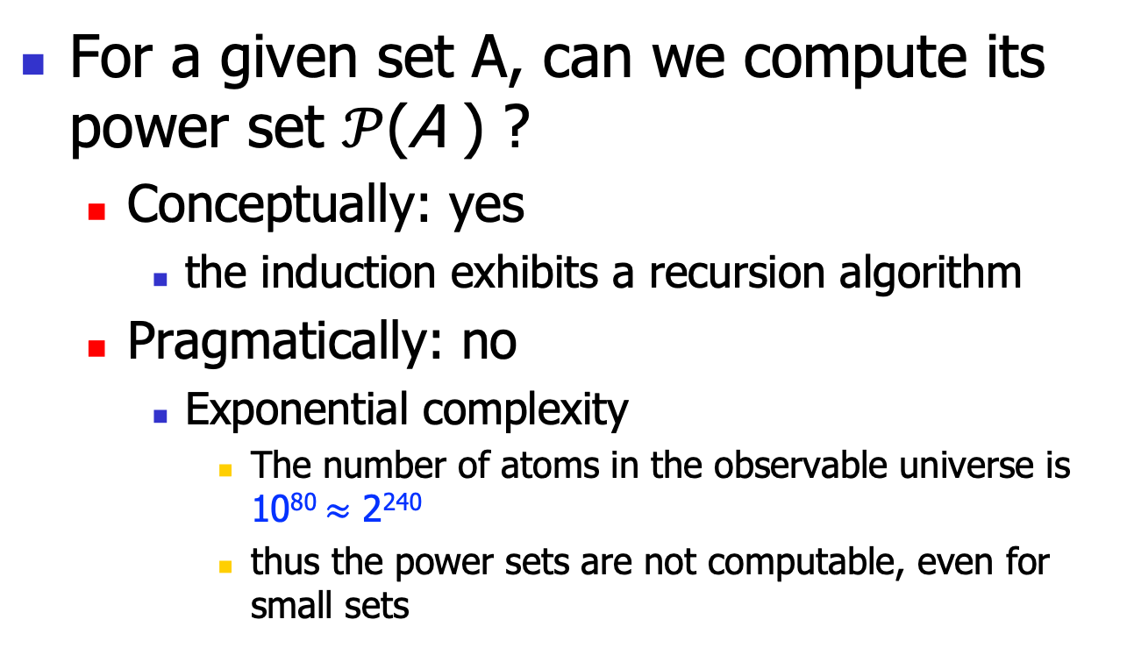
Complexity Implication
For a given set A, can we compute its power set $𝒫$(A ) ?
Conceptually: yes
the induction exhibits a recursion algorithm
Pragmatically: no
Exponential complexity
The number of atoms in the observable universe is 10⁸⁰ $≈$ 2²⁴⁰
thus the power sets are not computable, even for small sets

Slide 10
Set Implementation

Slide 11
Implementation
Most languages have decent support of set
we will leverage Python throughout this course
and will utilize PEP 484 whenever possible to write solid code

Slide 12
Implementation
# see the published code
def powerset0(the_set: Set[int]) -> List[Set[int]]: if len(the_set) <= 0: empty_set: Set[int] = set() return [empty_set] element = the_set.pop() the_partial_powerset = powerset0(the_set) # to avoid infinite recursion temp_sets = the_partial_powerset.copy() for each_set in temp_sets: new_each_set = each_set.union({element}) the_partial_powerset.append(new_each_set) return the_partial_powerset

Slide 13
Relation

Slide 14
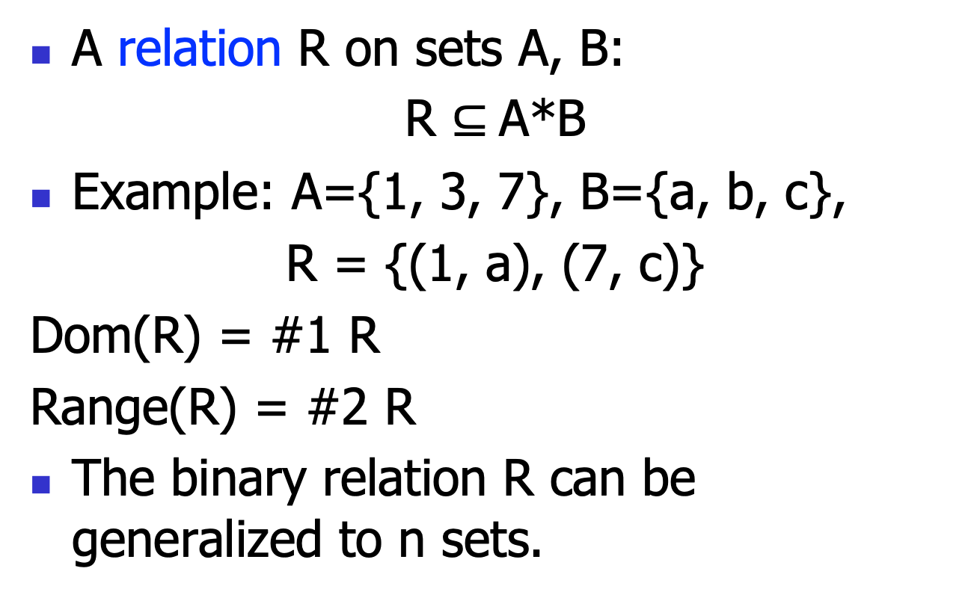
Relation
A relation R on sets A, B:
R $⊆$A*B
Example: A={1, 3, 7}, B={a, b, c},
R = {(1, a), (7, c)}
Dom(R) = #1 R
Range(R) = #2 R
The binary relation R can be generalized to n sets.

Slide 15
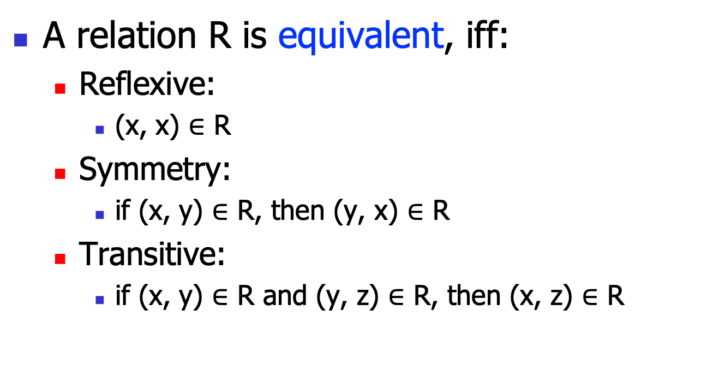
Relation: Equivalence Relation
A relation R is equivalent, iff:
Reflexive:
(x, x) $∈$ R
Symmetry:
if (x, y) $∈$ R, then (y, x) $∈$ R
Transitive:
if (x, y) $∈$ R and (y, z) $∈$ R, then (x, z) $∈$ R

Slide 16
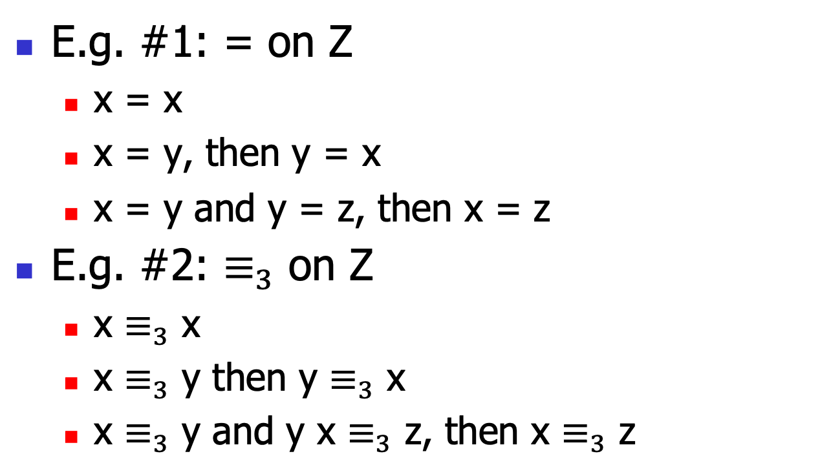
Relation: Equivalence Relation
E.g. #1: = on Z
x = x
x = y, then y = x
x = y and y = z, then x = z
E.g. #2: $≡_{3}$ on Z
x $≡_{3}$ x
x $≡_{3}$ y then y $≡_{3}$ x
x $≡_{3}$ y and y x $≡_{3}$ z, then x $≡_{3}$ z

Slide 17
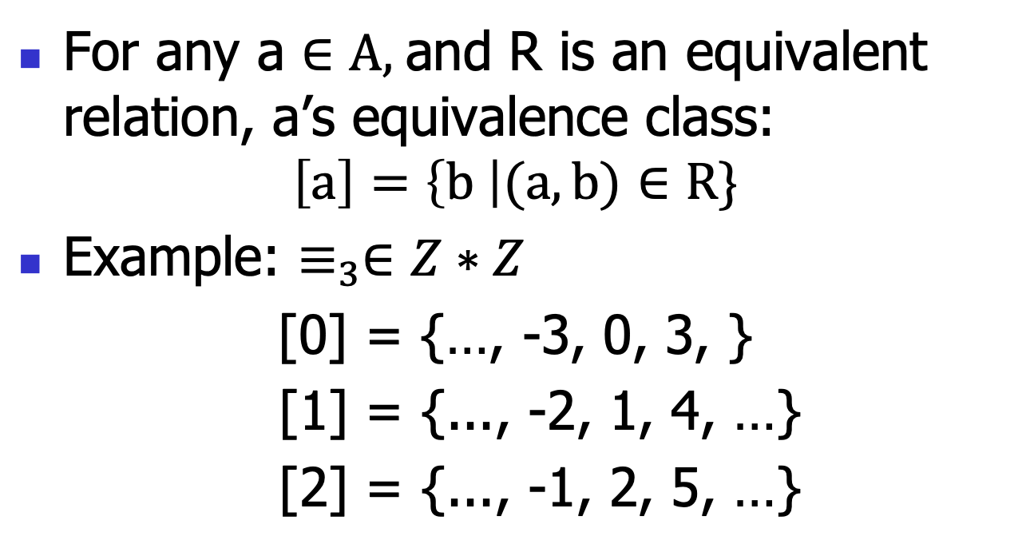
Equivalence Class
For any a $∈A,$and R is an equivalent relation, a’s equivalence class:
$$\left[a\right]=\left\{b \right|(a, b)∈R\}$$
Example: $≡_{3}∈Z∗Z$
[0] = {…, -3, 0, 3, }
[1] = {..., -2, 1, 4, …}
[2] = {..., -1, 2, 5, …}

Slide 18
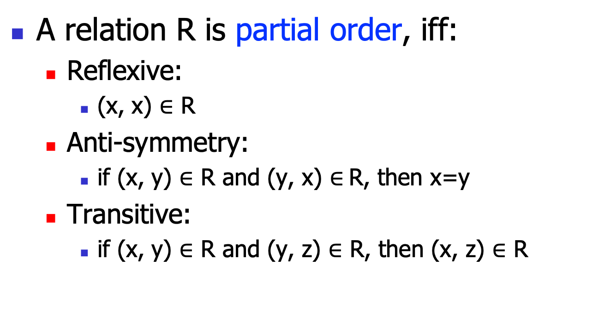
Relation: Partial Order
A relation R is partial order, iff:
Reflexive:
(x, x) $∈$ R
Anti-symmetry:
if (x, y) $∈$ R and (y, x) $∈$R, then x=y
Transitive:
if (x, y) $∈$ R and (y, z) $∈$ R, then (x, z) $∈$ R

Slide 19
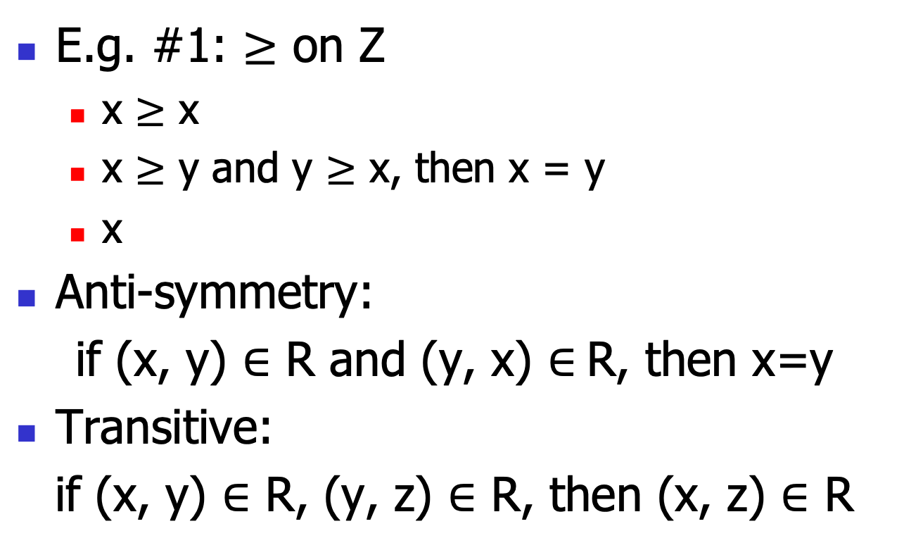
Relation: Partial Order
E.g. #1: $≥$ on Z
x $≥$ x
x $≥$ y and y $≥$ x, then x = y
x
Anti-symmetry:
if (x, y) $∈$ R and (y, x) $∈$R, then x=y
Transitive:
if (x, y) $∈$ R, (y, z) $∈$ R, then (x, z) $∈$ R

Slide 20
Relation Implementation

Slide 21
Implementation
# we can leverage Tuple type to implement a relation
# see the published code
@dataclass class Relation[X]: elements: Set[X] # the set of the relation theSet: Set[Tuple[X, X]] # the tuples def isReflexive(self) -> bool: for element in self.elements: if not (element, element) in self.theSet: return False return True

Slide 22
Function

Slide 23
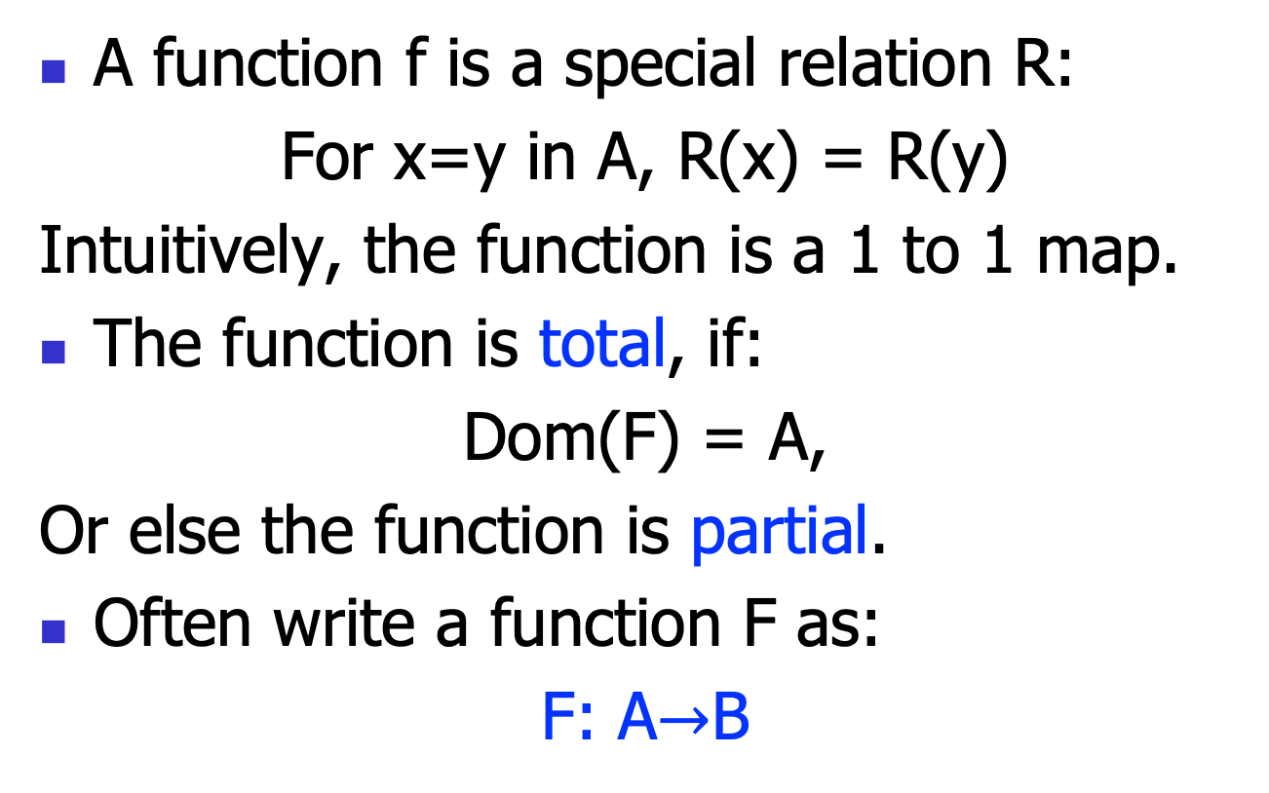
Function
A function f is a special relation R:
For x=y in A, R(x) = R(y)
Intuitively, the function is a 1 to 1 map.
The function is total, if:
Dom(F) = A,
Or else the function is partial.
Often write a function F as:
F: A$→$B

Slide 24
Function Implementation

Slide 25
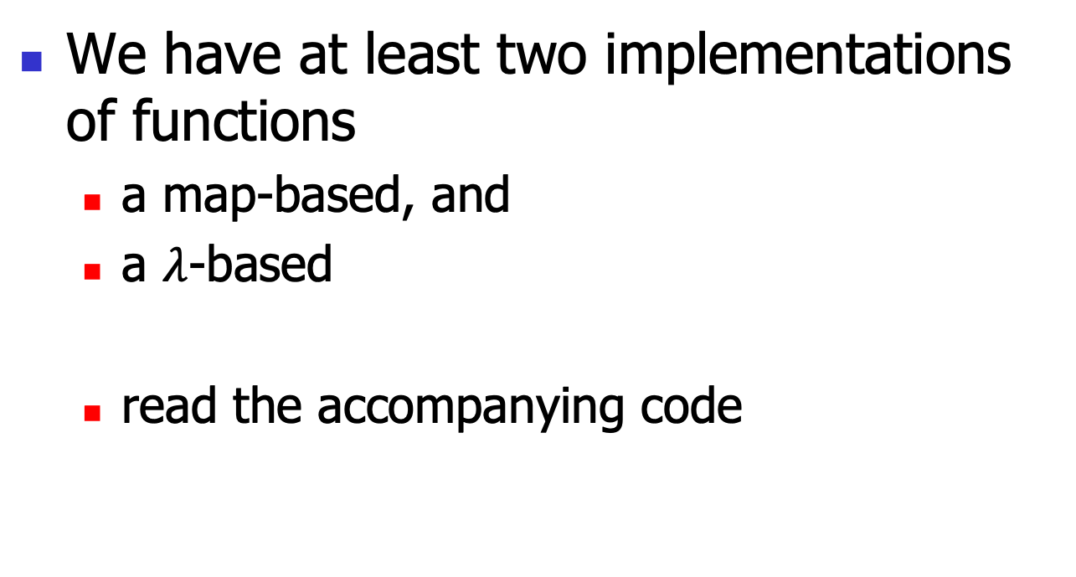
Implementation
We have at least two implementations of functions
a map-based, and
a $λ$-based
read the accompanying code

Slide 26
Implementation
# map-based
@dataclass class FunctionWithMap[X, Y]: theMap: Mapping[X, Y] # the map def get(self, key: X) -> Optional[Y]: if key in self.theMap: return self.theMap[key] return None def put(self, key: X, value: Y): self.theMap[key] = value

Slide 27
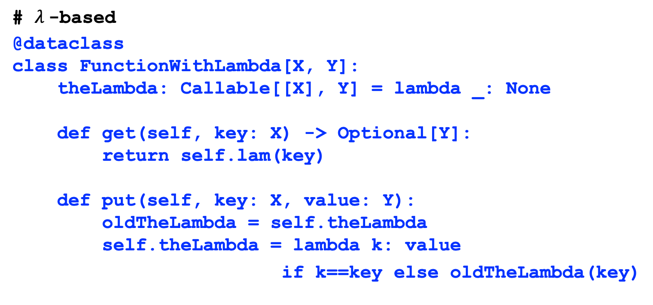
Implementation
# $λ$-based
@dataclass class FunctionWithLambda[X, Y]: theLambda: Callable[[X], Y] = lambda _: None def get(self, key: X) -> Optional[Y]: return self.lam(key) def put(self, key: X, value: Y): oldTheLambda = self.theLambda self.theLambda = lambda k: value
if k==key else oldTheLambda(key)

Slide 28
Basic Computation Complexity

Slide 29
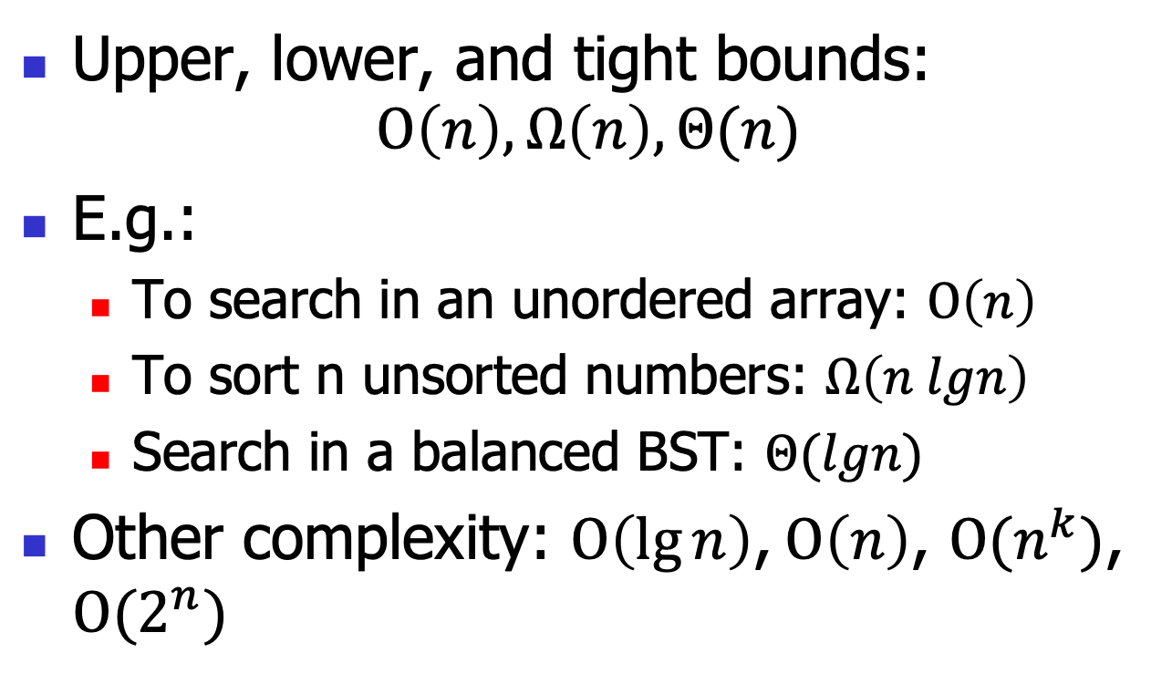
Recall some notations on complexity
Upper, lower, and tight bounds:
$$O\left(n\right), Ω\left(n\right), Θ(n)$$
E.g.:
To search in an unordered array: $O\left(n\right)$
To sort n unsorted numbers: $Ω\left(n lgn\right)$
Search in a balanced BST: $Θ(lgn)$
Other complexity: $O\left(\lg{n}\right)\text{,} O\left(n\right)$, $O{(n}^{k})$, $O{(2}^{n})$

Slide 30
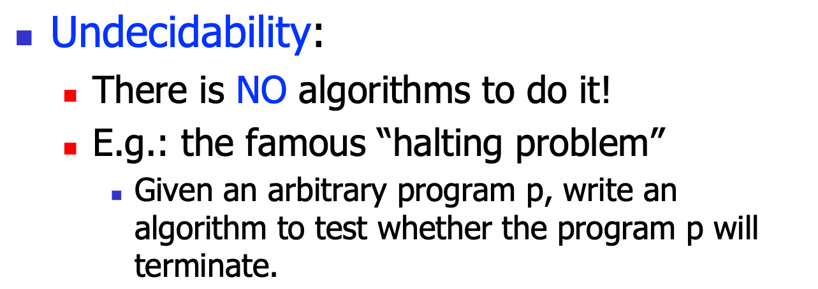
How hard a problem is?
Easy
Hard
Undecidability
$\text{Undecidability}\text{:}$
$\text{There} \text{is} \text{NO} \text{algorithms} \text{to} \text{do} \text{it}\text{!}$
$\text{E}\text{.}\text{g}\text{.: }\text{the} \text{famous} \text{“}\text{halting} \text{problem}\text{”}$
$\text{Given} \text{an} \text{arbitrary} \text{program} \text{p}\text{,} \text{write} \text{an} \text{algorithm} \text{to} \text{test} \text{whether} \text{the} \text{program} \text{p} \text{will} \text{terminate}\text{.}$

Slide 31
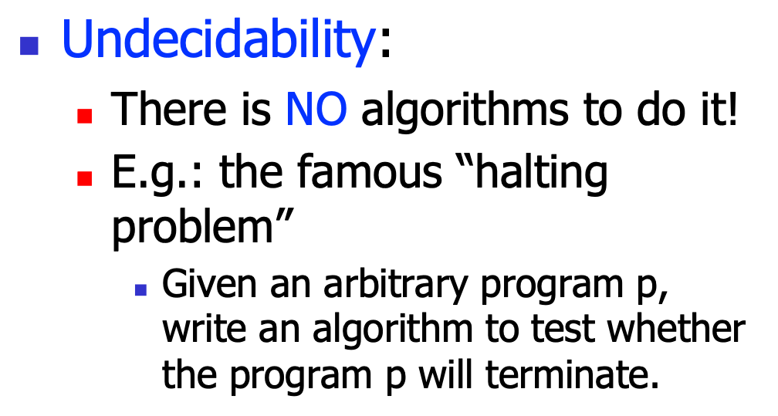
How hard a problem is?
Easy
Hard
Undecidability
$\text{Undecidability}\text{:}$
$\text{There} \text{is} \text{NO} \text{algorithms} \text{to} \text{do} \text{it}\text{!}$
$\text{E}\text{.}\text{g}\text{.: }\text{the} \text{famous} \text{“}\text{halting} \text{problem}\text{”}$
$\text{Given} \text{an} \text{arbitrary} \text{program} \text{p}\text{,} \text{write} \text{an} \text{algorithm} \text{to} \text{test} \text{whether} \text{the} \text{program} \text{p} \text{will} \text{terminate}\text{.}$
void f(){
return;
}
void f(){
for(;;);
}

Slide 32
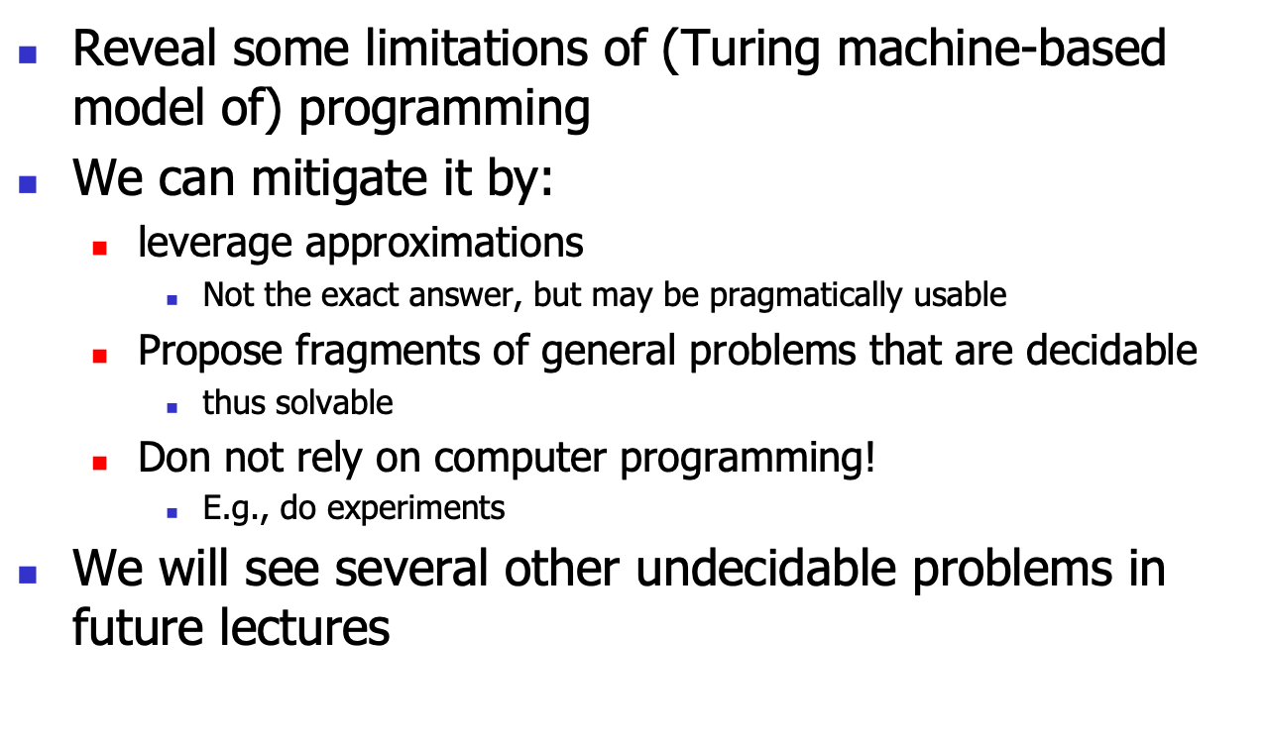
undecidable != unsolvable
Reveal some limitations of (Turing machine-based model of) programming
We can mitigate it by:
leverage approximations
Not the exact answer, but may be pragmatically usable
Propose fragments of general problems that are decidable
thus solvable
Don not rely on computer programming!
E.g., do experiments
$\text{We} \text{will} \text{see} \text{several} \text{other} \text{undecidable} \text{problems} \text{in} \text{future} \text{lectures}$

Slide 33
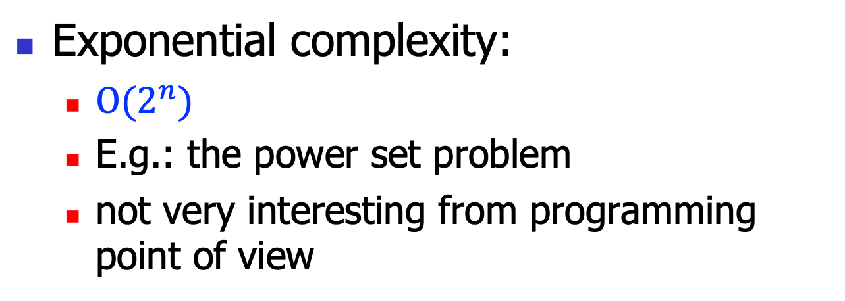
How hard a problem is?
Easy
Hard
Exponential
Undecidability
$\text{Exponential} \text{complexity}\text{:}$
$O{(2}^{n})$
E.g.: the power set problem
not very interesting from programming point of view

Slide 34
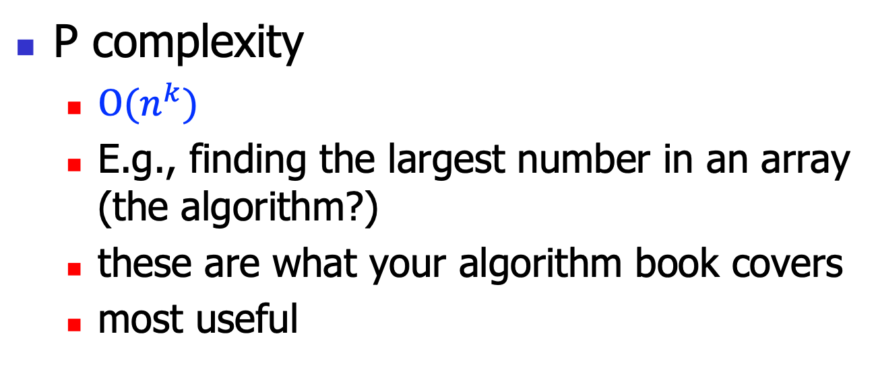
How hard a problem is?
Easy
Hard
P
Exponential
Undecidability
$\text{P} \text{complexity}$
$O{(n}^{k})$
E.g., finding the largest number in an array (the algorithm?)
these are what your algorithm book covers
most useful

Slide 35
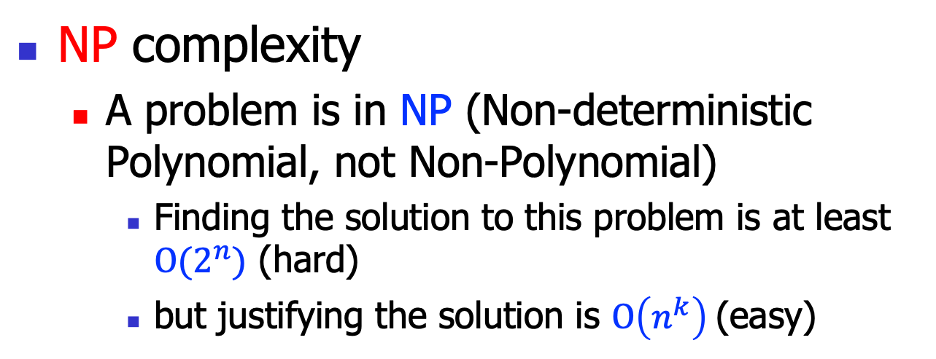
How hard a problem is?
Easy
Hard
P
NP
Exponential
Undecidability
$\text{N}\text{P} \text{complexity}$
A problem is in NP (Non-deterministic Polynomial, not Non-Polynomial)
Finding the solution to this problem is at least $O(2^{n})$ (hard)
but justifying the solution is $O\left(n^{k}\right)$(easy)

Slide 36
NP complexity
Can we overlook these problems by just ignoring them?
No, because more than several thousands of problem have been identified as NP
most of these problems are essential
E.g.:
subset sum problem
0-1 knapsack problem
traveling salesman problem

Slide 37
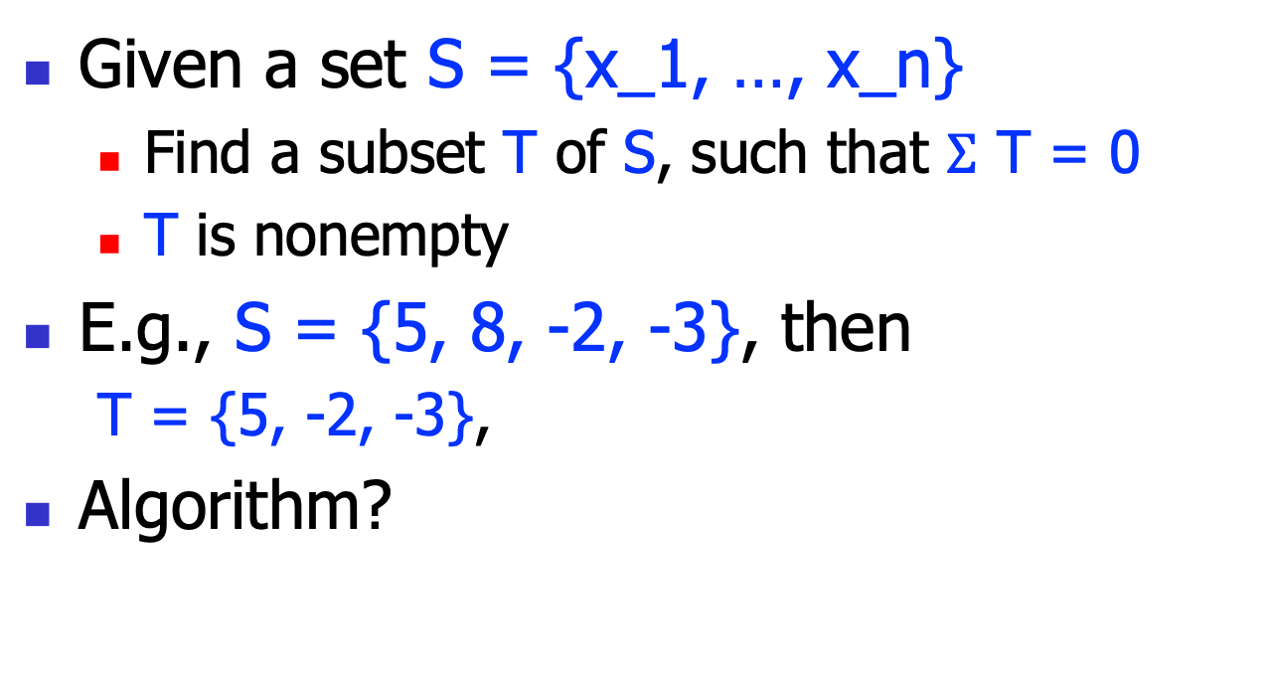
Subset sum problem
Given a set S = {x_1, …, x_n}
Find a subset T of S, such that $Σ$ T = 0
T is nonempty
E.g., S = {5, 8, -2, -3}, then
T = {5, -2, -3},
Algorithm?

Slide 38
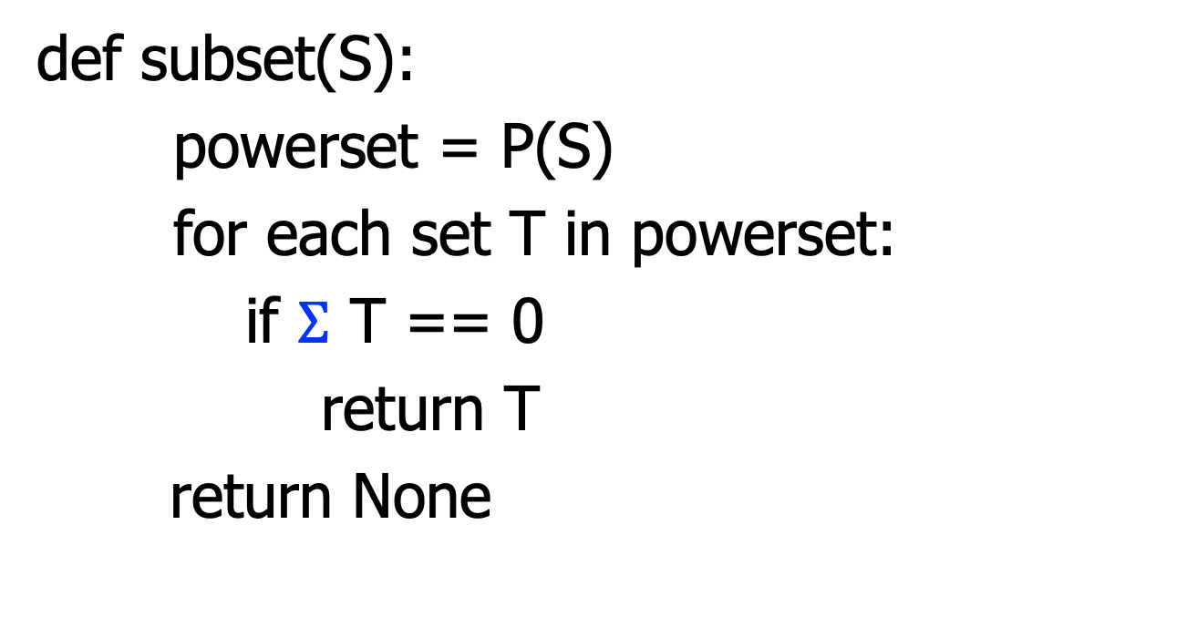
Subset sum problem
def subset(S):
powerset = P(S)
for each set T in powerset:
if $Σ$ T == 0
return T
return None

Slide 39
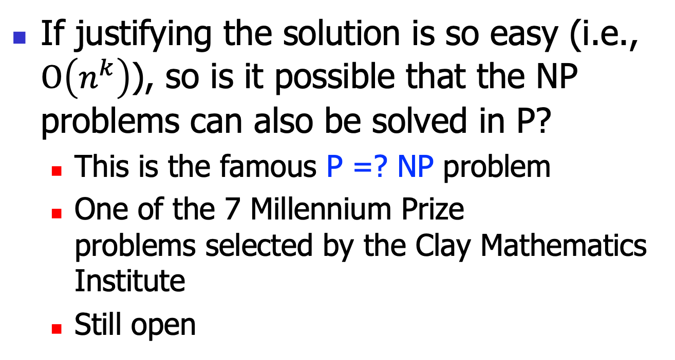
P =? NP
If justifying the solution is so easy (i.e., $O\left(n^{k}\right)$), so is it possible that the NP problems can also be solved in P?
This is the famous P =? NP problem
One of the 7 Millennium Prize problems selected by the Clay Mathematics Institute
Still open
NP
P

Slide 40
The 7 Millennium Prize Problems
P versus NP
The Hodge conjecture (algebraic geometry)
The Poincaré conjecture
solved, by Grigori Perelman (topology)
The Riemann hypothesis
Yang–Mills existence and mass gap
Navier–Stokes existence and smoothness
The Birch and Swinnerton-Dyer conjecture

Slide 41
NP-Complete (NPC)
All problems in NP can be transformed to a subset called NP-complete (NPC)
Intuitively, this is the hardest problems in NP
If NPC can be solved in polynomial time, so does NP
The first NPC is SAT
Cook, 1971
More later in this course
NP
P
NPC

