Slide 1

Introduction to Fuzzing
Computer Systems and Security Group (CSS Group) , USTC
www.csslab.io

Slide 2

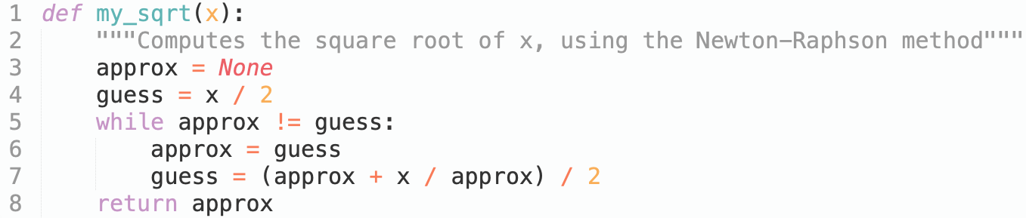

Introduction to Software Testing
Suppose we want to test the code below which computes the square root of the number x:
How to find out whether my_sqrt() works correctly?

Slide 3
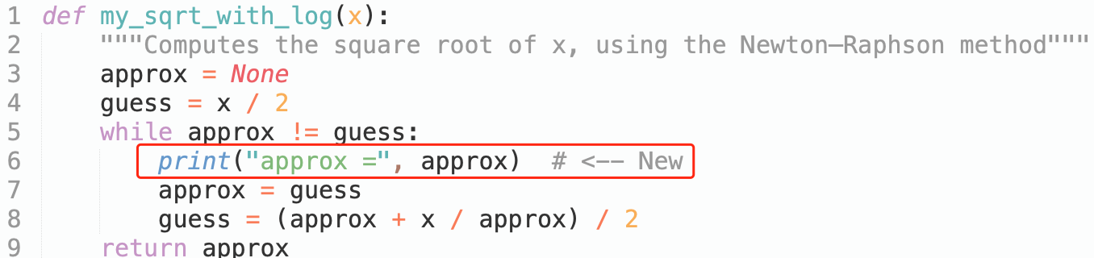
Introduction to Software Testing
Method 1: Run & Check Manually
Moreover，Debug the Function

Slide 4
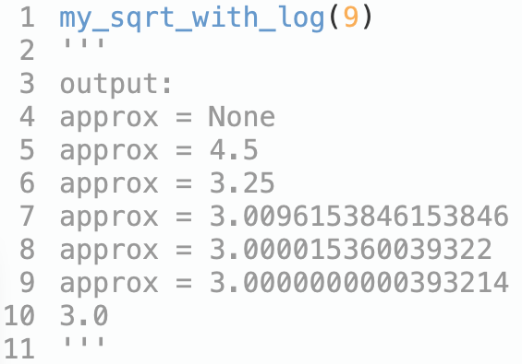
Introduction to Software Testing
Method 1: Run & Check Manually
Moreover，Debug the Function

Slide 5
Introduction to Software Testing
Method 1: Run & Check Manually
How to verify the results?

Slide 6
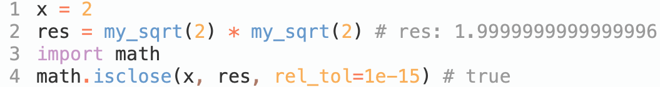
Introduction to Software Testing
Method 1: Run & Check Manually
How to verify the results?
Checking the Function

Slide 7
Introduction to Software Testing
Method 1: Run & Check Manually
Problems:
Can only check a very limited number of executions and their results
After any change to the program, you have to repeat the testing process

Slide 8
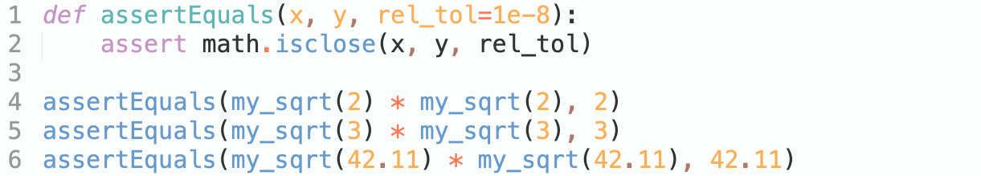
Introduction to Software Testing
Method 2: Automated Testing

Slide 9
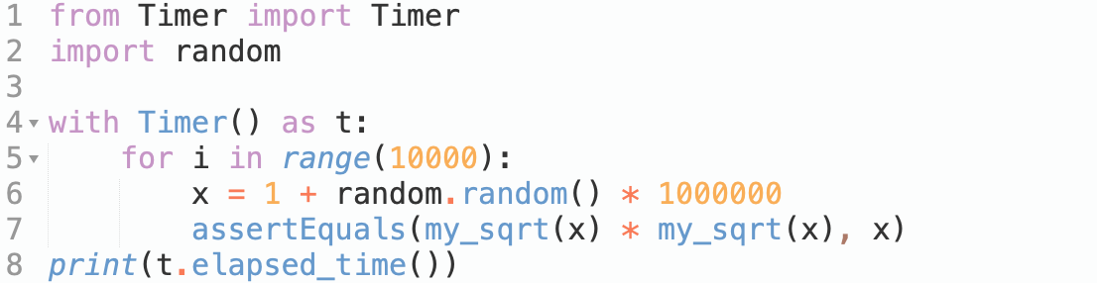
Introduction to Software Testing
Method 2: Automated Testing
With Loop, Random and Timer
Generate 100000 test cases
automatically and randomly!

Slide 10
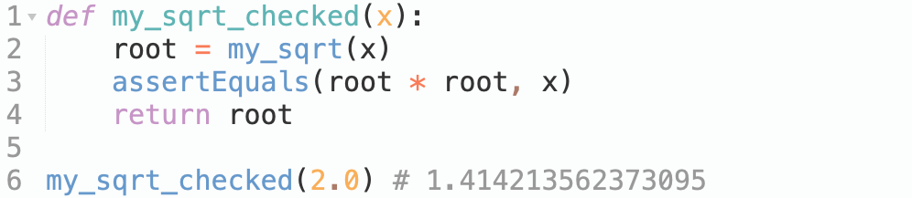
Introduction to Software Testing
Run-Time Verification

Slide 11
Introduction to Software Testing
Run-Time Verification

Slide 12
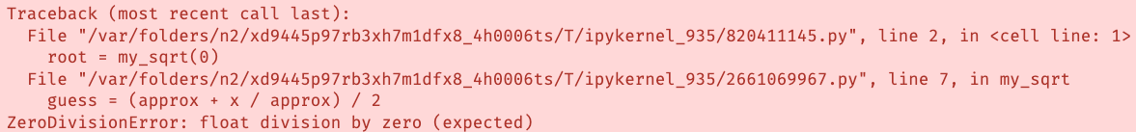
Introduction to Software Testing
The Limits of Testing
Incompleteness: there may always be untested inputs for which the function may still fail.
After any change to the program, you have to repeat the testing process

Slide 13

Fuzzing 101
The Origin of Fuzzing
Fuzzing was born on a“ dark and stormy night in the Fall of 1988”. Prof. Barton Miller, connected to his university computer via a 1200 baud line, noticed frequent crashes. As a scientist, he wanted to investigate the extent of the problem and its causes. So, he created a programming exercise for his students at UW-Madison to create the first fuzzer.
The Goal of the First Fuzzer
Evaluate UNIX utility programs' robustness with an unpredictable input stream
Build a fuzz generator to output random characters, then use it to attack multiple programs to try to break them.
Prof. Barton P Miller

Slide 14
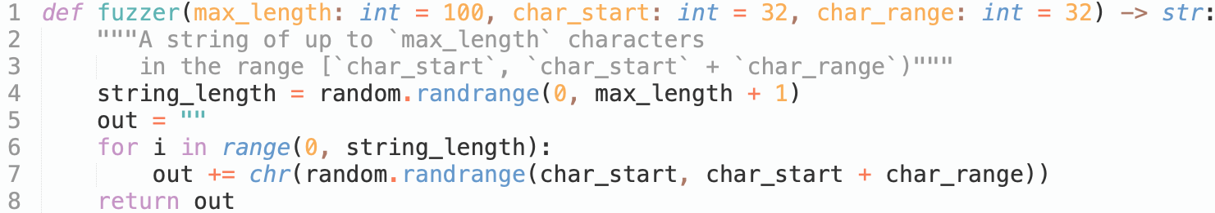
Fuzzing 101
A Simple Fuzzer
Randomly generate strings length which range is [0, 100]

Slide 15
Fuzzing 101
A Simple Fuzzer
Randomly generate characters in ASCII order [32, 64)

Slide 16
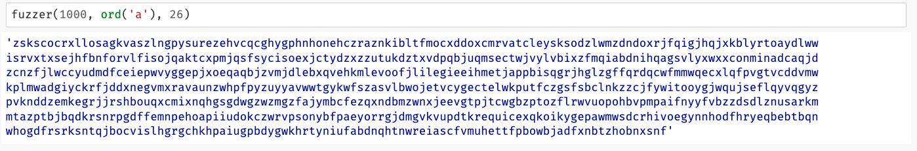
Fuzzing 101
A Simple Fuzzer

Slide 17
Fuzzing 101
A Simple Fuzzer
More Pythonic!

Slide 18


Fuzzing 101
Long-Running Fuzzing External Programs
How to fuzzing Linux tools bc using our simple fuzzer() ?

Slide 19
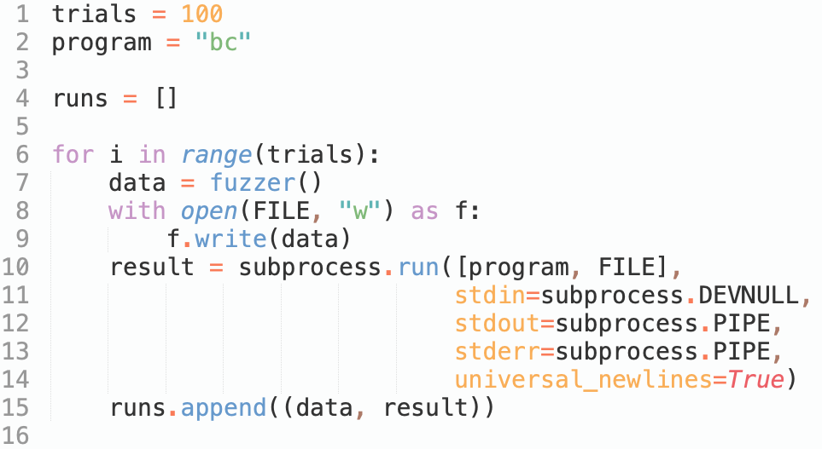
Fuzzing 101
Long-Running Fuzzing External Programs
How to fuzzing Linux tools bc using our simple fuzzer() ?
Number of test sets

Slide 20
Fuzzing 101
Long-Running Fuzzing External Programs
How to fuzzing Linux tools bc using our simple fuzzer() ?
Fuzzing target

Slide 21
Fuzzing 101
Long-Running Fuzzing External Programs
How to fuzzing Linux tools bc using our simple fuzzer() ?
Save fuzzing results

Slide 22
Fuzzing 101
Long-Running Fuzzing External Programs
How to fuzzing Linux tools bc using our simple fuzzer() ?
Generate test case by fuzzer()

Slide 23
Fuzzing 101
Long-Running Fuzzing External Programs
How to fuzzing Linux tools bc using our simple fuzzer() ?
Run target with test case in sub-process

Slide 24
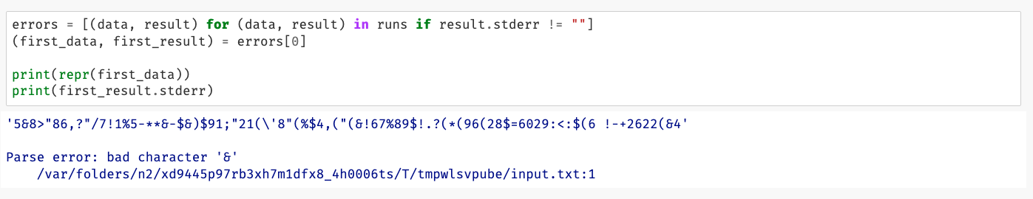
Fuzzing 101
Long-Running Fuzzing External Programs
Let us take a look at the first error message?

Slide 25
Fuzzing 101
Long-Running Fuzzing External Programs
Let us take a look at the first error message?
Are there any runs crashed (return code is not 0)?:

Slide 26
Bugs Fuzzers Find
The Goal of the First Fuzzer
Evaluate UNIX utility programs' robustness with an unpredictable input stream
Build a fuzz generator to output random characters, then use it to attack multiple programs to try to break them.
The Result of the First Fuzzer
When Miller and his students ran their first fuzzers in 1989, they found an alarming result: About a third of the UNIX utilities they fuzzed had issues – they crashed, hung, or otherwise failed when confronted with fuzzing input [1]
[1] Barton P. Miller, Lars Fredriksen, and Bryan So. 1990. An empirical study of the reliability of UNIX utilities. Commun. ACM 33, 12 (Dec. 1990), 32–44. https://doi.org/10.1145/96267.96279
Prof. Barton P Miller

Slide 27
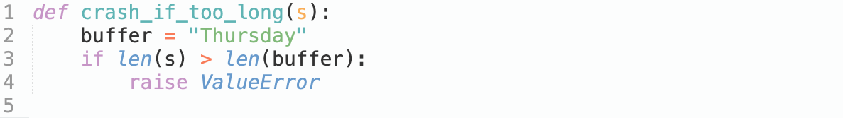
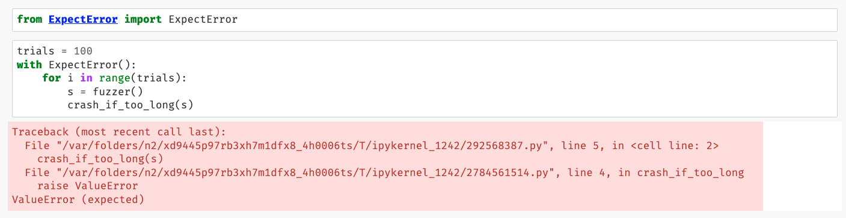
Bugs Fuzzers Find
Buffer Overflows
C
Python

Slide 28
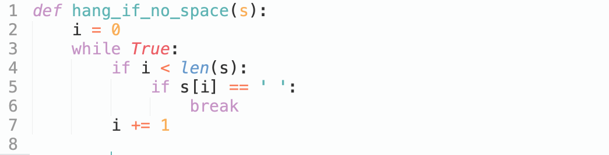
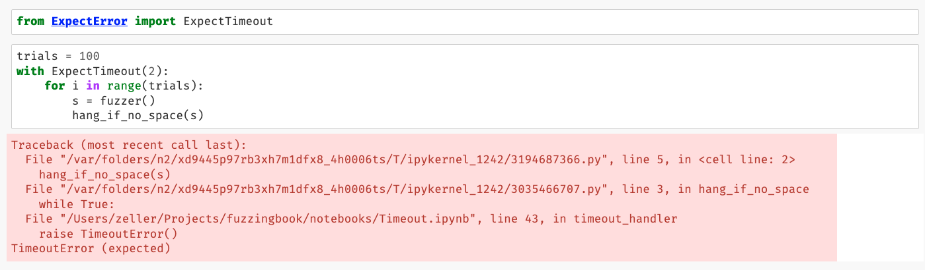
Bugs Fuzzers Find
Missing Error Checks
Some programming languages like C do not have exceptions
Python

Slide 29
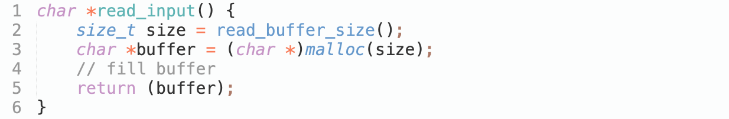
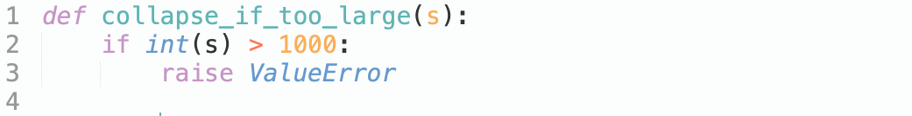
Bugs Fuzzers Find
Rogue Numbers
C
What happens if size is very large, exceeding program memory?
What happens if size is less than the number of characters following?
What happens if size is negative?
Python

Slide 30
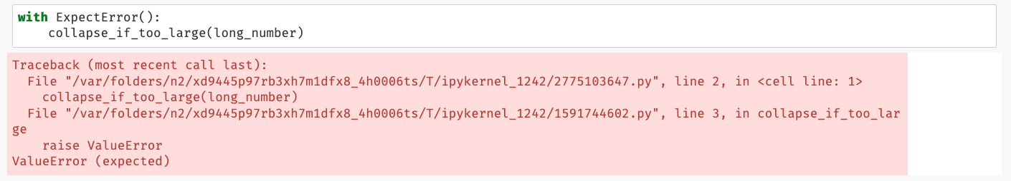
Bugs Fuzzers Find
Rogue Numbers
Python

Slide 31
Catching Errors
Generic Checkers

Slide 32
Catching Errors
Program-Specific Checkers

Slide 33
Catching Errors
Static Code Checkers

Slide 34
A Fuzzing Architecture

Slide 35
A Fuzzing Architecture

Slide 36
Code Coverage
How do we measure the effectiveness of these generated tests?
check the number of bugs found
code coverage: measuring which parts of a program are actually executed during a test run

Slide 37


Code Coverage
A CGI Decoder
CGI encoding is used to encode characters to be invalid in a URL
CGI encode
Blanks are replaced by '+'

Slide 38
Code Coverage
A CGI Decoder
CGI encoding is used to encode characters to be invalid in a URL
CGI encode
Other invalid characters are replaced by“%xx”,
where xx is the two-digit hexadecimal equivalent

Slide 39
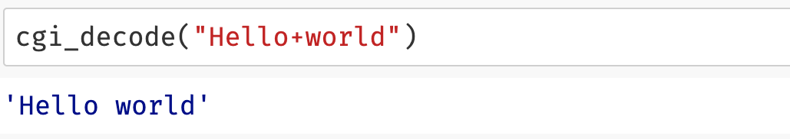
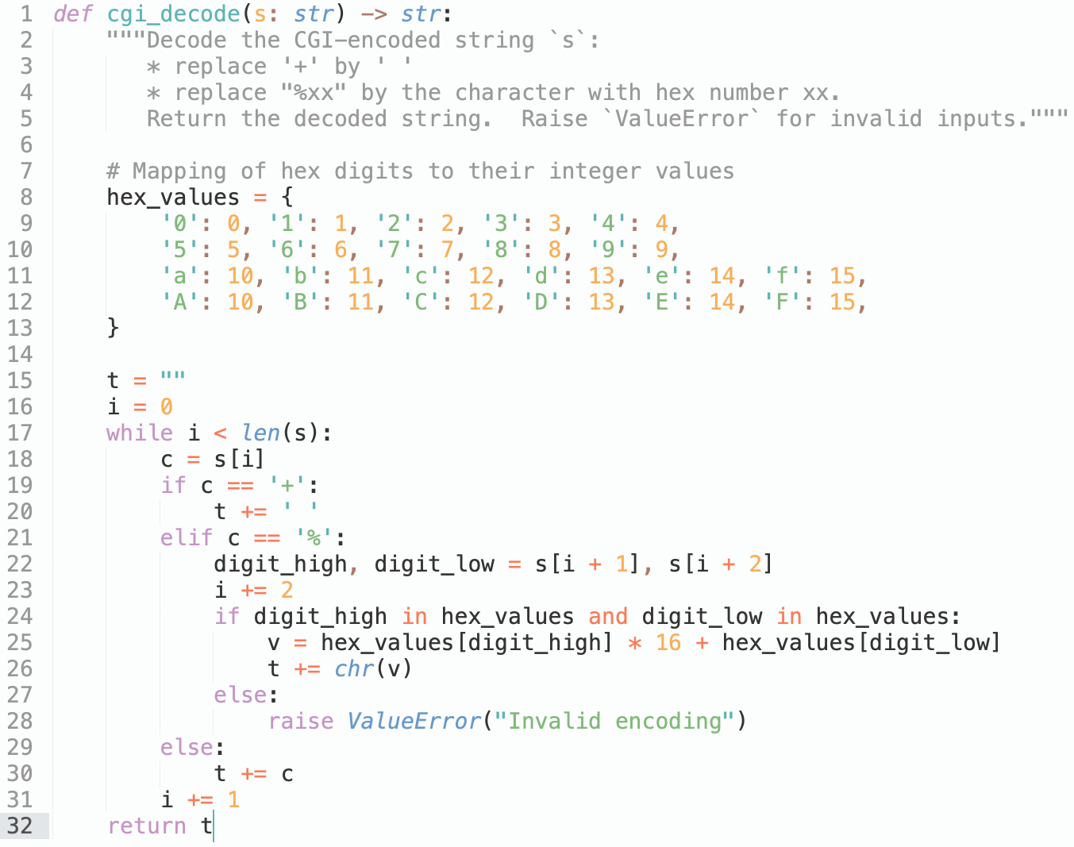
Code Coverage
The function cgi_decode() takes such an encoded string and decodes it back to its original form:

Slide 40
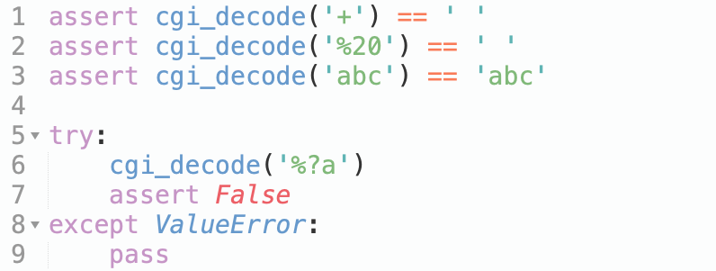
Code Coverage
Black-Box Testing
We can test the function cgi_decode() from the specification to these four features:
testing for correct replacement of '+’;
testing for correct replacement of "%xx";
testing for non-replacement of other characters; and
testing for recognition of illegal inputs.

Slide 41
Code Coverage
Black-Box Testing
Advantage:
finds errors in the specified behavior
independent from a given implementation
allows to create test even before implementation;
Downside:
implemented behavior typically covers more ground than specified behavior
typically do not cover all implementation details.

Slide 42
Code Coverage
White-Box Testing
We can derive tests from the implementation of the function cgi_decode(), White-Box testing is closely tied to the concept of covering structural features of the code.
It introduces a number of coverage criteria :
Statement coverage – each statement in the code must be executed by at least one test input
Branch coverage – each branch in the code must be taken by at least one
test input
Sequences of branches taken
Loop iterations taken
……

Slide 43
Code Coverage
White-Box Testing
Let us consider cgi_decode().
We’d have to cover：
The block following if c == ‘+’
The two blocks following if c == ‘%’
The final else case for all other characters

Slide 44
Code Coverage
White-Box Testing
Advantage:
finds errors in the implemented behavior
can be conducted even in cases where the specification does not provide sufficient details
can identifying corner cases in the specification
Downside:
may miss non-implemented behavior
If some specified functionality is missing, white-box testing will not find it.

Slide 45
Code Coverage
Tracing Executions
White-box testing allows for automatic assessment of program feature coverage by instrumenting the program's execution
This information can be used by the programmer to focus on writing tests that cover the remaining uncovered code.
In Python, the function sys.settrace(f) allows to:
define a tracing function f() that is called for each and every line executed
gets access to the current function and its name, current variable contents, and more
do dynamic analysis (the analysis of what actually happens during an execution)

Slide 46
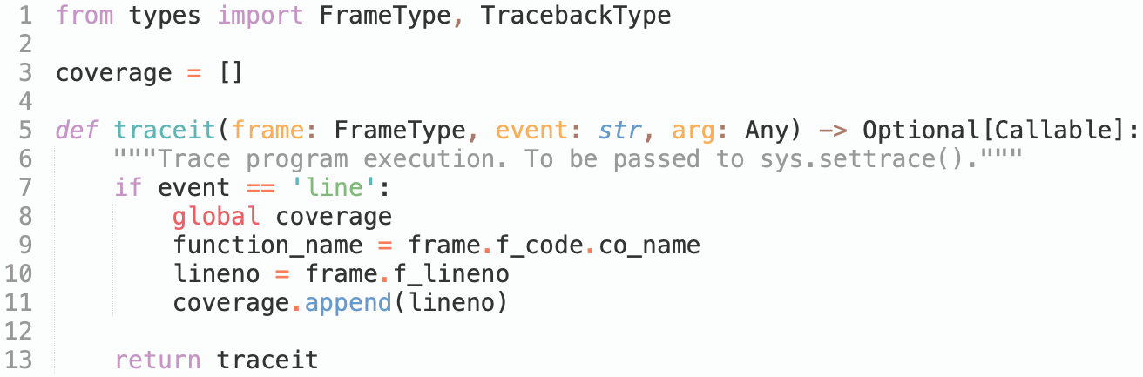
Code Coverage
f_code.co_name: current function name
f_lineno: current line number
f_locals: current local variables and arguments
Tracing Executions
"line" (a new line has been reached)
OR
"call" (a function is being called)
Store the tracing information

Slide 47
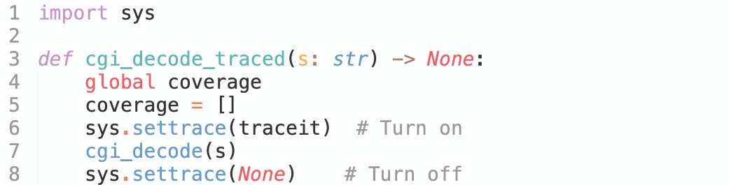
Code Coverage
Tracing Executions
switch tracing on and off
with sys.settrace()

Slide 48
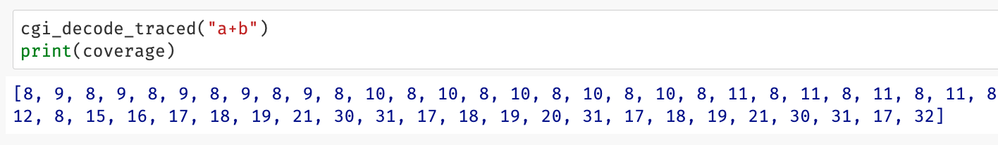
Code Coverage
Tracing Executions
switch tracing on and off
with sys.settrace()
line number only!

Slide 49
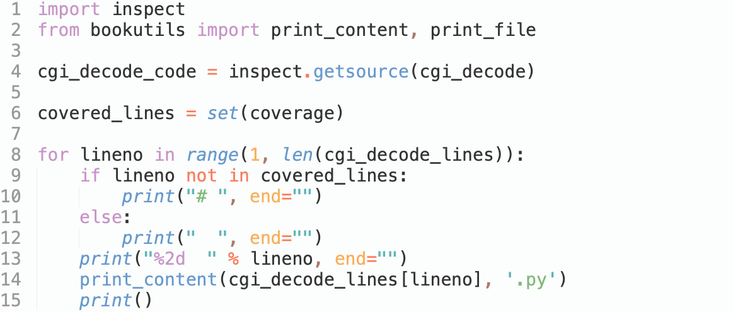
Code Coverage
Tracing Executions
get target function source code
deduplication of code line numbers
print the code coverage

Slide 50
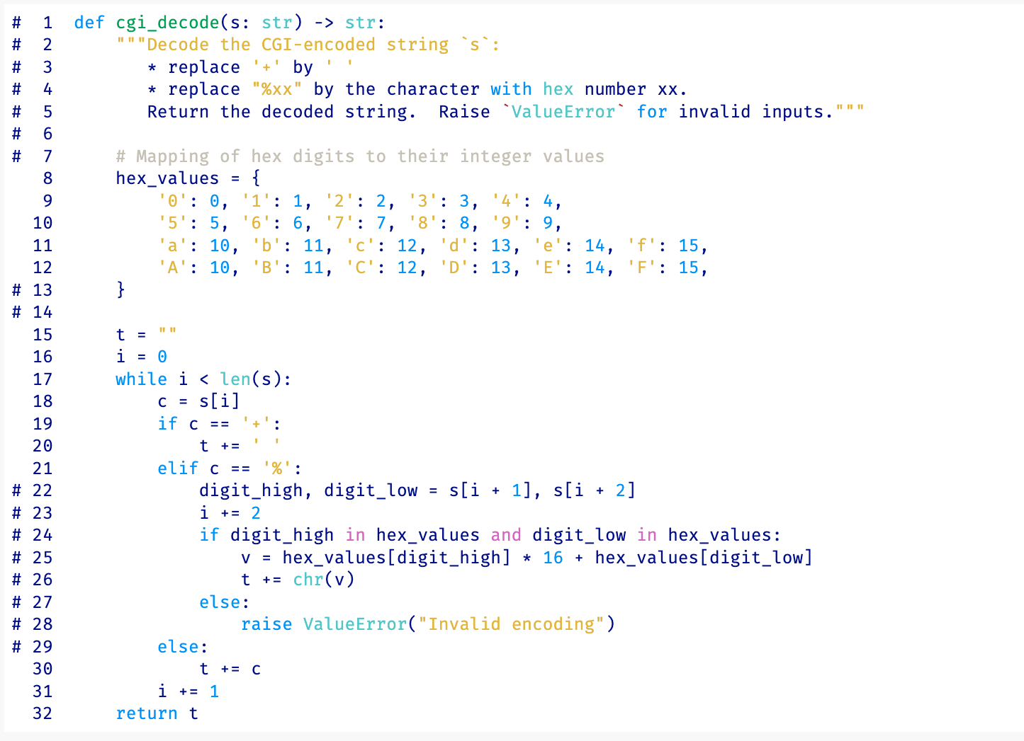
Code Coverage
Tracing Executions
Covered code with
input "a+b"

Slide 51
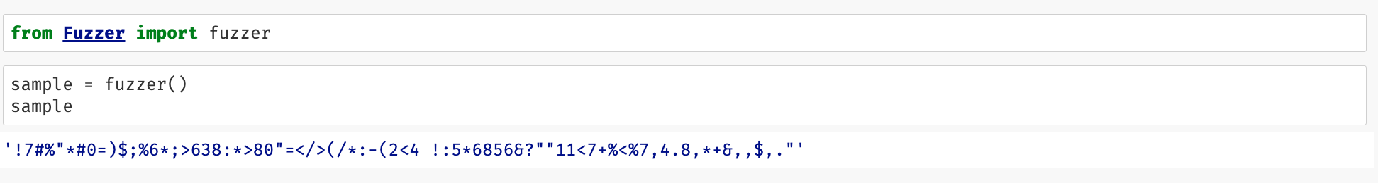
Code Coverage
Coverage of Basic Fuzzing

Slide 52
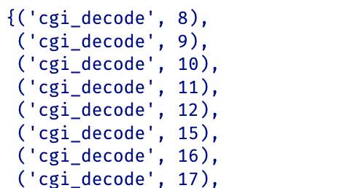
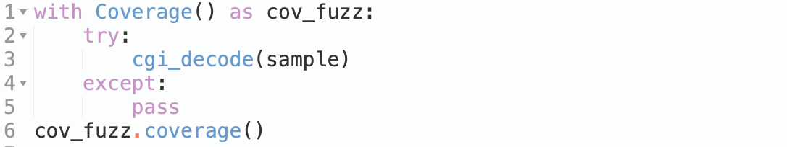
Code Coverage
Coverage of Basic Fuzzing

Slide 53
Code Coverage
Coverage of Basic Fuzzing

Slide 54
Code Coverage
Getting Coverage from External Programs

Slide 55
Code Coverage
Finding Errors with Basic Fuzzing

