Slide 1
Overview
Principle of Programming Languages
Baojian Hua
bjhua@ustc.edu.cn

Slide 2
What are programming languages?
Communications between programmers and underlying HW.
One of the most fundamental area of computer science
C/C++, Java, C#, html, SQL, LaTeX, ...
Still relevant today, both in academia and industry

Slide 3
Why do we care? or. Why is it difficult?
Easy to use
design
good syntax, clear semantics
Better performance
implementations (compilers, lib, GCs, etc.)
Quality
safety properties
Foundation
semantics, type systems, logics

Slide 4
What will this course cover?
Rigorous analysis of programs
statically, its semantics
dynamically, its behavior
Potential topics include, but not limited to:
control-flow graphs and analysis
data-flow analysis and optimizations
lattice and fix-point
static single-assignment forms (SSA)
interprocedural analysis
pointer analysis
abstract interpretation

Slide 5
What should you take this course?
Programming language concepts
from the practical programming aspects
Solid theory underpinnings
many theoretical results
Better programming skills
you write programs that manipulate programs
thus you will take the opportunity to write the (arguably) most complex code in your career

Slide 6
Theory & Practice
This course elegantly combines theory and practice
Theory part: grammar, type theory, closure, lattice, fix-point, …
Practice part: various data structures & algorithms, software engineering techniques to handle all of them

Slide 7
How This Course Works

Slide 8
Structure of this course
Lectures
Now
Readings
Textbooks, research papers
Exercises & quizzes
before each lecture
Projects
development of software from scratch

Slide 9
Online Resources
Web site:
http://csslab-ustc.github.io/courses/advanced
Material:
course policies and schedule of lectures
readings and exercises
project information
development resources
some lecture notes
Check the web site frequently

Slide 10
Textbooks & Reference
Principle of Program Analysis.
state-of-the-art for static analysis
Static Program Analysis.
A more modern approach to static analysis
Types and Programming Languages.
from the type system point of view.
Modern compiler implementation in C/ML/Java (tiger book)
focus on implementation

Slide 11

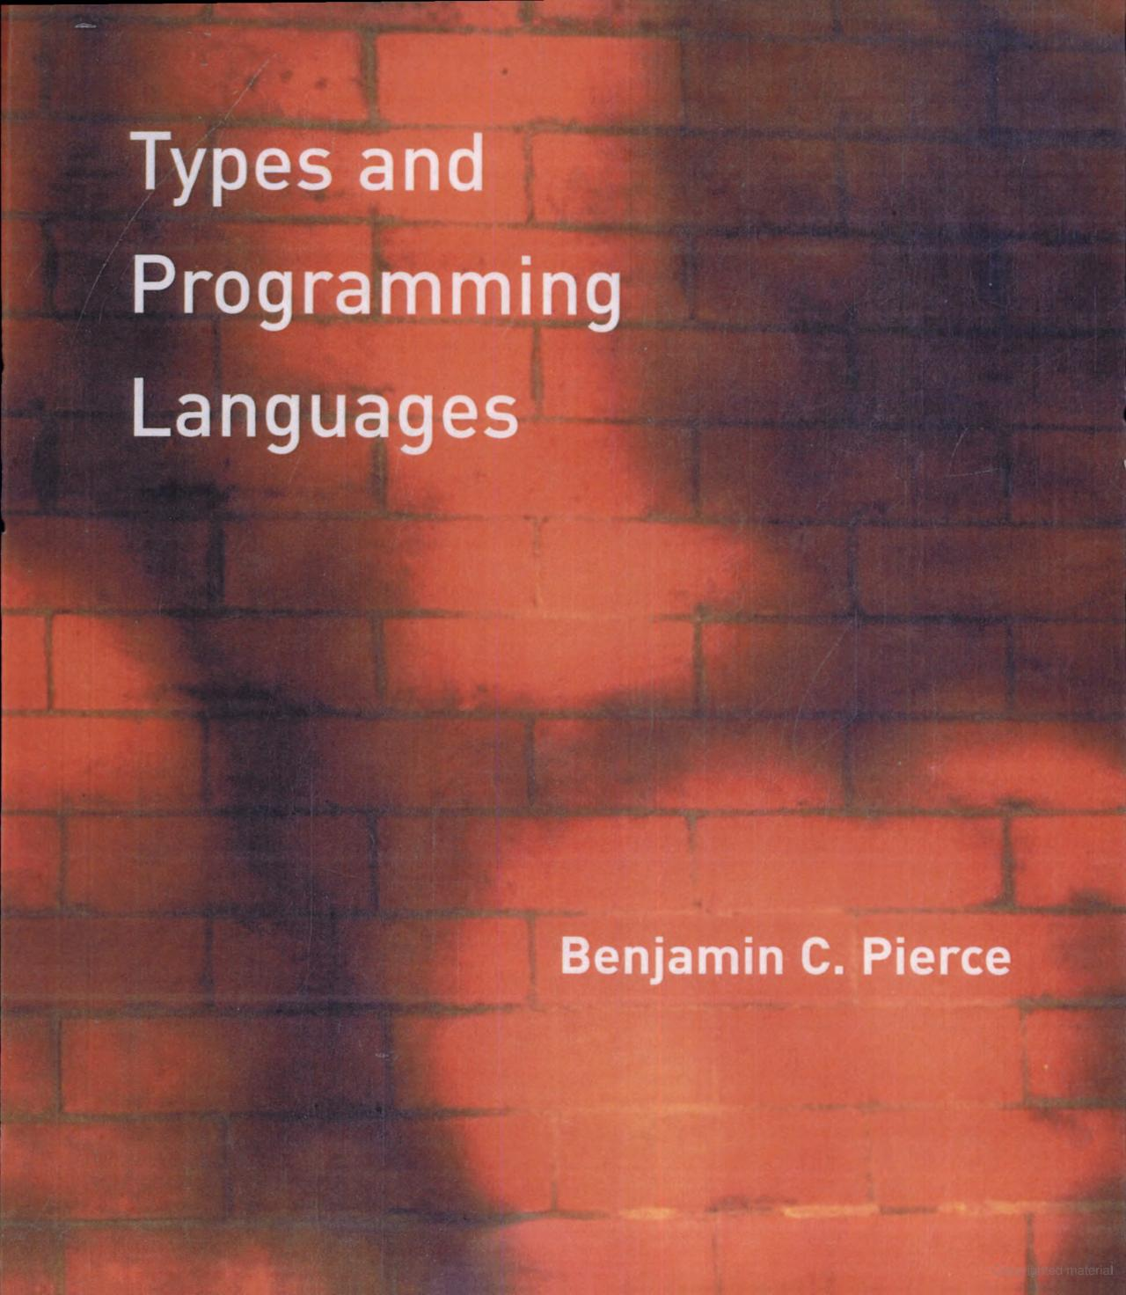
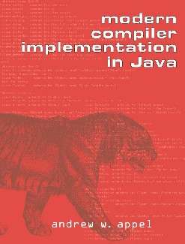
Textbooks & References
(ppa book)
(types book)
(tiger book)

Slide 12
Projects
You will build a working prototype Dragon, from scratch, in Java:
6 labs planned + one final
Lab1: control-flow graph
Lab2: data-flow analysis and optimizations
Lab3: lattice and fix-points
Lab4: static single-assignment (SSA)
Lab5: interprocedural analysis
Lab6: pointer analysis
Final: a project on your own
lab 1 is out, start early

Slide 13
Projects
In each lab, you will build working components step by step
Using Java as the implementation language
we offer some code skeleton for you to start with

Slide 14
Evaluation
50%: projects
50%: final test

Slide 15
Summary
Programming languages are the most fruitful and amazing subject of research in CS!
Many beautiful results
Still relevant today, in every aspects of programming
More challenges and open problems!
This is intended to be a fun and engaging project-oriented class

Slide 16
Last Thing
Read the handout
Install software
Start early on lab1

