Slide 1
SSA: Static Single-Assignment Form
Compiler
Baojian Hua
bjhua@ustc.edu.cn

Slide 2
Middle End
AST
translation
IR1
translation
IR2
more IRs and translation
asm

Slide 3
Optimizations
opt
opt
AST
translation
IR1
opt
translation
IR2
opt
opt
more IRs and translation
asm

Slide 4
SSA in General

Slide 5
SSA History
Optimization is IR-dependent:
We’ve discussed optimizations on the AST, TAC, or CFG
Key problem: is there a best IR suitable for program analysis/optimization?
If yes, what is it?
In late 1980’, researchers at IBM Watson research center developed a new IR: SSA
with many nice properties
great for optimizations
Later, SSA is used in many optimizing compilers:
GCC, MS VC, Jikes, MLton, LLVM, hotspot, …
Nowadays, SSA becomes the de-factor standard IR for optimizing compilers for imperative languages

Slide 6
Values ≠ Locations
The location matters!
By introducing variable versions, making the use-def explicit
This is functional programming!
int a, b, c;
a = x+y
b = a+x
a = b+2
c = y+1
a = c+a
int a₁, a₂, a₃, b, c;
a₁ = x+y
b = a₁+x
a₂ = b+2
c = y+1
a₃ = c+a₂

Slide 7
Values ≠ Locations
int i, sum1=0, sum2=0;
for (i=0; i<10; i++)
sum1 += i;
for (i=0; i<100; i++)
sum2 += i;

Slide 8
Use-Def Chains & Def-Use Chains
int i, sum1=0, sum2=0;
for (i=0; i<10; i++)
sum1 += i;
for (i=0; i<100; i++)
sum2 += i;

Slide 9
UD Chains & DU Chains can be very Expensive
int i, j, x, y;
switch (i){
case 1: x = 1; break;
case 2: x = 2; break;
case 3: x = 3; break;
case 4: x = 4; break;
default: x = 5; break;
}
switch (j){
case 1: y = x+1; break;
case 2: y = x-2; break;
case 3: y = x*8; break;
default: y = x/3; break;
}
For M uses and N defs:
O(M *N) space and time.

Slide 10
UD Chains & DU Chains can be Expensive
int i, j, x, y, z;
switch (i){
case 1: x = 1; break;
case 2: x = 2; break;
case 3: x = 3; break;
case 4: x = 4; break;
default: x = 5; break;
}
z = x;
switch (j){
case 1: y = z+1; break;
case 2: y = z-2; break;
case 3: y = z*8; break;
default: y = z/3; break;
}
A mitigation to this problem is to guarantee that each variable to have just a unique definition.

Slide 11
SSA
SSA is an IR in which every variable is assigned at most once (statically, in text)
so SSA is functional programming!
more on this in future lectures
x = 1
x = 2
x = 1
x = 2
y = x

Slide 12
Advantages of SSA
Make DU and UD chains explicit
each definition knows all its uses
each use knows its unique definition
Make optimizations:
easier
often no program analysis needed
faster
often linear time complexity
For most optimizations, SSA also reduces the time/space requirements

Slide 13
Example: Constant propagation on SSA
x = 3
…
Each variable has just a unique definition, so we do not need to perform reaching definition analysis.
…
a = x
Can we replace this “x” with constant “3”?

Slide 14
Example: Copy propagation on SSA
x = y
…
Each variable has just a unique definition, so we need not do reaching definition analysis.
…
a = x
Can we replace this “x” with the variable “y”?

Slide 15
Example: Dead code elimination (DCE) on SSA
x = v
…
Can we eliminate this assignment?
…
If “x” is not used anywhere, then one can eliminate this assignment. (No liveness analysis required at all!)
…

Slide 16
Example: Common Sub-expression Elimination (CSE) on SSA
x = a+b
…
Both a and b should have been assigned before this definition!
SSA: each variable is assigned at most once!
If x dominates y, then one can do this substitution! (Why?)
…
y = a+b
Can we replace this “a+b” with the variable “x”?
No available expression analysis and reaching expression analysis required!

Slide 17
Construction of SSA

Slide 18
Converting to SSA
Easy for a basic block (i.e., linear code)
rename each definition
and rewrite each use to refer to the most recent definition
a = x+y
b = a+x
a = b+2
c = y+1
a = c+a
a₁ = x+y
b₁ = a₁+x
a₂ = b₁+2
c₁ = y+1
a₃ = c₁+a₂

Slide 19
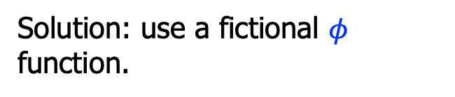
CFG poses challenges
L_0:
L_0:
if(…)
if(…)
L_1:
L_2:
L_1:
L_2:
a = 3
a = 4
a₁ = 3
a₂ = 4
L_3:
L_3:
b = a
b = a?
So how to rewrite such variable uses such as a?
Solution: use a fictional $φ$ function.

Slide 20
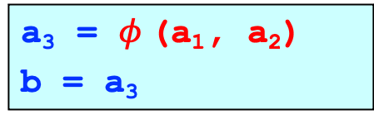

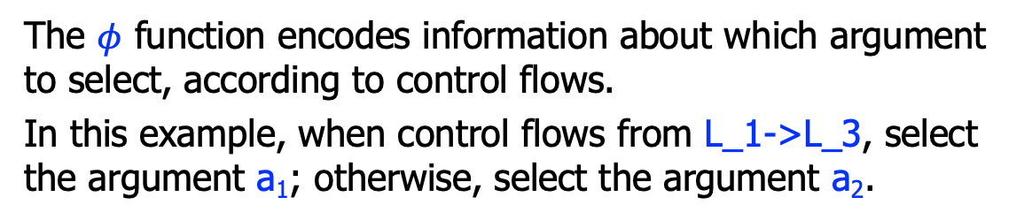
Merging at joins with $φ$ functions
L_0:
L_0:
if(…)
if(…)
L_1:
L_2:
L_1:
L_2:
a = 3
a = 4
a₁ = 3
a₂ = 4
L_3:
L_3:
b = a
a₃ = $φ$(a₁, a₂)
b = a₃
The $φ$ function encodes information about which argument to select, according to control flows.
In this example, when control flows from L_1->L_3, select the argument a₁; otherwise, select the argument a₂.

Slide 21
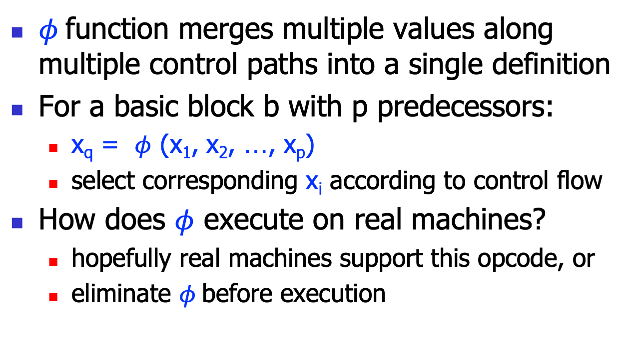

The $φ$ function
$φ$function merges multiple values along multiple control paths into a single definition
For a basic block b with p predecessors:
x_{q} = $φ$ (x₁, x₂, …, x_{p})
select corresponding x_{i} according to control flow
How does $φ$ execute on real machines?
hopefully real machines support this opcode, or
eliminate $φ$before execution

Slide 22

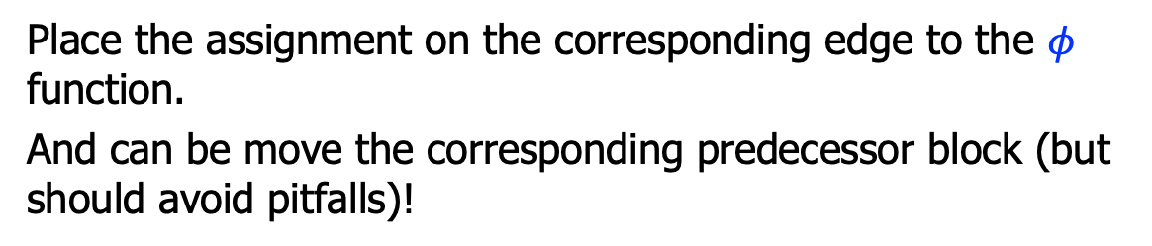
Eliminating $φ$ functions
L_0:
L_0:
if(…)
if(…)
L_1:
L_2:
L_1:
L_2:
a₁ = 3
a₂ = 4
a₁ = 3
a₂ = 4
a₃=a₁
a₃=a₂
L_3:
L_3:
a₃ = $φ$(a₁, a₂)
b = a₃
b = a₃
Place the assignment on the corresponding edge to the $φ$ function.
And can be move the corresponding predecessor block (but should avoid pitfalls)!

Slide 23
Eliminating $φ$ functions
L_0:
L_0:
if(…)
if(…)
L_1:
L_2:
L_1:
L_2:
a₁ = 3
a₂ = 4
a₁ = 3
a₃ = a₁
a₂ = 4
a₃ = a₂
L_3:
a₃ = $φ$(a₁, a₂)
b = a₃
L_3:
b = a₃
Place the assignment on the corresponding edge to the $φ$ function.
And can be move the corresponding predecessor block (but should avoid pitfalls)!

Slide 24

$φ$ Function Placement

Slide 25
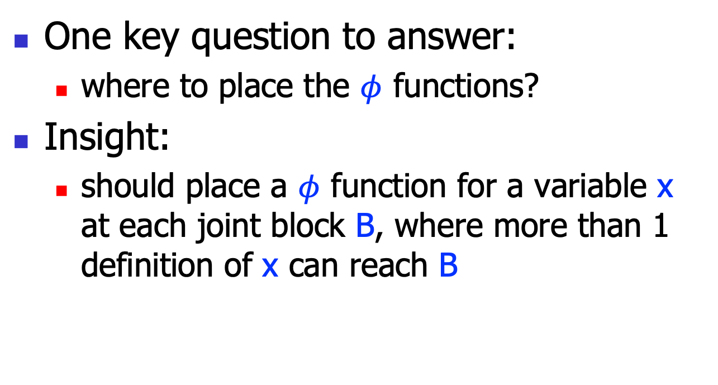

$φ$ Function Placement
One key question to answer:
where to place the $φ$ functions?
Insight:
should place a $φ$ function for a variable x at each joint block B, where more than 1 definition of x can reach B
x=…
x=…
B:
y = x

Slide 26



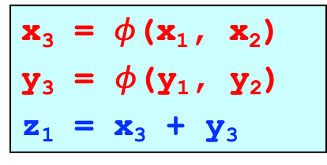
Trivial $φ$ Placement
At each join point B, insert $φ$ for every variable
…
…
x = 1
y = 2
x = 5
y = 6
x₁ = 1
y₁ = 2
x₂ = 5
y₂ = 6
z = x + y
x₃ = $φ$(x₁, x₂)
y₃ = $φ$(y₁, y₂)
z₁ = x₃ + y₃
Should we place a $φ$ function for the variable z?

Slide 27


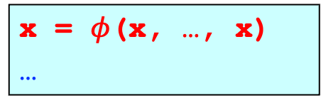
Algorithm for Trivial $φ$ Placement
trivial_phi_placement()
foreach(joint block ”B”)
foreach(variable “x”)
place this $φ$: x = $φ$(x, …, x);
x=…
…
x=…
B:
x = $φ$(x, …, x)
…

Slide 28



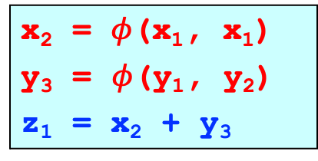
Problems with Trivial $φ$ Placement
May place more $φ$ functions than strictly needed!
x = 1
x₁ = 1
y = 2
y = 3
y₁ = 2
y₂ = 3
z = x + y
x₂ = $φ$(x₁, x₁)
y₃ = $φ$(y₁, y₂)
z₁ = x₂ + y₃
Is this $φ$ function necessary?

Slide 29
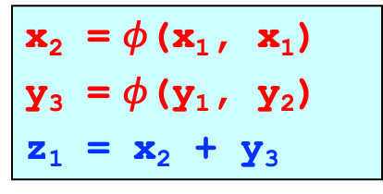

Dominance
Why should we place a $φ$ for y in L_3, but not for x?
Dominance!
L_0:
L_0:
x = 1
x₁ = 1
L_1:
L_2:
L_1:
L_2:
y = 2
y = 3
y₁ = 2
y₂ = 3
L_3:
x₂ = $φ$(x₁, x₁)
y₃ = $φ$(y₁, y₂)
z₁ = x₂ + y₃
z = x + y
L_3:

Slide 30
Dominance
Block L_0 dominates L_3 (def for x), but neither block L1 nor L_2 (def for y) dominates L3
L_0:
x₁ = 1
Dominance: a block B dominates a block C, if every execution path reaching block C must go through block B.
Dominance frontier (DF): the border area lies between dominance and non-dominance.
L_1:
L_2:
y₁ = 2
y₂ = 3
x₂ = $φ$(x₁, x₁)
y₃ = $φ$(y₁, y₂)
z₁ = x₂ + y₃
L_3:

Slide 31
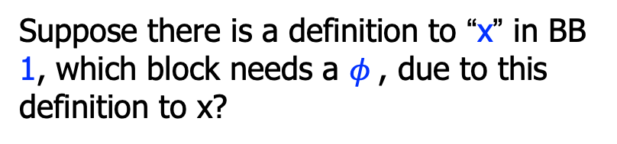
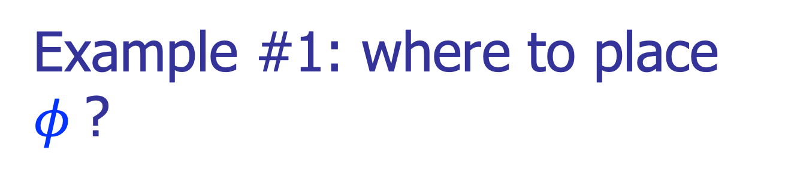
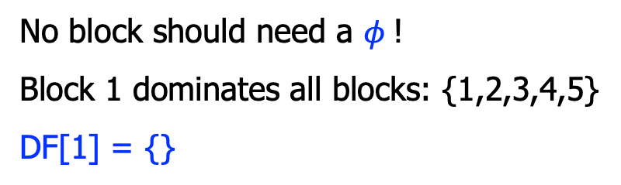
Example #1: where to place $φ$?
Suppose there is a definition to “x” in BB 1, which block needs a $φ$, due to this definition to x?
1
x = …;
2
No block should need a $φ$!
Block 1 dominates all blocks: {1,2,3,4,5}
DF[1] = {}
3
4
5

Slide 32
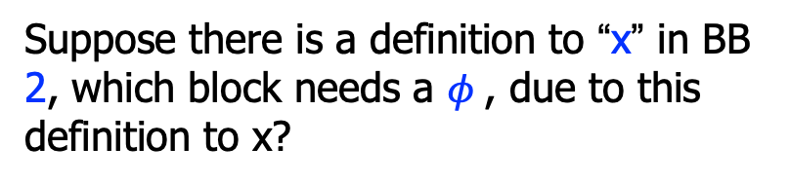

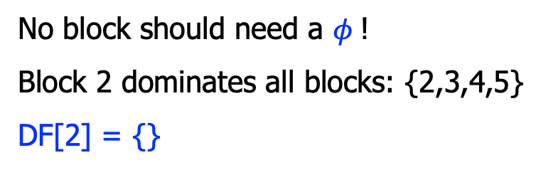
Example #2: where to place $φ$?
Suppose there is a definition to “x” in BB 2, which block needs a $φ$, due to this definition to x?
1
2
x = …;
No block should need a $φ$!
Block 2 dominates all blocks: {2,3,4,5}
DF[2] = {}
3
4
5

Slide 33
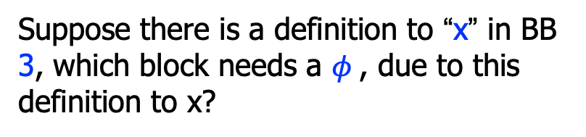


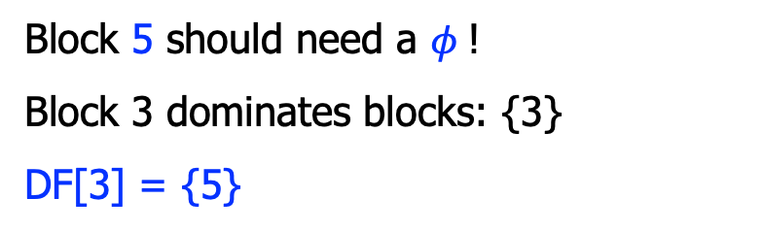
Example #3: where to place $φ$?
Suppose there is a definition to “x” in BB 3, which block needs a $φ$, due to this definition to x?
1
2
Block 5 should need a $φ$!
Block 3 dominates blocks: {3}
DF[3] = {5}
3
x = …;
4
5
x = $φ$(x, x);

Slide 34
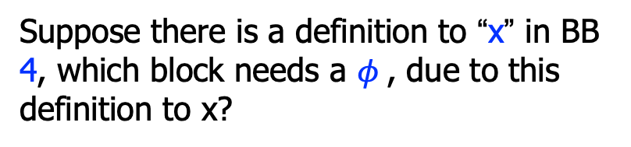
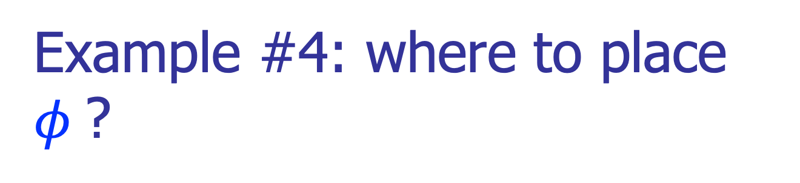

Example #4: where to place $φ$?
Suppose there is a definition to “x” in BB 4, which block needs a $φ$, due to this definition to x?
1
2
Block 5 should need a $φ$!
Block 4 dominates blocks: {4}
DF[4] = {5}
x = …;
3
4
5
x = $φ$(x, x);

Slide 35
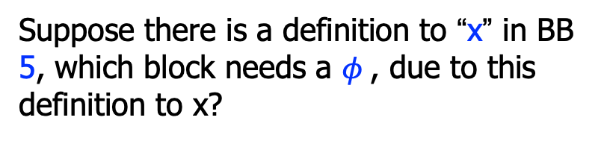

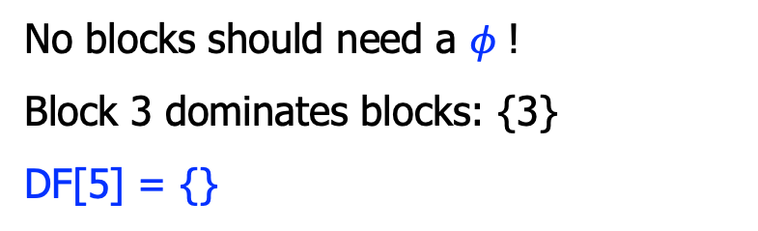
Example #5: where to place $φ$?
Suppose there is a definition to “x” in BB 5, which block needs a $φ$, due to this definition to x?
1
2
No blocks should need a $φ$!
Block 3 dominates blocks: {3}
DF[5] = {}
3
4
5
x = …;

Slide 36
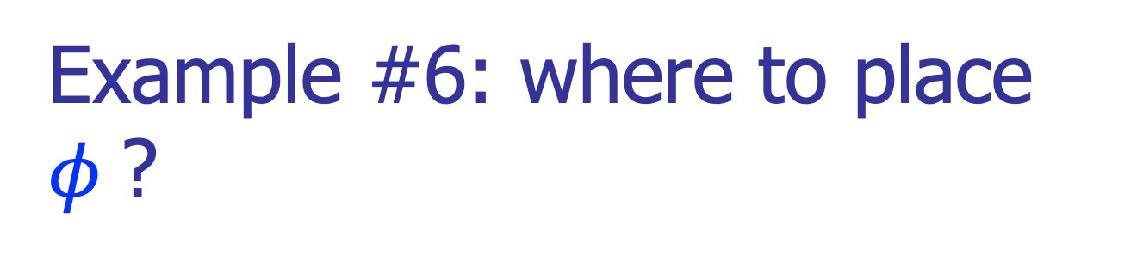
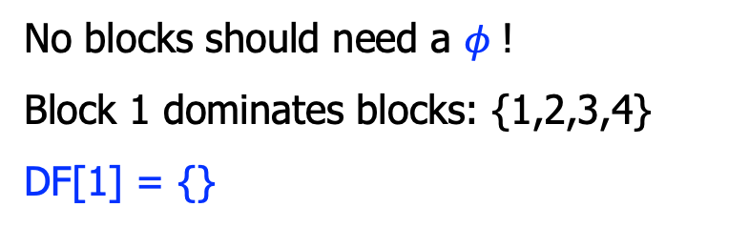
Example #6: where to place $φ$?
Suppose there is a definition to “x” in BB 1, which block needs a $φ$, due to this definition to x?
1
x = …;
2
No blocks should need a $φ$!
Block 1 dominates blocks: {1,2,3,4}
DF[1] = {}
3
4

Slide 37
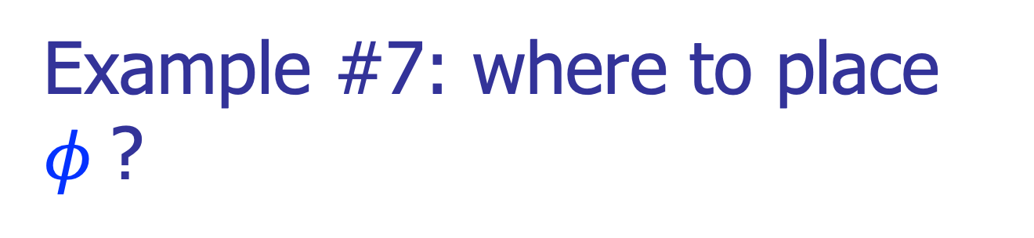

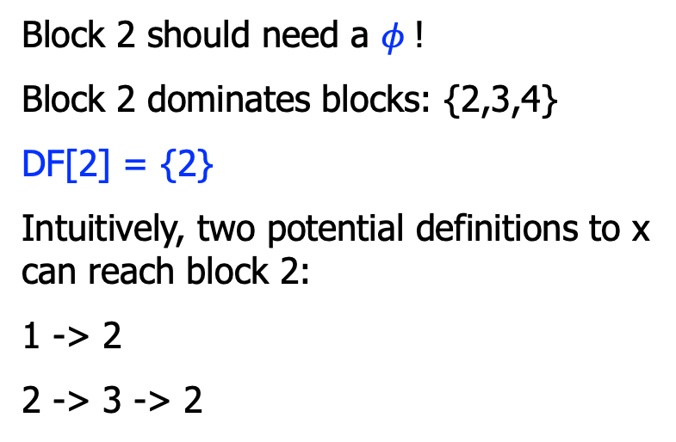
Example #7: where to place $φ$?
Suppose there is a definition to “x” in BB 2, which block needs a $φ$, due to this definition to x?
1
x = $φ$(x, x);
2
x = …;
Block 2 should need a $φ$!
Block 2 dominates blocks: {2,3,4}
DF[2] = {2}
Intuitively, two potential definitions to x can reach block 2:
1 -> 2
2 -> 3 -> 2
3
4

Slide 38
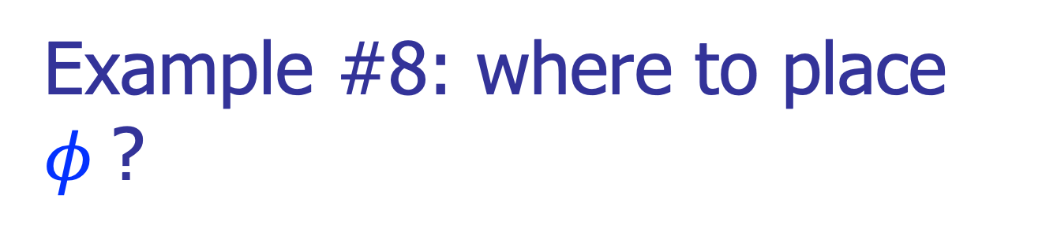
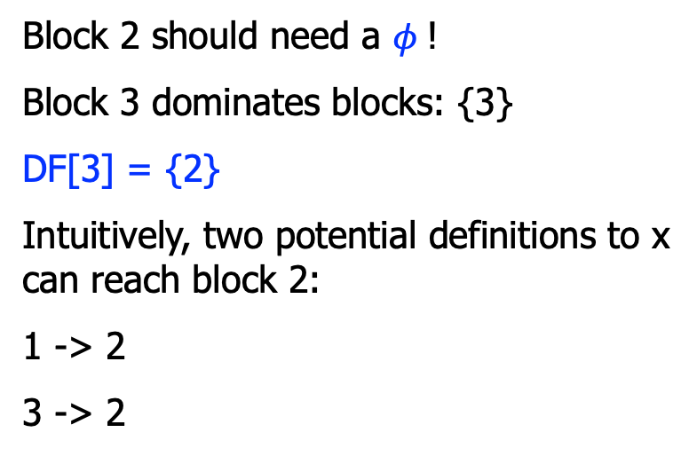
Example #8: where to place $φ$?
Suppose there is a definition to “x” in BB 3, which block needs a $φ$, due to this definition to x?
1
x = $φ$(x, x);
2
Block 2 should need a $φ$!
Block 3 dominates blocks: {3}
DF[3] = {2}
Intuitively, two potential definitions to x can reach block 2:
1 -> 2
3 -> 2
3
4
x = …;

Slide 39
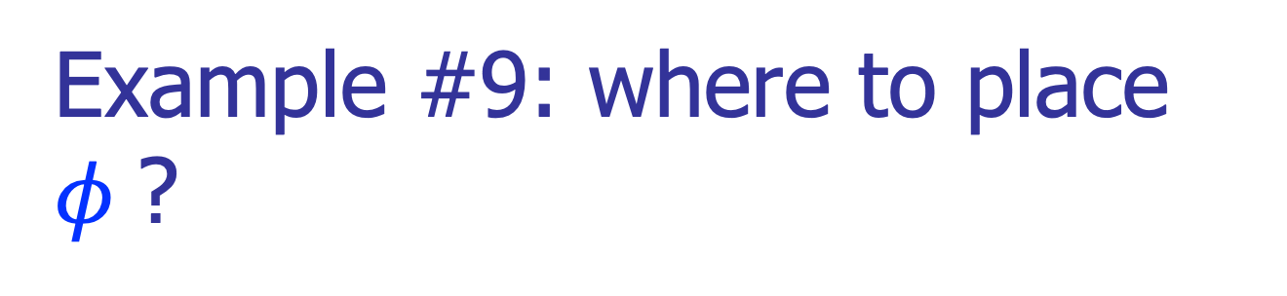
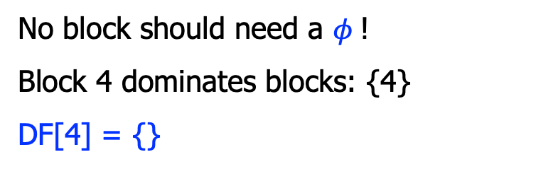
Example #9: where to place $φ$?
Suppose there is a definition to “x” in BB 4, which block needs a $φ$, due to this definition to x?
1
2
No block should need a $φ$!
Block 4 dominates blocks: {4}
DF[4] = {}
x = …;
3
4

Slide 40

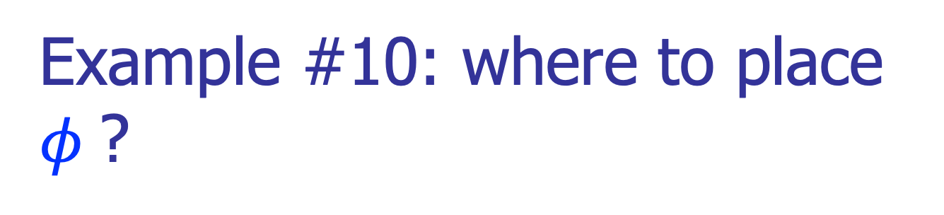
Example #10: where to place $φ$?
Suppose there is a definition to “x” in BB 4, which block needs a $φ$, due to this definition to x?
1
2
3
4
x = …;
5
6
8
7
9
11
10
12

Slide 41
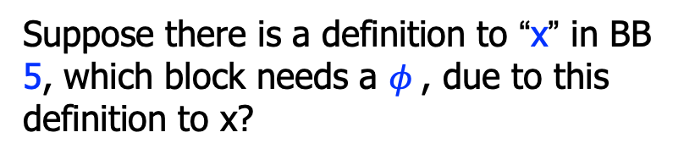
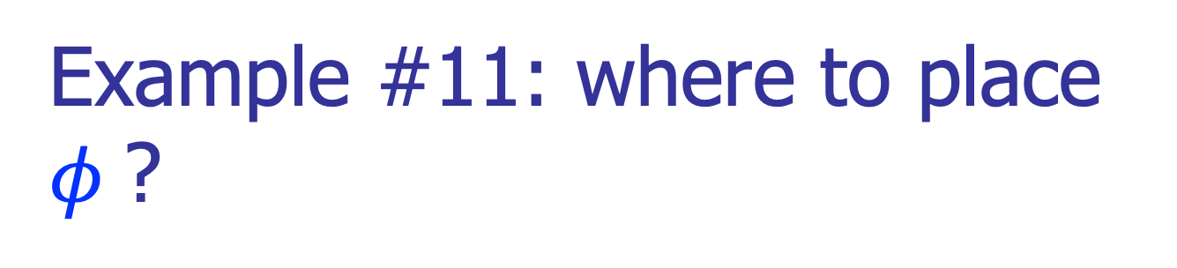
Example #11: where to place $φ$?
Suppose there is a definition to “x” in BB 5, which block needs a $φ$, due to this definition to x?
1
2
3
4
5
6
8
7
9
11
10
12

Slide 42

$φ$ Function Placement
with Dominance Frontier

Slide 43
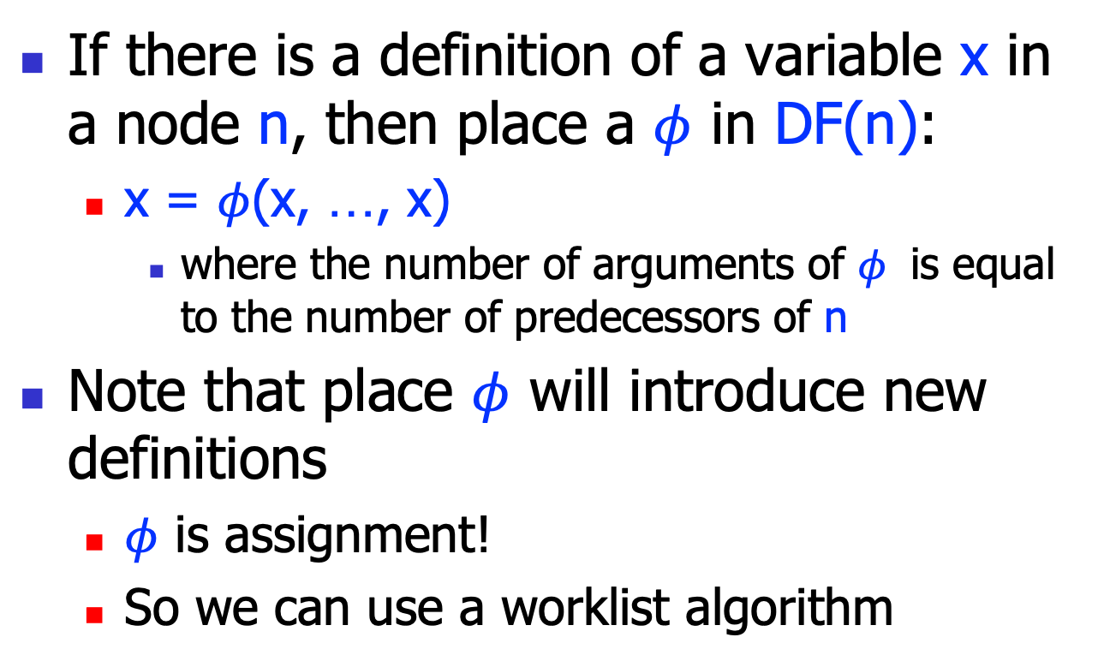

Using DF to Place $φ$
If there is a definition of a variable x in a node n, then place a $φ$ in DF(n):
x = $φ$(x, …, x)
where the number of arguments of $φ$ is equal to the number of predecessors of n
Note that place $φ$ will introduce new definitions
$φ$ is assignment!
So we can use a worklist algorithm

Slide 44
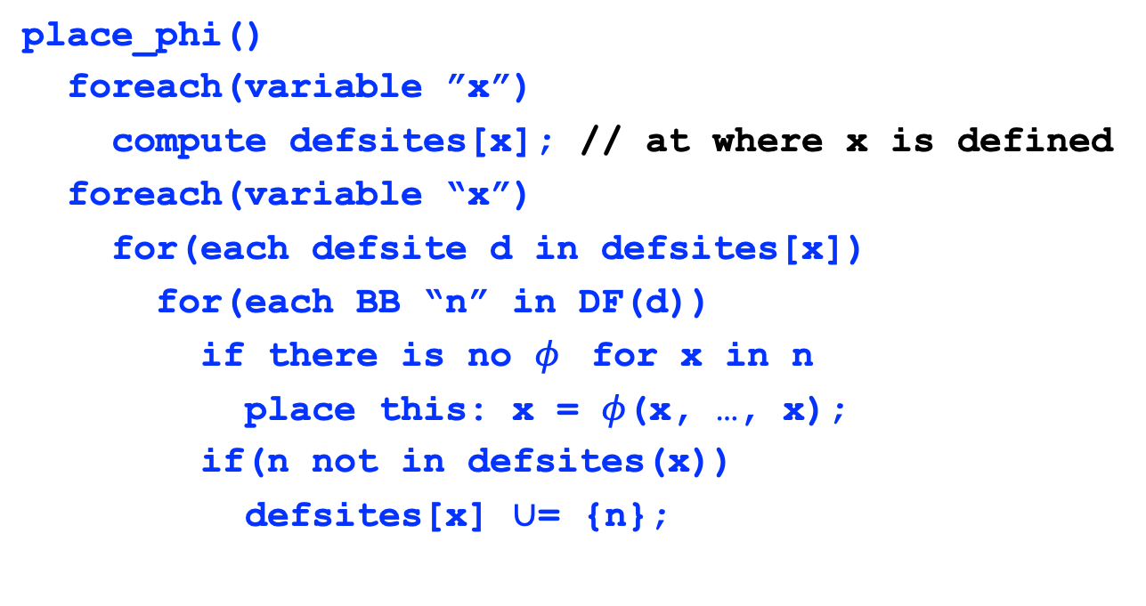

Placing $φ$
place_phi()
foreach(variable ”x”)
compute defsites[x]; // at where x is defined
foreach(variable “x”)
for(each defsite d in defsites[x])
for(each BB “n” in DF(d))
if there is no $φ$ for x in n
place this: x = $φ$(x, …, x);
if(n not in defsites(x))
defsites[x] $∪$= {n};

Slide 45
Example
1: {}
2: {2}
3: {2}
4: {}
5: {7}
6: {7}
7: {2}
1
i = 1
j = 1
k = 0
1
2
3
4
2
k < 100?
3
j < 20?
4
return j
5
6
7
5
j = i
k = k+1
6
j = k
k = k+2
Var. | defsites[ ]
i | {1}
j | {1, 5, 6}
k | {1, 5, 6}
7

Slide 46
Placing $φ$
1: {}
2: {2}
3: {2}
4: {}
5: {7}
6: {7}
7: {2}
Var i:
defsites[i] = {1}
DF[1] = {}
1
i = 1
j = 1
k = 0
2
k < 100?
3
j < 20?
4
return j
5
j = i
k = k+1
6
j = k
k = k+2
Var. | defsites[ ]
i | {1}
j | {1, 5, 6}
k | {1, 5, 6}
7

Slide 47
Placing $φ$
1: {}
2: {2}
3: {2}
4: {}
5: {7}
6: {7}
7: {2}
Var j:
defsites[j] = {1,5,6}
1
i = 1
j = 1
k = 0
DF[1] = {}
DF[5] = {7}
j= 𝜙(j, j)
DF[6] = {7}
2
k < 100?
DF[7] = {2}
3
j < 20?
4
return j
DF[2] = {2}
5
j = i
k = k+1
6
j = k
k = k+2
Var. | defsites[ ]
i | {1}
j | {1, 5, 6}
k | {1, 5, 6}
7
j= 𝜙(j, j)

Slide 48
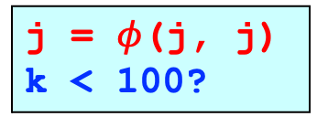

Placing $φ$
i = 1
j = 1
k = 0
1: {}
2: {2}
3: {2}
4: {}
5: {7}
6: {7}
7: {2}
Var k:
Leave to you.
1
2
j = $φ$(j, j) k < 100?
3
j < 20?
4
return j
5
j = i
k = k+1
6
j = k
k = k+2
Var. | defsites[ ]
i | {1}
j | {1, 5, 6}
k | {1, 5, 6}
7
j = $φ$(j, j)

Slide 49
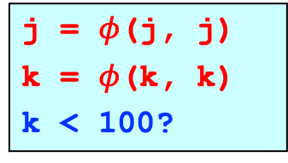

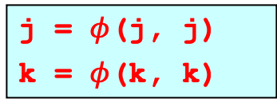
Placing $φ$: Final Result
i = 1
j = 1
k = 0
1: {}
2: {2}
3: {2}
4: {}
5: {7}
6: {7}
7: {2}
1
2
j = $φ$(j, j)
k = $φ$(k, k)
k < 100?
3
4
j < 20?
return j
5
6
j = i
k = k+1
j = k
k = k+2
Var. | defsites[ ]
i | {1}
j | {1, 5, 6}
k | {1, 5, 6}
7
j = $φ$(j, j)
k = $φ$(k, k)

Slide 50
Renaming variables
Walk the dominator tree, renaming variable as you go
Replace each variable use with most recent renamed definition
easy for a basic block
for branches, use the most recent definition above the dominator tree nodes
that is, a pre-order tree walk

Slide 51
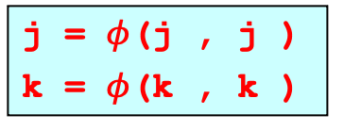
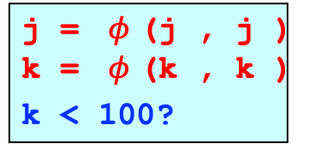
Rename Variables
i = 1
j = 1
k = 0
1
1
1
1
1
2
2
j = $φ$(j , j ) k = $φ$(k , k )
k < 100?
1
3
4
1
3
5
6
7
4
j < 20?
return j
5
6
j = i
k = k + 1
j = k
k = k + 2
Walk the dominator tree (in pre-order).
7
j = $φ$(j , j )
k = $φ$(k , k )

Slide 52
Rename Variables
i = 1
j = 1
k = 0
1
1
1
1
1
2
2
j = $φ$(j , j ) k = $φ$(k , k )
k < 100?
2
1
3
4
2
1
2
3
5
6
7
4
j < 20?
return j
5
6
j = i
k = k + 1
j = k
k = k + 2
Walk the dominator tree (in pre-order).
7
j = $φ$(j , j )
k = $φ$(k , k )

Slide 53
Rename Variables
i = 1
j = 1
k = 0
1
1
1
1
1
2
2
j = $φ$(j , j ) k = $φ$(k , k )
k < 100?
2
1
3
4
2
1
2
3
5
6
7
4
j < 20?
return j
2
5
6
j = i
k = k + 1
j = k
k = k + 2
Walk the dominator tree (in pre-order).
7
j = $φ$(j , j )
k = $φ$(k , k )

Slide 54
Rename Variables
i = 1
j = 1
k = 0
1
1
1
1
1
2
2
j = $φ$(j , j ) k = $φ$(k , k )
k < 100?
2
1
3
4
2
1
2
3
5
6
7
4
j < 20?
return j
2
5
6
j = i
k = k + 1
j = k
k = k + 2
3
1
Walk the dominator tree (in pre-order).
3
2
7
j = $φ$(j , j )
k = $φ$(k , k )
3
3

Slide 55
Rename Variables
i = 1
j = 1
k = 0
1
1
1
1
1
2
2
j = $φ$(j , j ) k = $φ$(k , k )
k < 100?
2
1
3
4
2
1
2
3
5
6
7
4
j < 20?
return j
2
5
6
j = i
k = k + 1
j = k
k = k + 2
3
1
4
2
Walk the dominator tree (in pre-order).
3
2
4
2
7
j = $φ$(j , j )
k = $φ$(k , k )
3
4
3
4

Slide 56
Rename Variables
i = 1
j = 1
k = 0
1
1
1
1
1
2
2
j = $φ$(j , j ) k = $φ$(k , k )
k < 100?
2
1
5
3
4
2
1
5
2
3
5
6
7
4
j < 20?
return j
2
5
6
j = i
k = k + 1
j = k
k = k + 2
3
1
4
2
Walk the dominator tree (in pre-order).
3
2
4
2
7
j = $φ$(j , j )
k = $φ$(k , k )
5
3
4
5
3
4

Slide 57
Rename Variables
i = 1
j = 1
k = 0
1
1
1
1
1
2
2
j = $φ$(j , j ) k = $φ$(k , k )
k < 100?
2
1
5
3
4
2
1
5
2
3
5
6
7
4
j < 20?
return j
2
2
5
6
j = i
k = k + 1
j = k
k = k + 2
3
1
4
2
Walk the dominator tree (in pre-order).
3
2
4
2
7
j = $φ$(j , j )
k = $φ$(k , k )
5
3
4
5
3
4

Slide 58
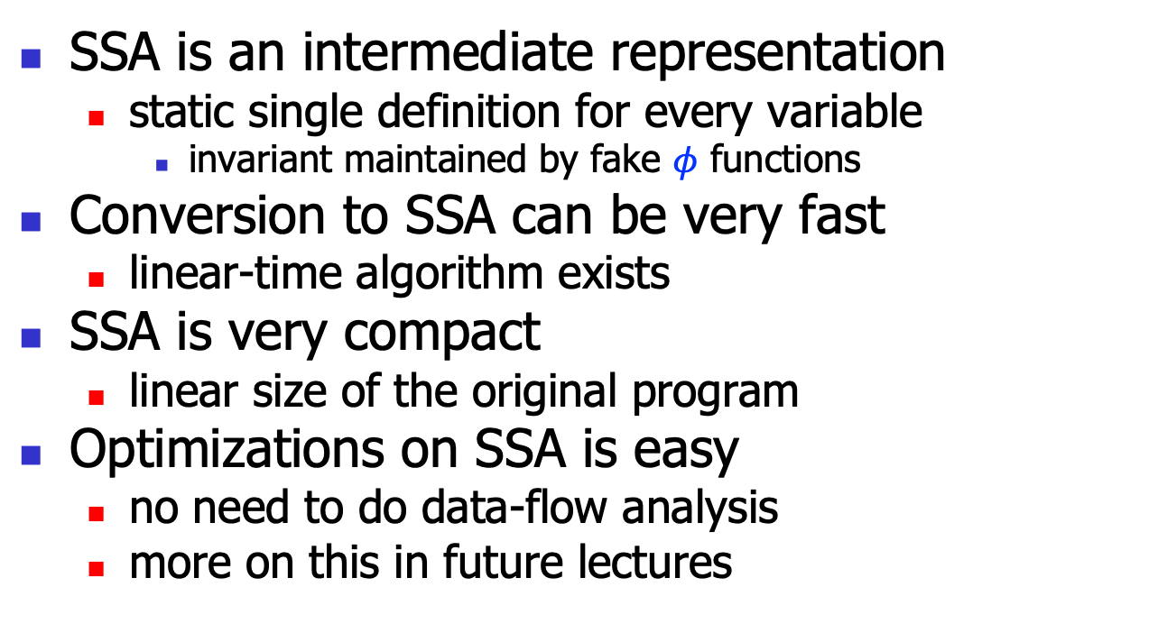
Summary
SSA is an intermediate representation
static single definition for every variable
invariant maintained by fake $φ$ functions
Conversion to SSA can be very fast
linear-time algorithm exists
SSA is very compact
linear size of the original program
Optimizations on SSA is easy
no need to do data-flow analysis
more on this in future lectures

