Slide 1
Functional List
C and Data Structures
Baojian Hua
bjhua@ustc.edu.cn

Slide 2
Recap
We discussed two implementations of list:
extensible array-based
easy to implement but slow and space waste
linked list-based
good performance but tedious and error-prone to implement
General computer science idea:
“pay as you go”

Slide 3
Functional List
A functional list is inductively defined:
case #1: it is empty, or
case #2: non-empty with a head element and a tail of another smaller list
(x1, (x2, (x3, …)))
head: x1
tail: (x2, (x3, …))
Next, we sometimes write “list” for simplicity

Slide 4
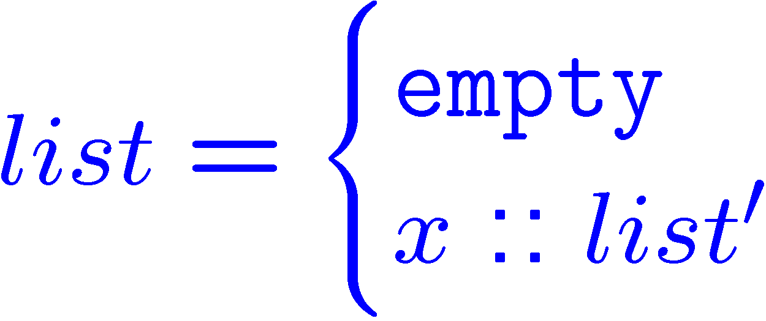
Mathematical Notation
A functional list is inductively defined:
case #1: it is empty, or
case #2: a head element and a tail of another smaller list

Slide 5
Data Structure
We use a pointer “p” to point to a list:
case #1: NIL, empty list
case #2: CONS, head::tail,

Slide 6
Implementation
// We use tagged union data structure:
// in file “fun-list.c”
#include “fun-list.h”
enum List_Kind_t{NIL, CONS};
struct List_t{
enum List_Kind_t kind;
union{
struct{
Poly_t data;
List_t next;
}cons;
}u;
};

Slide 7
Create a list
// create a new list
List_t List_new(){
List_t l = calloc(1, sizeof(*l));
l->kind = NIL;
// l->u?
return l;
}

Slide 8
Add a new Head
List_t List_concat(Poly_t data, List_t l){
List_t temp = calloc(1, sizeof(*temp));
temp->kind = CONS;
temp->u.cons.data = data;
temp->u.cons.next = l;
return temp;
}
l
temp
…
data
data
data
data
next
next
next
next

Slide 9
Traverse the List
void List_foreach(List_t l, void (*f)(Poly_t)){
switch(l->kind){
case NIL: return;
case CONS:{
f(l->u.cons.data);
List_foreach(l->u.cons.next, f);
// tail recursion!
}
}
}

Slide 10
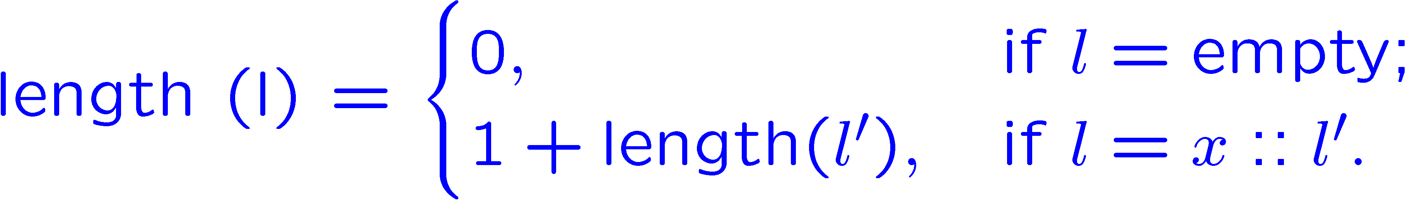
Operation: “length”
l
…
data
data
data
data
next
next
next
next

Slide 11
Operation: “length”
int List_length(List_t l){
switch(l->kind){
case NIL: return 0;
case CONS:{
return 1 + List_length(l->u.cons.next);
}
}
l
…
data
data
data
data
next
next
next
next

Slide 12
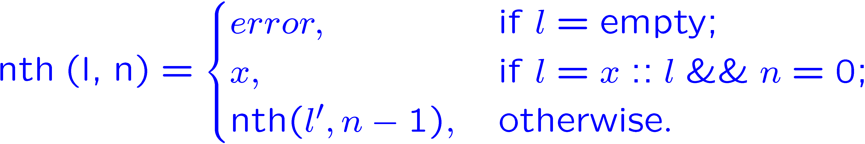
Operation: “nth”
l
…
data
data
data
data
next
next
next
next

Slide 13
Operation: “nth”
Poly_t List_nth(List_t l, int n){
assert(l && n>=0);
switch(l->kind){
case NIL: error(“empty list”);
case CONS:{
if(0==n)
return l->u.cons.data;
return List_nth(l->u.cons.next, n-1);
}
}
l
…
data
data
data
data
next
next
next
next

Slide 14
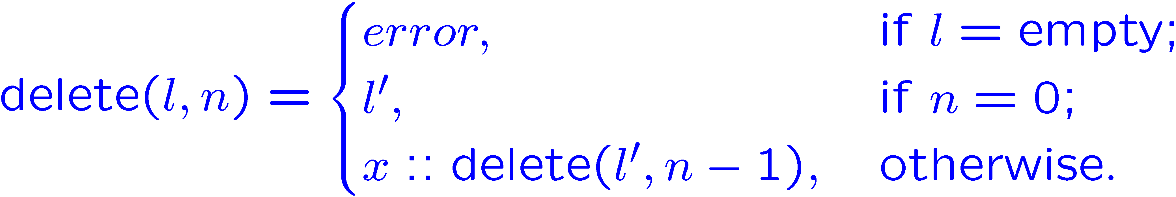
Operation: “delete(l, n)”
l
…
data
data
data
data
next
next
next
next

Slide 15
Operation: “delete”
List_t List_delete(List_t l, int n){
assert(l && n>=0);
switch(l->kind){
case NIL: error(“empty list”);
case CONS:{
if(0==n)
return l->u.cons.next;
return List_concat(
l->u.cons.data,
List_delete(l->u.cons.next, n-1));
}

Slide 16
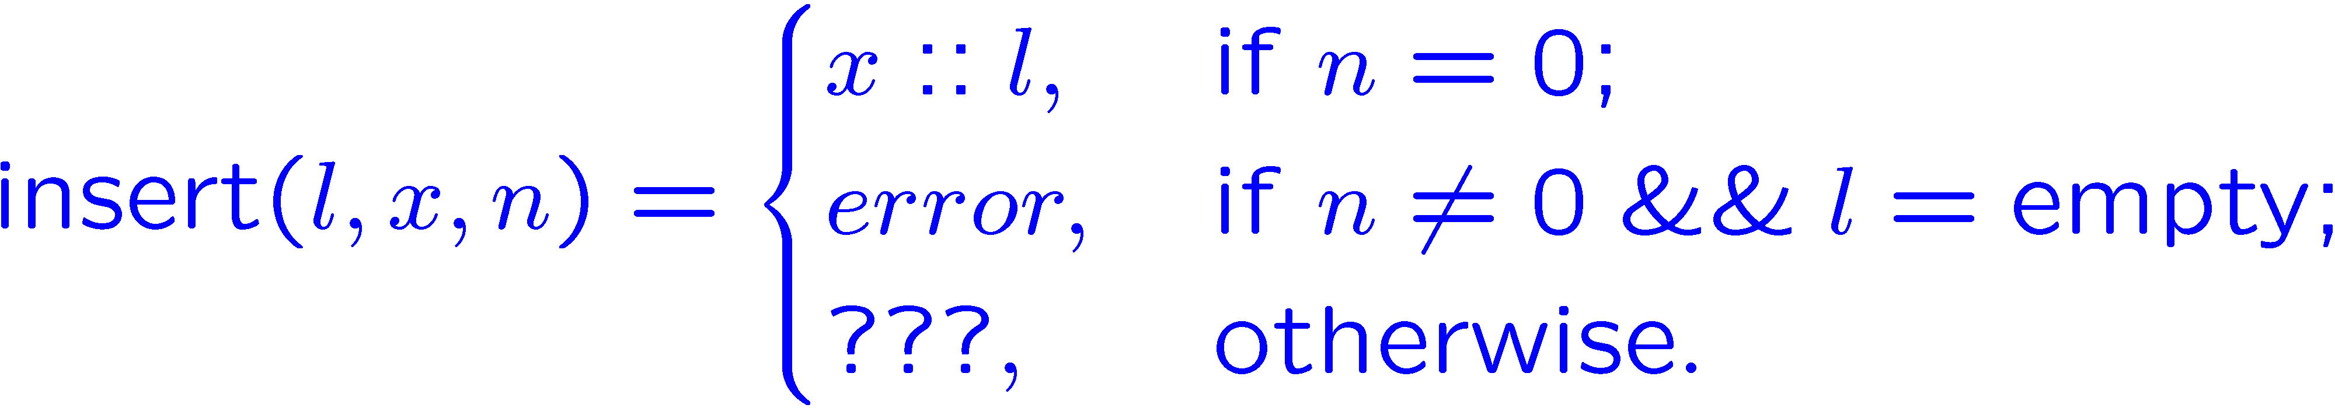
Operation: “insert(l, x, n)”
l
…
data
data
data
data
next
next
next
next

Slide 17
Operation: “insert”
List_t List_insert(List_t l, poly x, int n){
if(0==n)
return List_concat(x, l);
if(0==l)
error(“…”);
return List_concat(l->data,
List_insert(l->next, x, n-1);
}
l
…
data
data
data
data
next
next
next
next

Slide 18
Functional programming
We are doing functional programming, in C:
long history, even older than C
stems from mathematics (\lambda calculus from Church)
John McCarthy‘s LISP (60’s), and subsequent Scheme, ML, Haskell, Scala, etc.
considered academic and impractical for long time
steep learning curve
and efficiency issues
renew industry’s interest in recent decades
e.g., F# from Microsoft
good for parallel, multi-core, etc.

Slide 19
Summary
A functional implementation of list
Pros:
good for programmer
data structures are persistent
elegant, and easy to write, to maintain, and to debug
Cons:
(maybe) bad for machine
code maybe too slow
require better compiler supports
unfortunately, both MS vc and GCC are bad in this

